Slide 1
C
B
高职备考
A
英语阅读教程
主编 江韵 曾洪 罗婷

Slide 2
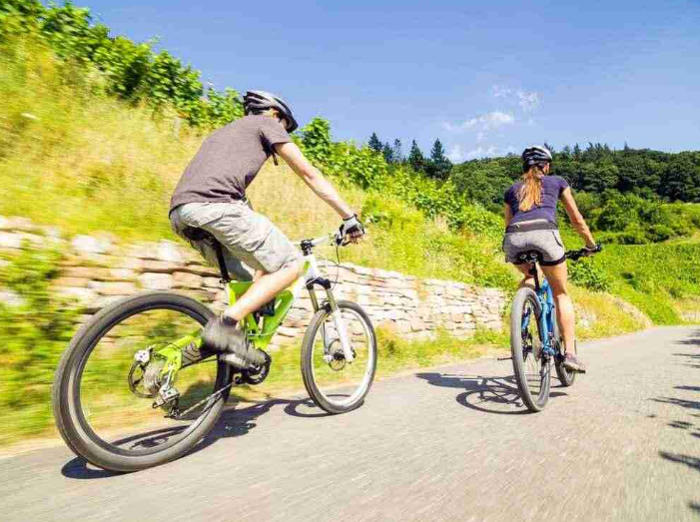
Unit 3
Sports, Travel, Transport and Health

Slide 3
目 录
contents
Objectives
Guide
Exploration
Skills
Practice
Assessment

Slide 4
Objectives
能识记与运动、旅游、交通和健康生活相关的单词与词组。
能识别过渡词和过渡句，以理清文章内容的组织脉络。
了解语篇常用的衔接和连贯手段。
关注主题相关的社会热点，丰富个人业余生活，培养健康的生活方式。

Slide 5
Could you list some words or phrases about the topic “Sports, Travel, Transport and Health”?
你能列出一些与运动、旅游、交通和健康主题相关的单词或词组吗？
About sports: (精力) (比赛) (积极的)
About travel: (旅程) (景色) (当地的)
About transport: (地址) (方便的) (网络)
About health: (身体的) (健康) (恢复)
contents

Slide 6
Guide
本单元的主题是“运动、旅游、交通与健康”，涉及的内容包括交通旅游、体育运动、健康生活等，共有六篇文章，体裁包含记叙文、说明文和议论文。具体内容见下图。

Slide 7
“网球运动”相关词汇：
tennis, competition, strength, talent, energy
Passage One
Level 1
记叙文
Olympic Star
Unit 3
Sports, Travel,
Transport and
Health
运动、旅游、
交通与健康
Autonomous Driving
“无人驾驶”相关词汇：
rapid, transport, address, network, convenient
Passage Two
Level 1
说明文
Passage Three
Level 1
议论文
“健康”相关词汇：
value, benefit, natural, physical
Exposure to Nature

Slide 8
“独自旅行”相关词汇：
journey, travel, discover, scenery
Passage Four
Level 2
记叙文
Solo Travelling
Unit 3
Sports, Travel,
Transport and
Health
运动、旅游、
交通与健康
“城市运动”相关词汇：
popular, fitness, trend, active
Passage Five
Level 2
说明文
Urban Sports
Flu Treatment
“流感防治”相关词汇：
flu, illness, treatment
Passage Six
Level 2
说明文
contents

Slide 9
Exploration
Read the following three passages and choose the best answers.
阅读以下三篇文章，并选择最佳选项。

Slide 10
Passage One
Zheng Qinwen is a 21-year-old tennis player from China. She became the first person from China and Asia to win an Olympic gold medal in women’s singles tennis competition.
Zheng started playing tennis when she was young. Actually, it was because of her constant illness that her parents asked her to play sports to strengthen her body. She quickly showed her talent in this sport. With hard work and training, she developed an aggressive (积极进取的) playing style and strong mental toughness (坚韧) on the court.

Slide 11
In 2024, Zheng participated in the Olympic Games, hoping to win a gold medal. In the women’s singles tennis final at the Paris Olympics, she played against a Croatian player named Donna Vekic. Despite the hot weather, the long match and great stress, Zheng won the gold medal in the end.
Earning this gold medal was not easy at the outdoor tennis court because the temperature once reached as high as 36 degrees Celsius. Zheng Qinwen was full of energy and went through two battles that lasted for over three hours each. In an interview after the match, Zheng said that she would be willing to play for another three hours for her country because she believed that victory belongs to those who have strong wills.

Slide 12
Zheng’s process of becoming the Olympic champion shows her talent, hard work and the spirit of pursuing excellence. Zheng’s story is a good example to everyone who wants to achieve greatness in their field.

Slide 13
( ) 1. Why did Zheng Qinwen start playing tennis?
A. Because she was very interested in it.
B. Because her parents wanted her to strengthen her body.
C. Because she wanted to be an Olympic champion.
D. Because her friends invited her to play tennis.
B
【解析】事实细节题。根据文章第二段第二句“Actually, it was because of her constant illness that her parents asked her to play sports to strengthen her body”可知，父母希望她通过运动增强体质。故选B项。

Slide 14
( ) 2. Who did Zheng Qinwen defeat in the women’s singles tennis final at the 2024 Olympic Games?
A. A Japanese player. B. An American player.
C. A Croatian player. D. A Russian player.
C
【解析】事实细节题。根据文章第三段第二句“...she played against a Croatian player named Donna Vekic”可知，郑钦文在决赛中与一名克罗地亚球员对决并最终胜出。故选C项。

Slide 15
( ) 3. What was the highest temperature at the outdoor court in the women’s singles tennis final at the Paris Olympics?
A. 26 degrees Celsius. B. 30 degrees Celsius.
C. 33 degrees Celsius. D. 36 degrees Celsius.
D
【解析】事实细节题。根据文章第四段第一句“...the temperature once reached as high as 36 degrees Celsius”可知，比赛时的温度曾高达36℃。故选D项。

Slide 16
( ) 4. Why did Zheng Qinwen believe she was able to win the gold medal?
A. Because of her natural talent.
B. Because she played aggressively.
C. Because she has a strong will.
D. Because she trained hard for many years.
C
【解析】事实细节题。根据文章第四段最后一句“...she would be willing to play for another three hours for her country because she believed that victory belongs to those who have strong wills”可知，郑钦文认为胜利属于意志坚强的人，这反映了她对意志力的重视。故选C项。

Slide 17
( ) 5. We can learn from the passage that __________.
A. Zheng Qinwen will definitely win more gold medals in the
future
B. only by playing tennis can people strengthen their bodies
C. Zheng Qinwen’s success is mainly due to her talent
D. Zheng Qinwen’s story can inspire people to pursue their
dreams
D
【解析】推理判断题。文章结尾提到“Zheng’s story is a good example to everyone who wants to achieve greatness in their field”，可以推断出她的故事能激励人们追求梦想。故选D项。

Slide 18
Passage Two
In recent years, China has been rapidly advancing in the field of smart transportation, leading to the development of new applications for smart cities in China.
Technology companies have worked hard to speed up the commercial use of robotaxis (无人驾驶出租车). Beijing has issued autonomous (自动的) driving permits to a tech giant and a self-driving startup, allowing them to operate fully driverless robotaxis on open roads. Later on, the tech company carried out its driverless ride-hailing (打车) service in Shenzhen, Guangdong Province.

Slide 19
Passengers can easily use their smartphones to download the ride-hailing app and tell the app where they are and where they want to go. Then, a car will appear quickly within several minutes.
Meanwhile, drivers in cities like Guiyang, Guizhou Province, can also benefit from smart transportation. At certain smart parking lots, drivers simply need to park their cars at an induction (感应)line, and a smart network system will arrange the vehicles to specific areas. When retrieving (取回) their cars, drivers can make a request on a terminal device, and the car will exit the parking lot autonomously within about a minute.

Slide 20
All in all, smart transportation uses new technologies to make moving around a city more convenient and safer.

Slide 21
( ) 1. What is one of the efforts technology companies made in the field of smart transportation?
A. Slowing down the research on autonomous driving.
B. Preventing the commercial use of robotaxis.
C. Speeding up the commercial use of robotaxis.
D. Focusing only on traditional transportation methods.
C
【解析】事实细节题。文章第二段第一句提到，科技公司努力加快无人驾驶出租车的商业应用。故选C项。

Slide 22
( ) 2. In which city did the tech company carry out its driverless ride-hailing service?
A. Shanghai. B. Shenzhen.
C. Beijing. D. Guiyang.
B
【解析】事实细节题。根据文章第二段最后一句“...the tech company carried out its driverless ride-hailing service in Shenzhen, Guangdong Province”可知，该科技公司在深圳市开放了无人驾驶打车服务。故选B项。

Slide 23
( ) 3. What is Paragraph 3 mainly about?
A. Why tech giants in China develop the ride-hailing system.
B. Why smartphones are important for using ride-hailing apps.
C. How ride-hailing apps changed car making.
D. How the ride-hailing system works.
D
【解析】段落大意题。文章第三段详细描述了如何使用打车软件来召唤自动驾驶车辆，包括下载应用、输入位置和目的地信息，以及车辆到达的过程。故选D项。

Slide 24
( ) 4. Why did the author write about smart parking lots?
A. To show the changes that driverless systems have brought.
B. To prove that drivers need special skills to park their cars.
C. To explain why drivers need to park their cars properly.
D. To show that drivers can also enjoy smart transportation.
D
【解析】推理判断题。文章第四段提到，在像贵阳这样的城市，司机也可以从智能交通中受益，特别是在智能停车场的应用上。这表明智能交通的好处不仅限于乘客，也扩展到了司机。故选D项。

Slide 25
( ) 5. What is the main topic of the passage?
A. The development of smart transportation in China.
B. The issuance of autonomous driving permits in Beijing.
C. The operation of fully driverless robotaxis.
D. The use of smartphones to download apps for transportation.
A
【解析】主旨大意题。全文围绕中国在智能交通领域的快速进步展开，提到了自动驾驶出租车的商业化应用、智能停车场等，显示了智能交通系统的多方面发展和应用。故选A项。

Slide 26
Passage Three
We all know the value of taking a walk outdoors in the fresh spring weather. (1) __________ But did you know that getting close to nature during childhood could benefit your mental health as an adult?
C
【解析】
A. However, many children in Europe tend to lead an indoor lifestyle.
B. So remember to make time to involve yourself in nature.
C. It allows your mind to relax and get refreshed.
D. The participants were then given a psychological test.
E. They were also asked about the importance they put on using such places.

Slide 27
1. 【解析】第一段提到在户外散步的价值，并引出了亲近自然对心理健康的益处。C项意为“它让你的大脑放松并得到恢复”，很好地总结了户外活动的好处，衔接上下文，为下一段探讨儿童时期亲近自然与成年后心理健康之间的关系作了铺垫。故选C项。
Back

Slide 28
Recently, a study by the Barcelona Institute for Global Health (ISGlobal) surveyed 3,600 people from all over Europe. The study gave the adult participants a questionnaire on how frequently they used natural spaces during childhood. (2) __________ For example, play in a garden, ride a bike at the park or hike in a forest.
E
【解析】
A. However, many children in Europe tend to lead an indoor lifestyle.
B. So remember to make time to involve yourself in nature.
C. It allows your mind to relax and get refreshed.
D. The participants were then given a psychological test.
E. They were also asked about the importance they put on using such places.

Slide 29
2.【解析】第二段提到研究调查了3 600名欧洲境内的人，询问他们童年时期亲近自然的频率。空格后一句列举了在不同地点做的不同事情，E项意为“他们还被问及对这些地方的重视程度”，逻辑上衔接前后文，说明了研究问卷的内容不仅限于频率，还包括对亲近自然的重要性的认识。故选E项。
Back

Slide 30
(3) __________ It included various questionnaires and problem-solving activities to analyze their nervousness and feelings of depression within a four-week period.
D
【解析】
A. However, many children in Europe tend to lead an indoor lifestyle.
B. So remember to make time to involve yourself in nature.
C. It allows your mind to relax and get refreshed.
D. The participants were then given a psychological test.
E. They were also asked about the importance they put on using such places.

Slide 31
3. 【解析】第三段提到进行了一系列测试来分析参与者的紧张程度和抑郁情绪。D项意为“然后参与者接受了心理测试”，直接引出下文描述的具体测试方法，即通过各种问卷和解决问题的活动来进行心理分析。故选D项。
Back

Slide 32
The results showed that the people who were exposed more to natural spaces had higher mental health scores compared to those with lower childhood exposure (接触). (4) __________ Thus the director of ISGlobal’s Urban Planning call on policymakers to improve the availability (可得性) of natural spaces for children.
A
【解析】
A. However, many children in Europe tend to lead an indoor lifestyle.
B. So remember to make time to involve yourself in nature.
C. It allows your mind to relax and get refreshed.
D. The participants were then given a psychological test.
E. They were also asked about the importance they put on using such places.

Slide 33
4.【解析】第四段讨论了研究结果，即童年亲近自然更多的人在心理健康方面的得分更高。A项意为“然而，欧洲的许多儿童倾向于室内的生活方式”，作为转折，指出尽管亲近自然的好处已被证实，但现实中仍有许多儿童的生活方式与此相悖，强调了儿童亲近自然空间的必要性。故选A项。
Back

Slide 34
While this study was based in Europe, a lack of green space can affect anyone, anywhere. (5) __________ After all, your mental health is just as important as the physical one.
B
【解析】
A. However, many children in Europe tend to lead an indoor lifestyle.
B. So remember to make time to involve yourself in nature.
C. It allows your mind to relax and get refreshed.
D. The participants were then given a psychological test.
E. They were also asked about the importance they put on using such places.

Slide 35
5.【解析】最后一段强调了绿色空间的重要性。B项意为“所以记得找时间让自己融入大自然”，作为全文的总结，提醒读者要认识到自然对心理健康的重要性，并鼓励人们积极参与户外活动。故选B项。
Back

Slide 36
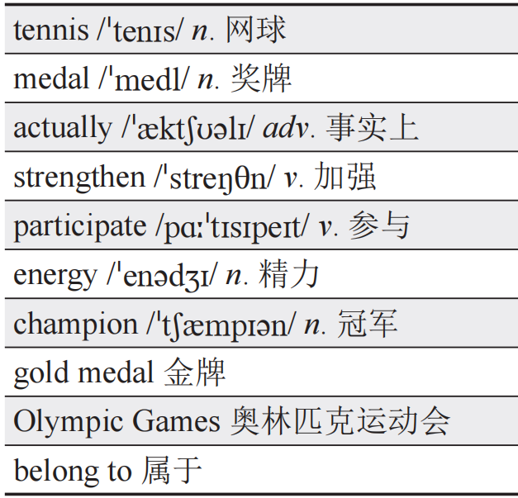
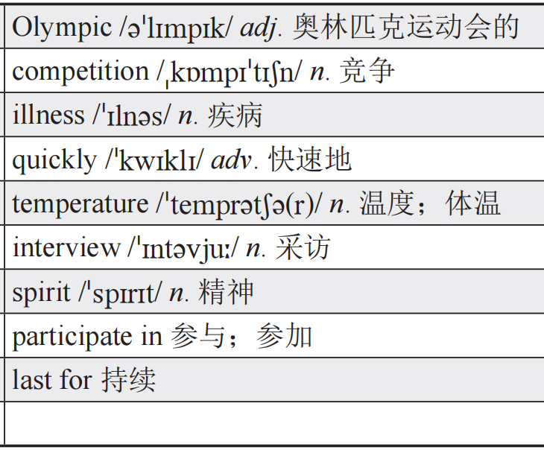
Words and Expressions
Passage One

Slide 37
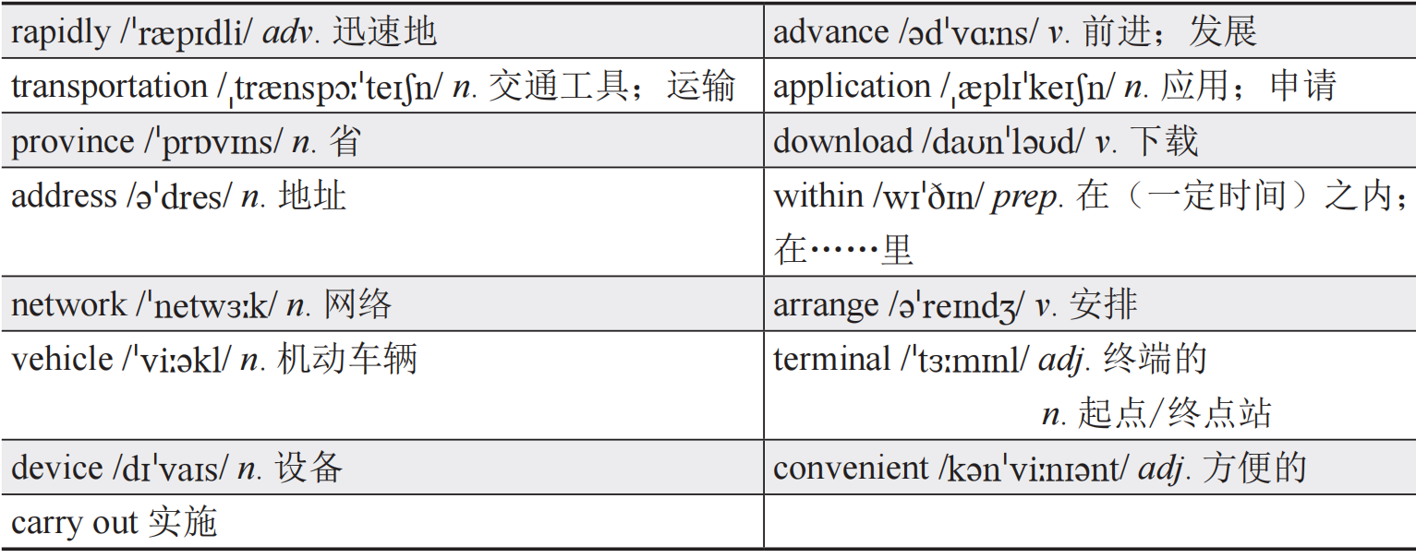
Passage Two

Slide 38
Passage Three
contents

Slide 39
Skills
过渡句的辅助阅读技巧
在英语阅读理解中，过渡句起着连接上下文、推动文章逻辑发展的重要作用。掌握过渡句的辅助阅读技巧，可以帮助读者更好地理解文章结构，理解段落关系，把握文章主旨，从而提高阅读的速度和效率。

Slide 40
过渡句一般包括段落间过渡句和段落内过渡句，前者往往出现在段落的开头或结尾，用于引入新的话题或总结前文；后者则往往出现在同一段落内，反映该段落内部的内容联系和逻辑脉络。因此在阅读过程中，可以有意识地寻找过渡句，关注常见过渡词，以便更好地梳理文章的内容结构。
常见的过渡词有：
（1）并列与递进关系，如first, next, finally, at last, in the end, also, as well, further, moreover, what’s more, in addition, in summary。

Slide 41
（2）转折关系，如but, however, although, in fact, nevertheless, yet, in spite of, on the contrary, (un)fortunately, or, otherwise, while, whereas, rather than, even if, despite。
（3）因果关系，如so, therefore, hence, thus, accordingly, consequently, as a result。
（4）例析关系，如for example, for instance, such as。
在阅读文章的过程中，需要通过理解过渡词以及过渡句，综合运用多种阅读技巧，以便更好地理解文章内容。

Slide 42
Have a Try
Exercise 1（2022年广东省真题）
Animals, including insects, do not have a language like ours. They do not talk to each other in words or sentences. But if we watch them, we can see that they do have ways of communicating with each other.

Slide 43
Q: What can we learn from Paragraph 1?
A. Animals are able to communicate.
B. Animals understand people’s work.
C. Animals make different sounds.
D. Animals can speak a language.
解析：推理判断题。根据段内过渡词But可知，上下文是转折关系，将动物与人类的沟通方式进行对比，强调动物也有其独特的沟通方式。故选A项。
contents

Slide 44
Exercise 2（2024年广东省真题）
Write a letter. Some people may have helped you on some occasions, but you didn’t have a chance to thank them in time. Think of them and send them a letter. (43) __________
A. Pay attention to the world around you.
B. He is really nice or waits an extra minute for you.
C. How do you express gratefulness in your daily life?
D. Even better, deliver it in person and read it to them.
E. You can write in your notebook or do it on your phone.

Slide 45
解析：经过文段分析可知，该段是总分结构，段内的but表示转折关系，用以说明“有时候你无法及时感谢帮助你的人”，以此引出写信的建议。D项的Even better表示递进关系，表示最好亲自送达感谢信或亲自读给对方听。故选D项。
总的来说，读者在阅读过程中可以通过有意识地寻找过渡句，识别过渡词，来理顺文章结构、段落关系以及内容脉络，有效提升阅读理解的能力，从而提高解题的效率。
contents

Slide 46
Practice
Read the following three passages and choose the best answers.
阅读以下三篇文章，并选择最佳选项。

Slide 47
Passage Four
When I was in my mid-20s, I decided to have a backpacking trip in South America despite my family and friends warning me that South America wasn’t a place for a solo female traveller. And it ended up being my best trip ever and one of my life-changing trips.
It was really challenging for me, from dealing with long bus rides and car sickness to falling off my bicycle and getting injured badly. However, there are also many unforgettable travel experiences that I’d like to record during the journey.

Slide 48
I was pretty honored to get invited to have dinner with my Brazilian plane seatmate and her grandma. A group of complete strangers took me to eat and dance in Mendoza, where I celebrated my 25th birthday. When I got stuck on a broken-down bus, it was interesting to have a free language exchange with an elderly woman in Peru. I attended a small family gathering party in Argentina and got to know the unique local traditions. I used to live in a giant tree house with a group of strangers in Brazil and we spent our days exploring hiking trails and our nights drinking and exchanging stories about travelling. Also, I enjoyed the moments when I was experiencing some of the world’s most well-known natural wonders by myself.

Slide 49
I fell in love with discovering amazing scenery and I was impressed by the friendliness of people along the way. Most importantly, this trip showed me how independent I could be and what ability I really have. It also made me see the beauty of immersing myself in different cultures and connecting with locals who are willing to share these cultures.

Slide 50
( ) 1. How did the author feel about taking a trip in South America despite warnings?
A. Determined. B. Nervous.
C. Confident. D. Worried.
A
【解析】推理判断题。根据第一段“despite my family and friends warning me”可知，尽管家人和朋友警告过作者，她还是决定去南美洲背包旅行，因此她的态度是十分坚定的。故选A项。

Slide 51
( ) 2. What was one of the challenges the author faced during her trip?
A. Finding safe accommodation.
B. Adapting to different eating habits.
C. Dealing with different languages.
D. Coping with car sickness.
D
【解析】事实细节题。根据第二段第一句中的“challenging”以及后续的“long bus rides and car sickness”可知，作者在旅途中的主要挑战之一是晕车。故选D项。

Slide 52
( ) 3. Which activity allowed the author to learn about the unique local traditions?
A. Hiking in the Amazon rainforest.
B. Attending a small party in Argentina.
C. Dancing with strangers in Mendoza.
D. Visiting ancient ruins in Peru.
B
【解析】事实细节题。根据第三段“I attended a small family gathering party in Argentina and got to know the unique local traditions”可知，作者在阿根廷参加了一个小型家庭聚会，从中学习了当地独特的习俗。故选B项。

Slide 53
( ) 4. What did the author do in the daytime when she was in Brazil?
A. Living in a big tree house. B. Drinking.
C. Hiking. D. Sharing travelling stories.
C
【解析】事实细节题。根据第三段“spent our days exploring hiking trails”可知，作者白天是去徒步探索。故选C项。

Slide 54
( ) 5. What is the main idea of the whole passage?
A. Facing challenges during a solo trip.
B. Learning to be independent during a solo trip.
C. Being brave enough to travel alone.
D. Having a positive attitude while travelling alone.
B
【解析】主旨大意题。根据第四段“this trip showed me how independent I could be”可知，作者南美洲之旅的最大收获是学会了独立。故选B项。

Slide 55
Passage Five
Still playing basketball and soccer? Why not try some new sports? Cycling, but outdoors on city roads; surfing, but on the land. New sports are becoming more and more popular, which bring more fun to physical exercise.
National fitness has been a part of the national strategy for a decade, aiming at promoting people’s overall health. Doing physical exercise has become a part of many people’s daily life. With the country’s great attention to the development of national fitness, new sports have begun to appear. According to the research of over 1,200 young people by the Houlang Research Institute, more than 93% of Generation Z are interested in urban sports.

Slide 56
Why do young people play an active part in new sports? Houlang’s report claims that instead of just maintaining a healthy lifestyle, young people use them to socialize. Groups of players have online group chats, talking about the sport or simply sharing their lives.
The new sports are also “suitable for taking photos, not limited by locations”, Zou Qingling, the CEO of a travelling website, told China News Service. With the help of social media, it is convenient for people to enjoy new sports in many places in the city, from parks to sidewalks.

Slide 57
As people attach more importance to health care, they tend to enjoy outdoor activities rather than indoor exercises, and have a stronger love for a healthier lifestyle.
Young people have fun in various new sports, and more people are willing to enjoy sports. Urban sports do have brought new lifestyles to China.

Slide 58
( ) 1. What is the goal of the strategy of national fitness?
A. To encourage people to do more exercise.
B. To provide more places for sports.
C. To improve people’s overall health.
D. To support young people’s new sports.
C
【解析】事实细节题。文章第二段第一句提到，全民健身的目标在于提升人们的整体健康。故选C项。

Slide 59
( ) 2. The underlined word “socialize” in Paragraph 3 refers to “__________”.
A. expanding circles of friends
B. learning new skills
C. showing off talents
D. realizing personal dreams
A
【解析】推理判断题。文章第三段提到，年轻人除了通过新型运动来保持健康的生活方式外，还借此来扩大生活圈子，进行交友分享。另外，从构词法考虑，socialize的词根是social，当“social”与后缀“-ize”结合时，形成了动词“socialize”，其含义为“交往；交际”。故选A项。

Slide 60
( ) 3. According to the Houlang’s report, why do young people favor new sports?
A. To be professional players. B. To lose weight quickly.
C. To win in competitions. D. To make new friends.
D
【解析】事实细节题。文章第三段指出，年轻人不只是通过新型运动健身，还借此进行社交。故选D项。

Slide 61
( ) 4. Zou Qingling mentioned that new sports are ___________.
A. expensive and require special equipment
B. difficult to learn
C. suitable for taking photos and less limited by places
D. only suitable for young people
C
【解析】事实细节题。从文章第四段“The new sports are also ‘suitable for taking photos, not limited by locations’”可知，这些新型运动也“适合拍照，而且不受地点限制”。故选C项。

Slide 62
( ) 5. What is the result of people paying more attention to health care issues?
A. People started doing sports.
B. People preferred outdoor sports.
C. People chose easy sports.
D. People became less interested in sports.
B
【解析】事实细节题。文章第五段“they tend to enjoy outdoor activities”表示大家更倾向于享受室外活动。故选B项。

Slide 63
Passage Six
Flu, caused by virus, is an infection (感染) of the nose, throat and lungs. Most people with the flu get better on their own. But sometimes, this illness can be dangerous. (1) __________
B
【解析】
A. Know when to seek medical treatment.
B. Thus it pays to know how to treat it.
C. Take a few days off to give your body time to recover.
D. Although rare, too much of it may get you poisoned.
E. But the flu tends to come on quickly.

Slide 64
1.【解析】第一段开篇提及流感的起因，表示大部分人患流感后会自愈，但有时流感也会很危险，随后引出结论，表示了解流感的治疗方法是有益的。B项与前文是因果关系，故选B项。
Back

Slide 65
Recognize flu symptoms. The flu may seem like a cold with a runny nose, sneezing and a sore throat at first. Colds usually start slowly. (2) _______ And you usually feel much worse with the flu. Common symptoms of the flu often include a fever as well as aching muscles, coughs, chills and sweats.
E
【解析】
A. Know when to seek medical treatment.
B. Thus it pays to know how to treat it.
C. Take a few days off to give your body time to recover.
D. Although rare, too much of it may get you poisoned.
E. But the flu tends to come on quickly.

Slide 66
2.【解析】空格前文指出感冒发作得比较慢。与感冒相比，流感症状会更快显现，与前者形成对比。故选E项。
Back

Slide 67
A
(3) __________ Most people who get the flu can treat themselves at home and often don’t need to go to a hospital. But you need to see a doctor immediately if you are suffering the following symptoms: shortness of breath or difficulty in breathing, chest pain or pressure, and headache or neck pain.
【解析】
A. Know when to seek medical treatment.
B. Thus it pays to know how to treat it.
C. Take a few days off to give your body time to recover.
D. Although rare, too much of it may get you poisoned.
E. But the flu tends to come on quickly.

Slide 68
3.【解析】第三段主要陈述患流感时如何根据症状判断及时寻求治疗的情况。故选A项。
Back

Slide 69
Have some rest. Sometimes it’s possible to keep working or go to school with a cold, but when you have the flu, it’s important to rest. (4) __________ Since the flu may spread by contact, staying at home is as considerate as it is necessary for your recovery.
C
【解析】
A. Know when to seek medical treatment.
B. Thus it pays to know how to treat it.
C. Take a few days off to give your body time to recover.
D. Although rare, too much of it may get you poisoned.
E. But the flu tends to come on quickly.

Slide 70
4.【解析】第四段指出患流感要注重休息，C项提到请假休息，并与后文“staying at home”互相呼应。故选C项。
Back

Slide 71
Take vitamin C. Studies suggest that a proper amount of vitamin C can help remove cold and flu symptoms. Remember not to continue taking too much vitamin C after you feel better. (5) __________
D
【解析】
A. Know when to seek medical treatment.
B. Thus it pays to know how to treat it.
C. Take a few days off to give your body time to recover.
D. Although rare, too much of it may get you poisoned.
E. But the flu tends to come on quickly.

Slide 72
5.【解析】最后一段谈及患流感后可以服用适量的维生素C帮助治疗，但是不能服用过量，不然会引发中毒。故选D项。
Back

Slide 73
Words and Expressions
Passage Four

Slide 74
Passage Five

Slide 75
Passage Six
contents

Slide 76
Assessment
A. Please choose the best Chinese meanings for the underlined words.
请选出句中画线单词的最佳中文意思。
( ) 1. We should strengthen our efforts to finish the project on time.
A. 减弱 B. 加强 C. 限制 D. 减少
C
【解析】strengthen意为“加强”。句意：我们应该加强努力，按时完成这个项目。

Slide 77
( ) 2. She has a talent for painting.
A. 技能 B. 天赋 C. 知识 D. 人才
B
【解析】talent意为“天赋”。句意：她有绘画的天赋。

Slide 78
( ) 3. After a good night’s sleep, he felt full of energy.
A. 疲劳 B. 精力 C. 饥饿 D. 能源
B
【解析】energy意为“精力”。句意：经过一夜好眠，他感到充满活力。

Slide 79
( ) 4. Please fill out this job application form.
A. 取消 B. 申请 C. 预约 D. 面试
B
【解析】application意为“申请”。句意：请填一下这份工作申请表。

Slide 80
( ) 5. The train will arrive at the terminal station in ten minutes.
A. 终端 B. 航站楼 C. 终点 D. 学期
C
【解析】terminal作名词意为“起点/终点站”。句意：火车将在十分钟后到达终点站。

Slide 81
( ) 6. Smartphones are one type of modern device.
A. 家具 B. 策略 C. 设备 D. 设计
C
【解析】device意为“设备”。句意：智能手机是一种现代设备。

Slide 82
( ) 7. Online shopping is very convenient.
A. 昂贵的 B. 不便的
C. 方便的 D. 便宜的
C
【解析】convenient意为“方便的”。句意：网购非常方便。

Slide 83
( ) 8. Eating a balanced diet has lots of health benefits.
A. 赤字 B. 益处 C. 津贴 D. 利益
B
【解析】benefit意为“益处”。句意：均衡饮食对健康有许多益处。

Slide 84
( ) 9. The store offers a various range of products to choose from.
A. 相同的 B. 相似的
C. 各种各样的 D. 一样的
C
【解析】various意为“各种各样的”。句意：这家店提供各种各样的产品可供选择。

Slide 85
( ) 10. A recent survey showed that more people prefer online shopping to traditional retail.
A. 争论 B. 调查 C. 测试 D. 视察
B
【解析】survey意为“调查”。句意：最近的调查显示，相比传统零售，更多人喜欢在线购物。

Slide 86
( ) 11. He hopes to exchange gifts with his friend to celebrate their friendship.
A. 购买 B. 交换 C. 兑换 D. 捐赠
B
【解析】exchange意为“交换”。句意：他希望与朋友交换礼物以庆祝他们的友谊。

Slide 87
( ) 12. Each person’s fingerprint is unique.
A. 相似的 B. 普通的 C. 独特的 D. 稀罕的
C
【解析】unique意为“独特的”。句意：每个人的指纹都是独特的。

Slide 88
( ) 13. Let’s explore this city this weekend.
A. 探险 B. 探索 C. 考察 D. 探测
B
【解析】explore意为“探索”。句意：这个周末，让我们来探索这座城市。

Slide 89
( ) 14. We discovered a beautiful beach while on vacation.
A. 发明 B. 发现 C. 发觉 D. 恢复
B
【解析】discover意为“发现”。句意：我们在度假时发现了一个美丽的海滩。

Slide 90
( ) 15. We need to maintain order in the classroom.
A. 维修 B. 维持 C. 断言 D. 重视
B
【解析】maintain意为“保持；维持”。句意：我们需要维持教室的秩序。

Slide 91
( ) 16. You can remove the mark by washing your hands.
A. 搬迁 B. 除去 C. 脱掉 D. 免除
B
【解析】remove意为“除去”。句意：你可以通过洗手来除去这个印记。

Slide 92
( ) 17. No one knows how to treat the disease.
A. 治疗 B. 处理 C. 招待 D. 对待
A
【解析】treat意为“治疗”。句意：没有人知道应该怎样治疗这个疾病。

Slide 93
( ) 18. This book belongs to the library.
A. 属于 B. 拥有 C. 购买 D. 阅读
A
【解析】belong to意为“属于”。句意：这本书属于图书馆。

Slide 94
( ) 19. The meeting lasted for three hours.
A. 发生 B. 取消 C. 推迟 D. 持续
D
【解析】last for意为“持续”。句意：会议持续了三小时。

Slide 95
( ) 20. She suffered from a headache.
A. 受益于 B. 遭受 C. 恢复 D. 享受
B
【解析】suffer from意为“遭受”。句意：她遭受过头痛之苦。

Slide 96
B. Read the passage and choose the best answer for each blank.
阅读文章，并为各题选出最佳选项。
Today’s world is very busy. Many of us have to work hard to support ourselves and our families. Thus it has become a growing 1___ that people want to live a balanced lifestyle. It can reduce 2___ , make us happier, and improve our 3___ and mental health.
( ) 1. A. trend B. challenge C. habit D. opportunity
( ) 2. A. harm B. risk C. stress D. size
( ) 3. A. economical B. financial C. emotional D. physical
A
C
D
1【解析】
2【解析】
3【解析】

Slide 97
1.【解析】根据文章开篇可知，在当今快节奏的社会，人们忙于养活自己和家人，因此追求平衡的生活方式成为一种趋势。A项意为“趋势”，符合语境。B项意为“挑战”；C项意为“习惯”；D项意为“机会”，均不符合文意。故选A项。
Back

Slide 98
2.【解析】根据文意，平衡的生活方式有很多益处，reduce stress意为“减压”，符合语境。A项意为“伤害”；B项意为“风险”；D项意为“尺寸”，均不符合文意。故选C项。
Back

Slide 99
3.【解析】根据文意，平衡的生活方式有很多益处，包括促进身心健康。physical health意为“身体健康”，符合语境。A项意为“节约的”；B项意为“经济的”；C项意为“情感的”，均不符合文意。故选D项。
Back

Slide 100
Balanced living is about creating a balance among 4 aspects of life. But 5 a balanced lifestyle is a 6 process for each person. You need to consider your own needs and current situation. Here are some simple tips to help you.
( ) 4. A. famous B. various C. similar D. single
( ) 5. A. achieving B. reaching C. getting D. knowing
( ) 6. A. same B. unique C. common D. standard
B
A
B
4【解析】
5【解析】
6【解析】

Slide 101
4.【解析】根据文意推断，平衡是指生活不同方面的平衡，B项意为“各种各样的”，符合语境。A项意为“著名的”；C项意为“相似的”；D项意为“单一的”，均不符合文意。故选B项。
Back

Slide 102
5.【解析】根据上下文可知，要实现平衡的生活方式是一个具体且需要努力的过程。A项意为“实现”，最符合语境。B项意为“到达”，常指物理位置上的到达；C项意为“得到”；D项意为“知道”，均不符合语境。故选A项。
Back

Slide 103
6. 【解析】从后文可知，平衡的生活方式需要根据个人的需求与情况采取不同的措施，因此每个人实现平衡生活方式的过程都有所不同。A项意为“相同的”；B项意为“独特的”；C项意为“共同的”；D项意为“标准的”。故选B项。
Back

Slide 104
Firstly, enjoy your food and 7 a good relationship with it. Eat plenty of fresh fruits, vegetables, whole grains and food rich in proteins to stay healthy. Secondly, regular exercise is important for a healthy and balanced lifestyle. It helps you to 8 a healthy weight and 9 your body. It also helps to 10 your immune (免疫) system,
( ) 7. A. consider B. discover C. develop D. create
( ) 8. A. gain B. lose C. maintain D. change
( ) 9. A. build B. waken C. weakens D. strengthen
( ) 10. A. decrease B. connect C. ruin D. enhance
C
C
D
D
7【解析】
8【解析】
9【解析】
10【解析】

Slide 105
7.【解析】根据文意，要达到平衡的生活方式，应与食物建立并发展出一种积极的关系，A项意为“考虑”；B项意为“发现”；C项意为“发展”；D项意为“创造”。故选C项。
Back

Slide 106
8.【解析】根据前文可知，定期锻炼也可以实现平衡的生活方式，这有许多好处，maintain a healthy weight意为“保持健康的体重”，符合语境。A项意为“增加”；B项意为“失去”；D项意为“改变”，均不符合文意。故选C项。
Back

Slide 107
9.【解析】根据前文可知，定期锻炼可以实现平衡的生活方式，这有许多好处，strengthen your body意为“增强你的体魄”，符合语境。A项意为“建造”；B项意为“唤醒”；C项意为“弱化”，均不符合文意。故选D项。
Back

Slide 108
10.【解析】根据前文可知，定期锻炼可以实现平衡的生活方式，这有许多好处，enhance your immune system意为“提高你的免疫系统”，符合语境。A项意为“减少”；B项意为“连接”；C项意为“毁坏”，均不符合文意。故选D项。
Back

Slide 109
which helps to improve your overall 11 . Finally, take a(n) 12 part in activities you love. Make time for yourself to relax, such as taking a(n) 13 bath, having a trip to experience different cultures and discover beautiful 14 .
( ) 11. A. shape B. condition C. fitness D. illness
( ) 12. A. passive B. active C. energetic D. lively
( ) 13. A. relaxing B. amazing C. exciting D. tiring
( ) 14. A. location B. scenery C. land D. scenes
C
B
A
B
11【解析】
12【解析】
13【解析】
14【解析】

Slide 110
11.【解析】定期锻炼可以提升整体的健康水平。C项意为“健康”，符合文意。A项意为“形状”；B项意为“条件”；D项意为“疾病”，均不符合文意。故选C项。
Back

Slide 111
12.【解析】空格句应是建议积极参与自己喜欢的活动，take an active part in意为“积极参与”，符合文意。A项意为“消极的”；C项意为“精力充沛的”；D项意为“生动的”，均不符合文意。故选B项。
Back

Slide 112
13.【解析】根据文意，应为洗个舒服的澡，A项意为“使人放松的”，符合文意。B项意为“惊人的”；C项意为“使人兴奋的”；D项意为“令人疲惫的”，均不符合文意。故选A项。
Back

Slide 113
14. 【解析】空格句描述外出旅行去体验不同的文化，发现美丽的风景。A项意为“地点”；B项意为“风景”；C项意为“陆地”；D项指戏剧、电影或电视剧中的场景，或指生活中的某个片段。故选B项。
Back

Slide 114
Being and staying healthy in different aspects of your life is a 15___ , and it can be hard to stick to healthy habits. However, by following these steps, you can build a strong foundation for long-term well-being.
( ) 15. A. task B. destination C. goal D. journey
D
15【解析】

Slide 115
15.【解析】根据第二段第二句，追求平衡的生活方式是一个过程，D项意为“旅程”，符合文意。A项意为“任务”；B项意为“目的地”；C项意为“目标”，均不符合文意。故选D项。
Back

Slide 116
C. Have a check.
开展自我评价。
我掌握的词汇：
fitness | strengthen | maintain | actually | competition
energy | champion | travel | terminal | national
well-known | scenery | convenient | treat | cough
address | province | download | transportation | adult
nature | virus | symptom | suffer | limit

Slide 117
我掌握的阅读理解技能：
自评情况 | 评价指标 | 对应内容
☆☆☆☆☆ | 能理解语篇的段落或主旨大意。 | Passage Two第三题、第五题 Passage Four第五题
☆☆☆☆☆ | 能识别文本之间的关联，作出合乎逻辑的推论。 | Passage One第五题 Passage Two第四题 Passage Four第一题
☆☆☆☆☆ | 能根据上下文和构词法猜测词义。 | Passage Five第二题
☆☆☆☆☆ | 能从主题熟悉的文本中找出特定信息。 | 除上述题目外的其他阅读理解题
☆☆☆☆☆ | 能了解过渡词及过渡句技巧并在阅读中有效运用。 | Passage Three第二、三、四、五题 Passage Six第一、二、五题
contents

Slide 118
B
C
Thank you !
A

