Slide 1
C
B
高职备考
A
英语阅读教程
主编 江韵 曾洪 罗婷

Slide 2
Unit 1
Individual, Family and Community Life

Slide 3
目 录
contents
Objectives
Guide
Exploration
Skills
Practice
Assessment

Slide 4
Objectives
能识记与个人、家庭和社区生活相关的单词与词组。
能运用略读技巧，获取文章的大意。
了解语篇中段首句、主题句的作用、位置及行文特征，意识到家庭的重要性，学会思考与个人、家庭、社区生活相关的社会热点问题。

Slide 5
Could you list some words or phrases about the topic “Individual, Family and Community Life”?
你能列出一些与个人、家庭、社区生活主题相关的单词或词组吗？
About individuals: (外貌) (快乐的) (独立的)____________
___________________________________________________
About families: (与……相像) (家务) (父母)________
___________________________________________________
About community: (便利店) (健身中心) (邻居)_____
___________________________________________________
contents

Slide 6
Guide
本单元的主题是“个人、家庭和社区生活”，涉及的内容包括个人生活与自我管理、家庭关系和社区生活等，共有六篇文章，体裁包含记叙文、说明文和议论文。具体内容见下图。

Slide 7
“友谊”相关词汇：
friendship, bond, difference
Passage One
Level 1
记叙文
Two Friends
Unit 1
Individual,
Family and
Community Life
个人、家庭
和社区生活
“青少年健康”相关词汇：
mental health, self-expression,
communication
How Social Media
Affects Your Teen’s
Mental Health
Passage Two
Level 1
议论文
“时间管理”相关词汇：
management, effective, busy,
achieve
Passage Three
Level 1
说明文
What Is Time
Management?

Slide 8
“家庭关系”相关词汇：
family, warmth, support, pride
Passage Four
Level 2
记叙文
Going Back Home
Unit 1
Individual,
Family and
Community Life
个人、家庭
和社区生活
“老年化社会”相关词汇：
aging, stress, role, community, society
Passage Five
Level 2
说明文
Silver Economy
Passage Six
Level 2
议论文
“学业压力”相关词汇：
pressure, reduce, score, grading system
Stress-reducing
Policy
contents

Slide 9
Exploration
Read the following three passages and choose the best answers.
阅读以下三篇文章，并选择最佳选项。

Slide 10
Passage One
Once upon a time, there were two friends, Emma and Joy. Emma was a happy girl with long black hair, and she loved to laugh. Joy was tall and quiet, but she had a good sense of humor. Even though they looked different, they were very close friends.

Slide 11
One sunny weekend, they decided to have a picnic by the river. They brought a tent and some food to cook over the fire. “This is going to be so much fun!” Emma said as she packed her favorite dress and a hat. Joy made a list of everything they needed. As they enjoyed their picnic, they talked about old times, like the time when they climbed mountains together, and about their dreams for the future. When the sun began to set, Joy started the barbecue, and they ate the delicious food they had prepared. While Joy was a good listener, Emma told her stories about her life at school.

Slide 12
Years passed, and they took up different jobs. Emma worked at a beauty salon, and Joy had a job at a high-tech company. But they always found time for each other, whether it was for a short meet-up or a weekend trip.
Their friendship lasted through good times and bad, respecting each other’s independence and their differences. They might not have looked alike, but they shared a strong bond that lasted a long time. And just like their favorite barbecue by the river, their friendship was warm and juicy.

Slide 13
( ) 1. What did Emma and Joy decide to do on a sunny weekend?
A. Go to the beach. B. Have a picnic by the river.
C. Climb a mountain. D. Visit a beauty salon.
B
【解析】事实细节题。根据文章第二段第一句“One sunny weekend, they decided to have a picnic by the river”可知，两位好朋友决定去河边野餐，have a picnic意为“去野餐”。故选B项。

Slide 14
( ) 2. What did Joy do before the picnic?
A. She packed her favorite dress.
B. She made a list of what they needed.
C. She told stories about her life at school.
D. She cooked the food over the fire.
B
【解析】事实细节题。根据文章第二段第五句“Joy made a list of everything they needed”可知，去野餐之前，乔伊列出了野餐所需物品的清单。故选B项。

Slide 15
( ) 3. Where did Emma work after years had passed?
A. At a beauty salon. B. At a high-tech company.
C. By the river. D. At a primary school.
A
【解析】事实细节题。根据文章第三段第二句“Emma worked at a beauty salon”可知，多年后艾玛在美容院工作。故选A项。

Slide 16
( ) 4. We can infer from the passage that ___________.
A. Emma and Joy had many common hobbies
B. Emma and Joy didn’t like each other anymore
C. Emma and Joy’s friendship became weaker over time
D. Emma and Joy still cared about each other although they
took up different jobs
D
【解析】推理判断题。从文中未能找到艾玛和乔伊有共同爱好的相关内容，故不选A项。通读文章可知，艾玛和乔伊长期以来都维持良好的友谊，B项与文章内容不符。最后一段的第一句和最后一句分别说明，艾玛和乔伊两位好朋友相互陪伴，经历了风雨，互相尊重。她们的友谊就像她们最爱的烧烤一样，温暖而有趣。C项意为“她们的友谊变得越来越薄弱”，与原文意思不符。从文章第三、四段可知，尽管她们从事不同的工作，但她们的友谊仍然十分坚固，故选D项。

Slide 17
( ) 5. What is the main idea of the story?
A. The importance of regular meet-ups with friends.
B. The adventures of Emma and Joy.
C. The story of two friends and their friendship.
D. The differences between Emma and Joy.
C
【解析】主旨大意题。通读全文可知，文章是围绕艾玛和乔伊两位好友的友情故事展开的。故选C项。

Slide 18
Passage Two
Mental health issues among teens have been rising for more than ten years, and some people wonder how much social media use is to blame. If you’re a parent questioning how you should monitor the way your teenager uses social media, you’re not alone.
“The problems we face now with social media are similar to those we faced when TV came out,” said Linda Mayes from Yale Child Study Center (YCSC). She noted both advantages and disadvantages for youths using social media. The challenge lies in how to help parents remove harmful contents from the Internet.

Slide 19
Some teenagers enjoy a benefit when they use social media to connect with others who have common interests, creating a space for self-expression (自我表达). These connections can lead to positive interactions (互动) beyond their offline circles (线下生活圈).
Research shows that American teens aged 12–15 who use social media over three hours every day have double the risk of poor mental health. If teens search for mental health conditions, it shows them information about those things, so soon they may begin to think that everyone around them is unhappy. What’s more, teens can easily get unhealthy information from social media.

Slide 20
YCSC gives advice for parents: Find out the right age for your child to access social media; keep cellphones out of bedrooms and keep open communication, allowing teenagers to make mistakes; parents should also be role models by following the same rules, like limiting screen time.

Slide 21
( ) 1. What did Linda Mayes say about social media?
A. It has only benefits.
B. It has only disadvantages.
C. It has both pros and cons.
D. It has no effect on teenagers.
C
【解析】事实细节题。根据第二段第二句“She noted both advantages and disadvantages for youths using social media”可知，她认为青少年使用社交媒体各有利弊。故选C项。

Slide 22
( ) 2. What benefit do some teenagers experience from using social media?
A. A decrease in poor mental health risk.
B. Connections with others who share common interests.
C. Access to a great deal of information of study.
D. Improved academic performance and daily behavior.
B
【解析】事实细节题。A项意为“降低不良心理健康的风险”，C项意为“获取大量有关学习的信息”，D项意为“改善学业表现和日常行为”，都与原文意思不符。根据第三段第一句“...when they use social media to connect with others who have common interests, creating a space for self-expression”可知，青少年使用社交媒体的收获在于与拥有共同兴趣的人建立联系，这为他们提供了一个自我表达的空间。故选B项。

Slide 23
( ) 3. What does research show about American teens aged 12–15 who use social media over three hours daily?
A. They have a lower risk of poor mental health.
B. They have double the risk of poor mental health.
C. Their academic performance will improve.
D. They become more sociable online and offline.
B
【解析】事实细节题。根据第四段第一句“...have double the risk of poor mental health”可知，不良心理健康的风险会增加一倍。故选B项。

Slide 24
( ) 4. Why might teens begin to think that everyone around them is unhappy according to the passage?
A. Because they are exposed to harmful information.
B. Because they see updates from unhappy friends.
C. Because they search for information about mental health
conditions.
D. Because they compare themselves to others online.
C
【解析】推理判断题。第四段第二句提到，如果青少年搜索心理健康问题，社交媒体会不断向他们提供相关主题的信息，他们会认为身边的所有人都不快乐，由此可以推断出青少年搜索相关信息并得到推送是原因。故选C项。

Slide 25
( ) 5. We can infer from the passage that __________.
A. social media use is directly causing mental health issues in teens
B. parents should monitor and guide their teens’ social media use
C. teens should be allowed to use social media without restrictions
D. all social media content is harmful to teens
B
【解析】推理判断题。从文章中可推断出，家长应监管并引导青少年合理使用社交媒体。故选B项。

Slide 26
Passage Three
Do you ever feel like there’s not enough time in the day? We all have the same 24 hours. (1) __________ The answer is: good time management.
D
【解析】
A. These include greater efficiency and less stress, and more chances to meet your goals.
B. It is helpful to experiment with different tools to see what works best for you.
C. Get it right, and you’ll end up working smarter and get more things done in less time.
D. Why do some people seem to achieve more with their time than others?
E. In fact, for many people, the busier they are, the less they achieve.

Slide 27
1. 【解析】根据空格后一句“The answer is”可推测，前一句 应为问句。故选D项。
Back

Slide 28
Time management is the process of organizing and planning how to divide your time between different activities. (2) __________
C
【解析】
A. These include greater efficiency and less stress, and more chances to meet your goals.
B. It is helpful to experiment with different tools to see what works best for you.
C. Get it right, and you’ll end up working smarter and get more things done in less time.
D. Why do some people seem to achieve more with their time than others?
E. In fact, for many people, the busier they are, the less they achieve.

Slide 29
2.【解析】根据空格前一句可知，时间管理是组织和规划如何将你的时间分配给不同活动的过程，后一句应对前一句进行衔接。C项意为“如果你能合理地管理时间，你将会更聪明地工作，用更少的时间完成更多的事情”，符合上下文逻辑关系。故选C项。
Back

Slide 30
When you know how to manage your time effectively, you can unlock many benefits. (3) _______ Overall, you start feeling more in control, with the confidence to choose how to use your time in the best way. And by feeling happier, more relaxed and better able to think, you’re in a great place to help others reach their goals, too.
A
【解析】
A. These include greater efficiency and less stress, and more chances to meet your goals.
B. It is helpful to experiment with different tools to see what works best for you.
C. Get it right, and you’ll end up working smarter and get more things done in less time.
D. Why do some people seem to achieve more with their time than others?
E. In fact, for many people, the busier they are, the less they achieve.

Slide 31
3. 【解析】根据空格前半句“you can unlock many benefits”可知，空格处应列出时间管理的益处。故选A项。
Back

Slide 32
Good time management needs a change in focus from activities to results. Being busy isn’t the same as being effective. (4) ________
E
【解析】
A. These include greater efficiency and less stress, and more chances to meet your goals.
B. It is helpful to experiment with different tools to see what works best for you.
C. Get it right, and you’ll end up working smarter and get more things done in less time.
D. Why do some people seem to achieve more with their time than others?
E. In fact, for many people, the busier they are, the less they achieve.

Slide 33
4.【解析】根据空格前一句“Being busy isn’t the same as being effective”可知，忙碌不等于有效率，空格处应对前一句进行更详细的补充，E项意为“事实上，对许多人来说，越忙收获越少”，符合上下文逻辑。故选E项。
Back

Slide 34
Mind tools have a range of resources designed to improve your time management. They offer practical solutions to common time-management challenges. They can also change your key habits of time management for the better. Remember, different tools work for different people. (5) __________
B
【解析】
A. These include greater efficiency and less stress, and more chances to meet your goals.
B. It is helpful to experiment with different tools to see what works best for you.
C. Get it right, and you’ll end up working smarter and get more things done in less time.
D. Why do some people seem to achieve more with their time than others?
E. In fact, for many people, the busier they are, the less they achieve.

Slide 35
5.【解析】第五段介绍时间管理工具。在5个选项中，只有B项提及了工具，意为“尝试不同的工具，看看哪一种最适合你，这是很有帮助的”。故选B项。
Back

Slide 36
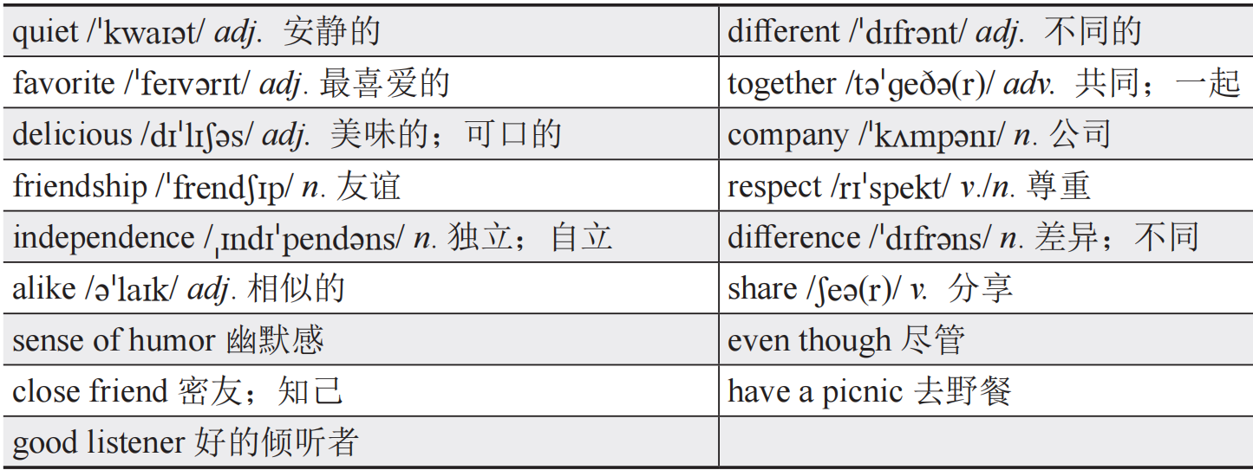
Words and Expressions
Passage One

Slide 37
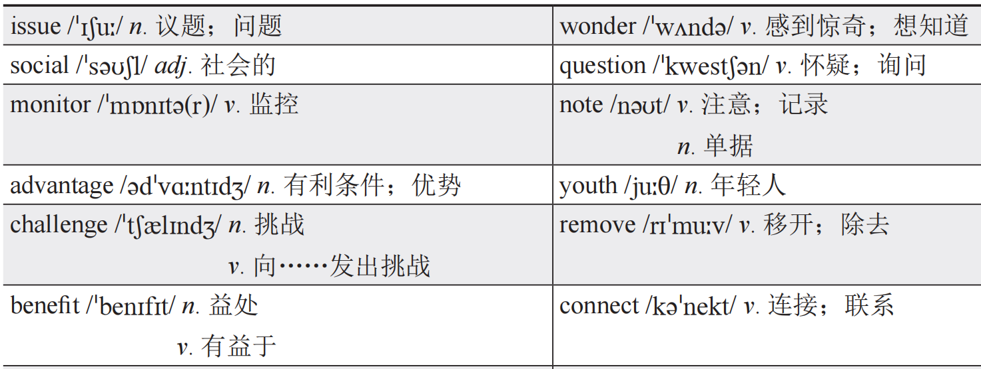
Passage Two

Slide 38
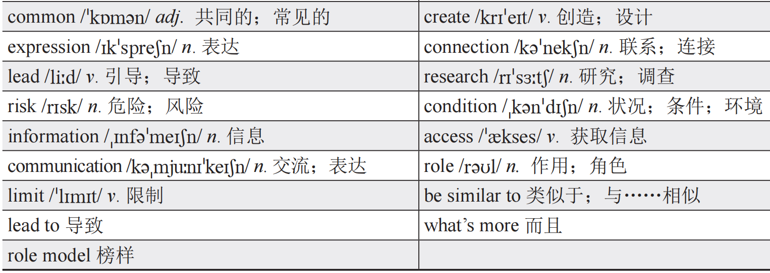
Passage Two

Slide 39
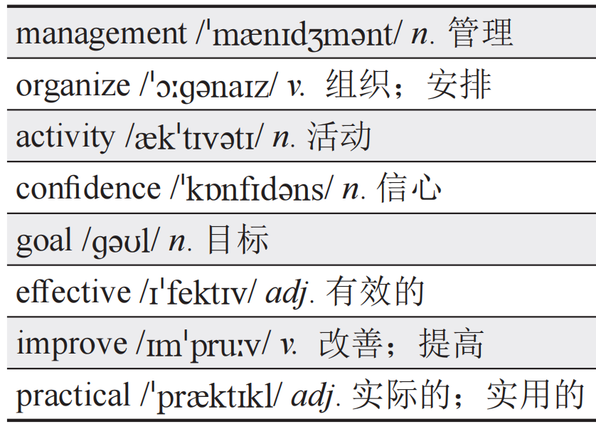
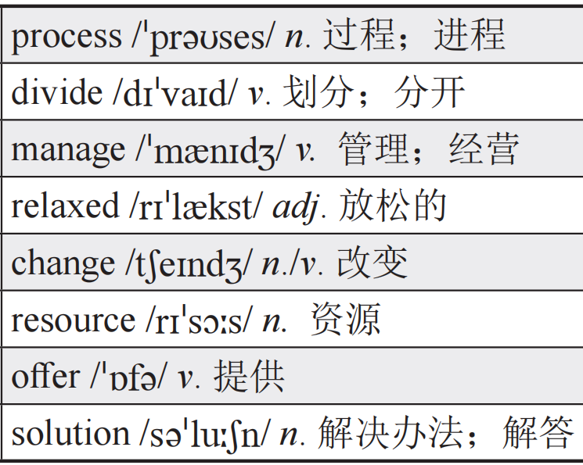
Passage Three
contents

Slide 40
Skills
快速阅读的略读技巧
快速阅读法（Fast Reading）是从文中迅速提取有用信息的阅读方法。它不只追求时间上的快速浏览，还十分重视质量，是一种积极的创造性理解过程。在快速阅读过程中，读者对一些概念进行综合加工，对有关事实和结论进行分析，从而掌握所读材料的主要信息，形成新的知识结构。常用方法有略读、查读、猜测阅读等。

Slide 41
略读（Skimming）又称为跳读，是一种实用的快速阅读方法，指读者带着一定目的，迅速浏览、捕捉所需信息，迅速获取文章大意或主题思想。这要求读者有选择地进行阅读，跳过某些不必要的细节，只读重点，从而加快阅读速度。具体来说，在阅读时，先粗略地浏览文章，推断这篇文章的题材和体裁，看看文章中是否有自己解题所需要的信息。在考试过程中，如果没有充分的时间，而且文章又不需要深层次理解，就可以运用略读的方法。一般阅读的目标是在保持常规阅读速度的条件下，获得尽可能高的理解水平，通常达到70%或80%。略读时，理解水平可以降低为50%至60%。

Slide 42
略读的阅读技巧包括：
（1）阅读标题、副标题和开头段落：这些部分通常能提供文章的主题和大致方向。
例如，通过阅读Passage Three的第一段，我们能很迅速地理解该文章和“时间管理”有关。
（2）扫视段落的开头和结尾：段落的开头和结尾句往往包含关键信息，能概括段落的主旨。
例如，在Passage One中，通过略读每段的首句，我们可以了解到该篇文章讲述了艾玛和乔伊两位小伙伴的友情故事，从而快速掌握文章主旨。

Slide 43
（3）留意突出显示的部分：如加粗、斜体、图表等，这些通常是重点内容。
（4）跳过细节和具体例子：不纠结于具体的数据、人名、地名等详细信息。

Slide 44
Have a Try
Exercise 1（2024年广东省真题）
However, mixed age education also brings some challenges, especially to teachers. Teaching can be more difficult because mixed age classes tend to be larger and teachers are required to make sure that students are in right groups. Applying such an approach to standardized learning can be difficult, though not impossible.

Slide 45
Q: What is discussed about mixed age education in the last paragraph?
A. Its future. B. Its history.
C. Its difficulties. D. Its standards.
解析：主旨大意题。根据段落第一句话中的“mixed age education also brings some challenges”可知，混龄教育也带来了一些挑战，即混龄教育的难处。故选C项。在阅读的时候，可以忽略段落首句后的具体细节。

Slide 46
Exercise 2（2023年广东省真题）
One day, Topher White went to a protected area for wildlife in Indonesia...
White, a trained engineer, thought technology could be part of the solution in the fight against illegal tree cutting...
Over the next few months, White created a piece of warning equipment called “Guardian”...
White set the first Guardians in a wildlife protection area in Indonesia...

Slide 47
Q: What is the purpose of the passage?
A. To describe a forest guard’s job.
B. To share an adventure in the rainforest.
C. To explain the importance of forest protection.
D. To introduce an invention for forest protection.
解析：主旨大意题。运用略读技巧，阅读每一段的首句。我们可以了解到，文章通过描述发明的背景、过程和结果，介绍了一种打击非法砍伐树木的发明。故选D项。

Slide 48
通过以上两个练习，可以发现许多文章在全文或者各段的开头便提出了文章的主题。在阅读段落寻找中心思想时，速度应尽量快于平时的一般阅读，将注意力集中在段落的中心思想上。此外，不应浪费太多时间推敲不认识的单词，最重要的是全面理解阅读材料。
contents

Slide 49
Practice
Read the following three passages and choose the best answers.
阅读以下三篇文章，并选择最佳选项。

Slide 50
Passage Four
Nana had always been expected to take over her family’s restaurant in Sampaje, a small village in India. However, Nana dreamed of a different life, one beyond the quiet village. She wanted to experience city life in Bengaluru, where she hoped to find better job opportunities.

Slide 51
After a year in Bengaluru, Nana felt lost and lonely. She was busy with her job and missed her family deeply. The excitement of city life has gone, leaving her unsure about her choice to leave home. One evening, Nana was surprised to find her mother and brother waiting outside her apartment. She ran to her mother’s arms and said, “Ma, I miss home so much.” Her mother held her tightly, “We miss you too, Nana.” Later, they sat down in Nana’s living room. Her brother said, “Nana, we want you to know that we support you, no matter what.”

Slide 52
During their visit, they visited local places of interest and shared delicious meals. Nana enjoyed every moment, realizing how much she had missed their warmth. One evening, Nana looked at her mother and took a deep breath, her heart feeling lighter than before. “Ma, I’ve been thinking a lot. I realize that running our family business in Sampaje isn’t just about duty. It’s about continuing what you and Dad have built with so much love. So, I want to come back home to run our restaurant and make you both proud,” she said. Her mother smiled, her eyes shining with pride and joy.
She knew she had made the right decision. Home wasn’t just a place; it was where her heart felt at peace, surrounded by love and support.

Slide 53
( ) 1. Why did Nana move to Bengaluru?
A. To take over her family’s restaurant.
B. To find better job opportunities.
C. To study in a city college.
D. To live independently.
B
【解析】事实细节题。根据第一段最后一句可知，她希望去班加罗尔找寻更好的工作机会。故选B项。

Slide 54
( ) 2. How did Nana feel after a year in Bengaluru?
A. Excited. B. Happy.
C. Lonely. D. Confident.
C
【解析】事实细节题。根据第二段第一句中的“lost and lonely”可知，娜娜在班加罗尔工作一年后很孤单。故选C项。

Slide 55
( ) 3. How did Nana likely feel after she made the decision to return home to run her family’s restaurant?
A. Stressed about the future.
B. Excited about new opportunities.
C. Proud and relieved.
D. Disappointed about leaving the city.
C
【解析】推理判断题。根据第三段第三句中的“took a deep breath”和“her heart feeling lighter than before”可以推测，娜娜下定决心回家继承自家的餐馆后，感觉很自豪和放松。故选C项。

Slide 56
( ) 4. According to the passage, which of the following statement is true?
A. Nana’s mother didn’t want her to come back.
B. Nana will never leave home again.
C. Nana’s family will move to Bengaluru.
D. Nana’s family loves her very much.
D
【解析】推理判断题。根据第二、三段可知，娜娜的弟弟表示，无论娜娜作怎样的决定，家人都支持她，可以推测出她的家人很爱她。故选D项。

Slide 57
( ) 5. What is the main theme of the story?
A. The struggles of working in the city.
B. The importance of family support.
C. Leaving home for personal growth.
D. The realization of one’s dream.
B
【解析】主旨大意题。原文中多次出现support，且提到娜娜的家人都很支持她的任何选择。故选B项。

Slide 58
Passage Five
The world’s population is aging: By 2025, people aged 60 or above will make up 20% of the global population. It means that many people are reaching old age healthier, wealthier and better educated than previous generations. The market aimed at people over 50 years old is known as the “silver economy” (银发经济).
China has the largest number of elderly people in the world with 216.8 million of its population aged 65 or above, and that number is going to increase to 400 million by 2050. As a result, China’s silver economy will triple (三倍) in value, from $ 750 billion in 2020 to $ 2.1 trillion by 2030, and may reach a value of $ 4.2 trillion, accounting for 10% of China’s GDP by 2035.

Slide 59
The United Nations (联合国) stresses the rights of elderly people to be important roles in the development of their societies, and the duties of governments to ensure that an age-friendly community is created for them. Elderly people make great social and economic contributions to the society through paid work, as community volunteers, and in family care roles. At the same time, active participation in social, economic and volunteering activities and lifelong learning support the personal growth and well-being of elderly people.

Slide 60
The silver economy offers a lot of benefits—for the industries that design their products and services to meet the needs of elderly people, for the elderly who are able to live more independently and for the government who wants to achieve economic growth and social development.

Slide 61
( ) 1. What is the projected value of China’s silver economy by 2030?
A. $ 750 billion. B. $ 1.5 trillion.
C. $ 2.1 trillion. D. $ 4.2 trillion.
C
【解析】事实细节题。文章第二段第二句提到，2030年中国的银发经济可达2.1万亿美元。故选C项。

Slide 62
( ) 2. Which of the following is NOT a way elderly people make contributions to the society?
A. Through paid work. B. As community volunteers.
C. In family care roles. D. As major consumers.
D
【解析】事实细节题。文章第三段第二句提到，老年人通过有偿工作、社区志愿服务以及家庭照料角色，为社会作出了巨大的社会和经济贡献。只有D选项未提及，故选D项。

Slide 63
( ) 3. Why does the United Nations stress the rights of elderly people and the duties of governments regarding age-friendly communities?
A. To increase government control over the elderly.
B. To ensure the well-being and active participation of elderly people in society.
C. To reduce the economic contributions of elderly people in the future.
D. To limit the growth of the silver economy and boost the online economy.
B
【解析】事实细节题。文章第三段第一句提到，联合国强调老年人的权利和政府的责任是希望老年人在社会中继续发光发热，起到积极的作用。故选B项。

Slide 64
( ) 4. We can infer from the passage that ___________.
A. the silver economy has few benefits
B. elderly people have very few rights in society
C. the silver economy offers many benefits
D. the silver economy will not develop at a fast pace in the future
C
【解析】推理判断题。联系上下文可知，银发经济给社会带来了发展的机遇，老年人同等享有社会公民的权利，银发经济今后还会继续增长。故选C项。

Slide 65
( ) 5. What is the main idea of the passage?
A. The development of the silver economy in China.
B. The aging population and the silver economy.
C. The rights of elderly people.
D. The loss in the silver economy.
B
【解析】主旨大意题。通读上下文，可知文章主要描述老龄化社会的发展趋势、银发经济的益处。故选B项。

Slide 66
Passage Six
The introduction of a stress-reducing policy in southern China, which told students to stop working on homework after 9:30 p.m. to ensure they have enough sleep, has started discussions on the best way to reduce study pressure.

Slide 67
A school in Nanning said that students would not be blamed for homework left unfinished after 9:30 p.m. (1) ______ It aims to reduce students’ pressure on homework and extra lessons during nine years of schooling. Since the implementation of the policy, most primary and secondary schools in China have reduced students’ workloads. Some think this will help children sleep more. (2) _______
E
C
A. So it’s not only a school decision.
B. “We need to really change the grading system,” he said.
C. But many people question if it was the best way to reduce their study pressure.
D. They are worried that unfinished homework may influence their children’s scores or rankings.
E. This is not the first school to take this step to follow the national rule.
(1)【解析】
(2)【解析】

Slide 68
1. 【解析】空格前介绍南宁一家学校实施了减负措施，5个选项中只有E项与“学校采取措施”相关。故选E项。
Back

Slide 69
2. 【解析】空格所在段落主要谈及各校执行减负措施，空格前一句提到，有些人认为这将有助于孩子的睡眠，下一句要么表示赞同，要么表示质疑。C项意为“但许多人质疑这是否是减轻学生学习压力的最好方法”，符合上下文逻辑。故选C项。
Back

Slide 70
Xiong Bingqi, from the 21st Century Education Research Institute, said cooperation from parents will be needed for this to work, because some ask their children to do extra tasks. After schoolwork, some children have to do exercises given by parents until 10 p.m. or 11 p.m. (3) __________
A
【解析】
A. So it’s not only a school decision.
B. “We need to really change the grading system,” he said.
C. But many people question if it was the best way to reduce their study pressure.
D. They are worried that unfinished homework may influence their children’s scores or rankings.
E. This is not the first school to take this step to follow the national rule.

Slide 71
3.【解析】第三段提及了21世纪教育研究院熊先生的观点，他认为减负需要家长的配合，这不仅仅是学校的一个决定。故选A项。
Back

Slide 72
Even though schools may allow students to stop doing homework at 9:30 p.m., many parents are still worried. (4) _______
D
【解析】
A. So it’s not only a school decision.
B. “We need to really change the grading system,” he said.
C. But many people question if it was the best way to reduce their study pressure.
D. They are worried that unfinished homework may influence their children’s scores or rankings.
E. This is not the first school to take this step to follow the national rule.

Slide 73
4.【解析】空格前提到许多家长仍然很担心，后一句应该是对前一句的延伸或补充。只有D项提及家长担忧的内容。故选D项。
Back

Slide 74
Xiong said the main reason for the study pressure placed on students is the country’s grading system. The middle school and college entrance exams still rely on single scores to judge students. (5) _________
B
【解析】
A. So it’s not only a school decision.
B. “We need to really change the grading system,” he said.
C. But many people question if it was the best way to reduce their study pressure.
D. They are worried that unfinished homework may influence their children’s scores or rankings.
E. This is not the first school to take this step to follow the national rule.

Slide 75
5.【解析】最后一段谈到学业压力来源于考试评价制度，因此，熊先生呼吁我们改变评价体制。故选B项。
Back

Slide 76
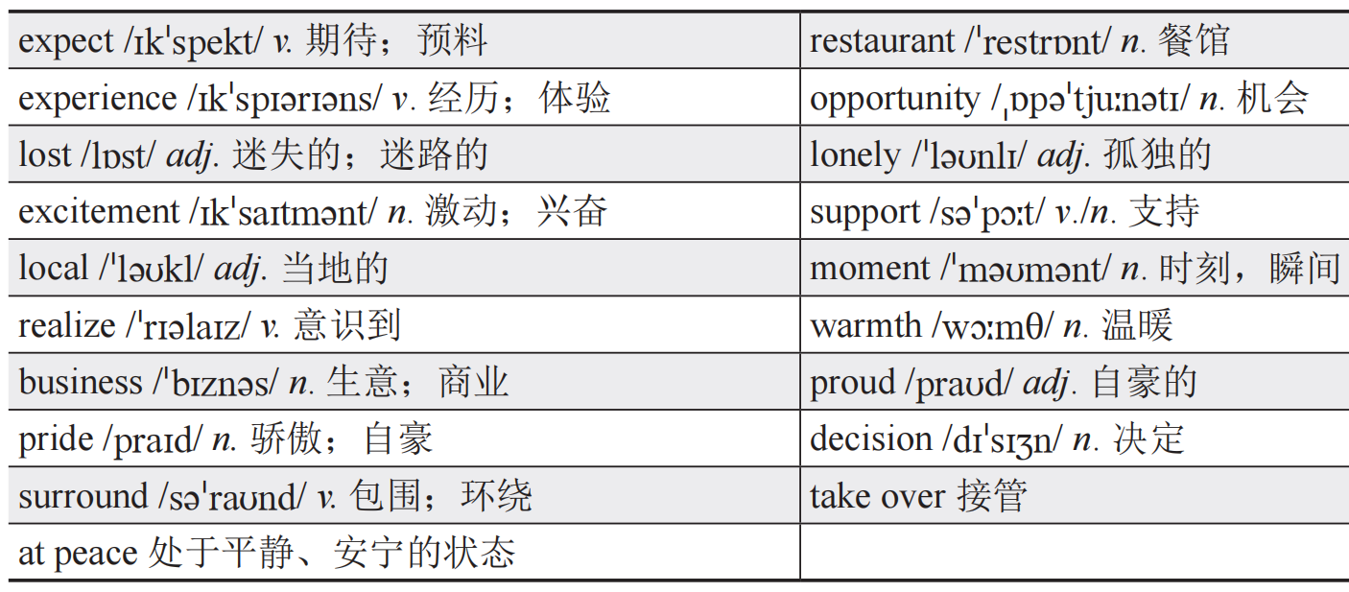
Words and Expressions
Passage Four

Slide 77
Passage Five

Slide 78
Passage Five

Slide 79
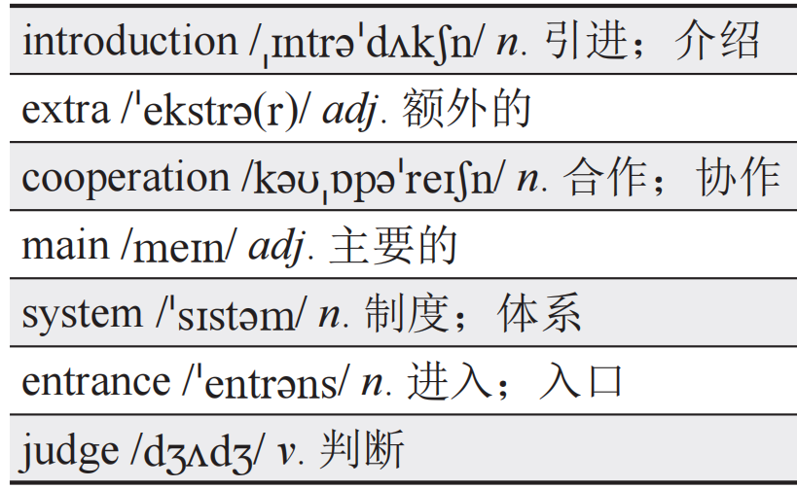
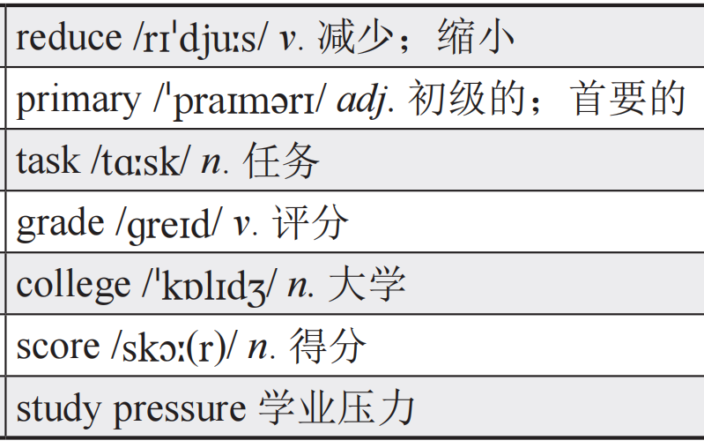
Passage Six
contents

Slide 80
Assessment
A. Please choose the best Chinese meanings for the underlined words.
请选出句中画线单词的最佳中文意思。
( ) 1. My close friends always support me.
A. 普通朋友 B. 密友 C. 网友 D. 同学
B
【解析】close friends意为“密友”。句意：我的密友总是支持我。

Slide 81
( ) 2. There is a big difference between the two books.
A. 相似之处 B. 不同之处 C. 共同点 D. 优点
B
【解析】difference意为“差异；不同”。句意：这两本书之间有很大的不同。

Slide 82
( ) 3. They are very alike.
A. 不同的 B. 相似的 C. 相反的 D. 陌生的
B
【解析】alike意为“相似的”。句意：他们非常相似。

Slide 83
( ) 4. I need to monitor my diet.
A. 忽视 B. 享受 C. 监控 D. 改变
C
【解析】monitor意为“监控”。句意：我需要监控我的饮食。

Slide 84
( ) 5. The problem is similar to the one we had last year.
A. 类似于 B. 与……不同 C. 比……好 D. 对……有害
A
【解析】be similar to意为“类似于；与……相似”。句意：这个问题和我们去年遇到的很相似。

Slide 85
( ) 6. I wonder if it will rain tomorrow.
A. 知道 B. 确定 C. 怀疑 D. 想知道
D
【解析】wonder意为“感到惊奇；想知道”。句意：我想知道明天是否会下雨。

Slide 86
( ) 7. My goal is to become a doctor.
A. 目标 B. 梦想 C. 计划 D. 想法
A
【解析】goal意为“目标”。句意：我的目标是成为一名医生。

Slide 87
( ) 8. The experience made me stronger.
A. 时机 B. 想法 C. 经历 D. 感受
C
【解析】experience意为“经历；体验”。句意：这次经历让我变得更强大。

Slide 88
( ) 9. The population of the city is increasing.
A. 人口 B. 面积 C. 环境 D. 经济
A
【解析】population意为“人口”。句意：这个城市的人口正在增长。

Slide 89
( ) 10. We should stress the importance of safety.
A. 忽略 B. 强调 C. 体积 D. 重读
B
【解析】stress作动词意为“强调”。句意：我们应该强调安全的重要性。

Slide 90
( ) 11. Many teenagers face mental health issues that often go unaddressed.
A. 问题 B. 作用 C. 情况 D. 连接
A
【解析】issue意为“议题；问题”。句意：许多青少年面临的心理健康问题常常得不到解决。

Slide 91
( ) 12. Encouraging open communication helps teenagers express their feelings and thoughts better.
A. 交流 B. 通信 C. 设备 D. 通道
A
【解析】communication意为“交流”。句意：鼓励开放的交流有助于青少年更好地表达他们的感受和想法。

Slide 92
( ) 13. Setting reasonable limits on screen time can reduce eye strain in teenagers.
A. 研究 B. 通讯 C. 调查 D. 限制
D
【解析】limit作名词意为“限制”。句意：设定合理的屏幕时间限制可以减少青少年的眼睛疲劳。

Slide 93
( ) 14. Efficiently manage your time by dividing your day into blocks of work.
A. 控制 B. 管理 C. 改进 D. 达到
B
【解析】manage意为“管理”。句意：高效地管理你的时间，把一天的工作分成几块。

Slide 94
( ) 15. Prioritizing tasks helps you improve productivity and reduce stress.
A. 导致 B. 提高 C. 实现 D. 分配
B
【解析】improve意为“改善；提高”。句意：对任务进行优先级排序有助于提高工作效率和减轻压力。

Slide 95
( ) 16. Providing warm fulfilling environment at home is crucial for children’s emotional development.
A. 温暖的 B. 美味的
C. 令人兴奋的 D. 紧张的
A
【解析】warm意为“温暖的”。句意：在家提供温暖充实的环境对孩子的情感发展至关重要。

Slide 96
( ) 17. Taking a decision to run a marathon shows the pride and commitment one has towards their health.
A. 自负 B. 责任 C. 自豪 D. 得意
C
【解析】pride意为“自豪；骄傲”。句意：决定参加马拉松比赛表明了一个人对自身健康的自豪和承诺。

Slide 97
( ) 18. Family gatherings are often filled with exciting conversations and laughter.
A. 美味的 B. 孤独的
C. 紧张的 D. 激动人心的
D
【解析】exciting意为“激动人心的”。句意：家庭聚会常常充满了激动人心的谈话和欢笑。

Slide 98
( ) 19. Feeling relaxed after a day of well-managed time can improve your overall mood.
A. 放松的 B. 自信的 C. 平静的 D. 实用的
A
【解析】relaxed意为“放松的”。句意：在经过妥善管理好时间的一天后感到放松，可以改善你的整体情绪。

Slide 99
( ) 20. Setting achievable goals is the first step to effectively achieve time management.
A. 记录 B. 管理 C. 提高 D. 实现
D
【解析】achieve意为“实现”。句意：设定可实现的目标是有效实现时间管理的第一步。

Slide 100
B. Read the passage and choose the best answer for each blank.
阅读文章，并为各题选出最佳选项。
True friendship is something to cherish. I have some 1__ and we often take part in various 2__ together. Last weekend, we decided to 3__ in a beautiful park. We were all very 4__ . I started to prepare the things for the picnic.
( ) 1. A. families B. close friends C. relatives D. classmates
( ) 2. A. tasks B. exams C. activities D. jobs
( ) 3. A. have a picnic B. have a swim C. have a walk D. have a exam
( ) 4. A. relaxed B. lost C. exciting D. excited
B
C
A
D
1【解析】
2【解析】
3【解析】
4【解析】

Slide 101
1.【解析】根据文章第一句“True friendship is something to cherish”可知本文主题为友谊，故第二句中的第一个空格应填写“close friends（密友）”。A项意为“家人”；C项意为“亲戚”；D项意为“同学”，均不符合题意。故选B项。
Back

Slide 102
2.【解析】根据该空格前的动词短语take part in，结合下文主人公去了公园，可推测该空选择“activities（活动）”。A项意为“任务”；B项意为“考试”；D项意为“工作”，均不符合题意。故选C项。
Back

Slide 103
3.【解析】本句意为“上周，我们决定去一个美丽的公园__________”。考虑公园内可以进行的活动，排除D项“have a exam（考试）”。结合第一段最后出现的picnic，可知他们去公园野餐。故选A项。
Back

Slide 104
4.【解析】根据上下文，主人公与朋友一起去公园野餐，并为此做准备，可推测他们感觉非常兴奋。A项意为“放松的”；B项意为“失落的”；C项意为“令人兴奋的”，一般用来描述事件；D项意为“感到兴奋的”，一般用来描述人的感受。故选D选。
Back

Slide 105
One of my friend Lily has a wonderful sense of humor and she always makes us laugh. She is also a good listener. Whenever I have problems, I can talk to her and ask for her advice. We share our 5 and sorrows, and this 6 our friendship stronger.
( ) 5. A. sorry B. joys C. limits D. pride
( ) 6. A. makes B. finds C. shows D. breaks
B
A
5【解析】
6【解析】

Slide 106
5. 【解析】A项意为“抱歉的”；B项意为“喜悦”；C项意为“限制”；D项意为“骄傲”。本句中，空格处与“伤心”并列，可推测需要填入另一种情绪。B项最符合上下文的意思，故选B项。
Back

Slide 107
6. 【解析】A项意为“使；制作”；B项意为“发现”；C项意为“展示”；D项意为“打破”。承接上文，主人公和朋友分享伤心与喜悦，这使他们的友谊更坚固。故选A项。
Back

Slide 108
However, as teens, we also face some issues. The 7 of study and the 8 to social media have brought some challenges to us. Our parents always seem to worry about it. We often 9 how to balance our time and keep a healthy lifestyle.
( ) 7. A. present B. problem C. pressure D. process
( ) 8. A. access B. limit C. connection D. research
( ) 9. A. question B. wonder C. answer D. plan
C
A
B
7【解析】
8【解析】
9【解析】

Slide 109
7. 【解析】该空格前一句“However, as teens, we also face some issues”意为“然而，作为青少年，我们也面临一些问题”，可知空格处应该说明具体碰到哪些问题。A项意为“现在”；B项意为“难题”；C项意为“压力”；D项意为“过程”。结合上下文，pressure of study意为“学习压力”，符合题意。故选C项。
Back

Slide 110
8. 【解析】A项意为“使用权”；B项意为“限制”；C项意为“联系”；D项意为“研究”。同上题，本句应该表达青少年面临的问题，根据后面的social media，可推测出应为“the access to social media”，即“使用社交媒体”。故选A项。
Back

Slide 111
9.【解析】A项意为“怀疑”；B项意为“想知道”；C项意为“回答”；D项意为“计划”。本句意为“我们想知道如何能平衡时间管理与保持健康的生活方式”。故选B项。
Back

Slide 112
In order to 10 our time effectively, we need to set clear 11 and make practical plans. We should 12 our tasks into small steps and complete them one by one. It’s not easy, but with determination and 13 , we can achieve it.
( ) 10. A. waste B. connect C. manage D. set
( ) 11. A. challenges B. goals C. questions D. tasks
( ) 12. A. divide B. decide C. delay D. design
( ) 13. A. confidence B. surprise C. pride D. stress
C
B
A
A
10【解析】
11【解析】
12【解析】
13【解析】

Slide 113
10. 【解析】A项意为“浪费”；B项意为“连接”；C项意为“管理”；D项意为“设定”。根据上文，本句意为“为了有效地管理时间”。故选C项。
Back

Slide 114
11. 【解析】A项意为“挑战”；B项意为“目标”；C项意为“问题”；D项意为“任务”。set goals为固定搭配，意为“设定目标”。故选B项。
Back

Slide 115
12. 【解析】A项意为“分为”；B项意为“决定”；C项意为“延迟”；D项意为“设计”。根据本空格后面的 into，可知考查固定搭配divide...into...，意为“将……分为……”。故选A项。
Back

Slide 116
13. 【解析】A项意为“自信”；B项意为“惊喜”；C项意为“自豪”；D项意为“压力”。根据句意“这不容易，但凭着决心和自信，我们能完成”。故选A项。
Back

Slide 117
For our own future, we should study hard and aim for high grades in school. We should also 14 with our classmates and 15 from each other.
( ) 14. A. criticize B. choose C. cooperate D. confidence
( ) 15. A. teach B. learn C. protect D. follow
C
B
14【解析】
15【解析】

Slide 118
14. 【解析】A项意为“批评”；B项意为“选择”；C项意为“合作”；D项意为“自信”。cooperate with为固定搭配，意为“与……合作”，故选C项。
Back

Slide 119
15. 【解析】A项意为“教”；B项意为“学习”；C项意为“保护”； D项意为“跟随”。learn from为固定搭配，意为“向……学习”。故选B项。
Back

Slide 120
C. Have a check.
开展自我评价。
我掌握的词汇：
favorite | monitor | independence | realize | connect
issue | wonder | note | lead | divide
effective | confidence | achieve | experience | opportunity
support | proud | role | stress | society
community | reduce | pressure | system | score

Slide 121
我掌握的阅读理解技能：
自评情况 | 评价指标 | 对应内容
☆☆☆☆☆ | 能理解语篇的主旨大意。 | Passage One/Four/Five第五题
☆☆☆☆☆ | 能根据主题熟悉的文本信息作出推理判断。 | Passage One/Four/Five第四题和Passage Two第四、五题
☆☆☆☆☆ | 能根据上下文推测前后文内容。 | Passage Three/Six
☆☆☆☆☆ | 能从主题熟悉的文本中找出特定信息。 | 除上述题目外的其他阅读理解题
☆☆☆☆☆ | 能了解略读技巧并在阅读中有效运用。 | 除上述题目外的其他阅读理解题
contents

Slide 122
B
C
Thank you !
A

