Slide 1
学术英语写作
Academic English Writing

Slide 2
目录
CONTENT
第一单元
引言 Introduction
第1节
什么是学术英语写作？
What Is Academic English Writing?
第2节
常见的英语写作文体及特征
Common types of Writings and Their Features

Slide 3
第一单元
引言
Introduction

Slide 4
当今时代，信息的交流越来越频繁。英语作为一种交流工具在国际交往中的作用越来越大，其地位日渐攀升。写作能力是英语听、说、读、写四种基本能力之一。英语写作可作为传递信息、交流感情的手段，还能有效促进语言知识的内化。读是信息的输入，而写则是信息的反馈与提取，旨在训练学生对所学知识的实践运用，特别是测试学生的书面表达能力。
引言 Introduction

Slide 5
英语写作能力包括使用书面语言清楚有效地传达信息——恰当地写作常规体裁与文体；语篇能力——观点及其组织安排、结构完整连贯，针对性强；语言能力——得体地使用流畅准确的句子结构以及写作基本技能（标点符号和拼写）（Spaan 1993：98）。Weigle（2002：14—38）认为，写作能力的本质可以从以下三个方面来理解：
引言 Introduction

Slide 6
第一，从语言学角度讲，书面写作不同于口头表达。口头表达和书面写作用于不同的场合、不同的目的，用来满足不同的交际需要。当然，口头表达和书面写作也有一定的联系，这在实际应用中有具体的体现。第二，写作是社会文化现象（social and cultural phenomenon）。写作是为了完成某种目的而产生于语境的行为，是为既定读者服务的。第三，写作也是认知活动（cognitive activity）。
引言 Introduction

Slide 7
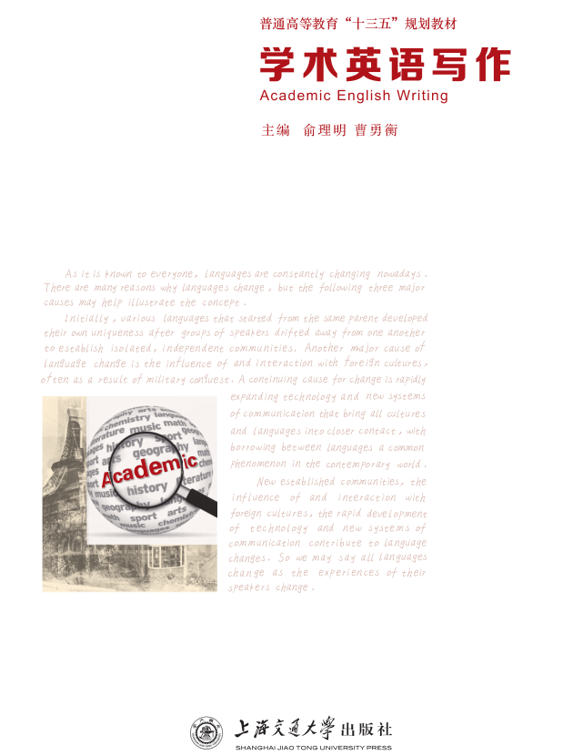
引言 Introduction
This book aims to offer a comprehensive English writing course for college students.
Although there are so many writing course books on the market, this one stands out because of its comprehensiveness and practicality.

Slide 8
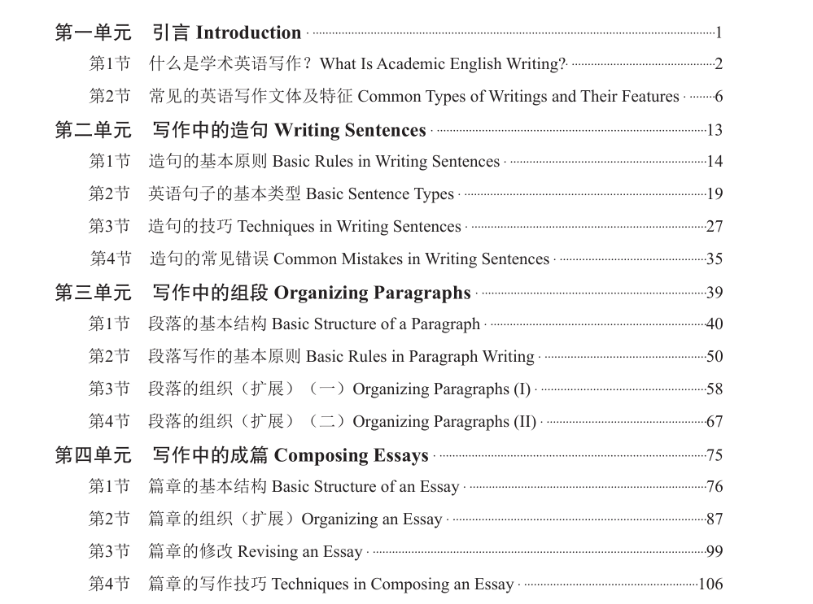
引言 Introduction
First, it helps students improve their basic writing ability from the basic language unit, sentence, to the larger units, paragraph and essay. Besides, the linguistic elements such as sentence types and grammaticality, the structural components including coherence and completeness are given due attention.

Slide 9
引言 Introduction
Second, writing does not only include those practiced in schools for the purpose of finishing an assignment, it also includes writing for the real world to achieve a real purpose. We have devoted one chapter (Chapter 5) for the practical writing, hoping to help students improve their communication skills for their future career.

Slide 10
Third, we have given emphasis to the writing of research papers, which is an important part of students’ academic life. We start from the basic structure of a research paper, then go on with the specific components including abstract, body, conclusion and how to write literature review.
Lastly, writing for exams will also useful in students’ college studies.
引言 Introduction

Slide 11
第1节
什么是学术英语写作？
What Is Academic English Writing?

Slide 12
什么是学术英语写作？
What Is Academic English Writing?
Besides its general meaning, “Academic English” can also be regarded as English for Specific or Special Purpose (ESP) in comparison with Occupational English, or English for Academic Purpose (EAP) which serves to help students with their academic studies.
EAP

Slide 13
McGinnis ASPHALT Engineering
464 Line Road, Midland 03438
To: Jean Birch, Director of Sales
FROM: Michael Rourke, Research Engineer
SUBJECT: Research Update on County Road Repair
DATE: January 20, 2013
In response to your request for an update, the major problem is still the county road commission itself. Our new sulphur-asphalt mix could probably increase road life in this area by 20%, but the commission has consistently failed to lay test paving. Specifically, this mix:
1. offers a soft mix that also resists rutting
2. resists seepage and prevents stripping
3. provides better bonding, which allows the use of cheap local stone
4. will become cheaper as the cost of petroleum-based competitors increases.
If you could get the county to overcome its inertia and fund initial testing, we could offer improved mixes and the strong possibility of lower costs in the next three years. See the attached report for details.

Slide 14
什么是学术英语写作？
What Is Academic English Writing?
 | Issue | Readers | Objectives
(1)
(2)
The Problems of Senior Citizens in Shanghai
Teachers of the English Writing Course
Demonstrate students’ writing competence
Specifications of a New Product
Director of Sales
Encourage the government to purchase the product

Slide 15
什么是学术英语写作？
What Is Academic English Writing?
Compare this memo (2) with the article in the students’ book about Senior Citizens in Shanghai (1) and we can find that (2) is an example of practical English writing, aiming to report on the characteristics of their projects. On one hand, (1) is written to complete a course assignment and the reader would be the teacher/lecturer of that course and can be considered academic English writing in general sense. On the other hand, (1) can be used as part of research paper or research report and then be regarded as academic English writing in technical or specialized sense.

Slide 16
什么是学术英语写作？
What Is Academic English Writing?
Oshima & Hogue（1991）从写作对象（audience）、目的（purpose）和语气（tone） 这三个方面来界定学术写作，指出学术写作的对象是高校的教师或教授，这种写作总是采用正式的语气。写作使用什么语气，取决于写给谁和写作的目的。根据这三个维度，我们 可以认定(1)那篇文章属于学术英语写作。我国高校大学生的习作，都可以被看成一般意义上的学术英语写作。

Slide 17
EXERCISE
Questions:
1) How similar is the article in question to the one discussed in the text?
Both essays are written not for the purpose of solving specific problems in the real world, but to demonstrate the writer’s ability to write good English, present forceful argument in a logical way and supply supporting evidence for the arguments. In other words, they are written for the sake of “Writing”.

Slide 18
EXERCISE
Questions:
2) How would you characterize this article as a piece of academic writing in line with the three dimensions set by Oshima and Hogue?
According to Oshima and Hogue’s dimensions, we can see that the potential audience of this article are school/university teachers or professors who are to read and rate it for judging the writer’s writing ability and that it is written in a formal tone, so we can say that this piece of writing is academic English writing.

Slide 19
第2节
常见的英语写作文体及特征
Common types of Writings and Their Features

Slide 20
常见的英语写作文体及特征 Common types of Writings and Their Features
英语写作通常分基础写作和应用写作两大类。我们将在第五单元中详细介绍应用文体写作。这里谈的文体是对基础写作而言的。
英语基础写作的主要文体有四种：记叙文、描写文、说明文和议论文, 记叙文以记人叙事为主线，记录人的行为或事情发展变化的过程。描写文以描述为主，比如描写天气、人物形象、环境、情景，等等。说明文则以解释、说明的方法来说清楚某一事物，或讲清楚某一事理。议论文则通过摆事实、讲道理的方法来阐明白己的观点。
Notes:
there are only four general purposes that lead someone to write a piece, and these are known as the four styles, or types, of writing. Knowing the four different types of writing and their usages is important for any writer.
Here are the four categories of writing and their definitions:1. Narrative Writing:
A narrative tells a story. There will usually be characters and dialogues. 2. Descriptive Writing:
Descriptive writing focuses on communicating the details of a character, event, or place.

Slide 21
常见的英语写作文体及特征 Common types of Writings and Their Features
2.1 记叙文 Narrative Writing
记叙文是记录和叙述人物的行为、事件发展或环境气氛的文章，是我们在日常生活中最常见的一种文体。它经常和描写文、议论文等综合使用。记叙文的几个要点为：
①记叙文有六大要素：时间、地点、人物、事件、原因、结果。这几个要素在写作时要交代清楚。
请找出下文中的六要素。

Slide 22
常见的英语写作文体及特征 Common types of Writings and Their Features
New situations always make me a bit nervous, and my first swimming lesson was no exception. After I changed into my bathing suit in the locker room, I stood timidly by the side of the pool waiting for the teacher and other students to show up. After a couple of minutes the teacher came over. She smiled and introduced herself, and two more students joined us. Although they were both older than me, they didn’t seem to be embarrassed about not knowing how to swim. I began to feel more at ease.
时间： 地点：
人物： 事件：
原因： 结果：
During my first swimming lesson;
A swimming pool;
I, the teacher and other students;
My first swimming lesson;
I always feel nervous in new situation;
I began to feel more at ease.

Slide 23
常见的英语写作文体及特征 Common types of Writings and Their Features
②人称：记叙文一般可以有第一人称和第三人称两种叙事方式：第一人称是作者以当事人的口吻，把文章中的事情以“我”的所见所闻的方式来叙述，第三人称是写作者从旁观者的角度来叙述，反映事件中不同人的感受和见解。写作时要注意前后人称的统一。
③记叙文的线索一般为时间，即按照事件的发展顺序来写。也可以按照地点的线索来 写，即以地点的转移为顺序。
④重点突出，层次分明，详略得当。
⑤注意文章的完整性。
⑥所用的时态通常为一般过去时。下面的例子虽然很短，但是足以体现记叙文的特点。

Slide 24
常见的英语写作文体及特征 Common types of Writings and Their Features
Key Points:
In narrative writing, a person tells a story or event.
Narrative writing has characters and dialogues.
Narrative writing has definite and logical beginnings, intervals, and endings.
Narrative writing often has situations like actions, motivational events, and disputes or conflicts with their eventual solutions.

Slide 25
常见的英语写作文体及特征 Common types of Writings and Their Features
Examples of When You Would Use Narrative Writing:
Novels
Short stories
Novellas
Poetry
Autobiographies or biographies
Anecdotes
Oral histories

Slide 26
常见的英语写作文体及特征 Common types of Writings and Their Features
Which one is an example?
Example:
“I don’t think that’s a good idea,” said Jaclyn.
“You never used to be such a girl!” retorted Orin, pushing open the door.
Reluctantly, Jaclyn followed.
Cutting Edge Haunted House holds the Guinness World Record for the largest haunted house on earth. It’s located in a district in Fort Worth, Texas known as “Hell’s Half Acre” in a century-old abandoned meat-packing plant. The haunted house takes an hour to complete, winding through horrific scenes incorporating the factory’s original meat-packing equipment.
Non-example:

Slide 27
常见的英语写作文体及特征 Common types of Writings and Their Features
2.2 描写文Descriptive Writing
在写描写文的时候，需要注意下列问题：
①要有明确的目的；
②要突出特点，描写要有重点；
③要抓住事物的特征。

Slide 28
常见的英语写作文体及特征 Common types of Writings and Their Features
Key Points:
It is often poetic in nature.
It describes places, people, events, situations, or locations in a highly-detailed manner.
The author visualizes what he or she sees, hears, tastes, smells, and feels.
When You Would Use Descriptive Writing:
Poetry
Journal or diary writing
Nature writing
Descriptive passages in fiction

Slide 29
常见的英语写作文体及特征 Common types of Writings and Their Features
(2)
My most valuable possession is an old, slightly warped blond guitar—the first instrument I taught myself how to play. It’s nothing fancy, just a Madeira folk guitar, all scuffed and scratched and finger-printed. At the top is a bramble of copper-wound strings, each one hooked through the eye of a silver tuning key. The strings are stretched down a long, slim neck, its frets tarnished, the wood worn by years of fingers pressing chords and picking notes. The body of the Madeira folk guitar is shaped like an enormous yellow pear, one that was slightly damaged in shipping. The blond wood has been chipped and gouged to gray, particularly where the pick guard fell off years ago.

Slide 30
常见的英语写作文体及特征 Common types of Writings and Their Features
(2)
在上面这段文字里，作者描述了他/她的一把吉他。通过生动的语言把吉他的外形栩栩如生地展示在读者面前。我们可以通过下面的例子来体会一下简单记叙和描写的区别：
I saw a bird this morning.（记叙一个事件）
I saw the ribbon of spring this morning—a plump male—his red breast glowing in the sun.（描写一个场景）

Slide 31
常见的英语写作文体及特征 Common types of Writings and Their Features
Example:
In good descriptive writing, the author will not just say: “The vampire killed his lover.”
He or she will change the sentence, focusing on more details and descriptions, like: “The bloody, red-eyed vampire, sunk his rust-colored teeth into the soft skin of his lover and ended her life.”

Slide 32
常见的英语写作文体及特征 Common types of Writings and Their Features
Which one is an example?
Example:
The iPhone 6 is unexpectedly light. While size of its screen is bigger than those of the iPhones that came before, it is thinner, and its smooth body is made of aluminum, stainless steel, and glass. The casing comes in a whitish silver, gold, or a color the company calls “space gray,” the color of the lead of a pencil, with darker gray accents.
So you just brought home a shiny new smart phone with a smooth glass screen the size of your palm. The first thing you want to do when purchasing a new cell is buy a case. Cracking your screen is an awful feeling, and protection is inexpensive when you compare it to the costs of a new phone.
Non-example:

Slide 33
常见的英语写作文体及特征 Common types of Writings and Their Features
2.3 说明文Expository Writing
说明文一般分为三大类：实体事物说明文，包括说明书、广告、解说词、印刷小品、知识注解等；事理说明文，包括理论性的概念解释、书文简介、教材等；文艺性说明文，也就是把说明的对象进行拟人化，进而编成故事对其进行介绍。
具体来说要符合以下几个要求：
①要抓住事物的本质特征进行说明或解释；
②要掌握说明顺序；
③语言要浅显、准确、通俗易懂。

Slide 34
常见的英语写作文体及特征 Common types of Writings and Their Features
Key Points:
Expository writing usually explains something in a process.
Expository writing is often equipped with facts and figures.
Expository writing is usually in a logical order and sequence.
When You Would Use Expository Writing:
Textbook writing
How-to articles
Recipes
News stories (not including opinion or editorial pieces)
Business, technical, or scientific writing

Slide 35
常见的英语写作文体及特征 Common types of Writings and Their Features
总的来说，说明有几种基本方法：①下定义（definition），告诉人们“是什么”； ②说明过程（process），告诉人们“怎么做”，或事件的经过；③原因结果说明（cause and effect），告诉人们事件的前因后果、内在联系；④分类说明（classification），将较大的说明对象分成几类，逐步逐类地加以说明；⑤比较与对比的方法（comparison and contrast），是将相互关联的事物或现象进行比较，找出相似点和不同点。我们将在后面 的单元里详细介绍这些方法。

Slide 36
常见的英语写作文体及特征 Common types of Writings and Their Features
Which one is an example?
Example:
Many people associate the taste of pumpkins with fall. In October, companies from
Starbucks to McDonalds roll out their pumpkin-flavored lattes and desserts.
Here is how to make an easy pumpkin pie using only five ingredients. First, make sure you have all of the ingredients…
Everyone knows that the best part about fall is all of the pumpkin-flavored desserts. Pumpkin pie is the best fall treat because it is not only delicious but also nutritious. Pumpkin is filled with vitamin A, which is essential for a healthy immune system and good vision.
Non-example:

Slide 37
常见的英语写作文体及特征 Common types of Writings and Their Features
2.4 议论文Argumentative Writing
议论文可以分为立论和驳论两大类。立论的目的是阐明自己的观点或主张，应该有充分的、合乎逻辑的论据。立论可以有一个论点也可以有几个分论点。驳论是以驳斥某一个论点为目的的，应该结构严谨，论证充分、全面，做到无懈可击。
议论文与其他各类文章一样，对结构也有一定的要求。一般来说，议论文由开头、中间和结尾三个部分组成。全文应该前后贯通、条理分明，形成一个整体。第一部分通常告诉读者是关于哪方面的内容，起引导和点明主题的作用；第二部分是正文，是文章的主要部分，反映文章的主要内容以及论点；第三部分为结尾，通常是作者观点的总结，强调主题并指明方向。我们将在后面的单元里详细介绍议论文和其他文体的结构。

Slide 38
常见的英语写作文体及特征 Common types of Writings and Their Features
(4)
Why Students Should Take a Gap Year
The choice of a future career is, perhaps, among the most important decisions an individual makes throughout their life. Even though a profession may change with the flow of time, making the first step on this path is an essential and responsible act. And despite the fact that a particular college or university, where former school students enter after graduating from high school, will not necessarily design and determine their future, for many it is true. Assuming that a student is left to decide what he or she wants to become on his or her own terms, and that nobody should interfere in his or her decision-making process, a necessity to select a college—which equals making a fateful decision—requires deep analysis and contemplation. Therefore, taking a so-called gap year after graduating from high school is a reasonable alternative for those students who are not yet sure about their goals, dreams, and expectations for the future.

Slide 39
常见的英语写作文体及特征 Common types of Writings and Their Features
Perhaps, the first factor speaking in favor of taking a gap year is that by doing so a student learns how to take up responsibility and how to organize their life to a greater extent. Taking a gap year is expensive in terms of travelling (which is one of the main occupations of students during their gap years) or spending free time in some other way. When students realize this simple fact, they usually take temporary part-time jobs to cover the expenditures of future vacations. They can also collect money for further education to decrease the amount of student loans which they need to take out. All this makes students more self-sufficient and responsible for their decisions, the way they spend money, and organize their time.
The other significant reason for taking a gap year is better academic performance. Whereas many students and their parents are concerned about possible problems with academic performance after taking a year off, recent research proves the opposite. In

Slide 40
常见的英语写作文体及特征 Common types of Writings and Their Features
particular, studies show that students who decide to take a gap year before entering a college had a GPA (Grade Point Average) that was on average 0.1-0.4 higher than those students who enrolled into higher education immediately after high school. Researchers believe it is connected to the possibility to choose one’s sphere of interests, and make a more balanced and reasonable decision before choosing what to major in. In addition, another reason why the second category of students may often perform worse is fatigue from studying at high school; those who take a gap year do not experience this problem.
Taking a year off is also a perfect opportunity to see the world and feel completely free of daily routines, troubles, assignments—they are able to make new friends around the world, find inspiration, and dedicate time to introspect about their own behavior. To some degree this chance is the only one a person may have throughout their entire life, because in the future there await all kinds of credits, academic assignments, career

Slide 41
常见的英语写作文体及特征 Common types of Writings and Their Features
choices, family, and other manifestations of life in higher education. Many students choose to visit countries that they know they will never go to in the future; this often provides them with inspiration, different perspectives, broadens their outlooks, and helps them to understand the diversity of the world they live in on a deeper level.
As it turns out, there is no need to rush to enroll in a college immediately after high school; taking a gap year to take a breath and look around seems to be a more reasonable alternative. During the gap year students learn more about responsibility and organizing their lives, because they have to earn their own money to pay for the leisurely part of the gap year. Students who take a year off usually demonstrate better academic performance than those who enter colleges immediately after high school. In addition, a gap year is most likely the only chance for a person to see the world without being bothered by such problems as loans, assignments, career, and so on.

Slide 42
常见的英语写作文体及特征 Common types of Writings and Their Features
上面是一篇完整的议论文，旨在论述事理，发表意见。我们可以很容易找到文章的论点和论据。
论点：
论据：
Students Should Take a Gap Year.
① A student learns what responsibility to take and how to organize their life to a greater extent;
② A student has better academic performance;
③ It’s a perfect opportunity to see the world and feel completely free of daily routines, troubles, assignments.

Slide 43
常见的英语写作文体及特征 Common types of Writings and Their Features
4. Argumentative Writing (also called Persuasive Writing):
Key Points:
Argumentative writing is equipped with reasons, arguments, and justifications.
In argumentative writing, the author takes a stand and asks you to agree with his or her point of view.
It often asks for readers to do something about the situation (this is called a call-to-action).

Slide 44
常见的英语写作文体及特征 Common types of Writings and Their Features
When You Would Use Argumentative Writing:
Opinion and editorial newspaper pieces
Advertisements
Reviews (of books, music, movies, restaurants, etc.)
Letter of recommendation
Letter of complaint
Cover letters

Slide 45
常见的英语写作文体及特征 Common types of Writings and Their Features
Which one is an example?
Example:
Following the 2012 Olympic Games hosted in London, the UK Trade and Investment
department reported a £9.9 billion boost to the economy. Although it is expensive to host the
Olympics, if done right, they can provide real jobs and economic growth. This city should
consider placing a bid to host the Olympics.
According to legend, the Olympics were founded by Hercules. Now almost 100 countries
participate in the Games, with over two million people attending. So cities from Boston to
Hamburg begin considering their bid to be a host city more than 10 years in advance.
Non-example:

Slide 46
常见的英语写作文体及特征 Common types of Writings and Their Features
Conclusion:
These are the four different types of writing that are generally used. There are many sub-types of writing that may fall in any of those categories. A writer must know all these styles in order to identify the purpose of his or her own writing and make sure it’s something the
audience wants to read.

Slide 47
EXERCISE
1. The following paragraphs are taken from four different essays. Please indicate which type of essays they belong to.
Narrative Writing B. Descriptive Writing
C. Expository Writing D. Argumentative Writing
1) Most people think that the common cold is caused by cold weather, since it sounds logical and obvious. However, cold itself does not cause sickness, which is easily proved by people who can swim in ice-cold water, or by those who are less sensitive to cold weather. The most typical cause of the cold, however, is a family of viruses that are called rhinoviruses. A rhinovirus is transmitted through air, so when an infected person sneezes, and you inhale the air nearby, you may get infected as well (this is one of the reasons why doctors sometimes recommend to wear face masks in public places when it is cold outside). The virus can be transmitted in some other ways as well, like through handshakes (and touching in general).

Slide 48
EXERCISE
Narrative Writing B. Descriptive Writing
C. Expository Writing D. Argumentative Writing
2) This was my first time in the mountains, so I was turning my head in all directions. Unfortunately, the weather was foggy most of the time, and the higher we got into the mountains, the worse the visibility was. Even despite this fact, I still enjoyed the hike—I felt like I was Bear Grylls, whose show I used to watch with excitement: in the wild, with food and water in my backpack, carrying a flashlight and a knife. On the first day, we were making our way along the foothills; but the next day, we started to climb on one of the peaks. Though it was not that steep and high, I was still excited. I regularly hastened, and because of that I ran out of energy long before we got to the top; David, on the other hand, was well-paced.

Slide 49
EXERCISE
Narrative Writing B. Descriptive Writing
C. Expository Writing D. Argumentative Writing
3) On one corner of my dresser sits a smiling toy clown on a tiny unicycle—a gift I received last Christmas from a close friend. The clown’s short yellow hair, made of yarn, covers its ears but is parted above the eyes. The blue eyes are outlined in black with thin, dark lashes flowing from the brows. It has cherry-red cheeks, nose, and lips, and its broad grin disappears into the wide, white ruffle around its neck. The clown wears a fluffy nylon costume. The left side of the outfit is light blue, and the right side is red. The two colors merge in a dark line that runs down the center of the small outfit. Surrounding its ankles and disguising its long black shoes are big pink bows. As a cherished gift from my good friend Tran, this colorful figure greets me with a smile every time I enter my room.

Slide 50
EXERCISE
Narrative Writing B. Descriptive Writing
C. Expository Writing D. Argumentative Writing
4) Despite the technological advances and scientific inventions which make us believe we have nothing in common with the rest of the animal kingdom, we are still part of the planet’s fauna, whether we realize it or not. Needless to say, back when humanity’s main achievements were the invention of a round wheel, or specific tools for farming agriculture, human beings were dependent on nature and paid attention to the changes of its course. Now, with technological revolutions and discoveries which made up our past history, we seem to pay little attention to nature, getting more and more disconnected from it every day. However, the links we have with nature cannot disappear. There are a number of key reasons in favor of the concept that people should try to connect with nature more than they do today.

Slide 51
EXERCISE
II. Key to EXERCISE
1. The following paragraphs are taken from four different essays. Please indicate which type of essays they belong to.
1) C 2) A 3) B 4) D

Slide 52
EXERCISE
2. Study the following topics for essays and decide which of the four types they may belong to. Choose one topic and write an essay.
1) The Most Memorable Experience in My Life
2) My Favorite Restaurant
3) Christmas Traditions from around the World
4) Why the Drinking Age Should Not Be Lowered

Slide 53
EXERCISE
II. Key to EXERCISE
1) The Most Memorable Experience in My Life—Narrative Writing
Since I am a high school student, somebody might say I have my entire life ahead of me, with all of its beautiful experiences. But despite being so young, I already have a personal breath-taking experience, which I am sure I will carry with me until my last days: my first hike to the mountains.
Though travelling is not a big deal for me today, before my trip to the mountains, I used to be a homebody. I had friends to hang out with, several hobbies, and I felt completely comfortable spending weeks or even months in my hometown—or sometimes even on my block—without going anywhere. All my demands of novelty were satisfied by the Discovery and National Geographic channels, and I seriously thought there was no difference between seeing something on the TV or with one’s own eyes.

Slide 54
EXERCISE
II. Key to EXERCISE
The situation changed when one day David, my best pal who always got a couple of colorful bugs in his head (or, in other words, was always carrying out several crazy plans at once) tumbled into my room and proclaimed his disgust for civilization. I will not describe how he managed to persuade me to join him on his journey to the Rocky Mountains; all I will say is we departed in five days.
This was my first time in the mountains, so I was turning my head in all directions.
Unfortunately, the weather was foggy most the time, and the higher we got into the mountains, the worse the visibility was. Even despite this fact, I still enjoyed the hike—I felt like I was Bear Grylls, whose show I used to watch with excitement: in the wild, with food and water in my backpack, carrying a flashlight and a knife.

Slide 55
EXERCISE
II. Key to EXERCISE
On the first day, we were making our way along the foothills; but the next day, we started to climb on one of the peaks. Though it was not that steep and high, I was still excited. I regularly hastened, and because of that I ran out of energy long before we got to the top; David, on the other hand was more well-paced.
When we finally got to the top, nothing had really changed. The same fog was covering the surroundings, and even though I was teeming with positive emotions, I felt disappointed, because I counted on seeing the view from above and perhaps being able to take some photos. We spent a couple of hours on the top, and decided to turn back, when the wind suddenly dispersed the clouds, and the plateau we were standing on became illuminated with the sun. I saw a fantastic panorama in front of me, and for some moments I couldn’t believe my eyes. Seeing all those mountain ridges, cliffs, and edges on my own, not on TV, was like a revelation for me. The strong wind blew right into my face, and I just stood there and watched shreds of

Slide 56
EXERCISE
II. Key to EXERCISE
fog gliding over the ground far beneath me. At that moment, I realized that I won’t be able to live a life without visiting the mountains at least twice a year.
The next day we returned—my legs started to hurt so bad that I could hardly walk. But every time as my face wrinkled because of an ache, I remembered the feeling of being high above, with my head touching the skies and the clouds swimming below.

Slide 57
EXERCISE
II. Key to EXERCISE
2) My Favorite Restaurant—Descriptive Writing
As a child, I was not fond of eating out. My family would eat at a restaurant, diner, or buffet at least once a week, often more than once. Every time we went anywhere, but for a little place called Rivenee’s, it was a challenge for my parents. Rivenee’s was that lucky exception—I loved the place and this made my parents love it too. The restaurant seemed magical and fascinating to me when I was an elementary school kid, and surprisingly, the place still fascinates me today. Recently, when I visited my old family house for Thanksgiving, I was astonished and pleased to find out the place still operated and, in fact, was still run by the same family. Apart from the house in which I grew up, Rivenee’s is probably the dearest place to me in the small town, just outside of San Ramon, where I was born and raised.

Slide 58
EXERCISE
II. Key to EXERCISE
Rivenee’s is a small and cozy place, and this is what probably garnered my love of the restaurant initially. This, and the people who worked, and still work there. Unlike more spacious restaurants, diners and chain buffets my parents also took me to, Rivenee’s was a family-owned business run by a middle-aged couple, Janette and Derek. When I think about them now, I still remember their warm smiles and sincere care for each customer and employee. Mrs. Jan, as I would call her, loved orange shades, both in her outfits and in the restaurant’s interior decor. Warm orange and yellow-pomegranate furniture, sunny-colored napkins and curtains, country-style hard wooden tables and stools at the bar—everything was solid and comfortable about the place. Mrs. Jan would always have orange in her outfit—to match the place, as I then thought. Be it a bright orange ribbon in her hair, or a peachy neat cotton dress, or red nail polish—this woman always belonged to the place like nobody else, and I doubt it was only the external resemblance.

Slide 59
EXERCISE
II. Key to EXERCISE
Her husband Mr. Derek was older, with graying hair and a miniature mustache, which made him look a bit strict to me at the time. But the moment he started talking with his deep, soft and half-laughing voice, with that particular tender frog-in-the-throat vibe, he would make me listen to his every word with an open mouth. The man was like a magician to me: mysterious and a bit scary even, yet so fascinating and magnetic. There was his daughter as well, the first love of mine. She was a blonde pony-tailed girl of 7 or 8 with cute bangs, lively and active. She would be running around the place, attracting the attention of visitors with her sonorous laughter that made you laugh in return, or at least smile back at the small, sunny creature cruising around the place.

Slide 60
EXERCISE
II. Key to EXERCISE
When I visited Rivenee’s after all these years, the memories flashed back through my mind in a heartbeat, and I suddenly felt like a child again. The place was still an illuminating planet of orange and light, yet comfortably relaxing and pulsating with fresh energy. I instantly felt like I was home, and a big bouquet of freshly cut wild daisies, neatly tied with an orange ribbon made me think of Mrs. Jan. The food tasted the same—crispy and puffy home-made corn bread was my favorite part of the meal then, and it tasted like it did in my childhood to me now. My parents still eat at Rivenee’s from time to time, still order their favorite specials and enjoy the evening with Mrs. Jan and Mr. Derek, remembering the good old times.

Slide 61
EXERCISE
II. Key to EXERCISE
3) Christmas Traditions from around the World—Expository Writing
Christmas is coming, and most children are probably waiting for Santa to come to their homes, carrying gifts for them. It would not be an exaggeration to say Christmas has long ago lost its religious meaning for the majority of participants in this holiday—at least for a significant part of the public—and has turned into some kind of family celebration with presents and dinner. However, this is true mostly for the United States (and perhaps Great Britain); but what about other countries? Although not all the world is Christian (and Christmas is a Christian holiday), many nations celebrate it annually, each in a different way.
Countries of the European Union have different traditions regarding Christmas. For example, if you ever go to Sweden or Norway on Christmas, you will be surprised to discover how people of these countries prefer porridge to cookies. In

Slide 62
EXERCISE
II. Key to EXERCISE
Netherlands, Santa Claus comes not from the North Pole, but from Spain, using a steam boat, and his assistant is not an elf, but a guy named Black Peter. Italian people put up scenes of Christ’s nativity in churches, city squares, and homes. However, rather often Italians exchange gifts on January 6th. In Ukraine, Christmas is also celebrated not on December 25th, but on January 7th, which is connected to a different calendar which is used by the Orthodox Church for religious dates. Until Christmas Eve, people usually fast for 39 days, and then have a 12 course supper, in honor of the 12 apostles.
As for Asian countries, in Japan, for example, Christmas is considered to be a time to share one’s good mood and happiness with other people. As most Japanese people are not Christians, this holiday in Japan has no religious connotations. Japanese couples usually see Christmas Eve as a romantic occasion to spend time together, go to a restaurant, or have a walk, so it is somewhat similar to

Slide 63
EXERCISE
II. Key to EXERCISE
St. Valentine’s Day (which is, in its turn, super popular in Japan). Besides, unlike the United States, Christmas in Japan is not an official holiday, so companies work as usual, and the traditional Christmas food is cake and chicken.
Christmas is celebrated even in India, although there it possesses some national specifics. For example, instead of pine trees, Indians decorate their homes with mango leaves; they also decorate mango or banana trees the same way as we do with pine trees. Also, Indian people like to put oil burning lamps on flat rooftops—this symbolizes the light Jesus brings to the world.
Although Christmas was originally a Christian holiday, it has spread all over the world, and has become a popular and a favorite holiday in many countries. According to Christian ideals, Christmas brings peace and unity in the homes of people across the world, and regardless of how people decorate their homes or what they do on this occasion, the holiday still remains one of the main annual events for many families across the globe.

Slide 64
EXERCISE
II. Key to EXERCISE
4) Why the Drinking Age Should Not Be Lowered—Argumentative Writing
Alcohol belongs in the category of psychoactive substances one can legally buy in almost any country, according to certain criteria. Most often this criterion is age; in the majority of cases, it is set to 21 years. However, in a number of countries such as Australia, China, or Russia, it is set to 18. In the United States, calls for lowering the drinking age have sounded for a rather long time; considering that alcohol can lead to unpredictable behavior and other negative social consequences, the drinking age should not be lowered.
One of the first associations which come to mind when talking about alcohol is driving. For citizens of the United States, having a car is seen as a must starting from the age when a teenager is allowed to receive a driving license. According to data provided by the organization Mothers against Drunk Driving, in 2010 a high percentage of car accidents connected to drunk driving (15.1% out of 10.228

Slide 65
EXERCISE
II. Key to EXERCISE
individuals) was observed among young people aged between 18-20 years. Respectively, if youth were officially allowed to consume alcohol from 18 years old, this index of car accidents would necessarily be much higher. Moreover, the National Highway Traffic Safety Administration claims that since establishing the drinking age of 21 in 1975, the number of car fatalities among 18-20 year old drivers in the United States decreased by 13%.
The medical irresponsibility of allowing teenagers to drink alcohol on a legal basis is also obvious to those who have at least a basic knowledge in biology. Consuming alcohol on a regular basis can negatively affect the development of an individual’s brain’s frontal lobes, which are responsible for emotional regulation, as well as for planning and organization. Underage individuals who consume alcohol put themselves at more risks of addiction, decreased ability of decision-making, tend to behave less responsibly, and may become violent, depressed, and even prone to suicide.

Slide 66
EXERCISE
II. Key to EXERCISE
The so-called “trickle-down effect”, well-known to sociologists, is another reason against lowering drinking age which should be taken into consideration. This effect implies individuals who already have a right to legally purchase and consume alcohol tend to buy it for their younger peers; for example, 21-year old students buy beer or spirits for themselves and for their friends who can be of the age 18-20. In the case of the drinking age being lowered to 18 years, the age of individuals who in fact have access to alcohol will decrease even more, reaching ages of 15-17 or even less. Considering the specifics of adolescence, granting teenagers with a wider access to alcohol can have negative consequences for their health and wellbeing.

Slide 67
EXERCISE
II. Key to EXERCISE
Though in a number of countries worldwide the drinking age is 18 years, in the United States this index is 21, and it should not be lowered. Lowering the drinking age to 18 years old would lead to an increase of car accidents connected to drunk driving; it would also negatively affect the youth’s cognitive development, clouding their ability to make decisions and plans, and would make them more vulnerable to addiction and other negative effects; due to the so-called “trickle-down effect” lowering the drinking age would also mean granting access to alcohol to individuals who are younger than 18 years old. It seems this debate in the US will linger on much longer.

Slide 68
Thank you!

