Slide 1
全国英语等级考试
（一级）模拟卷
主 编
叶 秀 江 韵 赖 静
Notes:
本PPT模板部分元素使用了幻灯片母版制作。如果需要修改，点击-视图-幻灯片母版-修改 完成后关闭编辑母版即可。

Slide 2
模拟卷（九）
CONTENTS
第一部分 听 力
第二部分 英语知识运用
第三部分 阅 读
第四部分 写 作

Slide 3
第一部分 听 力
目录
下一页

Slide 4
第一节 图片判断
在本节中，你将听到10个句子，每句话配有[A]、[B]、[C]三幅图片，请选择与句子内容相符合的一幅图片，并标在试卷的相应位置。每句话后有10秒钟的停顿，以便选择图片并看下一组图片。每句话读两遍。
1. [A] [B] [C]
B
Script：It is snowy outside.

Slide 5
2. [A] [B] [C]
C
Script：The movie starts at a quarter to two.

Slide 6
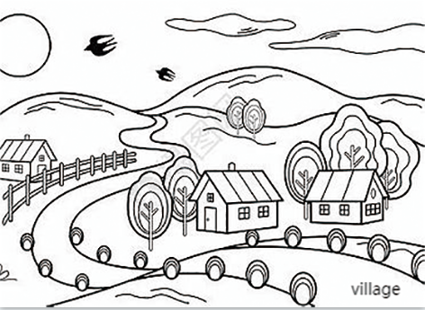
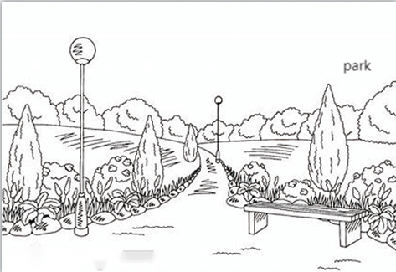
3. [A] [B] [C]
A
Script：They are going to the park tomorrow.

Slide 7
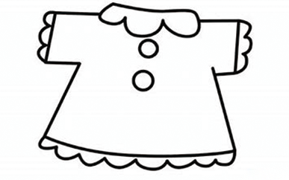
4. [A] [B] [C]
B
Script：My sister bought a skirt yesterday.

Slide 8
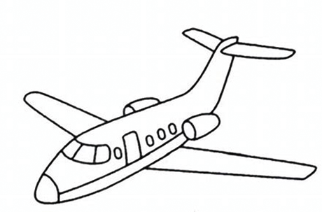
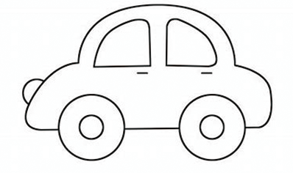
5. [A] [B] [C]
C
Script：The Greens went to New York by plane.

Slide 9
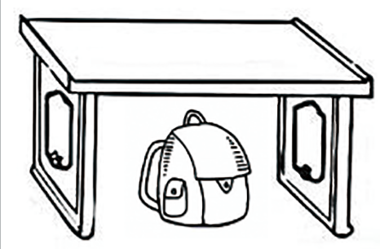
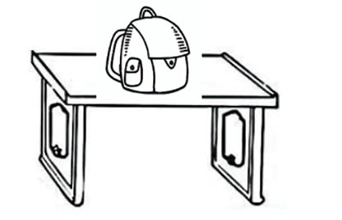
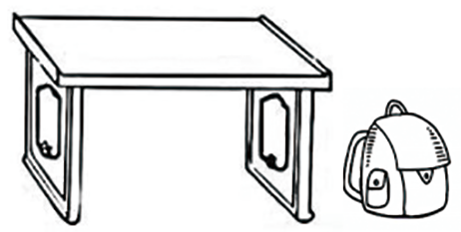
6. [A] [B] [C]
A
Script：The school bag is under the desk.

Slide 10
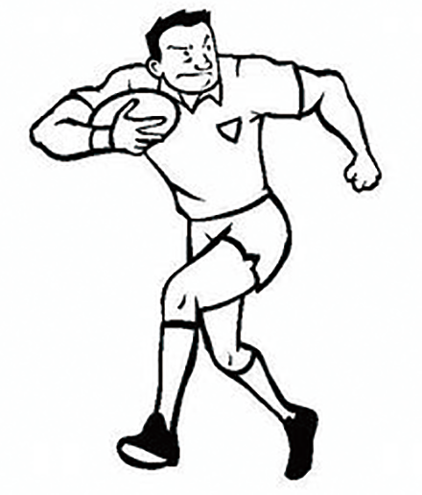
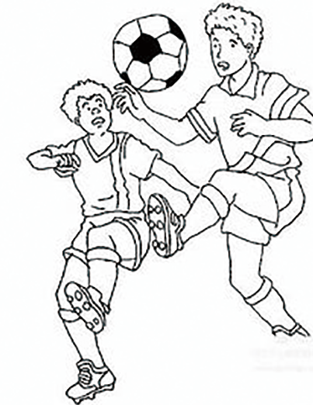
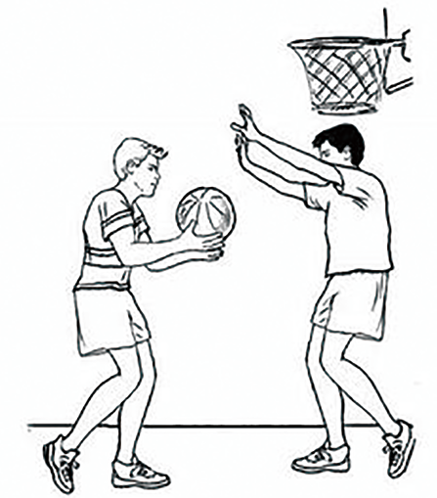
7. [A] [B] [C]
B
Script：He often plays soccer after school.

Slide 11
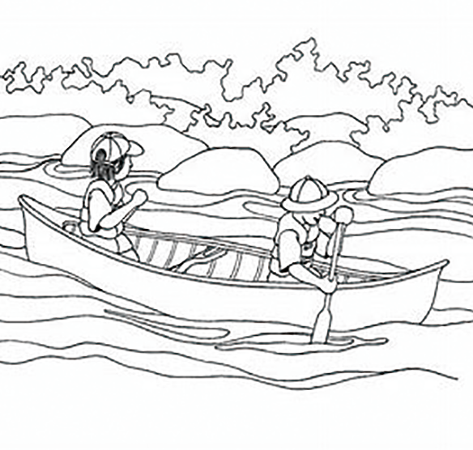
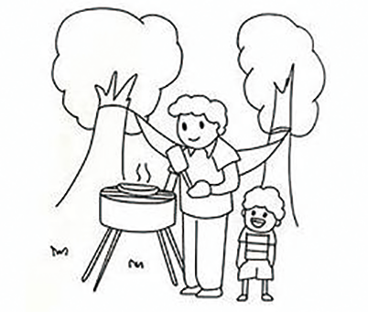
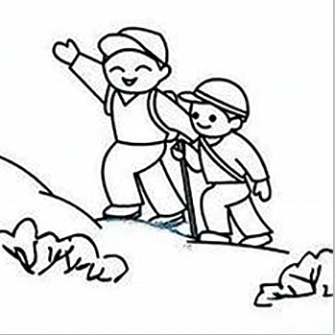
C
8. [A] [B] [C]
Script：My family plan to go boating this weekend.

Slide 12
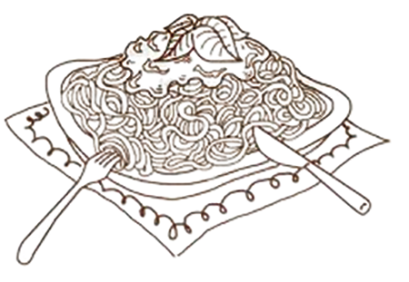
9. [A] [B] [C]
A
Script：Tom loves hamburgers very much.

Slide 13
10. [A] [B] [C]
B
Script：There are many roses around the garden.

Slide 14
第二节 对话应答
在本节中，你将听到10个话语，请从[A]、[B]、[C]三个选项中选出一个最佳应答，并标在试卷的相应位置。每个话语后有10秒钟的停顿，以便选择答案和阅读下一小题的选项。每个话语读两遍。
11. [A] How do you do? [B] So nice you are. [C] Not bad.
C
Script：How is everything going?
B
12. [A] Yes. I know him well.
[B] Sure. Turn left at the second crossing.
[C] Yes. She is crossing the street.
Script：Could you tell me how to get to the railway station?

Slide 15
13. [A] Hold on, please. [B] Who are you? [C] I am Mr. White.
A
Script：May I speak to Mr. White?
14. [A] OK. Give you. [B] No, this is mine. [C] Yes, here your are.
C
Script：Could you pass me the pencil?

Slide 16
15. [A] Once a month. [B] One month ago. [C] Last week.
A
Script：How often do you go to the cinema?
B
16. [A] I am happy to do so. [B] Never mind. [C] Yes, it is so long.
Script：I am so sorry for having kept you waiting for so long.

Slide 17
17. [A] You’re wrong. [B] It is too difficult. [C] Thanks. I will.
C
Script：You’d better go home and have a good rest.
18. [A] I am so glad you like it. [B] I am happy. [C] No, thanks.
A
Script：Thank you for giving me such a lovely gift.

Slide 18
B
19. [A] It rains a lot.
[B] Hurry up or we will get wet.
[C] It is raining heavily.
Script：It is going to rain
20. [A] It will be wonderful.
[B] Happy birthday.
[C] Of course. I will come on time.
C
Script：Would you like to attend my birthday party next Sunday?

Slide 19
第三节 对话理解
在本节中，你将听到10段对话，每段对话有一个问题。请从[A]、[B]、[C]三个选项中选出答案，并标在试卷的相应位置。每段对话后有10秒钟的停顿，以便回答问题和阅读下一问题及其选项。每段对话读两遍。
A
21. What does the man order?
[A] Salad and pizza.
[B] Fruit and pizza.
[C] Salad and cheese.
Script：W: Are you ready to order now, Sir?
M: Yes. I would like fruit salad and cheese pizza, please.

Slide 20
C
22. Why doesn’t the woman like the pink T-shirt?
[A] Because she doesn’t like pink.
[B] Because she is too young.
[C] Because she thinks it is too young for her.
Script：M: How about this pink T-shirt?
W: I don’t like it. It is too young for me.

Slide 21
A
23. Where is the man going to spend the holiday?
[A] Shanghai.
[B] Beijing.
[C] Nanjing.
Script：W: Where are you going to spend your holiday?
M: I prefer to go to Beijing and Nanjing, but my parents have decided
to go to Shanghai.

Slide 22
B
24. How long will the woman stay in the hotel?
[A] For one night.
[B] For two nights.
[C] For three nights.
Script：W: Good morning. I would like to book a room on July 8.
M: How long will you be staying?
W: I need the room for 2 nights.

Slide 23
C
25. Whom will the woman pick up?
[A] Mr. Johnson and his secretary.
[B] Mr. Johnson and Mr. Brown.
[C] Mr. Brown and his secretary.
Script：W: Shall I leave for the railway station to pick up Mr. Brown now, Mr.
Johnson?
M: Yes. Mr. Brown and his secretary will arrive in 30 minutes.

Slide 24
C
26. How much should the woman pay for the stamps?
[A] Six cents.
[B] Eight cents.
[C] Forty-eight cents.
Script：W: I need stamps to send six post cards. How much are they?
M: Eight cents each. Anything else?

Slide 25
A
27. Where does the dialogue take place?
[A] At a bank.
[B] In a post office.
[C] In a shop.
Script：W: Hello, how can I help you today?
M: I’d like to withdraw 5,000 yuan from my account.

Slide 26
B
28. When did the man come back?
[A] October 1.
[B] December 1.
[C] Two months ago.
Script：W: I heard that you just came back from England one month ago.
M: Yes, I planned to come back on October 1, but my job had
kept me for another two months.

Slide 27
A
29. Will the woman take the next airport bus?
[A] No, she won’t.
[B] Yes, she will.
[C] Not sure.
Script：W: Excuse me! I’m looking for the airport bus.
M: I think it’s on the other side of the road.
W: Oh, thanks. But the next bus leaves at 9:00. It is too late.

Slide 28
30. What is Mary busy with these days?
[A] She is taking care of children.
[B] She is writing a story book.
[C] She is reading books for children from the age of 3 to 6.
B
Script：M: What are you busy with these days, Mary?
W: I am writing a story book for children from the age of 3 to 6.

Slide 29
第二部分 英语知识运用
目录
下一页

Slide 30
第一节 单项填空
阅读下面的句子和对话，从[A]、[B]、[C]三个选项中选出一个能填入空白处的最佳选项，并在答题卡上将该项涂黑。
A
31. Lucy is _________ American girl.
[A] an [B] a [C] the
解析：本题考查冠词。American以元音/ə/开头，与不定冠词an搭配使用，故选[A]。

Slide 31
第一节 单项填空
32. _________ room is very nice.
[A] Jimmy and Timmy’s
[B] Jimmy’s and Timmy’s
[C] Jimmy’s and Timmy
A
解析：本题考查名词所有格。room为单数，指Jimmy和Timmy共有的房间，所有格放在两个名字最后面，故选[A]。

Slide 32
33. —Is that shirt your brother’s?
—No, it is _________.
[A] me
[B] mine
[C] my
B
解析：本题考查代词。句意：——那是你哥哥的衬衣吗？——不，那是我的。两处都用所有格。mine指my shirt，名词性物主代词，故选[B]。

Slide 33
34. —Must I go with them tomorrow?
—No, you _________.
[A] mustn’t
[B] shouldn’t
[C] needn’t
C
解析：本题考查情态动词。must开头的一般疑问句，否定回答用needn’t。故选[C]。

Slide 34
35. —Where is Mike?
—He _________ to the library.
[A] went [B] has gone [C] has been
B
解析：本题考查动词。have gone to表示“去了……”，人不在场。have been to 表示“去过……”，人已经回来。根据对话内容可以判断，Mike不在对话现场，因此用have gone to。故选[B]。

Slide 35
B
36. Who is the girl _________ under the tree?
[A] stand
[B] standing
[C] to stand
解析：本题考查非谓语动词。句意为“站在树下的女孩是谁？”现在分词表伴随状态，故选[B]。

Slide 36
37. She is _________ than his brother.
[A] older three years
[B] three years older
[C] three years oldest
B
解析：本题考查形容词的比较级。than与比较级连用，比较部分应该放在比较级前面。故选[B]。

Slide 37
A
38. He is nice. He gets _________ well with others.
[A] on
[B] up
[C] in
解析：本题考查介词。get on well with sb.为固定短语，意思是“与某人相处融洽”。故选[A]。

Slide 38
C
39. Work hard, _________ you’ll learn English well.
[A] for [B] or [C] and
解析：本题考查连词。这是一个并列句，表示顺延结果，因此用and。故选[C]。

Slide 39
40. _________ of the cake has been eaten.
[A] Two thirds
[B] Two third
[C] Two three
A
解析：本题考查数词。表达分数时，分子用基数词，分母用序数词。当分子大于1时，分母用复数形式。故选[A]。

Slide 40
41. There _________ a little water in the bottle.
[A] has
[B] are
[C] is
C
解析：本题考查there be句型。be的单复数形式要采用就近原则，a little water为不可数，应该用is充当谓语。故选[C]。

Slide 41
42. Neither Jim nor his parents _________ the boy.
[A] knows
[B] known
[C] know
C
解析：本题考查主谓一致。neither...nor...连接两个主语时，遵循就近原则，谓语动词应根据his parents而定。故选[C]。

Slide 42
43. She has a brother and a sister, _________ she?
[A] hasn’t
[B] doesn’t
[C] have
B
解析：本题考查反义疑问句。has在此句中为实义动词，表示“有”，反义疑问时需要用助动词does。根据反义疑问句“前肯后否、前否后肯”的规则，句子前半句是肯定句，反义疑问时用否定形式doesn’t。故选[B]。

Slide 43
44. _________ a lovely girl she is!
[A] What [B] How [C] So
A
解析：本题考查感叹句。根据感叹句结构：“What + a/an +形容词+名词+主语+谓语!”，故选[A]。

Slide 44
45. This is the best movie _________ I have ever seen.
[A] which [B] that [C] what
B
解析：本题考查定语从句。先行词movie被形容词最高级the best修饰，引导词用that。故选[B]。

Slide 45
第二节 完形填空
阅读下面短文，从短文后所给的[A]、[B]、[C]三个选项中选出能填入相应空白处的最佳选项，并在答题卡上将该项涂黑。
参考译文
One day, I went with the group to a nearby river. We wanted to check 46 it was clean. We did many 47 tests to see if the river was healthy. Surprisingly (令人惊奇地), it was!
C
A
46. [A] why [B] when [C] if
47. [A] scientific [B] science [C] scientists
46. 解析：本题考查宾语从句的连词。check意为“检查”，根据句意，我和小组成员去检查河水是否干净，故选[C]项。
47. 解析：本题考查形容词。tests是名词，要用形容词来修饰，故选[A]项。

Slide 46
C
We still, though, took 48 rubbish we could find out of the river. We wanted to make sure fish could live there 49 .
Recently I helped the group plant 50 in our school. We are hoping the flowers will bloom (花开) this spring and make the school 51 beautiful.
B
C
C
48. [A] many [B] a lot of [C] any
49. [A] happy [B] happily [C] happier
50. [A] trees [B] vegetables [C] flowers
51. [A] to look [B] looked [C] look
48. 解析：本题考查形容词。本句意为“带走了从河道里能找出来的任何垃圾”，故选[C]项。
49. 解析：本题考查副词。live是谓语动词，要用副词来修饰，故选[B]项。
50. 本题考查名词。根据下文“We are hoping the flowers will bloom this spring”可知我们种植的是花朵，故选[C]项。
51. 本题考查使役动词和非谓语动词。“make sb. do sth.”，故选[C]项。

Slide 47
A
A
How did we pay 52 all the plants? We made T-shirts and 53 them to our friends! We still got some money 54 from selling the T-shirts. We hope to use it 55 some recycling bins (回收箱) for the school.
B
B
52. [A] for [B] with [C] by
53. [A] sold [B] bought [C] gave
54. [A] leave [B] left [C] leaving
55. [A] buying [B] to buy [C] bought
52. 解析：本题考查介词。固定搭配“pay for sth.”付款，故选[A]项。
53. 解析：本题考查动词。根据下文“from selling the T-shirts”，可知我们通过出售T-shirt获得钱，故选[A]项。
54. 解析：本题考查非谓语动词。根据文章最后一句“We hope to use it to buy some recyclingbins (回收箱) for the school.”可以推断出买完植物后我们还有钱剩余，而钱是被用剩的，过去分词表示被动，故选[B]项。
55. 解析：本题考查非谓语动词。表目的，用to do，故选[B]项。

Slide 48
参考译文
一天，我和小组成员去了附近的一条河检查河水是否干净。我们做了很多科学实验以检测河水是否无污染。令人惊奇的是，居然真的无污染。不过我们还是把我们能发现的垃圾带走了。我们希望鱼儿能在河里快乐地生存。
最近我帮助小组在学校种花。我们希望今年春天鲜花会盛开，使我们学校看起来更漂亮。我们是怎么支付买植物的钱的？我们制作了T恤卖给朋友。剩下多余的一些钱，我们希望用它来为学校购买一些回收箱。
返回

Slide 49
第三部分 阅 读
目录
下一页

Slide 50
第一节 短文理解1
阅读下面短文，从[A]（Right）、[B]（Wrong）、[C]（Doesn’t say）三个选项中选择一个正确选项，并在答题卡上将该项涂黑。
参考译文
The wolf and fox wanted to eat the rabbit, but the rabbit was too hard to catch.
One day the wolf said to the fox, “Go home and pretend to lie in bed. I’ll tell the rabbit you’re dead. When he comes to see you, you can jump up and catch him.” “What a good idea!” said the fox.

Slide 51
The fox went home at once. The wolf went to the rabbit’s house and knocked at the door. “Who is it?” asks the rabbit. “It’s the wolf. I come to tell you that the fox is dead.” Then the wolf went away.
The rabbit went to the fox’s house. He looked in through the window and saw the fox lying in bed with his eyes closed. He thought, “Is the fox really dead or is he pretending to be dead? If he’s not dead, he’ll catch me when I go near him.” So he said, “The wolf says that the fox is dead. But he doesn’t look like a dead fox. The mouth of a dead fox is always open.”
When the fox heard this, he thought, “I’ll show him that I’m dead.” So he opened his mouth.

Slide 52
B
56. The fox asked the wolf to pretend to be dead.
[A] Right.
[B] Wrong.
[C] Doesn’t say.
解析：细节理解题。从文中第二段第一句“One day the wolf said to the fox, ‘Go home and pretend to lie in bed. I’ll tell the rabbit you’re dead.’”可知，狼让狐狸装死，不是狐狸让狼装死，故选[B]项。

Slide 53
A
57. The fox lay in bed with his eyes closed.
[A] Right.
[B] Wrong.
[C] Doesn’t say.
解析：细节理解题。从文中倒数第二段第二句“and saw the fox lying in bed with his eyes closed”可知，狐狸闭着眼睛躺在床上，故选[A]项。

Slide 54
B
58. The rabbit believed that the fox was dead.
[A] Right.
[B] Wrong.
[C] Doesn’t say.
解析：细节理解题。从文中倒数第二段第四句“If he’s not dead, he’ll catch me when I go near him.”可知，兔子怀疑狐狸并不是真的死了，故选[B]项。

Slide 55
C
59. The fox finally ate the rabbit.
[A] Right.
[B] Wrong.
[C] Doesn’t say.
解析：细节理解题。文中并未提及最终狐狸有没有吃掉兔子，故选[C]项。

Slide 56
A
60. The rabbit was very clever.
[A] Right.
[B] Wrong.
[C] Doesn’t say.
解析：推理判断题。从文中最后两段可知，兔子怀疑狐狸是不是真的死了，他故意说“死狐狸的嘴巴是一直张开着的”，而狐狸上当了，真的张开了嘴巴。狐狸一动，兔子就知道狐狸并没有死。他很聪明，故选[A]项。

Slide 57
参考译文
狼和狐狸想吃掉兔子，但是兔子很难抓。
一天，狼对狐狸说：“你回家假装躺在床上。我去告诉兔子你死了。兔子来看你的时候，你就可以跳起来抓住他了。”“真是个好主意！”狐狸说。
狐狸立刻回了家。狼去兔子的房前敲了敲门。“谁啊？”兔子问道。“是我，我是
来告诉你狐狸死了。”说完狼就走了。
兔子去狐狸家看情况。透过狐狸家的窗户看到闭着眼睛的狐狸躺在床上。他想，
狐狸是真的死了，还是装死呢？要是他没有死，那么我走近他就会被他抓住。于是他说：“狼说狐狸死了，但狐狸看上去不像死的样子，死了的狐狸嘴巴是张开的。”
狐狸听到这些话心里想：我得证明我是真的死了。于是他张开了嘴巴。
返回

Slide 58
第二节 短文理解2
阅读下列短文，从[A]、[B]、[C]三个选项中选择一个正确答案，并在答题卡上将该项涂黑。
参考译文
请根据下面短文回答第61—65题：
“Ten steps from the porch (走廊) and twenty steps from the rose bushes,” growled (低声吼叫) Bluebeard in Jimmy’s dream one night, “There be treasure there!”
So the next day Jimmy began to dig. He dug until the hole was deep and the dirt pile was high.
He kept digging. The hole got deeper and the dirt pile got higher.

Slide 59
He dug until the hole was deepest and the dirt pile was at its highest. He sighed, “I’m too tired. I can’t dig anymore.” Then he spied (突然看见) something…but it was only one of Woofy’s bones. Instead of treasure, all Jimmy had was a dog bone, a hole, and a big pile of dirt to fill it in with. He thought, “That pirate lied to me!”
But when Jimmy’s mother saw what he had done, she clasped her hands and smiled a smile on her face. “Oh, thank you, Jimmy. I always wanted a rhododendron (杜鹃花) bush planted just there. Here’s $ 5.00 for digging that hole.”

Slide 60
A
61. Bluebeard is _________.
[A] a pirate
[B] a farmer
[C] his friend
解析：细节理解题。从第四段最后一句“That pirate lied to me”可知，在梦中跟他说话的是个海盗，故选[A]项。

Slide 61
C
62. Why did Jimmy dig the hole?
[A] Because he wanted to plant roses.
[B] Because he wanted to make a dirt pile.
[C] Because he wanted to find the treasure.
解析：细节理解题。从第一段最后一句“There be treasure there!”可知，海盗告诉他那里会有珍宝，故选[C]项。

Slide 62
C
63. What did Jimmy find in the hole?
[A] Treasure.
[B] A note of 5 dollars.
[C] One of Woofy’s bones.
解析：细节理解题。从第四段倒数第三句“but it was only one of Woofy’s bones”可知，他发现了伍菲的一根骨头，故选[C]项。

Slide 63
B
64. Was Jimmy’s mother happy to see he had dug a deep hole?
[A] Not sure.
[B] Yes, she was.
[C] No, she wasn’t.
解析：细节理解题。从最后一段第一句“she clasped her hands and smiled a smile on her face”可知，妈妈很开心，故选[B]。

Slide 64
A
65. What can you infer from the story?
[A] Jimmy was happy although he did not find the treasure.
[B] Jimmy’s mother doesn’t like flowers.
[C] Jimmy filled the hole with dirt.
解析：细节理解题。从最后一句妈妈说的话中可得知，妈妈给了吉米5美元作为挖坑的报酬。虽然没有挖到宝藏，但是有意外的收获，故选[A]项是正确的。选项[B]“吉米的妈妈不喜欢花朵。”从文中最后一段第三句“I always wanted a rhododendron (杜鹃花) bush planted just there.”可知，吉米的妈妈是爱花之人。故选项[B]错误。选项[C]“吉米用泥土把坑填埋了。”从最后一段可以得知，妈妈打算用这个坑来种植杜鹃花，所以吉米不会把坑埋了。故选项[C]错误。

Slide 65
参考译文
“距离走廊十步，玫瑰花丛20步的地方，”一天夜里蓝胡子在吉米的梦里咆哮
道：“那里有珍宝！”
第二天瑞吉米开始挖。他一直挖，直到坑很深了，挖出的土堆得很高了。
他不停地挖。坑越来越深，土越堆越高。
他一直挖，直到坑已经非常深，土堆得非常高。他叹了口气：“我太累了。再也挖不动了。”这时他突然看见有个东西……但那只是伍菲的一块骨头，没有珠宝，只有一块狗骨头，一个深坑还有一大堆土。他想：“我被海盗骗了！”
但当吉米的妈妈看到他所做的一切，她高兴得拍起手来，满脸笑容。“哦，谢谢
你，吉米。我一直以来都想在那里栽一丛杜鹃花。这5美元奖励你挖了那个坑。”
返回

Slide 66
请根据下面短文回答第66—70题：
参考译文
The computer is a wonderful machine. It is the most important invention in many years.
Today it is used a great deal in various fields. Especially, it is useful in automatic control and data processing (数据处理). And now it is finding its way into the home.

Slide 67
Computer plays an important role in our life. They can do most of things people can do. They can give you information on buying and selling things, provide you with suggestions of how to deal with certain illness and how to solve the problems you are faced with. There is no doubt that people can live more easily with the help of the computer.
Some people worry that someday computers may replace human beings. Then most people will have no jobs.
However, many scientists don’t think that computers will replace us completely. Even though computers can take over some difficult tasks that we cannot do. They are nothing but machines. No matter how clever they may become, computers are no more than an extension of our human brains.

Slide 68
C
66. What is the topic of this passage?
[A] The computer is an important machine at home.
[B] The computer can do a lot of things for people.
[C] The computer is useful in various fields.
解析：主旨大意题。从第二段第一句可知，今天计算机已被广泛应用于不同的领域，故选[C]项。

Slide 69
C
67. Computers can provide us with suggestions of _________.
[A] how to deal with certain illness
[B] how to solve the problems we are faced with
[C] both A and B
解析：细节理解题。从第三段第三句可知，计算机可以提供买卖方面的信息，也可以就如何处理某种疾病和如何解决面临的问题给出建议，故选[C]项。

Slide 70
B
68. People can live _________ with the help of the computer.
[A] more freely
[B] more easily
[C] more happily
解析：细节理解题。从第三段最后一句可知，在计算机的帮助下，人们活得愈加轻松，故选[B]项。

Slide 71
A
69. What’s the meaning of the underlined word “extension” in the last sentence?
[A] 延伸 [B] 外部 [C] 内部
解析：词义猜测题。从最后一段最后一句可知，不管计算机将变得如何聪明，它们也只是人类大脑的延伸，故选[A]项。

Slide 72
C
70. Which of the following statements is RIGHT?
[A] Computers are cleverer than humans.
[B] Computers will take the place of humans in the future.
[C] Computers are very helpful for humans.
解析：推理判断题。从第三段第二句可知，计算机可以为人们做大部分的事情，因此计算机很有用，故选项[C]是正确的。选项[A]“计算机比人类聪明”。从最后一段最后一句可知，计算机只是人类大脑的延伸，并不比人类聪明，故选项[A]是错误的。选项[B]“计算机在将来会取代人类”。从最后一段第一句可知，计算机并不能完全替代人类，故选项[B]是错误的。

Slide 73
参考译文
计算机是一种奇妙的机器。它是这么多年来最重要的发明。
今天计算机已被广泛应用于不同领域。它在自动化控制和数据处理方面很有用。而如今它已经开始应用于家庭。
计算机在我们的生活中起到很重要的作用。人们能做的事情，它大部分都能做。它可以提供买卖方面的信息，也可以就如何处理某种疾病和如何解决面临的问题给出建
议。毫无疑问，在计算机的帮助下，人们活得愈加轻松。
有些人担心某一天计算机会替代人类。然后大部分的人都会没有工作。
然而，许多科学家认为，计算机并不能完全替代人类。尽管计算机能够承担一些我们不能完成的困难的任务，但是它依然只是一台机器。不管计算机将变得如何聪明，它也只是人类大脑的延伸。
返回

Slide 74
第四部分 写 作
目录
下一页

Slide 75
第一节 改写句子
下面是关于Lucy买衣服的三对句子。每对句子中，第一句是原句，第二句是对第一句的改写。要求根据原句和第二句中已经给出的部分用一至五个单词补全第二句。把补出的部分写在答题卡各题的序号后。（注意：不能改变原句的意思。）
71. Lucy walked to the clothes shop.
Lucy went to the clothes shop ___________.
72. She prefers pink to purple.
She likes pink ____________ purple.
73. She spent 150 yuan on the pink skirt.
The pink skirt _______ her 150 yuan.
on foot
better than
cost

Slide 76
第二节 书面表达
74. 情景：今天下午，你在操场拾到一个书包，里面有一支笔、一本笔记本和钥匙。另外，还有一个钱包，里边有银行卡和现金。你的电话号码是6735**22。请失主与你联系。
任务：请你用英语写一则50个词左右的失物招领启事，内容包括：
拾获书包的地点；
书包里面的物品；
联系方式。
Reference answer

Slide 77
Reference answer
Found
I found a black school bag on the playground this afternoon. There was a pen, a notebook and keys inside the school bag. Besides, there was a wallet with credit cards and some money in it. The owner can call me at 6735**22 or come to Class One, Grade Two. Please contact me as soon as possible.
Li Ming
December 12, 2022
返回

Slide 78
感谢您的观看！
Notes:
本PPT模板部分元素使用了幻灯片母版制作。如果需要修改，点击-视图-幻灯片母版-修改 完成后关闭编辑母版即可。

