Slide 1
全国英语等级考试
（一级）模拟卷
主 编
叶 秀 江 韵 赖 静
Notes:
本PPT模板部分元素使用了幻灯片母版制作。如果需要修改，点击-视图-幻灯片母版-修改 完成后关闭编辑母版即可。

Slide 2
模拟卷（八）
CONTENTS
第一部分 听 力
第二部分 英语知识运用
第三部分 阅 读
第四部分 写 作

Slide 3
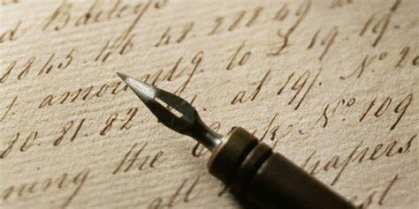
第一部分 听 力
目录
下一页

Slide 4
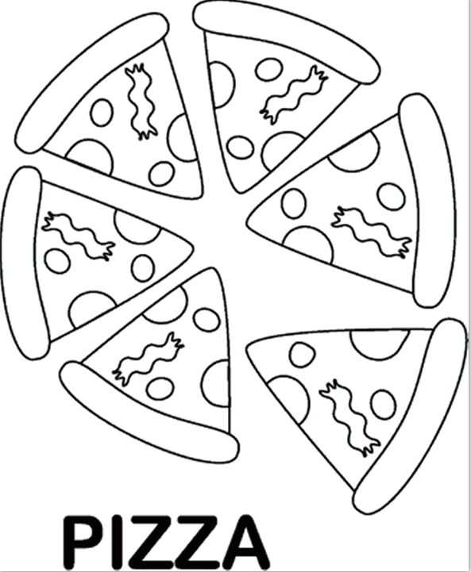
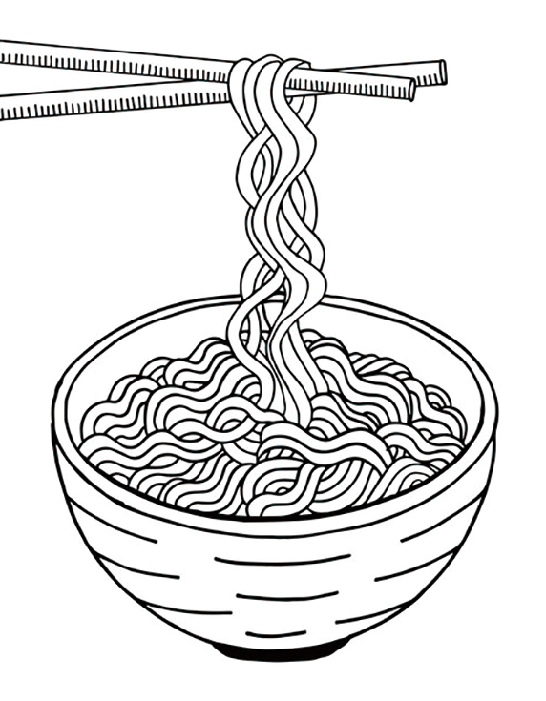
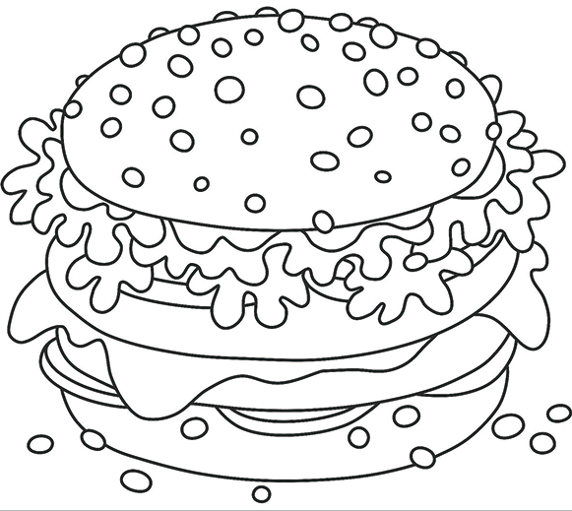
第一节 图片判断
在本节中，你将听到10个句子，每句话配有[A]、[B]、[C]三幅图片，请选择与句子内容相符合的一幅图片，并标在试卷的相应位置。每句话后有10秒钟的停顿，以便选择图片并看下一组图片。每句话读两遍。
1. [A] [B] [C]
C
Script：I’d like to have a hamburger for lunch.

Slide 5
B
2. [A] [B] [C]
Script：This is non-smoking area.

Slide 6
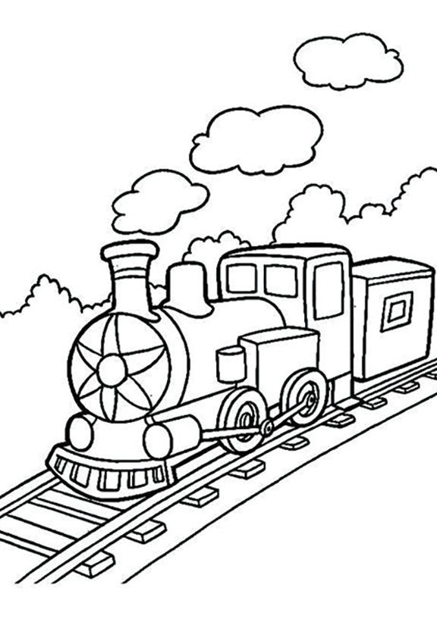
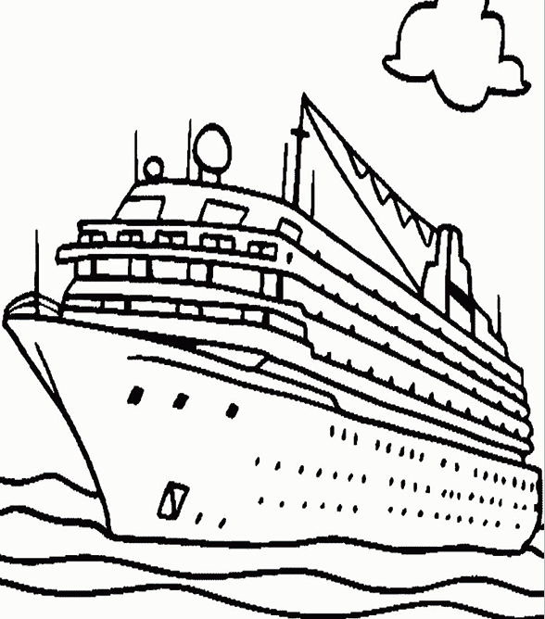
3. [A] [B] [C]
B
Script：I’m flying to Fiji for a holiday next week.

Slide 7
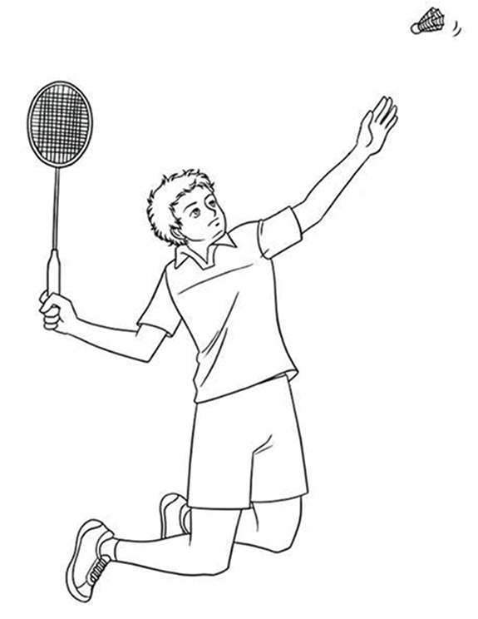
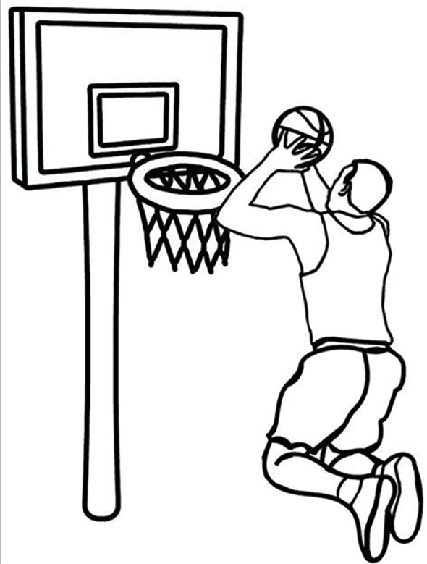
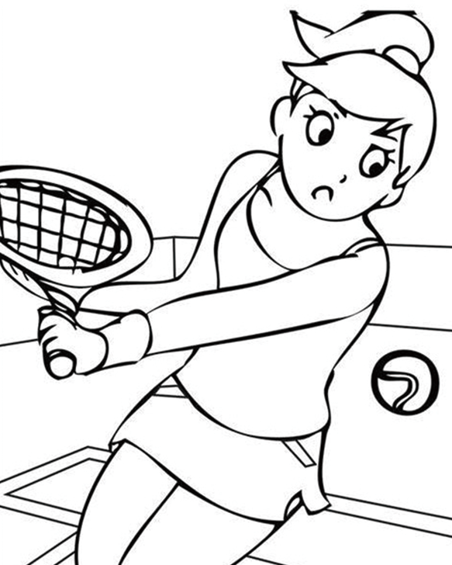
4. [A] [B] [C]
A
Script：Mike likes playing badminton in his free time.

Slide 8
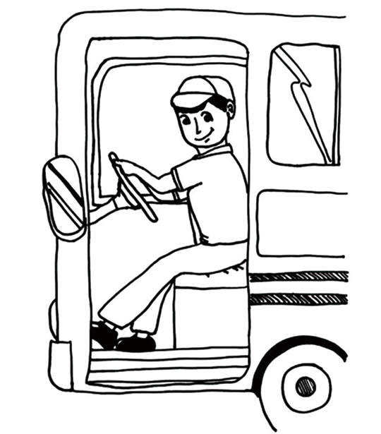
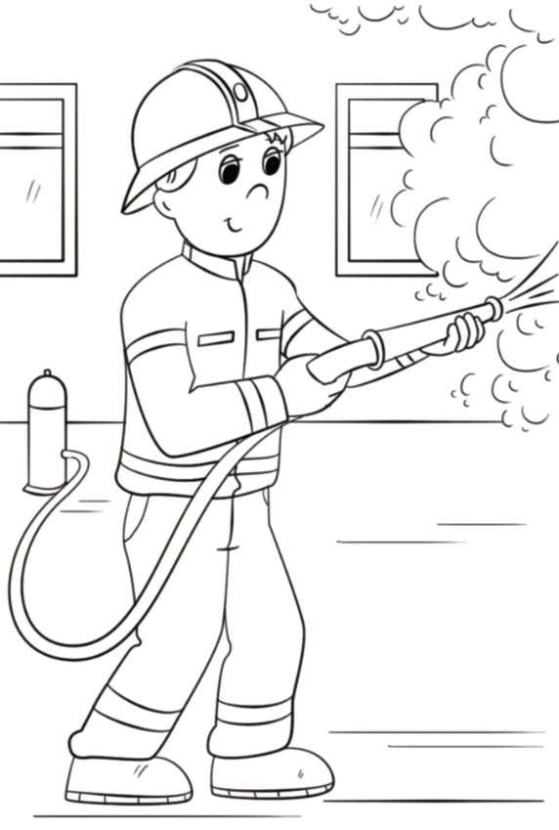
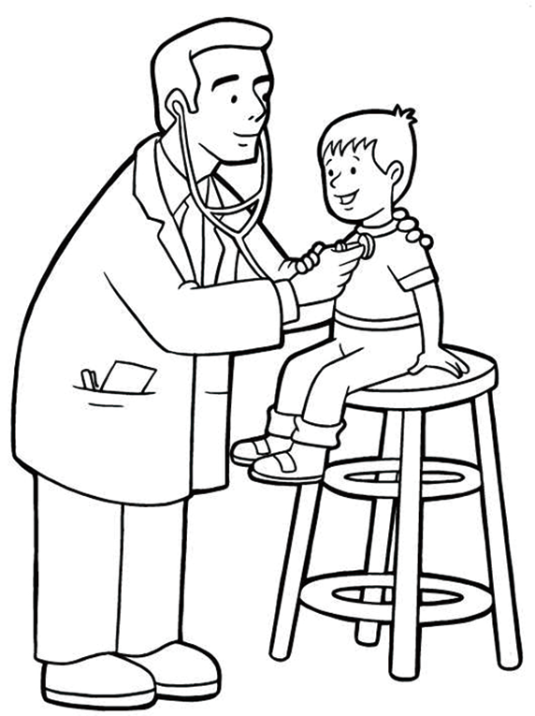
5. [A] [B] [C]
C
Script：My dream was to be a firefighter when I was a kid.

Slide 9
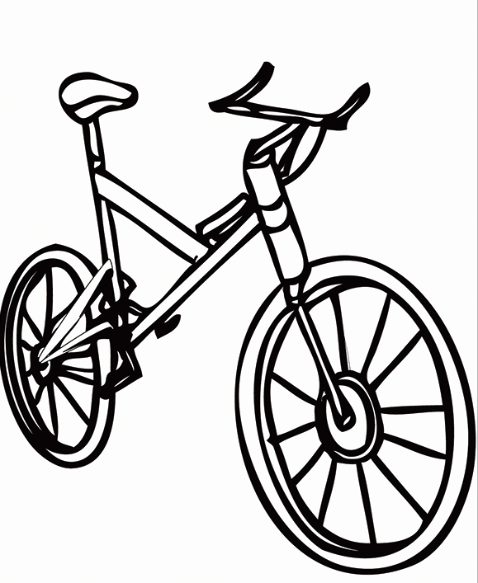
6. [A] [B] [C]
B
Script：His father bought him a bike as his birthday gift.

Slide 10
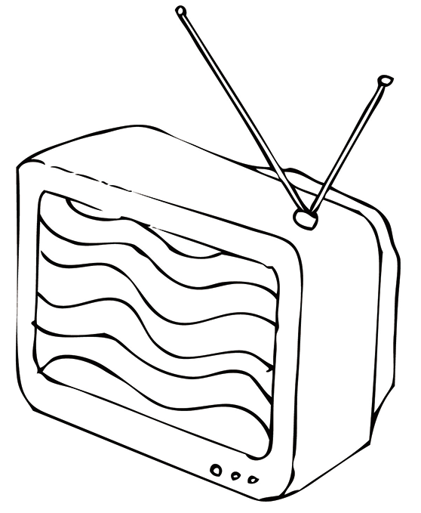
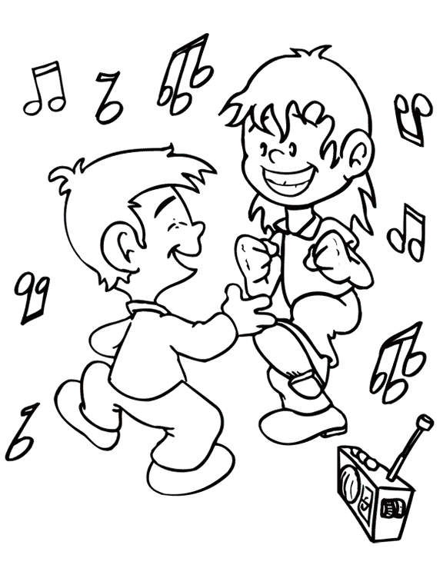
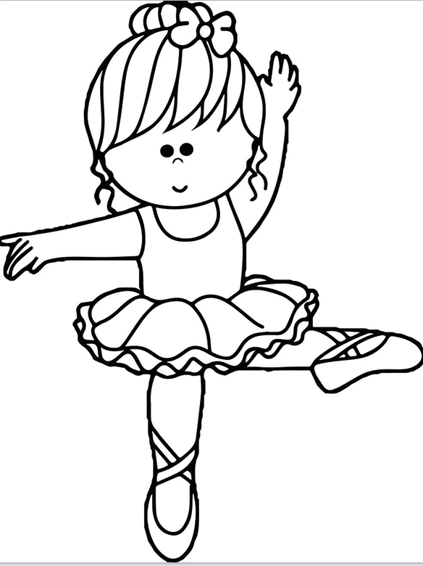
7. [A] [B] [C]
A
Script：I was watching TV when my mum came back last night.

Slide 11
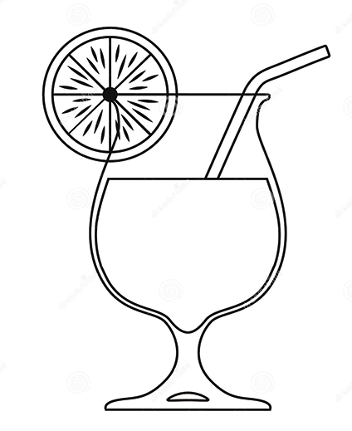
C
8. [A] [B] [C]
Script：I prefer to have a cup of coffee in the morning.

Slide 12
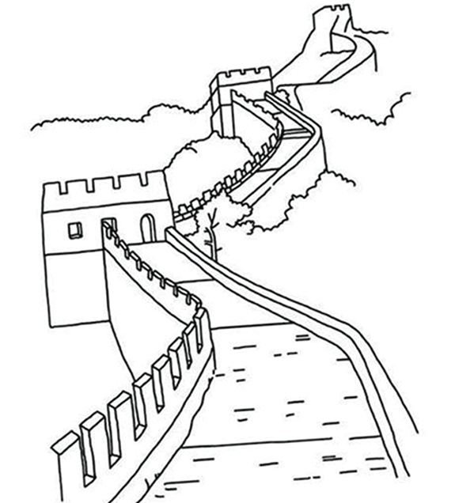
9. [A] [B] [C]
C
Script：The Browns are planning to go to Beijing this summer.

Slide 13
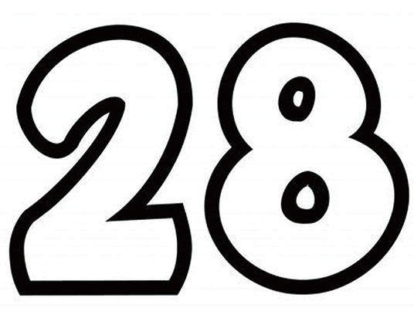
10. [A] [B] [C]
A
Script：Mike paid 28 yuan for this dictionary.

Slide 14
第二节 对话应答
在本节中，你将听到10个话语，请从[A]、[B]、[C]三个选项中选出一个最佳应答，并标在试卷的相应位置。每个话语后有10秒钟的停顿，以便选择答案和阅读下一小题的选项。每个话语读两遍。
11. [A] I have no time. [B] It’s half past ten. [C] Have a good time.
B
Script：What time is it?
A
12. [A] You can take the No. 6 bus.
[B] Three minutes’ walk.
[C] In half an hour.
Script：Excuse me, but how can I get to the post office?

Slide 15
13. [A] I like it very much. [B] It’s boring. [C] I don’t like it.
B
Script：How do you like the film?
14. [A] Of course not. [B] Please open the door. [C] Be careful.
A
Script：Would you mind my opening the window?

Slide 16
15. [A] My pleasure. [B] With pleasure. [C] No problem.
A
Script：Thank you for helping me with my English.
C
16. [A] I go with my mum. [B] Myself. [C] Twice a month.
Script：How often do you go to the cinema?

Slide 17
17. [A] I’m sorry to hear that. [B] Good luck. [C] I see.
B
Script：I’m going to have a job interview tomorrow.
18. [A] Yes, I do. [B] No, I like it. [C] Yes, I don’t.
A
Script：Do you like playing computer games?

Slide 18
19. [A] Don’t worry.
[B] Take your time.
[C] Yes, I’d like a hamburger.
C
Script：May I take your order now, Sir?
20. [A] All right. [B] It’s kind. [C] It’s Monday.
A
Script：You’d better take an umbrella with you.

Slide 19
第三节 对话理解
在本节中，你将听到10段对话，每段对话有一个问题。请从[A]、[B]、[C]三个选项中选出答案，并标在试卷的相应位置。每段对话后有10秒钟的停顿，以便回答问题和阅读下一问题及其选项。每段对话读两遍。
C
21. How are Danny’s eyes?
[A] It’s big and bright.
[B] They’re small.
[C] They’re big and bright.
Script：M: Look at Danny’s eyes. How are they?
W: Oh, they are big and bright.

Slide 20
B
22. What does the girl’s aunt do?
[A] She is a teacher.
[B] She is a cook.
[C] She is a nurse.
Script：M: Who’s that lady?
W: She is my aunt. She is a good cook. She cooks in a big restaurant.

Slide 21
C
23. What do girls like to do in the playground?
[A] Play basketball.
[B] Play football.
[C] Run and jump.
Script：M: Look, there is a big playground behind the building. How beautiful
it is!
W: Yes. Boys often play basketball there. And girls like to run and jump.

Slide 22
A
24. How many boys are there in Mike’s class?
[A] 27.
[B] 26.
[C] 25.
Script：W: How many students are there in your class, Mike?
M: There are 45 students and 18 of them are girls.

Slide 23
A
25. What does Anna often do on computer lessons?
[A] Surf on the Internet.
[B] Play computer games.
[C] Watch videos.
Script：M: Do you have a computer lesson on Friday, Anna?
W: Yes, I do. I often surf on the Internet on computer lessons.

Slide 24
B
26. What are the speakers going to do?
[A] Play near the fountain.
[B] Take photos.
[C] Go to the garden.
Script：M: There is a fountain near the garden.
W: It’s beautiful. Let’s take some photos.

Slide 25
C
27. What do people like to do in December in Australia?
[A] Go boating.
[B] Go swimming.
[C] Go to the beach.
Script：M: How is the weather in December in Australia?
W: It’s hot. People like to go to the beach.

Slide 26
B
28. Why are the elephants helpful?
[A] Because they’re strong.
[B] Because they can carry heavy things.
[C] Because they’re friendly.
Script：M: What animals do you like?
W: I like elephants. They are strong enough to help people carry
heavy things.
M: Yes, they’re helpful.

Slide 27
A
29. What does Kate usually do during the Spring Festival?
[A] Visit her grandparents and relatives.
[B] Visit her friends.
[C] Watch TV at home.
Script：M: What do you usually do during the Spring Festival, Kate?
W: I usually visit my grandparents and relatives.

Slide 28
30. What are the speakers talking about?
[A] Hobbies.
[B] Pets.
[C] Sports.
B
Script：M: How many pets do you have, Mary?
W: I have two. One is a dog, and the other is a cat.

Slide 29
第二部分 英语知识运用
目录
下一页

Slide 30
第一节 单项填空
阅读下面的句子和对话，从[A]、[B]、[C]三个选项中选出一个能填入空白处的最佳选项，并在答题卡上将该项涂黑。
A
31. It’s important for us _________ a healthy lifestyle.
[A] to keep [B] keeping [C] keep
解析：本题考查不定式。固定句型“It is + adj. + for sb. + to do sth.”，it是形式主语，真正的主语是其后的动词不定式短语，to keep符合题意，故答案为[A]。

Slide 31
第一节 单项填空
C
32. Sitting in front of the screen for too long is bad _________ your eyes.
[A] to
[B] with
[C] for
解析：本题考查介词。be bad for为固定短语，意思是“对……有害”，故选[C]。

Slide 32
A
33. Tom thinks he is _________ to travel by himself.
[A] old enough
[B] enough old
[C] enough young
解析：本题考查enough用法。enough做副词修饰形容词时，须放在形容词的后面，故选[A]。

Slide 33
B
34. When I went to say goodbye to Anna, she _________ the guitar.
[A] is playing
[B] was playing
[C] played
解析：本题考查过去进行时。句意为“当我去向安娜告别时，她正在弹吉他”。表示过去某一时刻正在发生的动作须用过去进行时，故[B]为正确选项。

Slide 34
B
35. Henry, you’d better _________ your T-shirt right now! It looks so dirty.
[A] take on [B] take off [C] put of
解析：本题考查动词短语辨析。take on意为“承担”，put off意为“推迟”，take off意为“脱下”。根据句意可知答案为[B]。

Slide 35
A
36. When winter comes, the weather gets _________.
[A] colder and colder
[B] more and more colder
[C] warmer and warmer
解析：本题考查比较级。比较级结构“more and more”表示“越来越……”，cold的比较级应为colder。根据“winter comes”，可知答案为[A]。

Slide 36
37. If you _________ him tomorrow, ask him if he will come to our party next week.
[A] will see [B] saw [C] see
C
解析：本题考查时态。if引导的条件状语从句中用一般现在时表示将来，故选[C]。

Slide 37
A
38. _________ pretty your dress is! Where did you buy it?
[A] How
[B] What a
[C] How a
解析：本题考查感叹句。感叹句常用句型是“What + (a/an) +形容词+名词+主语+谓语动词!”和“How +形容词或副词+主语+谓语!”。句中pretty为形容词，故选[A]。

Slide 38
B
39. Last month, many trees _________ along the streets to make our city more beautiful.
[A] planted [B] were planted [C] had planted
解析：本题考查被动语态。trees与plant之间是被动关系，故选[B]。

Slide 39
40. _________ of the students are girls in my class.
[A] Two third
[B] Second three
[C] Two thirds
C
解析：本题考查数词。分数的分子为基数词，分母为序数词，分子大于1时，分母要用复数形式，三分之二的正确表达为two thirds，故选[C]。

Slide 40
41. Come on, Mike! You will miss the first train _________ you hurry up.
[A] if [B] unless [C] because
B
解析：本题考查状语从句引导词。Because引导原因状语从句；if“如果”，引导条件状语从句；unless“除非”，引导条件状语从句。根据题意可知[B]为正确选项。

Slide 41
42. —What do you think of these two books?
—_________ of them are interesting. I have read them several times.
[A] Neither [B] Either [C] Both
C
解析：本题考查不定代词。neither意为“两者都不……”，是both的否定形式；either意为“两者中任意一个……”，后接名词单数；both意为“两者都……”，后接名词的复数形式。故选[C]项。

Slide 42
43. The number of people invited _________ fifty, but a number of them were absent for different reasons.
[A] were [B] was [C] are
B
解析：本题考查主谓一致。the number of意为“……的数量”，后接名词作主语时，谓语动词用单数形式，故选[B]。

Slide 43
44. —Must I finish the work today, Mr. Wang?
—No, you _________. You can finish it tomorrow.
[A] mustn’t [B] shouldn’t [C] needn’t
C
解析：本题考查情态动词。mustn’t表示“禁止”；回答must的提问，否定回答用needn’t，故选[C]。

Slide 44
45. This is the dictionary _________ Mary gave me for my birthday.
[A] which
[B] what
[C] whose
A
解析：本题考查定语从句的引导词。dictionary为先行词，指物，在从句中充当宾语。what不引导定语从句。正确答案应为which，故选[A]。

Slide 45
第二节 完形填空
阅读下面短文，从短文后所给的[A]、[B]、[C]三个选项中选出能填入相应空白处的最佳选项，并在答题卡上将该项涂黑。
参考译文
Mary was not in good health. She 46 often ill. She wanted to be 47 but she didn’t know what to do.
B
A
46. [A] is [B] was [C] were
47. [A] healthy [B] wealthy [C] happy
46. 解析：本题考查主谓一致及时态。根据前文“Mary was...”可知，时态用一般过去时，主语是单数，故选[B]。
47. 解析：本题考查词义辨析。[A]健康的，[B]富有的，[C]快乐的。根据前文“Mary was not in good health.”可知她想要变健康，故选[A]。

Slide 46
A
One day, she asked Miss Black 48 to keep healthy. Miss Black told her, “First, you must 49 yourself and then do something necessary for your health. For example, take a walk after supper, do morning exercises, 50 sports, eat more fruit and vegetables, and wash your hands 51 meals.
C
A
B
48. [A] how [B] what [C] why
49. [A] take care [B] look for [C] look after
50. [A] play [B] plays [C] playing
51. [A] after [B] before [C] then
48. 解析：本题考查连词。句意：她询问布莱克小姐要如何保持健康，用how引导，故选[A]。
49. 解析：本题考查词义辨析。[A]注意，小心；[B]寻找；[C]照顾。根据句意，Miss Black建议Mary要照顾好自己，故选[C]。
50. 本题考查动词。根据语境，此处为几个并列动词短语，前后须保持一致，因此用动词原形，故选[A]。
51. 本题考查连词。根据常识，为确保健康，饭前要洗手，需用before，故选[B]。

Slide 47
A
All of these things are good 52 your health.” Miss Black went on. “Remember! Don’t do 53 bad for your health, like going to school without breakfast, 54 your fingernails long, watching TV 55 , reading in the sun, staying up late and so on.” After that Mary always did as Miss Black told her. She is very healthy now.
C
B
A
52. [A] for [B] at [C] in
53. [A] something [B] nothing [C] anything
54. [A] keeps [B] keeping [C] kept
55. [A] too much [B] much too [C] too many
52. 解析：本题考查固定搭配。be good for意为“对……有好处”，be good at意为“擅长于……”。故选[A]。
53. 解析：本题考查不定代词。something意为“某事”，nothing意为“没什么”，anything意为“任何事物”。根据句意：不要做任何有害健康的事，故选[C]。
54. 解析：本题考查现在分词。根据语境，此处是几个并列的短语，前后须保持一致，因此需用动词的现在分词形式，故选[B]。
55. 解析：本题考查词义辨析。too much意为“太多（的）”，后接不可数名词，也可放在动词后面；much too 意为“太……”，后接形容词或副词；too many意为“太多（的）”，后接可数名词复数。根据题意，故选[A]。

Slide 48
参考译文
玛丽身体不好，经常生病。她想变健康但不知要做什么。一天，她询问布莱克小姐要如何保持健康。布莱克小姐告诉她：“首先，你必须要照顾好自己，然后再做一些必要的有益健康的事。例如：饭后散步，进行晨练，进行体育运动，多吃水果、蔬菜，饭前洗手。所有这些事都有益于你的健康。”布莱克小姐继续说道：“记住，不要做任何有害健康的事，如不吃早餐就上学、留长指甲、看电视过多、在太阳下阅读以及熬夜等等。”此后，玛丽总是按照布莱克小姐告诉她的那样做。她现在非常健康。
返回

Slide 49
第三部分 阅 读
目录
下一页

Slide 50
第一节 短文理解1
阅读下面短文，从[A]（Right）、[B]（Wrong）、[C]（Doesn’t say）三个选项中选择一个正确选项，并在答题卡上将该项涂黑。
参考译文
When you are reading something in English, you may often meet with a new word. What’s the best way to know it?
You may look it up in the English-Chinese dictionary. It will tell you a lot about the word: the pronunciation, the Chinese meaning and how to use the word. But how can you know where the word is in thousands of English words? How to find it in the dictionary both quickly and correctly?

Slide 51
First, all the English words are arranged (安排) in the letter order. In the dictionary you can first see the words beginning with letter A, then B, C, D...That means, if there are two words “desert” and “pull”, “desert” will be certainly before “pull”. Then if there are two words both beginning with the same letter, you may look at the second letter. Then the third, the fourth...
For example, “pardon” is before “plough”, “judge” is before “just”, etc.
Do you understand how to look up words in the dictionary? The dictionary will be your good friend. I hope you’ll use it as often as possible in your English study.

Slide 52
A
56. You may know the Chinese meaning of a word in the English-Chinese dictionary.
[A] Right. [B] Wrong. [C] Doesn’t say.
解析：细节理解题。根据第二段第二句“It will tell you a lot about the word: the pronunciation, the Chinese meaning and how to use the word.”可知查词典能获知单词的中文意思，故选[A]项。

Slide 53
A
57. In the English-Chinese dictionary, all the words are arranged in the letter order.
[A] Right. [B] Wrong. [C] Doesn’t say.
解析：细节理解题。根据第三段第一句“all the English words are arranged (安排) in the letter order”，可知选项[A]为正确项。

Slide 54
B
58. This group of words “foreign, entrance, headache” is in the right order.
[A] Right.
[B] Wrong.
[C] Doesn’t say.
解析：推理判断题。根据第三段第一句“all the English words are arranged (安排) in the letter order”，可知单词按字母顺序排列，所以题目中的三个单词的正确顺序应为：entrance，foreign，headache。故选[B]项。

Slide 55
A
59. In the English-Chinese dictionary, the first word begins with letter “A”.
[A] Right.
[B] Wrong.
[C] Doesn’t say.
解析：细节理解题。根据第三段第二句“In the dictionary you can first see the words beginning with letter A”，可知正确选项为[A]。

Slide 56
A
60. This passage is about how to use an English-Chinese dictionary.
[A] Right.
[B] Wrong.
[C] Doesn’t say.
解析：主旨大意题。根据第二段最后一句“How to find it in the dictionary both quickly and correctly”可知，本文介绍了怎样使用英汉字典，故选[A]项。

Slide 57
参考译文
当你在进行英语阅读时，你可能经常会遇到新词。学习新单词最好的方法是什么？
你可以查英汉词典。词典上有很多关于这个词的信息：发音、中文意思以及用法。但是你怎样才能从成千上万个英语单词中找到这个单词呢？怎样才能又快又准地在词典里查找到这个单词？
首先，所有的英语单词都是按字母顺序排列的。在词典中，你首先可以看到以字母A开头的单词，然后是B、C、D开头的单词，这意味着，如果有两个词“desert”
和“pull”，“desert”肯定会在“pull”之前。如果有两个单词都以同一个字母开头，你可以看第二个字母，然后是第三、第四个字母……
例如：“pardon”在“plough”之前，“judge”在“just”之前，等等。
明白怎么在词典里查单词了吗？词典会成为你的好朋友。我希望你在英语学习中尽可能多地使用它。
返回

Slide 58
第二节 短文理解2
阅读下列短文，从[A]、[B]、[C]三个选项中选择一个正确答案，并在答题卡上将该项涂黑。
参考译文
请根据下面短文回答第61—65题：
Tina was always afraid of the dark, and she always went to bed with the lights on. She was afraid monsters would come and eat her.
One night, Tina saw a huge 3-eyed monster get into her room. She was too scared (害怕的) to even cry for help, so she stayed in her bed, waiting to see what was going to happen next.

Slide 59
The monster went straight to Tina’s bed and said, “hello, little girl. My name is Mongus. If I can get some milk and cookies, I will run out.” Tina couldn’t believe her ears. “So you are not here to eat me. You just want cookies and milk?” she asked.
The monster laughed loudly, and said, “Eat you? No, I am a vegetarian (素食者) !”
Tina got up, and went to the kitchen. She got some milk and cookies for Mongus. After a while, Mongus left the room through the window, leaving Tina behind with a big smile on her face.
In the morning, Tina told her father the whole story about Mongus the night before. Her father told her that the whole thing was just a dream!

Slide 60
B
61. Tina went to bed with the lights on because _________.
[A] she wanted to see monsters
[B] she was afraid of the dark
[C] her mother asked her to do that
解析：细节理解题。从第一段第一句可知，蒂娜因为怕黑所以晚上开灯睡觉，故选[B]项。

Slide 61
C
62. After the monster got into her room, Tina _________.
[A] got up and ran out of her bedroom
[B] began to cry for help
[C] stayed in her bed and did nothing
解析：细节理解题。从第二段第二句可知，蒂娜看见怪兽后太害怕了，以至于不敢呼救，于是她待在床上，等着接下来要发生的事情。故选[C]项。

Slide 62
A
63. The monster came into Tina’s room to _________.
[A] ask for some milk and cookies
[B] eat the little girl
[C] tell Tina not to be afraid of him
解析：细节理解题。根据第三段怪兽说的话“If I can get some milk and cookies, I will run out.”可知，选项[A]为正确选项。

Slide 63
C
64. Which of the following is TRUE?
[A] Tina’s mother told her a story about a monster.
[B] The monster wanted to eat Tina.
[C] In fact, Tina just had a dream that night.
解析：细节理解题。根据最后一段最后一句“Her father told her that the whole thing was just a dream.”可知，那不过是一场梦，故选[C]项。

Slide 64
A
65. What’s the best title for the passage?
[A] A Friendly Monster.
[B] Tina Is a Real Coward (胆小鬼).
[C] Tina’s Dream Comes True.
解析：主旨大意题。蒂娜睡梦中的怪兽并没有像蒂娜担心的那样吃掉她，只是向她要了些饼干和牛奶后就离开了，故选[A]项。

Slide 65
参考译文
蒂娜怕黑，所以她总是开着灯睡觉。她害怕怪物会来吃她。
一天晚上，蒂娜看到一只巨大的三眼怪兽进入她的房间，她害怕得甚至都没法喊救命。她躺在床上，等待着接下来要发生的事情。
怪兽径直走到蒂娜的床边，说：“小女孩你好，我叫蒙格斯。如果我能拿到牛奶和
饼干，我就会走。”蒂娜简直不敢相信自己的耳朵，问道：“你不是来吃我的？你只是
想要饼干和牛奶？”
怪兽大笑着说：“把你吃掉？不，我只吃素食。”
蒂娜起床走到厨房。她给蒙格斯拿了一些牛奶和饼干。过了一会儿，蒙格斯从窗户离开了房间，留下满脸笑容的蒂娜。
第二天早上，蒂娜告诉了她父亲前天晚上关于蒙格斯的整个故事。她父亲说这只是一场梦而已。
返回

Slide 66
请根据下面短文回答第66—70题：
参考译文
He wears a suit and tie. He speaks very well, in excellent English, and he’s very polite. He’ll hold the door open for you and smile as he says “Good afternoon”. He travels a lot. He is a “man of the world”. He is interested in different cultures and speaks several languages. He likes sports, both playing and watching.
Who is he? He’s an English gentleman!

Slide 67
He’s always honest. He never lies. In fact, “a gentlemen’s agreement” is when two people agree to do something without signing anything, but they can trust each other because they are honest. They are gentlemen. According to the great Irish writer Oscar Wilde, a gentleman wouldn’t be rude to somebody by accident because he is always polite and thinks about others. But he will be rude if he wants to be!
In the past, a gentleman in England was a man of a certain “class”: a high position in society. He owned land. He had a good education and he was not part of the “working class”: He didn’t work; he didn’t need to work. These days, however, gentleman just means a man who is kind and polite. “Thank you. You’re a gentleman.” This means “You’re very kind” or “You’re a nice guy”.

Slide 68
A
66. What’s the passage mainly about?
[A] The English gentleman.
[B] Gentleman in the past.
[C] How to be a gentleman.
解析：主旨大意题。文章讲的是英国绅士，故选[A]项。

Slide 69
B
67. What do we know about a gentleman from the passage?
[A] A gentleman is always rude.
[B] In the past, a gentleman in England was rich.
[C] A gentleman is a part of working class in the past.
解析：推理判断题。从最后一段前两句“In the past, a gentleman in England was a man of a certain ‘class’: a high position in society. He owned land.”可知，过去英国的绅士很富有，故选[B]项。

Slide 70
C
68. What’s the Chinese meaning of the underlined word “rude” in Paragraph 3?
[A] 礼貌的 [B] 野蛮的 [C] 无礼的
解析：词义猜测题。从第三段倒数第二句“a gentleman wouldn’t be rude to somebody by accident because he is always polite and thinks about others.”可知，rude为polite的反义词，polite意为“礼貌的”，所以rude的意思是“无礼的”，故选[C]项。

Slide 71
A
69. What does gentleman mean today?
[A] A man who is kind and polite.
[B] A man who doesn’t need to work.
[C] A man who has a good education.
解析：细节理解题。由最后一段倒数第四句“These days, however, gentleman just means a man who is kind and polite.”可知，选项[A]为正确项。

Slide 72
C
70. From the text we know that a “gentlemen’s agreement” _________.
[A] is signed among three gentlemen
[B] is signed because they are dishonest
[C] is a personal agreement based on trust
解析：推理判断题。由文章第三段第三句“‘a gentlemen’s agreement’ is when two people agree to do something without signing anything, but they can trust each other because they are honest”可知，“君子协议”是两个绅士基于诚信私下签订的口头协议，故选[C]项。

Slide 73
参考译文
他穿西装，打领带，谈吐文雅，说流利的英语，而且彬彬有礼。他会帮你开门，面带微笑地对你说“下午好”。他经常旅行，阅历丰富，对不同的文化感兴趣，说多种语言。他喜欢体育运动和观看体育赛事。
他是谁？他就是一名英国绅士！
他总是很诚实，从不说谎。事实上，“君子协定”是两位绅士不签订任何协议而同意做一件事，但是他们彼此信任，因为他们都很诚实。他们都是绅士。爱尔兰伟大作家奥斯卡·王尔德认为，一位绅士不会无意中对人无礼，因为他总是很有礼貌且总为他人着想。但是当他想要无礼的时候，他也会无礼。
在过去，英格兰的绅士都来自特定的“阶层”：有很高的社会地位。他拥有土地，受过良好的教育。他不属于“工人阶级”：他不工作，他也不需要工作。然而现在的绅士仅仅是指善良、彬彬有礼的人。“谢谢，你真是个绅士”的意思是“你很善良”或“你是个好人”。
返回

Slide 74
第四部分 写 作
目录
下一页

Slide 75
第一节 改写句子
下面是关于Elizabeth上学的三对句子。每对句子中，第一句是原句，第二句是对第一句的改写。要求根据原句和第二句中已经给出的部分用一至五个单词补全第二句。把补出的部分写在答题卡各题的序号后。（注意：不能改变原句的意思。）
71. Elizabeth is too young to go to school on her own.
Elizabeth is not _____________ to go to school on her own.
72. Elizabeth goes to school by bike every day.
Elizabeth _____________ to school every day.
73. Elizabeth is always the first student to get to school.
Elizabeth always gets to school earlier than __________ student in her class.
old enough
rides a bike
any other

Slide 76
第二节 书面表达
74. 情景：你（Wang Fang）丢了一个钱包，你想要找回你的钱包。
任务：请你用英语写一份50个词左右的寻物启事，内容包括：
钱包丢失的时间和地点；
钱包里的物品；
如何与你联系。
Reference answer

Slide 77
Reference answer
Lost
I lost my black wallet in the school library this morning because of my carelessness. There is some money, my ID card and the key to my bedroom in it. These things are important to me. Will the finder please send it to the Students’ Union or call me at 223**68? I’ll be very grateful.
Wang Fang
返回

Slide 78
感谢您的观看！
Notes:
本PPT模板部分元素使用了幻灯片母版制作。如果需要修改，点击-视图-幻灯片母版-修改 完成后关闭编辑母版即可。

