Slide 1
全国英语等级考试
（一级）模拟卷
主 编
叶 秀 江 韵 赖 静
Notes:
本PPT模板部分元素使用了幻灯片母版制作。如果需要修改，点击-视图-幻灯片母版-修改 完成后关闭编辑母版即可。

Slide 2
模拟卷（四）
CONTENTS
第一部分 听 力
第二部分 英语知识运用
第三部分 阅 读
第四部分 写 作

Slide 3
第一部分 听 力
目录
下一页

Slide 4
第一节 图片判断
在本节中，你将听到10个句子，每句话配有[A]、[B]、[C]三幅图片，请选择与句子内容相符合的一幅图片，并标在试卷的相应位置。每句话后有10秒钟的停顿，以便选择图片并看下一组图片。每句话读两遍。
1. [A] [B] [C]
B
Script：I live on the fifth floor.

Slide 5
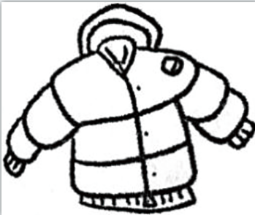
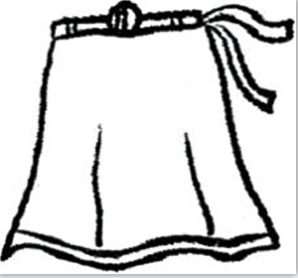
C
2. [A] [B] [C]
Script：My aunt sent me a new skirt.

Slide 6
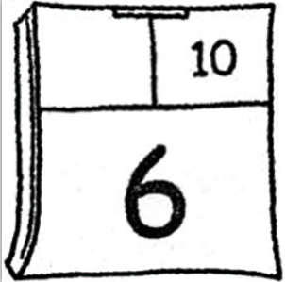
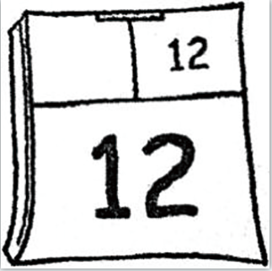
3. [A] [B] [C]
A
Script：Lily’s birthday is on October 6.

Slide 7
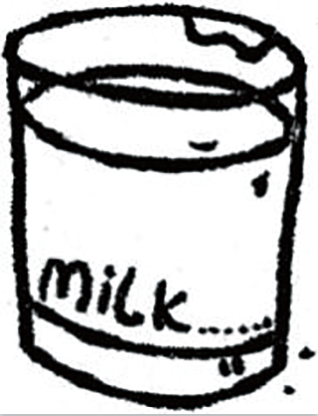
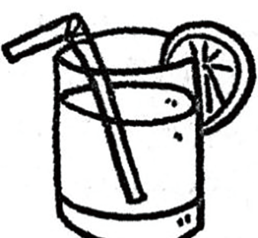
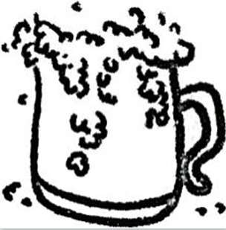
4. [A] [B] [C]
A
Script：Milk is good for our body.

Slide 8
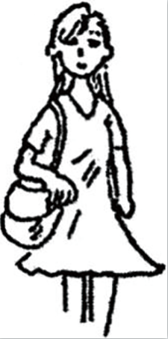
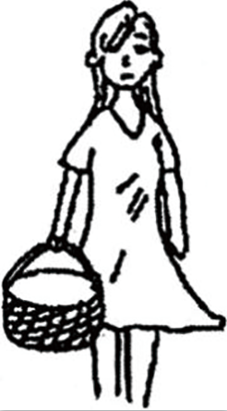
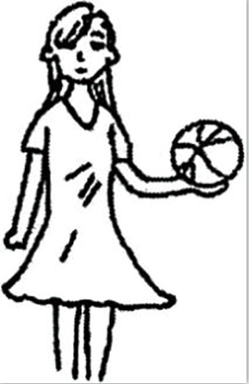
5. [A] [B] [C]
C
Script：On every Sunday afternoon, I play volleyball with my friends.

Slide 9
6. [A] [B] [C]
A
Script：My dad reads newspaper in the morning.

Slide 10
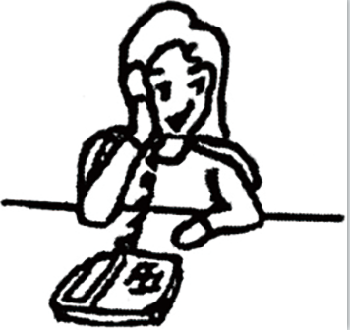
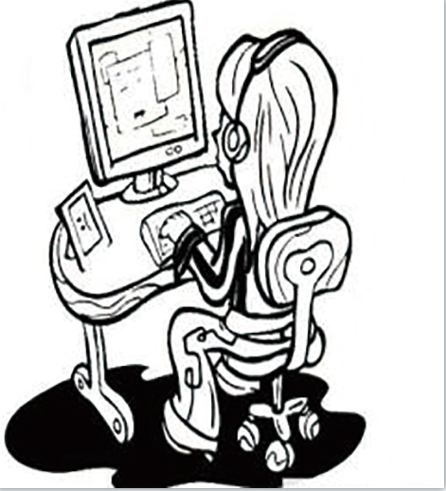
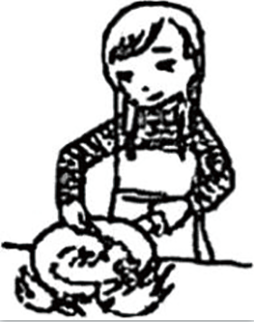
7. [A] [B] [C]
B
Script：My mum is working in front of the computer.

Slide 11
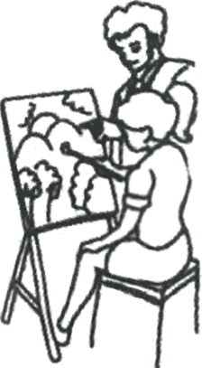
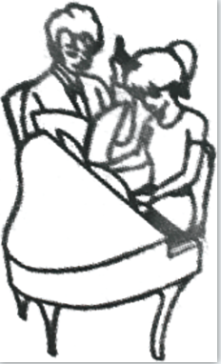
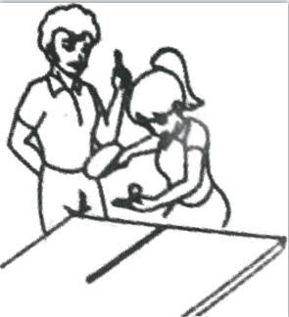
8. [A] [B] [C]
C
Script：I am having a piano class.

Slide 12
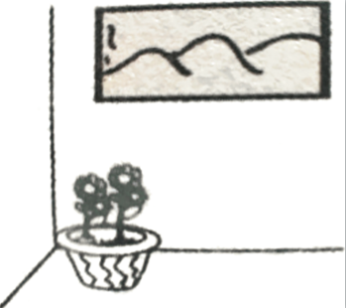
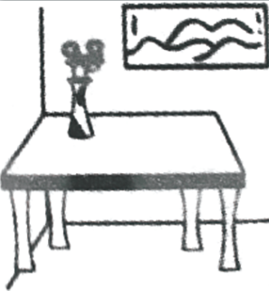
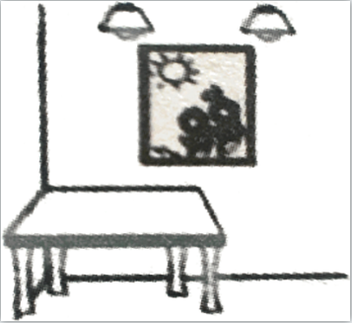
9. [A] [B] [C]
B
Script：The beautiful flowers are on the table.

Slide 13
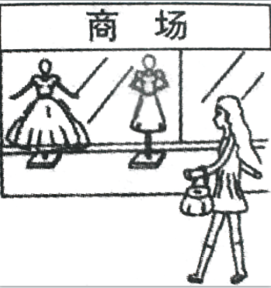
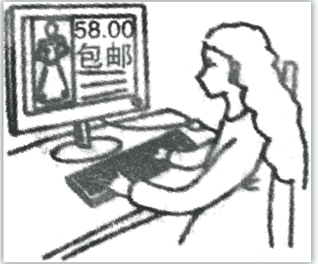
10. [A] [B] [C]
A
Script：Lily is on the way to the shopping mall.

Slide 14
第二节 对话应答
在本节中，你将听到10个话语，请从[A]、[B]、[C]三个选项中选出一个最佳应答，并标在试卷的相应位置。每个话语后有10秒钟的停顿，以便选择答案和阅读下一小题的选项。每个话语读两遍。
11. [A] It’s yellow. [B] It’s dear. [C] It’s beautiful.
A
Script：What color is your new coat?
C
12. [A] Next week. [B] Once a week. [C] For about a week.
Script：How long have you had a cold?

Slide 15
13. [A] It is among the trees. [B] It is Mr. White’s. [C] It is a new house.
B
Script：Whose house is that, on the top of the mountain?
14. [A] Three hundred dollars. [B] Three kilometers. [C] Three years.
A
Script：How much does that bicycle cost?

Slide 16
15. [A] That’s a pity. [B] I’ll miss you, too. [C] You’re welcome.
A
Script：I am afraid that I will miss your party this Saturday.
16. [A] Green tea, please. [B] How kind of you! [C] Certainly.
C
Script：Could you give me a cup of tea, please?

Slide 17
17. [A] Not at all. [B] Just a minute. [C] Nice to meet you!
B
Script：Hurry, Tom! We’re waiting for you.
C
18. [A] It’s too noisy. [B] It’s too warm. [C] It’s getting too dark.
Script：Why are you turning on the light?

Slide 18
19. [A] I’ll take it. [B] Yes, please. [C] Don’t mention it.
B
Script：I’m sorry she’s out right now, can I take a message?
C
20. [A] The plane has taken off.
[B] Surely he will.
[C] You’re right.
Script：I think we’ll have to make some plans soon.

Slide 19
第三节 对话理解
在本节中，你将听到10段对话，每段对话有一个问题。请从[A]、[B]、[C]三个选项中选出答案，并标在试卷的相应位置。每段对话后有10秒钟的停顿，以便回答问题和阅读下一问题及其选项。每段对话读两遍。
C
21. What are the speakers talking about?
[A] Their school life.
[B] Their parents.
[C] Their holiday plans.
Script：M: I am going to Canada during the summer holidays. What are your plans?
W: I am going to England to spend some time with my parents.

Slide 20
22. What does the woman suggest?
[A] Calling a taxi for Kevin.
[B] Asking Kevin for a ride.
[C] Borrowing Kevin’s car.
B
Script：M: We’d better call a taxi or we’ll be late for school.
W: Why not ask Kevin to drive us there? He is free at home.

Slide 21
B
23. How much money does the woman want to borrow?
[A] $ 16.
[B] $ 60.
[C] $ 66.
Script：W: Could you lend me 60 dollars? I need to buy a new dress.
M: Oh, I’m sorry, I’ve only got 16 dollars on me.

Slide 22
A
24. What did the woman do last night?
[A] She talked with a friend.
[B] She went to a show.
[C] She watched TV.
Script：M: Did you see the show on TV last night?
W: No, a friend came to see me, and we talked for a long time.

Slide 23
B
25. What does the man want to buy?
[A] A desk.
[B] A chair.
[C] A computer.
Script：M: Let’s go and see. I need a new chair for my computer desk.
W: OK. They’ve got some nice chairs here in the shop.

Slide 24
B
26. Whose birthday party is the woman going to?
[A] Layla’s.
[B] Jim’s.
[C] Ella’s.
Script：M: Layla, whose birthday party are you going to?
W: It’s Jim’s party. I am going with Ella.

Slide 25
C
27. Where are the speakers?
[A] In a library.
[B] In a cinema.
[C] In a restaurant.
Script：W: Would you like to sit here in the middle of the room, Sir?
M: I’m afraid this dinner table is too small for all eight of us.

Slide 26
C
28. What does the woman mean?
[A] Jack has an old bike.
[B] Jack will buy a new bike.
[C] Jack is good at fixing bikes.
Script：M: My old bike is broken. I’m not sure if Jack can fix it.
W: Well, if he can’t, no one can.

Slide 27
B
29. What does the man do on Sunday afternoon?
[A] Go to the park.
[B] Play basketball.
[C] Do some housework.
Script：M: What do you do on Sunday?
W: I usually go to the park. And you?
M: I do some housework on Sunday morning. In the afternoon, I
play basketball.

Slide 28
30. What does the woman ask Dennis to do?
[A] To make friends with Lucas.
[B] To give a ticket to Lucas.
[C] To live with Lucas.
B
Script：W: Dennis, do you know Lucas?
M: Yes, we are friends living in the same block.
W: Could you give this ticket to him?
M: Sure, I’ll do that.

Slide 29
第二部分 英语知识运用
目录
下一页

Slide 30
第一节 单项填空
阅读下面的句子和对话，从[A]、[B]、[C]三个选项中选出一个能填入空白处的最佳选项，并在答题卡上将该项涂黑。
31. He is badly ill. We must _________ a doctor at once.
[A] send to [B] send for [C] send away
B
解析：本题考查动词短语。send for为固定短语，意思是“派人去叫（请）”；send away，意思是“发送，派遣”，故选[B]项。

Slide 31
第一节 单项填空
32. —What’s wrong with the book?
—One page is _________.
[A] disappeared [B] losing [C] missing
C
解析：本题考查词义辨析。disappear意思是“消失”，disappeared要用主动语态，因为“消失”是不及物动词，没有被动式。losing意思是“损失的，失败的”；missing意思是“丢失的，找不到的”，故选[C]项。

Slide 32
B
33. My mother has never been to London, _________?
[A] is she [B] has she [C] isn’t she
解析：本题考查反义疑问句。前否后肯或前肯后否，题目里用的是现在完成时，has neverbeen to，用的是否定形式，后面就用肯定形式has she，故选[B]项。

Slide 33
34. Have you _________ your ticket?
[A] book [B] booked [C] booking
B
解析：本题考查现在完成时态。现在完成时态结构：have/has +过去分词，故选[B]项。

Slide 34
35. _________ Mr. Smith is well again, he can go on with his work.
[A] Now and then
[B] Now that
[C] The other day
B
解析：本题考查固定词组。now and then意思是“偶尔”；now that意思是“既然，由于，因为”；the other day意思是“不久前某一天；几天以前”，故选[B]项。

Slide 35
C
36. These trousers look very good. I wonder _________.
[A] how much cost they are
[B] how much do they cost
[C] how much they cost
解析：本题考查宾语从句。wonder 后跟宾语从句，要用陈述句的语序，故选[C]项。

Slide 36
A
37. Jason worked late in the evening to finish his report _________ his boss could read it the next morning.
[A] so that [B] because [C] before
解析：本题考查连词。so that 意为“以便，为的是”，because意为“因为”，before意为“在……之前”，故选[A]项。

Slide 37
38. I am looking forward to _________ your answer as soon as possible.
[A] receiving
[B] being received
[C] receive
A
解析：本题考查固定词组。look forward to doing sth.意为“期待做某事”，receive youranswer 意为“收到你的回复”，故选[A]项。

Slide 38
C
39. As winter comes, the weather is getting _________.
[A] cold and cold
[B] cold and colder
[C] colder and colder
解析：本题考查形容词的比较级。“比较级+ and +比较级”表示“越来越……”，故选[C]项。

Slide 39
C
40. While Jim _________, his brother is writing his homework.
[A] reads
[B] has read
[C] is reading
解析：本题考查从句中的时态。while引导从句，强调和主句动作的同时性，主句是现在进行时，从句也用现在进行时，故选[C]项。

Slide 40
B
41. It’s _________ to do your homework, Laurence.
[A] bad
[B] time
[C] good
解析：本题考查句型。It’s time to do sth.意为“是时候做某事了”，故选[B]项。

Slide 41
42. The teacher will not let anyone leave the classroom until the bell _________.
[A] rings [B] rang [C] will ring
A
解析：本题考查一般现在时。根据主将从现的规则，主句为一般将来时，从句应用一般现在时，故选[A]项。

Slide 42
43. Of the three brothers, the youngest runs _________.
[A] fast [B] faster [C] the fastest
C
解析：本题考查比较级和最高级。三个或三个以上的人或物进行比较，用最高级。故选[C]项。

Slide 43
A
44. The suggestion _________ all right.
[A] sounds [B] is sounded [C] has sounded
解析：本题考查一般现在时。主语suggestion是第三人称单数，因此要用sounds，故选[A]项。

Slide 44
A
45. The car is traveling _________ 40 kilometers per hour.
[A] at [B] in [C] with
解析：本题考查介词。速度前用介词at，故选[A]项。

Slide 45
第二节 完形填空
阅读下面短文，从短文后所给的[A]、[B]、[C]三个选项中选出能填入相应空白处的最佳选项，并在答题卡上将该项涂黑。
参考译文
B
No one could see time. But we 46 the earth revolves (自转) while it 47 around the sun. It takes the 48 24 hours to revolve once and we call it a day. It takes about 365.25 days 49 the earth to go around the sun and we call it a year.
C
B
B
46. [A] hope [B] know [C] guess
47. [A] go [B] will go [C] goes
48. [A] sun [B] earth [C] moon
49. [A] as [B] for [C] about
46. 解析：本题考查动词的词义。hope“希望”，know“知道”，guess“猜测”。根据上下文，答案应该是know“知道”，故选[B]项。
47. 解析：本题考查一般现在时。地球围绕太阳转，属于真理，用一般现在时，且是第三人称单数，因此用goes，故选[C]项。
48. 解析：本题考查名词词义辨析。上文讲到地球自转，这里应该也是选择地球自转24小时。故选[B]项。
49. 解析：本题考查介词。固定句型：It takes +时间+ for sb./sth. to do sth.，故选[B]项。

Slide 46
A
Our life is 50 , but we have many things to do. So, we should 51 good use of our time. We should plan 52 we should do every day.
C
A
50. [A] short [B] important [C] interesting
51. [A] have [B] take [C] make
52. [A] what [B] when [C] why
50 解析：本题考查形容词的词义。根据上下文，“生命是短暂的，但是有许多事情要做”，选[A]项。
51. 解析：本题考查固定词组。make good use of意思为“好好利用”，故选[C]项。
52. 解析：本题考查宾语从句引导词的用法。及物动词do缺宾语，用what来引导，故选[A]项。

Slide 47
B
Some people always postpone (推迟) doing things, 53 they can never finish work on time. So we 54 not leave today’s work till tomorrow. We should use time well by doing 55 useful.
B
C
53. [A] however [B] so [C] instead
54. [A] shall [B] should [C] may
55. [A] anything [B] nothing [C] something
53. 解析：本题考查连词。空格前后为因果关系，故选[B]项。however“然而”，表示转折，instead“代替”。
54. 解析：本题考查情态动词。shall意为“将要”，should意为“应该”，may意为“或许”。根据上下文，“我们不应该把今天的工作留到明天”，故选[B]项。
55. 解析：本题考查不定代词。我们应该通过做有用的事情，珍惜时光，故选[C]项。

Slide 48
参考译文
没有人能看见时间。但是我们知道地球绕着太阳转的同时也在自转。地球自转一周需要24小时，我们称之为一天。地球绕太阳一周大约需要365.25天，我们称之为一年。
我们的生命是短暂的，但我们有很多事情要做。所以，我们应该好好利用时间。我们应该计划每天该做什么。
有些人做事总是拖拉，所以他们永远不能按时完成工作。所以，我们不应该把今天的工作拖到明天完成。我们应该好好使用时间来做一些有用的事情。
返回

Slide 49
第三部分 阅 读
目录
下一页

Slide 50
第一节 短文理解1
阅读下面短文，从[A]（Right）、[B]（Wrong）、[C]（Doesn’t say）三个选项中选择一个正确选项，并在答题卡上将该项涂黑。
参考译文
Vending machines (自动售货机) sell many different kinds of things. Some of them sell cold drinks like coke or orange juice, or hot drinks like coffee or tea. Others sell sweets, stamps, tickets, newspapers and other small things. In some cities, vending machines are even used to sell a lot of hot meals.

Slide 51
These machines have been welcomed for two reasons. They save (节省) time and they are convenient (方便的). No shop assistant or cashier is needed when things are sold in vending machines. In many places people can use the machines at any time of day or night, and they can find vending machines everywhere.
Although there are many different sizes and kinds of vending machines, they all work in nearly the same way. People put money into the machine and then open a door to receive what they buy. Some machines will also return change to people, and a few will even give change to paper notes. But the idea is the same. People like to save time and are usually willing to pay a higher price for this convenience.

Slide 52
C
56. Many vending machines sell books and magazines.
[A] Right. [B] Wrong. [C] Doesn’t say.
57. Vending machines can be found only in very large cities.
[A] Right. [B] Wrong. [C] Doesn’t say.
解析：细节理解题。本文没有提到自动售货机售卖书本和杂志，故选[C]项。
B
解析：细节理解题。第二段最后一句话“In many places people can use the machines at anytime of day or night, and they can find vending machines everywhere.”提到“in manyplaces”，“everywhere”，应该不只是大城市，猜测该题错误，故选[B]项。

Slide 53
A
58. In some places the machines work 24 hours a day.
[A] Right. [B] Wrong. [C] Doesn’t say.
解析：细节理解题。第二段最后一句话中提到“at any time of day or night”，因此该题正确，故选[A]项。

Slide 54
A
59. Some vending machines accept paper notes.
[A] Right. [B] Wrong. [C] Doesn’t say.
60. The things sold in vending machines are usually more expensive.
[A] Right. [B] Wrong. [C] Doesn’t say.
解析：细节理解题。从文章最后一段倒数第三句“a few will even give change to paper notes”可知，自动售货机应该是接受纸币的，因此该题正确，故选[A]。
A
解析：细节理解题。从文章最后一段最后一句话“People like to save time and are usuallywilling to pay a higher price for this convenience.”可知，人们喜欢节省时间，通常愿意为这种便利支付更高的价格，故选[A]项。

Slide 55
参考译文
自动售货机出售各种东西。有些卖冷饮，如可乐或橙汁，或热饮，如咖啡或茶。其他卖糖果、邮票、门票、报纸和其他小东西。在一些城市，自动售货机甚至被用来卖热餐。
这些机器受到欢迎有两个原因：节省时间且便利。自动售货机卖东西不需要店员或收银员。在很多地方，不管是白天还是黑夜，人们可以随时使用自动售货机，而且到处都可以找到自动售货机。
尽管自动售货机的尺寸不一、种类多样，但它们的工作方式几乎都是一样的。人们把钱投入机器，然后打开门取出他们购买的东西。有些机器还有找零功能，有些甚至实现了纸币找零。但道理是一样的。人们喜欢省时，通常愿意为这种便利支付更高的价格。
返回

Slide 56
第二节 短文理解2
阅读下列短文，从[A]、[B]、[C]三个选项中选择一个正确答案，并在答题卡上将该项涂黑。
请根据下面短文回答第61—65题：
参考译文
Parkour is a cool sport where you run fast, jump and climb high.
How far can you jump? For British parkour athlete (跑酷运动员) Toby Segar, the answer is 2.96 meters. The 28-year-old broke a world record (纪录). How did he do it? Parkour helped him.

Slide 57
Parkour started in France. It comes from a French way of training soldiers (训练士兵). Today, it is a fun way to stay healthy. Parkour athletes take the city as their playground. They run along walls, climb to high places, jump from rooftop (屋顶) to rooftop and roll (翻滚). Behind their cool moves is the skillful way of training. To keep his body strong, Segar does strength training, cycling and climbing.
Not just young adults can do the sport. Many kids enjoy it. Segar started learning it when he was 11. “Each time I succeed (成功), I make a step further,” he said.
That is the charm of the sport. It is not about winning. People “win” when they make progress.

Slide 58
B
61. Parkour origins from _________.
[A] Britain [B] France [C] America
解析：细节理解题。从第三段第一句话可得知，跑酷起源于法国。[A]项的意思为“英国”，[B]项的意思为“法国”，[C]项的意思为“美国”，故选[B]。

Slide 59
A
62. What does the underlined word “charm” mean?
[A] 魅力 [B] 秘密 [C] 配方
解析：词义猜测题。从最后一段的两句话“It is not about winning. People ‘win’ when theymake progress.”可猜测前面说的是运动的“魅力”，故选[A]。

Slide 60
A
63. How would Segar feel when he succeeded each time?
[A] He would feel excited.
[B] He would feel sad.
[C] He would feel disappointed.
解析：推理判断题。[A]项excited意思为“感到兴奋的”，[B]项sad意思为“感到伤心的”，[C]项disappointed意思为“感到失望的”。从第四段的“Each time I succeed (成功), I make a step further”，可知答案为[A]。

Slide 61
C
64. Which of the following is CORRECT according to the passage?
[A] Segar started learning parkour at the age of 28.
[B] Only young adults can do parkour.
[C] Parkour athletes often run along walls, climb to high places and jump from rooftop to rooftop and roll in the city.
解析：细节理解题。从第四段第三句话得知，西格从11岁开始学习跑酷，故[A]项错误。从第四段第一句话得知，不是只有年轻人才能做这项运动，故[B]项错误。从第三段第四和第五句话得知，跑酷运动员把城市当作他们的游乐园，他们沿着墙壁跑，爬到高处，从一个屋顶跳到另一个屋顶，翻滚，故[C]项正确。

Slide 62
A
65. This passage is about _________.
[A] the introduction of parkour with an example of a world-record breaker
[B] how to play parkour and where to play parkour
[C] the winning charm of parkour
解析：主旨大意题。通过阅读本文可得知，本文讲述的是[A]项：通过世界纪录打破者西格的例子，介绍跑酷这种运动。[B]项的意思是“怎么跑酷和在哪里跑酷”，[C]项的意思是“跑酷胜利的魅力”，均不全面，因此[A]项正确。

Slide 63
参考译文
跑酷是一项很酷的运动，要求跑得快，跳得高，爬得高。
你能跳多远？英国跑酷运动员托比·西格的答案是2.96米。28岁的他打破了一项世界纪录。他是怎么做到的？跑酷帮助了他。
跑酷起源于法国。它来自法国训练士兵的一种方式。今天，这是一种保持健康的有趣方式。跑酷运动员把城市当作他们的游乐场。他们沿着墙壁跑，爬到高处，从一个屋顶跳到另一个屋顶，翻滚。在他们酷炫的动作背后，是技术性的训练方式。为了保持身体强壮，西格做力量训练、骑自行车和爬山。
不是只有青年人才能做这项运动。许多孩子喜欢它。西格11岁时开始练习跑酷。他说：“每次成功，我都会向前迈进一步。”
这就是这项运动的魅力所在。这与输赢无关。当人们取得进步时，他们就“赢”
了。
返回

Slide 64
请根据下面短文回答第66—70题：
参考译文
Every Wednesday, Amy goes to work in a bank. She knows all her customers (顾客) very well, because they are her classmates. In fact, Amy and her customers are all 10 years old. Amy’s bank is in a school in Chicago. The children run it themselves. It is open for 30 minutes a week. Every Wednesday morning, Amy opens the bank. Her classmates put their money in or take their money out. The bank pays interest (利息) to them.

Slide 65
The idea for a school bank came from their teacher, Mr. Harry White. Mr. White took his idea to the National Bank. The bank helped the school build a bank for children. “We want to give the children a chance to learn about money,” said Mr. White. “We are training them to look after their money carefully.”
The next plan for the school bank is the credit cards (信用卡). “Many people in the US don’t use credit cards very well,” said Mr. White. “Our school bank will give the students some practice in using credit cards.” Students can buy school meals and books with the credit cards.

Slide 66
B
66. The text is mainly about _________.
[A] the working story of Amy
[B] the introduction of a school bank
[C] the practice of using credit cards
解析：主旨大意题。根据上下文的内容，本文主要是对学校银行的介绍。[A]项的意思是“艾米的工作故事”，是文章第一段的段意；[C]项的意思是“信用卡的实际应用”，为文章第三段的段意，均不全面，故选[B]项。

Slide 67
B
67. How often does Amy go to work?
[A] Every Wednesday.
[B] Once a week.
[C] Twice a week.
解析：细节理解题。题目问的是频率，根据第一段第一句话“Every Wednesday, Amy goesto work in a bank”，可知她每周去一次，故选[B]项。[A]项每周三，不是针对频率的回答，[C]项每周两次，不符合原文意思。

Slide 68
C
68. What does the underlined word “run” mean?
[A] 跑步 [B] 拥有 [C] 经营
解析：词义猜测题。从第一段最后三句话可知，艾米担当工作人员，艾米的同学们去银行存取钱，因此可猜测，同学们自行经营银行，故选[C]项。

Slide 69
C
69. What is the purpose of the bank?
[A] The bank allows the customers to put their money in or take their money out.
[B] The bank pays interest to the customers.
[C] The bank helps the children learn about money.
解析：细节理解题。从第二段最后两句话可知，学校想给孩子们一个了解金钱的机会，训练他们认真理财，故选[C]项。[A]项“学校银行允许顾客把钱存入或取出”和[B]项“学校银行付给顾客利息”，均是学校银行的具体做法，但并不是学校银行的开设目的。

Slide 70
C
70. Which of the following is NOT correct according to the passage?
[A] The school bank is built with the help of the National Bank.
[B] The workers and the customers of the school bank are students.
[C] The school bank has offered credit cards to the students.
解析：细节理解题。从第二段第二句话和第三句话得知，国家银行帮助学校建立了一个儿童银行，[A]项正确。从第一段第二句话和第三句话得知，学校银行的顾客和工作人员都是艾米和她的同学，都是10岁的学生，[B]项正确。从最后一段第一句话得知，学校银行的下一个计划是信用卡，并没有执行，[C]项错误，故为本题答案。

Slide 71
参考译文
每个星期三，艾米去银行上班。她非常了解所有的顾客，因为这些顾客是她的同学。事实上，艾米和她的顾客都是10岁。艾米的银行在芝加哥的一所学校里。孩子们自己经营。每周营业30分钟。每个周三早上，艾米打开银行大门开始运营。她的同学把钱存入或取出。银行付给他们利息。
建立学校银行的想法来自他们的老师哈里·怀特先生。怀特先生把他的想法告诉了国家银行。国家银行帮助学校建立了一个儿童银行。“我们想给孩子们一个了解金钱的机会，”怀特先生说，“我们正在训练他们认真理财。”
学校银行的下一个计划是信用卡。怀特先生说：“在美国，许多人都不太会使用信用卡。我们学校的银行将给学生一些使用信用卡的练习。”学生可以用信用卡购买学校的饭菜和书籍。
返回

Slide 72
第四部分 写 作
目录
下一页

Slide 73
第一节 改写句子
下面是关于Jenny周末活动的三对句子。每对句子中，第一句是原句，第二句是对第一句的改写。要求根据原句和第二句中已经给出的部分用一至五个单词补全第二句。把补出的部分写在答题卡各题的序号后。（注意：不能改变原句的意思。）
71. Jenny spent half an hour on her homework on Saturday morning.
It _________ Jenny half an hour to do her homework on Saturday morning.
72. Jenny asked me what she should wear at the party on Saturday afternoon.
Jenny asked me what __________ at the party on Saturday afternoon.
73. Jenny couldn’t do the housework because she was very busy.
Jenny was __________ busy to do the housework.
took
to wear
too

Slide 74
第二节 书面表达
74. 情景：你（Chen Yao）的美国朋友Jim正在中国度假，他给你发了一些照片。
任务：请你用英语给Jim写一封50个词左右的电子邮件，内容包括：
表示感谢；
赞美他发来的照片；
邀请他到你家做客；
祝他假日愉快。
Reference answer

Slide 75
Reference answer
Dear Jim,
First of all, thank you so much for sending me the photos. These photos are so beautiful that I couldn’t help looking at them again and again. In addition, I hope you can pay a visit to my house before you go back to America. I am looking forward to your coming.
Enjoy your holiday!
Chen Yao
返回

Slide 76
感谢您的观看！
Notes:
本PPT模板部分元素使用了幻灯片母版制作。如果需要修改，点击-视图-幻灯片母版-修改 完成后关闭编辑母版即可。

