Slide 1
全国英语等级考试
（一级）模拟卷
主 编
叶 秀 江 韵 赖 静
Notes:
本PPT模板部分元素使用了幻灯片母版制作。如果需要修改，点击-视图-幻灯片母版-修改 完成后关闭编辑母版即可。

Slide 2
模拟卷（三）
CONTENTS
第一部分 听 力
第二部分 英语知识运用
第三部分 阅 读
第四部分 写 作

Slide 3
第一部分 听 力
目录
下一页

Slide 4
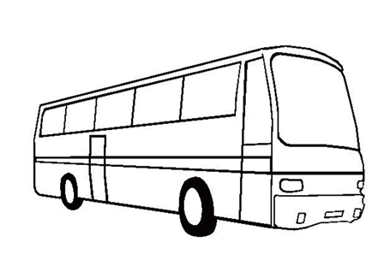
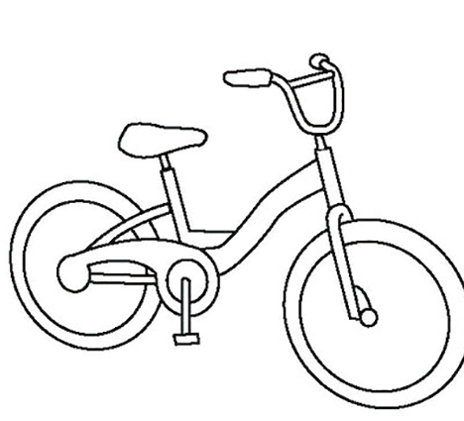
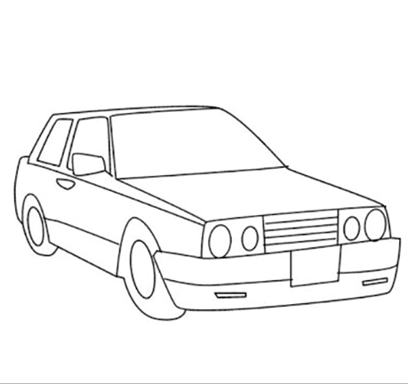
第一节 图片判断
在本节中，你将听到10个句子，每句话配有[A]、[B]、[C]三幅图片，请选择与句子内容相符合的一幅图片，并标在试卷的相应位置。每句话后有10秒钟的停顿，以便选择图片并看下一组图片。每句话读两遍。
1. [A] [B] [C]
B
Script: Lily often goes to school by bike.

Slide 5
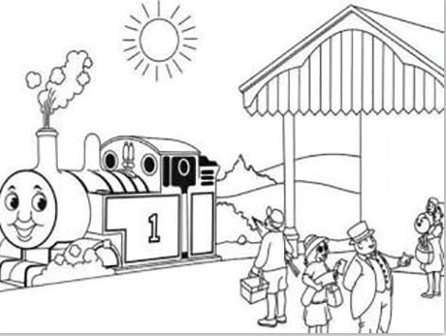
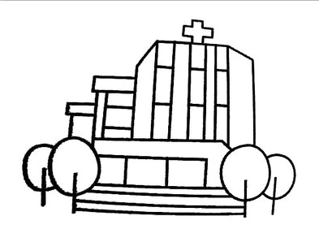
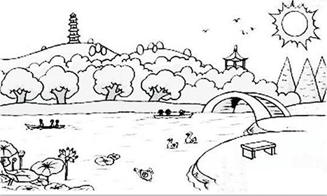
A
2. [A] [B] [C]
Script: Excuse me, how can I get to the train station?

Slide 6
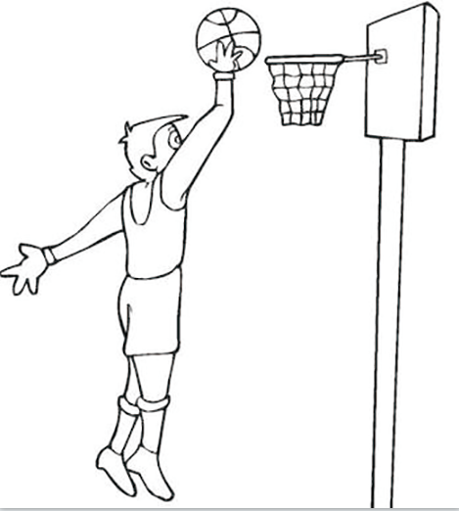
3. [A] [B] [C]
B
Script: I like running in the morning.

Slide 7
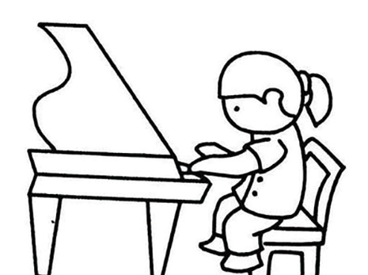
4. [A] [B] [C]
B
Script: Tom wants to learn singing.

Slide 8
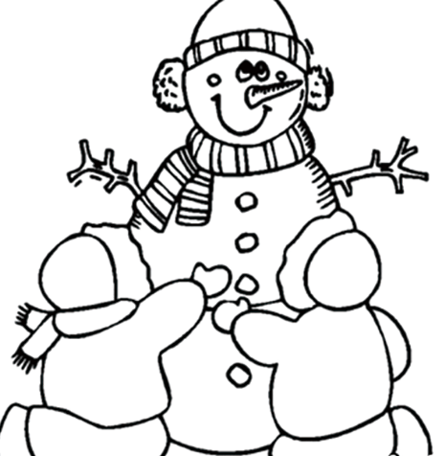
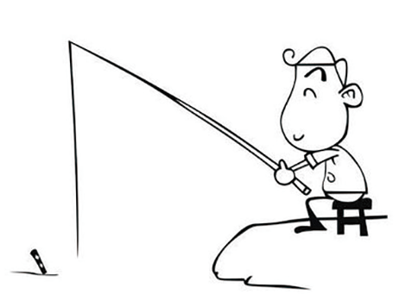
A
5. [A] [B] [C]
Script: It’s interesting to make a snowman.

Slide 9
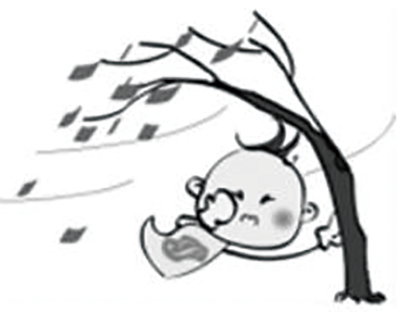
C
6. [A] [B] [C]
Script: It is going to rain tomorrow.

Slide 10
C
7. [A] [B] [C]
Script: Please call me as soon as you arrive at the airport.

Slide 11
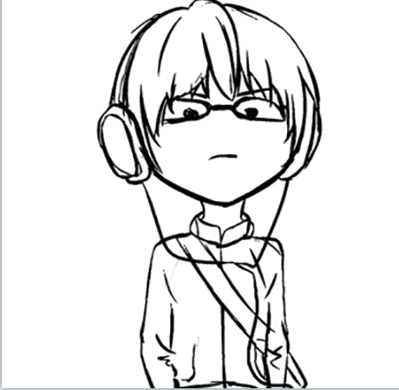
8. [A] [B] [C]
B
Script: Mike is reading a book.

Slide 12
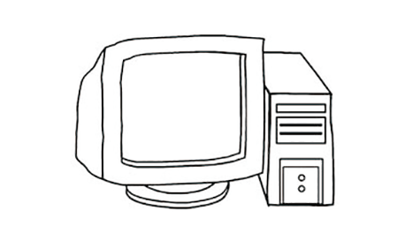
9. [A] [B] [C]
C
Script: The mobile phone is more and more important in daily life.

Slide 13
A
10. [A] [B] [C]
Script: Susan bought an umbrella last week.

Slide 14
第二节 对话应答
在本节中，你将听到10个话语，请从[A]、[B]、[C]三个选项中选出一个最佳应答，并标在试卷的相应位置。每个话语后有10秒钟的停顿，以便选择答案和阅读下一小题的选项。每个话语读两遍。
11. [A] How are you? [B] Yes, I’d like a T-shirt. [C] Mind your step.
B
Script: Can I help you, Sir?
B
12. [A] Well done. [B] 25 dollars. [C] I know.
Script: How much does the book cost?

Slide 15
13. [A] Certainly, 8800350. [B] I’m John Smith. [C] It’s over there.
A
Script: May I have your phone number, please?
C
14. [A] Yes, I’d like to. [B] It is raining. [C] You can go there by bus.
Script: How can I get to the post office, Sir?

Slide 16
15. [A] Yes, of course. [B] By train. [C] Wait a minute, please.
A
Script: Would you like to go shopping with me this weekend?
16. [A] All right. [B] No, thanks. [C] I’d love to.
A
Script: Shall we meet at the school gate this afternoon?

Slide 17
17. [A] I don’t know. [B] Here you are. [C] Take care.
B
Script: Can I borrow your English book?
B
18. [A] Learning English songs.
[B] Fine, thank you.
[C] Reading a story.
Script: We haven’t seen each other for a long time. How is everything going?

Slide 18
19. [A] I’m fine. [B] It’s snowing. [C] It’s Monday.
B
Script: What’s the weather like today?
20. [A] Let’s go. [B] Work hard. [C] It’s a good idea.
C
Script: How about having a picnic on Sunday?

Slide 19
第三节 对话理解
在本节中，你将听到10段对话，每段对话有一个问题。请从[A]、[B]、[C]三个选项中选出答案，并标在试卷的相应位置。每段对话后有10秒钟的停顿，以便回答问题和阅读下一问题及其选项。每段对话读两遍。
21. Where are they talking?
[A] In a classroom. [B] In a library. [C] At home.
C
Script: W: My dear, what’s for supper?
M: Tomato soup and fried chicken.

Slide 20
B
22. What does the woman think of the beef?
[A] It is delicious.
[B] It tastes bad.
[C] It is OK.
Script: W: Waiter, can you come here for a moment?
M: Yes, is there anything wrong?
W: The beef is too salty.
M: I’m sorry, Ma’am.

Slide 21
A
23. What does the man hear?
[A] He hears someone singing.
[B] He hears someone calling him.
[C] He hears someone calling the woman.
Script: W: Do you hear anything?
M: Yes, someone is singing in the next room.

Slide 22
C
24. Who are talking?
[A] Two students.
[B] Two policemen.
[C] A parent and a child.
Script: W: Dad, I just finished my paper. Can you check it before I hand it in?
M: Sorry, Honey. Do it by yourself.

Slide 23
B
25. What’s the color of the building?
[A] It’s yellow.
[B] It’s white.
[C] It’s orange.
Script: W: Pam, where’s the closest hospital?
M: It’s not that far. Do you see that white building over there?

Slide 24
A
26. What does their son do?
[A] He is a teacher.
[B] He is a doctor.
[C] He is a student.
Script: W: Our son hasn’t called us for nearly two months.
M: Maybe he is very busy with his students.

Slide 25
C
27. What does the woman want to buy?
[A] Watermelon juice.
[B] Apple juice.
[C] Orange juice.
Script: M: Can I help you, Madam?
W: Is there any orange juice here?

Slide 26
C
28. Why can’t the man go to dance?
[A] Because he has to prepare for the exam.
[B] Because he has to prepare for the supper.
[C] Because he has to prepare for the travel.
Script: W: Steven, would you like to go dancing with us tonight?
M: It’s a pity, Mary. I have to prepare for the travel.

Slide 27
A
29. What does the man suggest?
[A] He suggests that the woman take a bus.
[B] He suggests that the woman take a taxi.
[C] He suggests that the woman walk home.
Script: W: Excuse me, do you know how to get to Police Office?
M: It’s a bit far from here. You’d better go there by bus.

Slide 28
30. Why is the woman not going to Lucy’s party?
[A] Because she’s writing a book.
[B] Because she has to study.
[C] Because she’s making computers.
B
Script: W: I’m not going to Lucy’s party. I have to study.
M: But what can I tell Lucy?

Slide 29
第二部分 英语知识运用
目录
下一页

Slide 30
第一节 单项填空
阅读下面的句子和对话，从[A]、[B]、[C]三个选项中选出一个能填入空白处的最佳选项，并在答题卡上将该项涂黑。
B
31. Tom sings _________ than his brother.
[A] good [B] better [C] well
解析：本题考查比较级。句中than为比较级标志性词，Tom和his brother两者进行比较，Tom“唱得更好”，本题应该选副词的比较级better，故选[B]。

Slide 31
第一节 单项填空
A
32. —Could you tell me _________ he came here?
—He drove here.
[A] how [B] when [C] why
解析：本题考查疑问词。根据回答“他开车来这里”，可知应问怎么来，此处应该选提问交通方式的疑问词，故选[A]。

Slide 32
B
33. Can you give me _________ about learning English?
[A] an advice [B] advice [C] advices
解析：本题考查不可数名词。本题中advice为不可数名词，前面不能加a/an，也没有复数形式，故选[B]。

Slide 33
34. In order _________ English well, you should remember more words.
[A] to learn [B] learned [C] be learned
A
解析：本题考查动词不定式。in order to do sth.为固定短语，表示“为了做某事”。句意是“为了学好英语，你应该记更多单词。”故选[A]。

Slide 34
35. Robert is interested ________ the piano. He has played it for ten years.
[A] to [B] for [C] in
C
解析：本题考查介词。be interested in sth.意为“对某事感兴趣”，是固定搭配，故选[C]。

Slide 35
C
36. The ________ of the activity is to check the students’ English level.
[A] idea [B] result [C] purpose
解析：本题考查名词的词义。idea的中文含义为“想法，主意”，result的中文含义为“结果”，purpose的中文含义为“目的，意图”。根据句意“这个活动的目的是检查学生们的英语水平”，故选[C]。

Slide 36
37. I’m sure he’ll enjoy ________ us around the factory.
[A] showing [B] show [C] shows
A
解析：本题考查固定搭配。固定搭配enjoy (doing) sth.，意为“享受……的乐趣；喜欢（做）某事”。故选[A]。

Slide 37
B
38. David is a sports reporter. He asks for a(n) ________ with the big sports star.
[A] message [B] interview [C] choice
解析：本题考查名词的词义。message的中文含义为“信息”，interview的中文含义为“面试，访谈，采访”，choice的中文含义为“选择”。句意：大卫是一名体育记者，他请求采访那位体育大明星。故选[B]。

Slide 38
39. —Look at these stamps. I ________ them for five years.
—Wow, they are wonderful.
[A] kept [B] have kept [C] have bought
B
解析：本题考查现在完成时。“for + 一段时间”常用于现在完成时，因此本题应使用现在完成时。buy为短暂性动词，不能用于“for + 一段时间”的结构中，本题应使用持续性动词keep的过去分词形式，表达“我收藏这些邮票已有五年了”，故选[B]。

Slide 39
40. —How often do you chat with your friends online?
—________. I’m busy with my study.
[A] Only once a month
[B] About two hours
[C] About two minutes
A
解析：本题考查语义情景。根据句意“你隔多久会和朋友网络聊天？”可知本题询问与朋友聊天的频率。答句中“I’m busy with my study”，意思是“我忙于学习”，可见“我”很少和朋友网络聊天。选项“Only once a month”的中文含义为“仅一个月一次”，故选[A]。

Slide 40
41. —Tony, is this Lucy’s book?
—Yes, it’s ________.
[A] her [B] herself [C] hers
C
解析：本题考查物主代词。根据句意，答句应为“是的，这是她的”。此处应该填写名词性物主代词hers，故选[C]。

Slide 41
42. The new zoo is ________ than the old one.
[A] most beautiful [B] more beautiful [C] very beautiful
B
解析：本题考查形容词比较级的用法。题中“than”表明该题应该用比较级，beautiful是多音节形容词，beautiful的比较级应为more beautiful，故选[B]。

Slide 42
43. He ________ to finish the task quickly by the boss yesterday.
[A] is asked [B] asked [C] was asked
C
解析：本题考查被动语态。根据句意“昨天他被老板要求快点儿完成任务”和“by the boss”可判断此处用被动语态的结构。yesterday表示过去的时间，主语为第三人称单数，应用was + 动词过去分词，故选[C]。

Slide 43
44. They are very ________ with the results of the exam.
[A] satisfy [B] satisfies [C] satisfied
C
解析：本题考查词性变换。根据固定搭配be satisfied with sth.，意思是“对……满意”，故选[C]。

Slide 44
45. I asked one boy and two girls about the name of their headmaster, but ______ of them knew it.
[A] neither [B] none [C] both
B
解析：本题考查不定代词。neither“两者都不”，none“三者或三者以上都不”，both“两者都”。句中一个男孩加两个女孩，应用none，故选[B]。

Slide 45
第二节 完形填空
阅读下面短文，从短文后所给的[A]、[B]、[C]三个选项中选出能填入相应空白处的最佳选项，并在答题卡上将该项涂黑。
参考译文
A primary school in rural China with 46 than 1,000 teachers and students has fed itself for 15 years by offering farming for students.
B
46. [A] much [B] more [C] many
46. 解析：本题考查固定搭配。more than +数字，意为“超过，多于”，故选[B]。

Slide 46
C
Each class is allocated (分配) a piece of land 47 seasonal vegetables or raise livestock in Jingwai Mingde Primary School 48 Yunnan Province. Students 49 farm labors twice a week with the help of the teachers.
C
A
47. [A] to eat [B] to play [C] to plant
48. [A] at [B] on [C] in
49. [A] do [B] does [C] did
47 解析：本题考查上下文理解。“eat”意思是“吃”，“play”意思是“玩”，“plant”意思是“种植”，结合本题的语境，本句中“land”意思是“土地”，“seasonal vegetables”意思是“季节性蔬菜”，下一句提到“farm labors”，意思是“农场工作”。只有“to plant”符合语境，故选[C]。
48. 解析：本题考查介词。at表示“在什么地方（小地点）”，on表示“在什么上面”，in表示“在什么地方（大地点）”，根据本句中“Yunnan Province”云南省，故选[C]项。
49. 解析：本题考查一般现在时。根据twice a week，意思是“一周两次”，可知学生们经常做农活，本题要用一般现在时，故选[A]。

Slide 47
C
There is 50 a zoo in the school keeping deer, ostriches and other animals to help students learn more feeding skills and 51 along with animals.
52 school sets up a greenhouse with fruit trees and medicinal herbs (药草) for 53 to learn about knowledge in nature.
A
B
B
50. [A] either [B] never [C] also
51. [A] get [B] got [C] getting
52. [A] A [B] The [C] An
53. [A] workers [B] students [C] farmers
50. 解析：本题考查副词。either意思是“也”，一般用于疑问句或否定句中；“never”意思是“从不”；“also”意思是“还”，一般用于肯定句中。根据上下文，本题的句意为“学校里还有一个动物园……”，故选[C]。
51. 解析：本题考查动词词组。根据词组“help sb. do sth.”，以及句中的并列连词“and”，本题应选get的动词原形，故选[A]。
52. 解析：本题考查冠词。“school”在上文多次提到，此处应用“the”，故选[B]。
53. 解析：本题考查上下文理解。本句中提到“school”，“learn about knowledge”意思是“学习知识”，本文多次提到“students”，最符合语境的应是“students”，故选[B]。

Slide 48
C
The school principal Lei Yingfei 54 , “The farm labor will build excellent character (品 质) 55 influences a child’s lifetime.”
B
54. [A] say [B] saying [C] said
55. [A] what [B] that [C] where
54. 解析：本题考查谓语动词和主谓一致。“The school principal Lei Yingfei”在句子中作主语，句中缺少谓语动词，所以排除非谓语动词“saying”，又因主语是第三人称单数，排除“say”。“said”表示时态为一般过去时，“校长雷应飞曾说过”，符合上下文语境，选[C]。
55. 解析：本题考查定语从句的引导词。本句的先行词“character”是物，“what”不能用于定语从句，“where”表示地点，故本题只能选引导词“that”，表示物，故选[B]。

Slide 49
参考译文
在中国农村地区的一所小学里，通过学生们的农场劳动，15年以来，1 000多名师生实现了一日三餐食物的自给自足。在云南省靖外明德小学，每个班都分有一块地来种植时令蔬菜或饲养牲畜。在老师的帮助下，学生们一周从事两次农场劳动。
学校内还有一个动物园，饲养着梅花鹿、驼鸟和其他动物，这帮助学生们学习更多喂养技巧和学会与小动物相处。
为了让学生们学习自然知识，学校还建了一个温室，里面种植果树和药草。
这个小学的校长雷应飞曾说：“劳动形成的优秀品格，会影响一个孩子的一生。”
返回

Slide 50
第三部分 阅 读
目录
下一页

Slide 51
第一节 短文理解1
阅读下面短文，从[A]（Right）、[B]（Wrong）、[C]（Doesn’t say）三个选项中选择一个正确选项，并在答题卡上将该项涂黑。
参考译文
After a long, cold and dry winter, flowers are blooming, birds are singing and people are flying kites. Known as the birthplace of kites, Weifang in Shandong Province has a long history of making kites. Yang Hongwei, 56, is an inheritor of the Weifang kite-making technique. “Every time I see these beautiful kites, my boredom and negative feelings go away,” said Yang. Yang Hongwei learned the technique of making kites from her grandfather at the age of 16. After practicing the technique for 10 years, she started her own kites’ shop in 1992.

Slide 52
“Many places around the world have a tradition of flying kites,” Yang said. On Yang’s kites, people can see different kites telling Chinese legends and history. For example, she once made a kite showing a phoenix head. Though the idea was cool, the process was not easy. She spent much effort and time checking historical records or discussing the details with professionals. In her spare time, she also travels to different countries including Germany, Australia, the US and New Zealand to tell people about Chinese stories seen on kites and the traditional ways of making kites.

Slide 53
A
56. Weifang in Shandong Province is known as the birthplace of kites.
[A] Right. [B] Wrong. [C] Doesn’t say.
57. Yang Hongwei learned the technique from her father at the age of 16.
[A] Right. [B] Wrong. [C] Doesn’t say.
解析：细节理解题。从第一段第二句“Known as the birthplace of kites, Weifang in Shandong Province has a long history of making kites.”可知，山东潍坊市是风筝的发源地，故选[A]。
B
解析：细节理解题。从第一段倒数第二句“Yang Hongwei learned the technique of making kites from her grandfather at the age of 16.”可看出，16岁时，杨红卫跟她爷爷学习制作风筝的技艺，题目中是“learned the technique from her father”，该题是错误的，故选[B]。

Slide 54
A
58. After working with the technique for 10 years, Yang Hongwei started her own shop in 1992.
[A] Right. [B] Wrong. [C] Doesn’t say.
解析：细节理解题。第一段最后一句“After practicing the technique for 10 years,
she started her own kites’ shop in 1992.”意思是“在实践这项技艺10年后，她在1992年有了自己的风筝店。”本题“After working with the technique for 10 years, Yang Hongwei started her own shop in 1992.”意思是“在用这项技艺工作10年后，杨红卫在1992年有了自己的店。”两句的意思相近，故选[A]。

Slide 55
C
59. Yang Hongwei earns lots of money by making kites.
[A] Right. [B] Wrong. [C] Doesn’t say.
60. In her spare time, Yang Hongwei also travels to Britain.
[A] Right. [B] Wrong. [C] Doesn’t say.
解析：细节理解题。本题“Yang Hongwei earns lots of money by making kites.”意思是“杨红卫通过做风筝赚了很多钱。”文中没有提及她做风筝的收入，故选[C]。
C
解析：细节理解题。第二段最后一句“In her spare time, she also travels to different countries including Germany, Australia, the US and New Zealand”，没有提及有没有去过英国，故选[C]。

Slide 56
参考译文
漫长、寒冷又干燥的冬天之后，鲜花盛开，鸟儿歌唱，人们放起了风筝。山东省的潍坊以风筝的诞生地而闻名，其制作风筝的历史悠久。现年56岁的杨红卫是潍坊风筝制作技艺的继承者。杨红卫说：“每当看到这些美丽的风筝，我就不觉得无聊了，负面情绪也消失了。”在16岁时，杨红卫从祖父那里学习制作风筝的技艺。练习了10年之后，她在1992年开了自己的风筝店。
杨红卫说：“世界上许多地方都有放风筝的传统。”在她的风筝上，人们可以看到不同的风筝讲述着中国的传说和历史。例如，她曾经做过一只展示凤凰头的风筝。虽然这个想法很酷，但制作过程不容易。她花了很多精力和时间来查阅历史记录，或与专业人士讨论细节。在业余时间，她还前往不同的国家，包括德国、澳大利亚、美国和新西兰，告诉人们在风筝上看到的中国故事和制作风筝的传统方法。
返回

Slide 57
第二节 短文理解2
阅读下列短文，从[A]、[B]、[C]三个选项中选择一个正确答案，并在答题卡上将该项涂黑。
请根据下面短文回答第61—65题：
参考译文
With the support of fast and stable communication networks, service robots performing various functions at makeshift hospitals (方舱医院) became a force hard to ignore in Shanghai’s fight against the COVID-19 resurgence in the spring of 2022. Each of them was equipped with three disinfection modules: an ultraviolet lamp, an ultra-dry fog generator and a plasma air purifier, and could work 24 hours a day.

Slide 58
In the meantime, a group of “5G indoor multifunctional cloud robots” could deliver over 20 boxed meals at a time, and went to designated locations for patients to collect their food themselves. With the assistance of these robots, the manual distribution of meals, which originally took about 20 minutes, could be completed in just 5 minutes. The service robots helped reduce the risk of cross-infection between patients and effectively guarantee the safety of medical staff, according to an on-site worker.
According to the local government, more than 200 robots would soon enter service at a makeshift hospital in the city’s Lingang area. They would perform duties such as contactless delivery of materials. More 5G-based intelligent robots were also being readied to work at hospitals.

Slide 59
C
61. Why did people in Shanghai use the service robots at makeshift hospitals?
[A] Because the communication networks was fast and stable.
[B] Because the service robots were useful and cheap.
[C] Because people wanted to fight against the COVID-19 resurgence.
解析：细节理解题。根据第一段第一句“service robots performing various
functions at makeshift hospitals (方舱医院) became a force hard to ignore
in Shanghai’s fight againstthe COVID-19 resurgence in the spring of 2022”，
故选[C]项。

Slide 60
B
62. Which disinfection module was not equipped with the service robots?
[A] An ultraviolet lamp.
[B] An automatic spray sterilizer.
[C] A plasma air purifier.
解析：细节理解题。根据第一段最后一句“Each of them was equipped with three disinfection modules: an ultraviolet lamp, an ultra-dry fog generator and a plasma air purifier, and could work 24 hours a day”，故选[B]项。

Slide 61
A
63. How many boxed meals could the service robots deliver at a time?
[A] More than 20. [B] Fewer than 20. [C] 20.
解析：细节理解题。根据第二段第一句“In themeantime, a group of ‘5G indoor multifunctional cloud robots’ could deliver over 20 boxed meals at a time”故选[A]项。

Slide 62
C
64. Which of the following is NOT true about the service robots?
[A] They would perform duties such as contactless delivery of materials.
[B] They helped reduce the risk of cross-infection between patients.
[C] They couldn’t guarantee the safety of medical staff.
解析：细节理解题。根据最后一段最后一句“They would perform duties such as contactless delivery of materials”，选项[A]与文意相符，排除[A]。根据第二段最后一句中“The service robots helped reduce the risk of cross-infection between patients and effectively guarantee the safety of medical staff”，选项[B]与文意相符，排除[B]。选项[C]与文意不符，故选[C]项。

Slide 63
B
65. Which is the best title for the passage?
[A] The Makeshift Hospitals.
[B] The Service Robots.
[C] The Communication Networks.
解析：主旨大意题。整篇文章是围绕第一段第一句“service robots performing
various functions at makeshift hospitals became a force hard to ignore in
Shanghai’s fight against the COVID-19 resurgence in the spring of 2022”而
展开的，详细介绍了service robots，故选[B]项。

Slide 64
参考译文
在快速稳定的通信网络的支持下，在方舱医院内，服务机器人执行各种功能，它们成为2022年春天上海抗击新型冠状病毒肺炎疫情一股难以忽视的力量。每台机器配备三个消毒模块：一个紫外线灯、一个超干雾发生器和一个等离子空气净化器。每台机器可以全天候工作。
同时，一组“5G室内多功能云端机器人”一次性可以装下20多份盒饭，并能自主
送往指定位置，供患者自行领取盒饭。在机器人的辅助下，原先需要约20分钟的人工分发过程现在只需要5分钟。根据一位现场工作人员描述，服务机器人有助于降低患者之间交叉感染的风险，并有效保证了医务人员的安全。
据当地政府称，浦东临港方舱医院内有200多台机器人也已“整装待发”，它们将
承担起无接触式物资配送等工作。未来会有更多5G智能机器人在方舱医院“上岗”。
返回

Slide 65
请根据下面短文回答第66—70题：
参考译文
Japan Airlines has introduced a feature on its seat-booking system that shows where young children are seated. One traveler said the feature let him know where babies “plan to scream during a 13-hour trip”. But some people urged him to be tolerant, while others said the problem could easily be solved with noise-cancelling headphones (降噪耳机).

Slide 66
“They are babies, as we all once were. We need to learn tolerance,” said G Sundar. Andrew Lim said, “After having my own son, I am very sympathetic to parents traveling with kids.” Deirdra Hardimon said, “Babies are not capable developmentally of ‘planning’ crying or screaming.” Other Twitter users said noise-cancelling headphones were the answer. Jene Johnson said, “I don’t understand people that complain about babies crying on planes. I put on
my headphones and I hear nothing.”
According to the website flyingwithababy.com, one of the most family-friendly airlines is Etihad, which has an extra service such as free pushchairs. Emirates and Gulf Air also score highly according to the website.

Slide 67
C
66. What is the special feature on Japan Airlines’ seat-booking system?
[A] It can show where old people are seated.
[B] It tells passengers where young people are seated.
[C] It shows where young children, especially babies, are seated.
解析：细节理解题。根据第一段第一句“Japan Airlines has introduced a feature on its seat-booking system that shows where young children are seated”，故选[C]项。

Slide 68
A
67. Which of the following is NOT a reason for tolerating baby’s crying?
[A] We need a quiet place to relax.
[B] Babies are not capable developmentally of “planning” crying or screaming.
[C] We should be sympathetic to parents traveling with babies.
解析：细节理解题。根据第二段第三句“After having my own son, I am very sympathetic to parents traveling with kids”，第二段第四句“Babies are not capable developmentally of ‘planning’ crying or screaming”，可知选项“We need a quiet place to relax”是不对的。故选[A]项。

Slide 69
B
68. When there is a baby crying, what can we do?
[A] We can ask the baby to keep silence.
[B] We can put on a noise-cancelling headphone.
[C] We can complain about babies crying on planes.
解析：细节理解题。根据第二段最后两句“I don’t understand people that complain about babies crying on planes. I put on my headphones and I hear nothing”，故选[B]项。

Slide 70
B
69. Why is Etihad known as a family-friendly airline according to flyingwithababy.com?
[A] Because the price of Etihad is cheaper.
[B] Because Etihad has an extra service such as free pushchairs.
[C] Because Etihad offers milk and toys for babies.
解析：细节理解题。根据最后一段第一句“According to the website
flyingwithababy.com, one of the most family-friendly airlines is
Etihad, which has an extra service such as free pushchairs”，故
选[B]项。

Slide 71
A
70. Which one doesn’t score highly on flyingwithababy.com?
[A] Japan Airlines.
[B] Emirates.
[C] Gulf Air.
解析：细节理解题。根据最后一段最后一句“Emirates and Gulf Air also
score highly according to the website”，没有提到日本航空，故选[A]项。

Slide 72
参考译文
日本航空公司在其座位预订系统上引入了一项功能，可以显示孩子们的座位位置。一位旅行者说，这个功能让他知道，“在一个长达13小时的旅程中，婴儿‘计划’在哪个位置啼哭”。但有一些人提醒他要宽容。另一些人则说，通过降噪耳机可以很容易地解决这个问题。
“他们还是孩子，就像我们曾经一样。我们需要学会宽容。”吉•桑德尔说。安德鲁•林姆说：“在有了自己的儿子之后，我对父母带着孩子旅行感到非常同情。”迪尔格拉•哈迪莫姆说：“婴儿在发育过程中没有能力‘计划’哭泣或尖叫。”其他推特用户表示，降噪耳机是解决问题的答案。珍妮•约翰逊说：“我不理解那些抱怨婴儿在飞机上哭泣的人。我戴上耳机，什么也听不到。”
根据flyingwithababy.com网站报道，阿提哈德航空公司是最适合家庭乘坐的航空公司之一，它有一个额外的服务，比如免费的婴儿推车。该网站显示，阿联酋航空和海湾航空的得分也很高。
返回

Slide 73
第四部分 写 作
目录
下一页

Slide 74
第一节 改写句子
下面是关于Amy去中国旅游的三对句子。每对句子中，第一句是原句，第二句是对第一句的改写。要求根据原句和第二句中已经给出的部分用一至五个单词补全第二句。把补出的部分写在答题卡各题的序号后。（注意：不能改变原句的意思。）
71. It was Amy’s dream to visit China.
Amy was looking forward to _________ China.
72. Her dream came true when a friend invited her to join a party.
Her dream came true when she __________ by a friend to join a party.
73. She visited both Beijing and Guangzhou in China.
She visited Beijing, and she _________ visited Guangzhou in China.
visiting
was invited
also

Slide 75
第二节 书面表达
74. 情景：中秋假期临近，学校要你（Maggie）通知外教Miss Smith参
加9月20日20:00在学校餐厅举行的晚会。师生唱歌跳舞，共同庆祝
中秋节（the Mid-Autumn Festival）。
任务：请你用英语给Miss Smith写一封50个词左右的留言条。内容
包括：
晚会时间；
活动内容；
参加人员；
你的联系方式。
Reference answer

Slide 76
Reference answer
Dear Miss Smith,
The Mid-Autumn Festival is coming. I’m glad to invite you to our party. It will be held at 20:00 on September 20 in the school dining hall. My classmates and teachers will sing and dance to celebrate this festival. We will have a good time.
Please let me know if you will come. My telephone number is 1361234****. I hope to see you then.
Yours,
Maggie
返回

Slide 77
感谢您的观看！
Notes:
本PPT模板部分元素使用了幻灯片母版制作。如果需要修改，点击-视图-幻灯片母版-修改 完成后关闭编辑母版即可。

