Slide 1
全国英语等级考试
（一级）模拟卷
主 编
叶 秀 江 韵 赖 静
Notes:
本PPT模板部分元素使用了幻灯片母版制作。如果需要修改，点击-视图-幻灯片母版-修改 完成后关闭编辑母版即可。

Slide 2
模拟卷（二）
CONTENTS
第一部分 听 力
第二部分 英语知识运用
第三部分 阅 读
第四部分 写 作

Slide 3
第一部分 听 力
目录
下一页

Slide 4
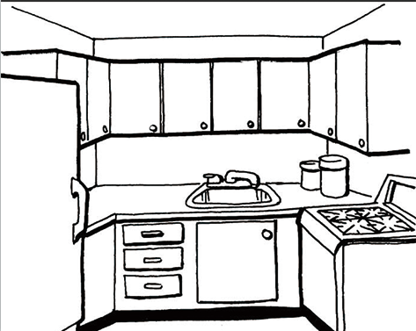
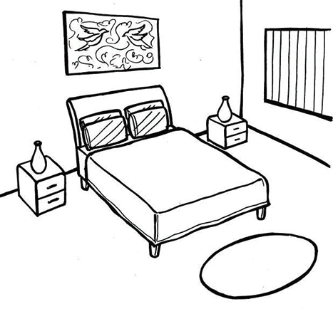
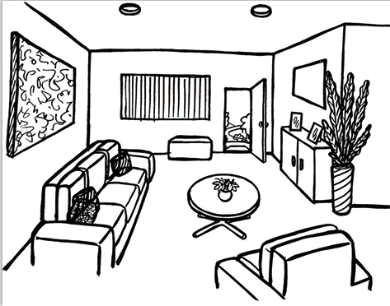
第一节 图片判断
在本节中，你将听到10个句子，每句话配有[A]、[B]、[C]三幅图片，请选择与句子内容相符合的一幅图片，并标在试卷的相应位置。每句话后有10秒钟的停顿，以便选择图片并看下一组图片。每句话读两遍。
1. [A] [B] [C]
A
Script: There is still some bread left in the kitchen.

Slide 5
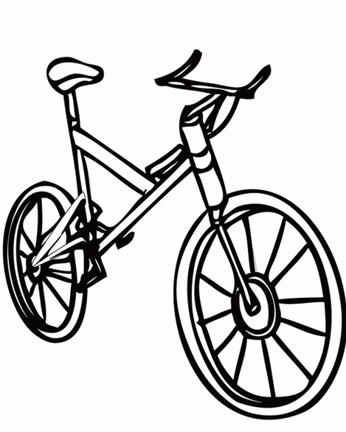
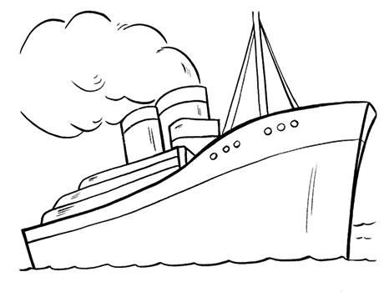
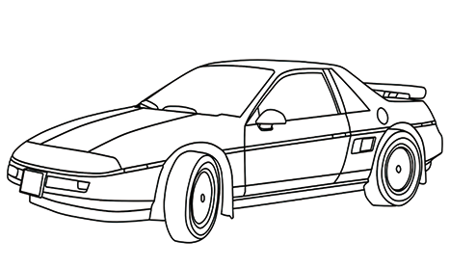
C
2. [A] [B] [C]
Script: It will save a lot of time, if you go by car instead of walking.

Slide 6
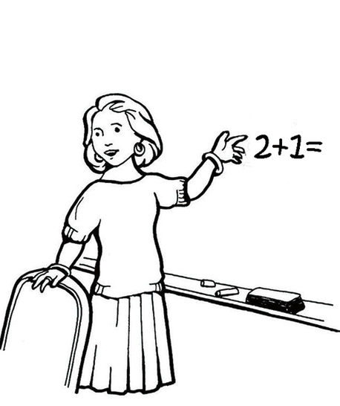
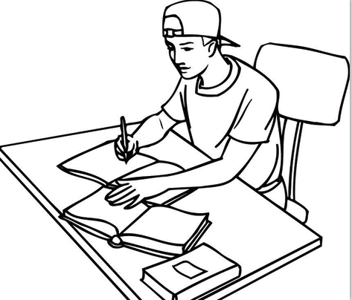
3. [A] [B] [C]
B
Script: Andy is very clever, and he is good at study.

Slide 7
4. [A] [B] [C]
C
Script: She often gets up at half past seven in the morning on weekdays.

Slide 8
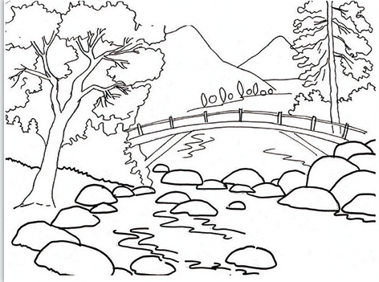
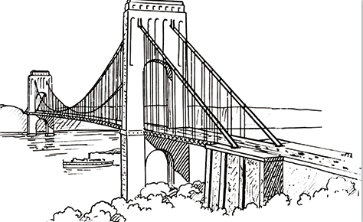
5. [A] [B] [C]
A
Script: The building in the center of the city has a history of 200 years.

Slide 9
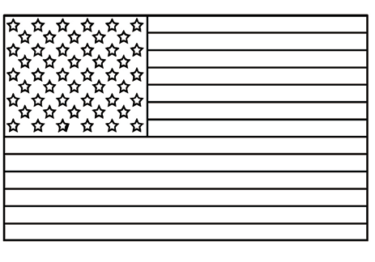
6. [A] [B] [C]
C
Script: The students standing there are from Australia.

Slide 10
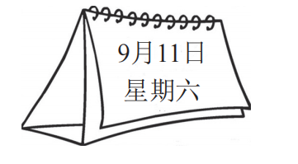
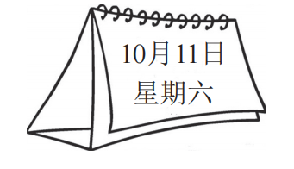
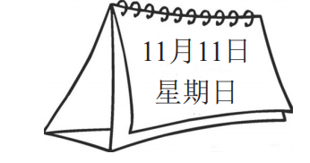
7. [A] [B] [C]
A
Script: The sports meeting will be held on Saturday, September 11.

Slide 11
B
8. [A] [B] [C]
Script: He was glad to get a ticket for the concert.

Slide 12
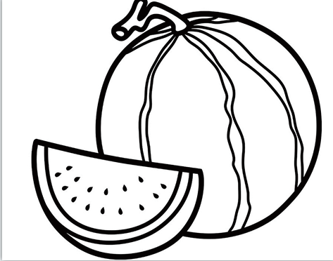
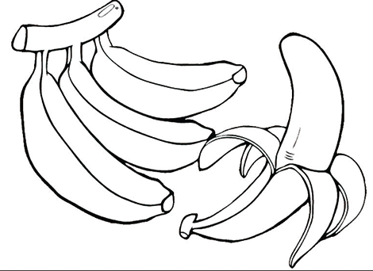
9. [A] [B] [C]
A
Script: Grapes are not expensive this time of year.

Slide 13
10. [A] [B] [C]
C
Script: He picked up a brush to clean the wall.

Slide 14
第二节 对话应答
在本节中，你将听到10个话语，请从[A]、[B]、[C]三个选项中选出一个最佳应答，并标在试卷的相应位置。每个话语后有10秒钟的停顿，以便选择答案和阅读下一小题的选项。每个话语读两遍。
11. [A] It’s cloudy. [B] It’s very kind. [C] A little shy.
A
Script: What’s the weather like today?
C
12. [A] I hope to visit it after I finish school.
[B] I’d like to buy a present.
[C] I’m going to book a train ticket to go there.
Script: How are you going to travel to Guangzhou this summer?

Slide 15
13. [A] By bus. [B] For about 10 minutes. [C] About 30 miles.
B
Script: How long will it take to get to the library?
14. [A] She likes music. [B] She is a teacher. [C] She is busy now.
C
Script: Why don’t you ask Cindy for advice?

Slide 16
15. [A] Not very good. [B] Yes, certainly. [C] So do I.
B
Script: Do you like learning Chinese?
16. [A] It’s 293015331. [B] Room 301. [C] I am 23 years old.
A
Script: Could you tell me your phone number, please?

Slide 17
17. [A] You’re welcome. [B] Don’t use it. [C] Sure, go ahead.
C
Script: Can I borrow your textbook this afternoon?
18. [A] Sure, I will. [B] That’s sorry. [C] No, I don’t think so.
C
Script: Excuse me, is this seat taken?

Slide 18
19. [A] Never mind. [B] All right. [C] Don’t mention it.
B
Script: You’d better put the money in a safe place.
20. [A] I’m glad. [B] No, thanks. [C] Don’t worry.
B
Script: Do you want me to take your luggage to your room?

Slide 19
第三节 对话理解
在本节中，你将听到10段对话，每段对话有一个问题。请从[A]、[B]、[C]三个选项中选出答案，并标在试卷的相应位置。每段对话后有10秒钟的停顿，以便回答问题和阅读下一问题及其选项。每段对话读两遍。
21. What are they talking about?
[A] A small bird. [B] A baby. [C] A fly.
A
Script: W: The little baby bird is so lovely. Can it fly?
M: Yes, it just learned to fly.

Slide 20
C
22. What does the woman mean?
[A] She wants to buy some tea cups.
[B] She needs to sleep for three or four hours.
[C] She needs more than one cup of tea.
Script: M: You look really sleepy, Susan. Would you like a cup of tea?
W: A cup of tea? I think I need three or four.
C
23. What are they talking about?
[A] Chinese. [B] French. [C] Food.
Script: W: I love hamburger and French fries. What kind of food do you like?
M: I enjoy Chinese food.

Slide 21
B
24. What do we know about the woman?
[A] She needs more time to read the book.
[B] She thinks the book is interesting.
[C] She does not like the book.
Script: M: I heard you have finished the book. What do you think of it?
W: Oh, excellent. I find it is worth reading a second time.

Slide 22
C
25. What does the man mean?
[A] He often goes to the cinema.
[B] He prefers to go to the cinema.
[C] He seldom goes to the cinema.
Script: W: Do you often go to the cinema?
M: No. I prefer to watch movies at home rather than go to the cinema.

Slide 23
A
26. What does the man ask the woman to do?
[A] He asks the woman to wait.
[B] He asks the woman to look for the closest telephone.
[C] He asks the woman to pay for the call.
Script: W: May I speak to Mary, please?
M: Hold on for a moment, please.
C
27. How much did Mrs. Li pay for the book?
[A] 12 dollars. [B] 8 dollars. [C] 4 dollars.
Script: M: This book cost me 8 dollars.
W: But Mrs. Li paid only half for the same one.

Slide 24
B
28. What do we know about the man?
[A] He has been to London once.
[B] He has been to London several times.
[C] He has never been to London.
Script: W: Linda plans to leave for London next month. This will be her first visit to the city.
M: Oh, I’ve been there four times.
C
29. Where are they talking?
[A] In a company. [B] In a police station. [C] In a hospital.
Script: M: Good afternoon, Ma’am. What’s wrong with you?
W: I have a headache. I must have caught a cold.

Slide 25
30. What does the woman mean?
[A] She thinks living in the country is bad.
[B] She likes living in the big city very much.
[C] She likes the country life.
C
Script: M: You’ve been living in the country for two years. Do you
want to go back to the big city?
W: No, I don’t. The life here agrees with me.

Slide 26
第二部分 英语知识运用
目录
下一页

Slide 27
第一节 单项填空
阅读下面的句子和对话，从[A]、[B]、[C]三个选项中选出一个能填入空白处的最佳选项，并在答题卡上将该项涂黑。
31. Kate looks so _________. Did she get into trouble?
[A] well [B] much [C] worried
C
解析：本题考查系表结构。句意：凯特看上去很担忧，她遇到什么事了吗？look是系动词，后接形容词表示看上去怎么样。根据后句询问“出什么事了吗？”可知，此处需填表示“情况不好”的词，故选[C]项。

Slide 28
第一节 单项填空
32. There’s _________ wrong with my watch. It doesn’t work.
[A] nothing [B] anything [C] something
C
解析：本题考查不定代词。句意：我的手表有些问题，它不能走了。something常用于肯定句；anything常用于否定句和疑问句；nothing表否定含义。根据后句句意，可判断出前句表示肯定的意思，故选[C]项。

Slide 29
A
33. The student was _________ tired to go on reading.
[A] too [B] quite [C] enough
解析：本题考查副词。句意：学生太疲惫了，以致无法继续阅读。too...to...为固定用法，表示“太……以致不能……”，故选[A]项。

Slide 30
34. I met my friend for _________ first time on the evening of March 20.
[A] a [B] the [C] /
B
解析：本题考查冠词。句意：我和我的朋友初次相遇是在3月20日的晚上。for the first time是固定搭配，意为“首次”，故选[B]项。

Slide 31
35. In l955, Walt Disney _________ opened the first Disney Park.
[A] themselves [B] himself [C] him
B
解析：本题考查反身代词。句意：1955年，沃尔特•迪士尼亲自创办了第一个迪士尼公园。反身代词可在句中作同位语，起强调作用，置于名词、代词的后面或句末，表示“自己，亲自”，故选[B]项。

Slide 32
36. My sister left suddenly without _________ any words.
[A] to say [B] saying [C] say
B
解析：本题考查动名词。句意：我的妹妹没说什么就突然离开了。without是介词，后应接动名词形式，故选[B]项。

Slide 33
37. He thinks _________ wonderful to see the rainbow in the wild.
[A] which [B] that [C] it
C
解析：本题考查形式宾语。句意：他觉得在野外能看到彩虹是一件美妙的事。不定式、动名词或从句在句中作宾语时，由于该宾语成分过长，为保持句子平衡，常使用it作形式宾语，将真正的宾语置于句后。这时，it并无实际意义。此句中think是谓语，后面的不定式to see the rainbow in the wild是真正的宾语，故选[C]项。

Slide 34
38. Tony _________ his paper after supper.
[A] caught up with [B] looked forward to [C] went on with
C
解析：本题考查动词短语。句意：托尼晚饭后，继续写论文。go on with sth.表示“继续做某事”，catch up with表示“赶上”，look forward to表示“盼望做某事”，故选[C]项。

Slide 35
39. Mrs. Smith prepares _________ for her children every day.
[A] meals [B] dishes [C] dinner
A
解析：本题考查名词词义辨析。句意：史密斯太太每天为她的孩子们准备饭菜。根据句意，句中强调的是“一顿饭”。虽meal、dish、dinner都表示膳食，但它们的侧重点不同：meal强调一顿饭，早、午、晚饭皆可；dish多指一道菜；而dinner多指晚餐或晚宴，故选[A]项。

Slide 36
40. I happen _________ the answer to your question.
[A] know [B] knowing [C] to know
C
解析：本题考查非谓语动词之不定式。句意：我碰巧知道你那道问题的答案。句中谓语动词后加to do形式作其宾语，happen to do sth.表示碰巧做某事，故选[C]项。

Slide 37
A
41. The story will become clearer to us _________ we read it a second time.
[A] when [B] but [C] although
解析：本题考查连词。句意：当我们再读一遍时，故事会更加清晰。when表示时间，意为“当……时候”，根据后句句意可知此句需要表示时间的连词，故选[A]项。

Slide 38
C
42. The river is the second _________ one in the town.
[A] long [B] longer [C] longest
解析：本题考查形容词最高级。句意：这条河是镇上第二长的河。序数词修饰形容词，表示第几高（大、长等）时，用形容词的最高级，故选[C]项。

Slide 39
43. Mary as well as her sister _________ listening to music.
[A] like [B] likes [C] are liking
B
解析：本题考查主谓一致。句意：玛丽和她妹妹喜欢听音乐。as well as her sister是伴随状语，主语是Mary，故选[B]项。

Slide 40
44. Remember to watch first before you walk _________ the road.
[A] through [B] over [C] across
C
解析：本题考查方位介词的用法。句意：穿马路前记得先看看。across多指从一定范围的一边到另一边，且在物体的表面进行；through是表示从一个范围的一端穿到另一端，表示从某个空间穿过；over意为“跨过，越过”，表示越过一座高的障碍物。此处指穿过路面，故选[C]项。

Slide 41
45. —Has your brother finished his letter yet?
—I am not sure. He _________ it this afternoon.
[A] was writing [B] writes [C] has written
A
解析：本题考查过去进行时。句意：——你兄弟写完信了吗？——不清楚。他今天下午还在写。表示过去某一时刻正在进行的动作，用过去进行时，故选[A]项。

Slide 42
第二节 完形填空
阅读下面短文，从短文后所给的[A]、[B]、[C]三个选项中选出能填入相应空白处的最佳选项，并在答题卡上将该项涂黑。
参考译文
Bank opening hours are different from area to area. In Europe, many banks are open 46 9:00 a.m. to 5:00 p.m., but some of them close late on weekends. Online banking can have longer 47 .
B
A
46. [A] at [B] from [C] between
47. [A] hours [B] times [C] moments
47. 解析：本题考查名词词义辨析。根据文章可知，此处指的是银行的营业时间，hour可以表示工作、办公等的固定时间，符合文意。moment意为“时刻，瞬间”，times表示次数，故选[A]项。
46. 解析：本题考查介词。根据前后文可知，此处需要表示时间范围的连词，from与to搭配，意为“从……到……”，符合文意。between...and...为固定搭配，意为“在……之间”，at表示在某一时间点，故选[B]项。

Slide 43
A
When you travel to Europe, what is the best way to 48 money with you? There are two 49 ways: traveler’s checks and credit cards. Most foreign tourists would 50 it is helpful to have a traveler’s check book and a credit card such as Visa or MasterCard 51 they are in Europe.
C
A
A
48. [A] carry [B] bring [C] fetch
49. [A] difficult [B] similar [C] usual
50. [A] say [B] tell [C] talk
51. [A] when [B] after [C] until
50. 解析：本题考查动词近义词辨析。文中横线后是外国游客会说的内容，say意为“说出，说过”，强调所说的内容，符合文意。tell意为“讲述，告诉”，指把一件事或一个故事讲出来；talk意为“谈话，谈论”，强调双方交谈，故选[A]项。
51. 解析：本题考查连词。此处指的是在旅游时，when意为“当……时”，符合文意。after意为“在……之后”，until意为“直到……为止”，故选[A]项。
48. 解析：本题考查动词词义的用法。carry指“携带”，bring指“带来”，fetch指“去拿来”，故选[A]项。
49. 解析：本题考查形容词词义辨析。根据文章可知，此处指的是多数外国游客携带金钱的方式，usual意为“通常的”，符合题意。difficult意为“困难的”，similar意为“相似的”，故选[C]项。

Slide 44
C
C
52 is easy and simple to use them to 53 meals and things when you are eating or shopping in a large shopping mall. Sure, you can choose 54 way—take some cash with you when you go out, but you don’t need to carry 55 .
A
C
52. [A] This [B] That [C] It
53. [A] send for [B] sell for [C] pay for
54. [A] another [B] any [C] others
55. [A] some [B] many [C] much
52. 解析：本题考查形式主语。不定式、动名词或从句在句中作主语时，如果主语成分过长，为保持句子平衡，常使用it作形式主语，将真正主语置于句后。此句中，后面的不定式to use them...是真正的主语，故选[C]项。
53. 解析：本题考查动词词组的用法。此处指的是为吃饭和购物付钱，pay for意为“为……付钱”，符合题意。send for“派人去请”，sell for意为“售价”。故选[C]项。
55. 解析：本题考查形容词。横线后省略cash，cash是不可数名词，much修饰不可数名词，符合题意。many“很多”，修饰可数名词；some“一些”，既可修饰可数名词也可修饰不可数名词。由于前面有but表示转折，故选[C]项。
54. 解析：本题考查不定代词辨析。此处指另一种方法，another表示“另一个”，后接单数名词。any指“任何”，others指“另一些（人或物）”，故选[A]项。

Slide 45
参考译文
银行营业时间因地区而异。在欧洲，许多银行的营业时间是从上午9点到下午5点，但有一些周末会晚点关门。在线银行的营业时间会比较长。
当你去欧洲旅游时，携带金钱的最好方式是什么呢？通常有两种方式：旅行支票和信用卡。大多数外国游客会觉得在欧洲旅行带上旅行支票本和信用卡如维萨卡或万事达卡，会有用。当你在大型商场吃饭或购物时，用它们来支付是很方便和简单的。当然，出门也可以选择另一种方式，那就是带现金，但是不需要带很多。
返回

Slide 46
第三部分 阅 读
目录
下一页

Slide 47
第一节 短文理解1
阅读下面短文，从[A]（Right）、[B]（Wrong）、[C]（Doesn’t say）三个选项中选择一个正确选项，并在答题卡上将该项涂黑。
参考译文
Susan is a very famous movie star. She hopes to use her name to do well in business. Today, her business covers many fields, from food to medicine. Susan first got into business about 10 years ago, but failed because she was not very good at it.

Slide 48
“I thought since I could make films, I could do business on my own, too. But I don’t know how to keep my business running. I don’t know how much my company costs, and also don’t know what the rent is for a month… So I lost a lot of money, ” she once told a reporter. “Now I have asked some businessmen to help me.”
So far, Susan is still making money mainly through making movies. She uses the money she earns from her business to help others, such as the poor and out-of-school children.
“I make money to do good things. I can’t use up the money myself, so I want to give it to people in need,” she says with a smile.

Slide 49
A
56. Susan started as a businesswoman about 10 years ago.
[A] Right. [B] Wrong. [C] Doesn’t say.
57. Susan is good at business, so she does it well.
[A] Right. [B] Wrong. [C] Doesn’t say.
解析：细节理解题。从第一段第四句“Susan first got into business about 10 years ago”可知，苏珊大约10年前开始从商，故选[A]项。
B
解析：细节理解题。根据第二段第一、二句“I thought since I could make films, I could do business on my own, too. But I don’t know how to keep my business running.”可知，苏珊原以为她能拍电影同样也能把生意做好，但是她不懂得怎样经营管理，故选[B]项。

Slide 50
C
58. Susan plans to develop new businesses abroad.
[A] Right. [B] Wrong. [C] Doesn’t say.
59. Susan earned most of her money from her business.
[A] Right. [B] Wrong. [C] Doesn’t say.
解析：细节理解题。文章并没有提及苏珊打算将生意拓展到国外，故选[C]项。
B
解析：细节理解题。从第三段第一句“So far, Susan is still making money mainly throughmaking movies.”可知，截至目前，苏珊的主要收入还是靠拍电影，而不是做生意，故选[B]项。

Slide 51
A
60. Susan helps people with the money made from her business.
[A] Right. [B] Wrong. [C] Doesn’t say.
解析：细节理解题。从第三段第二句“She uses the money she earns from her business to help others, such as the poor and out-of-school children.”可知，她用从商挣来的钱帮助别人，故选[A]项。

Slide 52
参考译文
苏珊是一个著名的电影明星。她希望借助她的名声把生意做好。如今她的生意覆盖了从食品到药品等多个领域。大约10年前苏珊开始从商，但是失败了，因为她不会做生意。
她曾经告诉记者说：“我一开始以为，既然我能拍电影，同样我也能把生意做好。但是我不懂得怎样经营管理，不知道公司开销多少，不知道一个月的租金是多少……所以我损失了许多钱。现在我请了几位商人帮我。”
目前，苏珊的主要收入还是靠拍电影。她用从商挣来的钱帮助别人，比如帮助穷人和失学儿童。
“我赚钱来做好事。我赚的这些钱自己用不完，我想回馈给需要的人。”她笑着说。
返回

Slide 53
第二节 短文理解2
阅读下列短文，从[A]、[B]、[C]三个选项中选择一个正确答案，并在答题卡上将该项涂黑。
请根据下面短文回答第61—65题：
参考译文
Mrs. Smith was about to take a flight back to Chicago. Sitting quietly in the waiting room, she found an old man and a little girl sitting in front of her. The man seemed to be in his fifties. He was wearing a uniform and Mrs. Smith couldn’t tell if he was a pilot or not. Shortly after, the man went away, leaving the girl sitting there with her eyes looking forward.

Slide 54
Mrs. Smith walked to the gate (登机口) where the flight attendants (乘务员) were just arriving. One of them was talking to another man, “See that old man? His name is Mike, and this is his last flight. He’s leaving his job after this one, and he’s taking his granddaughter to Chicago for the important moment!”
Mrs. Smith knew who they were talking about. She went back to the waiting room.
The pilot returned with a bag of candy, which he handed to the girl, and then sat next to her. They chatted slowly and then walked to the gate. They took a picture in front of the gate that said “Flight to Chicago at 2:25 p.m.”.
Soon he boarded the plane in the pilot’s seat and began his last flight in the pilot’s seat.

Slide 55
B
61. Where was Mrs. Smith?
[A] At the hotel. [B] At the airport. [C] In the train station.
62. What does the underlined word “pilot” mean?
[A] A person who flies a plane.
[B] A person who works in a shop.
[C] A person who works as a flight attendant.
解析：推理判断题。从第一段“Mrs. Smith was about to take a flight back to Chicago. Sitting quietly in the waiting room”可知，史密斯太太要乘飞机，此刻正在候机室。由此推断出，她现在在机场，故选[B]项。
A
解析：词义猜测题。从第二段“and this is his last flight. He’s leaving his job after this one”可知，这次是他最后一次飞行工作，由此可以推断出这位老人的职业是飞行员，故选[A]项。

Slide 56
B
63. What did the old man do after he left his seat?
[A] He went to find a good seat.
[B] He went to buy candy.
[C] He went to take a picture.
解析：细节理解题。从第四段“The pilot returned with a bag of candy, which he handed to the girl”可知，老人去买糖果了，故选[B]项。

Slide 57
B
64. The old man thought the flight was _________.
[A] expensive [B] important [C] difficult
65. According to the passage, Mrs. Smith might _________.
[A] be a traveler
[B] know the girl
[C] have met the old man before
解析：细节理解题。从第二段“he’s taking his granddaughter to Chicago for
the important moment”可知，老人觉得这次飞行很重要，故选[B]项。
A
解析：推理判断题。文章第一段“Mrs. Smith couldn’t tell if he was a pilot or not.”说明史密斯太太不知道老人是谁，即可排除[C]；又从文章第一段“Mrs. Smith was about to take a flight back to Chicago.”可知，她要坐飞机回芝加哥，由此可推测出她是一位旅行者，故选[A]项。

Slide 58
参考译文
史密斯太太马上就要乘飞机回芝加哥。她安静地坐在候机室里，发现前面坐着一位老人和一个小女孩。老人看上去50多岁的样子，穿着制服。史密斯太太看不出老人是不是飞行员。不一会儿，老人离开，留下女孩坐在那里，两眼盯着前面看。
史密斯太太走到登机口，乘务员也刚到。其中一位乘务员正和另一个男人聊着：“看到那位老人了吗？他叫麦克。这是他最后一次飞行，飞完这次他就离职了，他要带他孙女去芝加哥一起见证这重要的时刻！”
史密斯太太知道他们在说谁。她又回到候机室。
这位飞行员拿着一包糖果回来了，他把糖果递给了女孩，然后坐在她旁边。他们慢慢地聊着，然后走到登机口。他们在登机口合照了张相片，登机口上面写着“下午2:25飞往芝加哥的航班”。
不久他就登上了飞机，坐在飞行员的驾驶位置，开始他的最后一次飞行。
返回

Slide 59
请根据下面短文回答第66—70题：
参考译文
This is the biggest show of Chinese paintings to be held in New York. You are welcome to see for yourself the colorful Chinese paintings of flowers, birds and animals. For the very first time, a Chinese painting show has been brought right to you. Don’t miss this once-in-a-lifetime chance! Hurry now and pay a visit today!
Place: New York Art Centre
Date: December 15–31, 2022
Time: 10:00 a.m. to 5:00 p.m. (Mondays to Fridays)
9:00 a.m. to 6:00 p.m. (Saturdays and Sundays)

Slide 60
Ticket: Adult $ 8; Children (under 12) $ 4
Notes:
1. There are free Chinese painting lessons for children! All children between the ages of 6 and 12 years are welcome! Call us early for a seat.
2. Anybody with a ticket can meet and talk to a Chinese artist. If you are interested in meeting Chinese artists, call us now! Pay $ 2 and you can take a photo with the artists, and $ 15 for a hand-painted T-shirt.
3. There will also be a show of books on Chinese art for buying, reading and borrowing.
Please book online, by phone, by e-mail, or just come by. (TEL: 20789**36, e-mail:oerew@show.com).

Slide 61
B
66. What is the show about?
[A] Chinese films.
[B] Chinese paintings.
[C] Chinese flowers, birds and animals.
解析：细节理解题。从文章第一段“This is the biggest show of Chinese paintings to be held in New York.”可以看出，这是中国绘画展，故选[B]项。

Slide 62
B
67. How long does the show last on a weekday?
[A] For 6 hours. [B] For 7 hours. [C] For 8 hours.
68. How much does a ticket cost for a person over 18?
[A] 4 dollars. [B] 8 dollars. [C] 12 dollars.
解析：细节理解题。从文中“10:00 a.m. to 5:00 p.m. (Mondays to Fridays)”可以看出，展览在工作日持续7个小时。故选[B]项。
B
解析：细节理解题。从文中“Ticket: Adult $ 8”可知，成年人票价为8美元，成年人即18岁以上者，故选[B]项。

Slide 63
C
69. On the show, you can pay $ 15 for_________.
[A] taking a photo with an artist
[B] talking with a famous artist
[C] getting a hand-painted T-shirt
解析：细节理解题。从文中“$ 15 for a hand-painted T-shirt”可知，在展览上支付15美元可得到一件印有手绘图案的T恤衫。故选[C]项。

Slide 64
A
70. The e-mail address is given for_________.
[A] booking a ticket
[B] having a Chinese painting
[C] buying books on Chinese art
解析：推理判断题。从最后一段“Please book online, by phone, by e-mail, or just come by.”可知，邮箱地址是用于订票的。故选[A]项。

Slide 65
参考译文
这是即将在纽约举行的最大的中国绘画展。欢迎您莅临现场观看丰富多彩的中国花
鸟画。这是第一次在这里举行的中国画展。千载难逢的机会，不容错过！快来参观吧！
地点：纽约艺术中心
日期：2022年12月15日至31日
时间：上午10:00至下午5:00（周一到周五）
上午9:00至下午6:00（周六、周日）
门票：成人票8美元，儿童票（限12岁以下）4美元
注意：
1. 免费为儿童开设中国画课程，6–12岁儿童均可参加！请电话预约座位。
2. 有门票的观众可与中国艺术家会谈。如果您有意与中国艺术家会面，现在就打电话联系我们吧！2美元可以与艺术家们合影留念，15美元可以得到一件印有手绘图案的T恤衫。
3. 届时还将有关于中国艺术的书展，可以购买、阅读和借阅。
请通过网络、电话、电子邮件或直接来现场预订。（电话：20789**36，邮箱：
oerew@show.com）
返回

Slide 66
第四部分 写 作
目录
下一页

Slide 67
第一节 改写句子
下面是关于Tina新家的三对句子。每对句子中，第一句是原句，第二句是对第一句的改写。要求根据原句和第二句中已经给出的部分用一至五个单词补全第二句。把补出的部分写在答题卡各题的序号后。（注意：不能改变原句的意思。）
71. It took Tina and her family six months to build the new house.
Tina and her family _______ six months in building the new house.
72. It was not until this week that they moved into their house.
They ______________ into their house until this week.
73. Tina grew some flowers in the garden of the house.
Some flowers __________ by Tina in the garden of the house.
spent
didn’t move
were grown

Slide 68
第二节 书面表达
74. 情景：你是李明（Li Min），你的外国朋友Mary要来中国度假，希望
你推荐一家宾馆。
任务：请你给Mary写一封50个词左右的短信。内容包括：
宾馆的名称和地点；
宾馆的设施和服务；
宾馆的联系方式。
Reference answer

Slide 69
Reference answer
Dear Mary,
I am glad to hear that you are coming to China for your holiday. I would be happy to recommend a hotel for you. Its name is Garden Hotel, which is located at No.12 Dongfeng Road in Guangzhou. It has first-class facilities and high-quality services. You can contact it at 86-020-88237829.
Look forward to your early coming.
Li Min
返回

Slide 70
感谢您的观看！
Notes:
本PPT模板部分元素使用了幻灯片母版制作。如果需要修改，点击-视图-幻灯片母版-修改 完成后关闭编辑母版即可。

