Slide 1
全国英语等级考试
（一级）模拟卷
主 编
叶 秀 江 韵 赖 静
Notes:
本PPT模板部分元素使用了幻灯片母版制作。如果需要修改，点击-视图-幻灯片母版-修改 完成后关闭编辑母版即可。

Slide 2
模拟卷（一）
CONTENTS
第一部分 听 力
第二部分 英语知识运用
第三部分 阅 读
第四部分 写 作

Slide 3
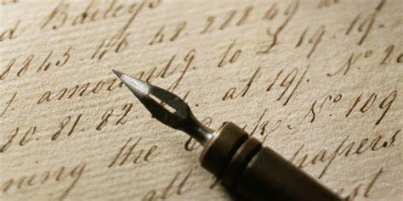
第一部分 听 力
目录
下一页

Slide 4
第一节 图片判断
在本节中，你将听到10个句子，每句话配有[A]、[B]、[C]三幅图片，请选择与句子内容相符合的一幅图片，并标在试卷的相应位置。每句话后有10秒钟的停顿，以便选择图片并看下一组图片。每句话读两遍。
1. [A] [B] [C]
C
Script: The boy goes to school on foot every day.

Slide 5
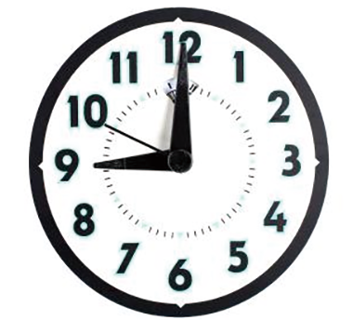
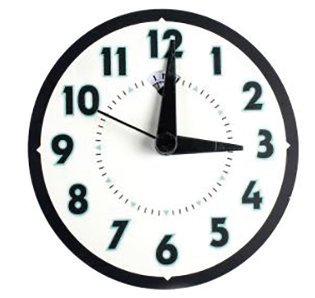
2. [A] [B] [C]
A
Script: Kate got up at 9:00 yesterday and she was late for school.

Slide 6
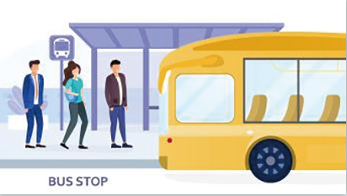
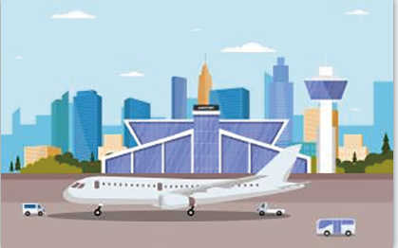
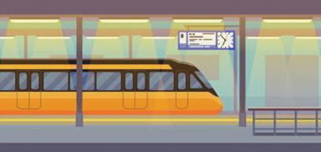
B
3. [A] [B] [C]
Script: Jack saw his friend off at the airport.

Slide 7
A
4. [A] [B] [C]
Script: Swimming is good for your health.

Slide 8
5. [A] [B] [C]
C
Script: I think we should find a restaurant and have something to eat.

Slide 9
C
6. [A] [B] [C]
Script: Mum, I’m thirsty. Can I have some water?

Slide 10
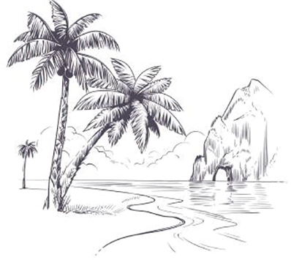
7. [A] [B] [C]
B
Script: Mr. King is going to pay a visit to the Great Wall.

Slide 11
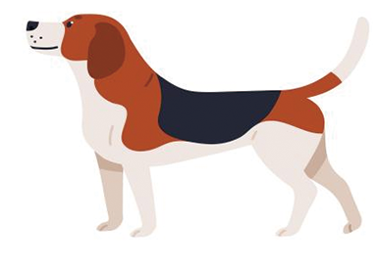
A
8. [A] [B] [C]
Script: Look! How naughty the monkey is!

Slide 12
B
9. [A] [B] [C]
Script: Don’t forget to take a hat with you on such a sunny day.

Slide 13
10. [A] [B] [C]
C
Script: If I drink too much coffee, I can’t sleep.

Slide 14
第二节 对话应答
在本节中，你将听到10个话语，请从[A]、[B]、[C]三个选项中选出一个最佳应答，并标在试卷的相应位置。每个话语后有10秒钟的停顿，以便选择答案和阅读下一小题的选项。每个话语读两遍。
11. [A] No problem. [B] Never Mind. [C] You’re welcome.
A
Script: Could you please close the window?
12. [A] That’s nice. [B] Not yet. [C] Quite good.
B
Script: Jack, have you finished the paper?

Slide 15
13. [A] At 8 o’clock. [B] It’s 13600001234. [C] Don’t mention it.
B
Script: Can I have your number, please?
14. [A] Thank you. [B] Sorry to hear that. [C] Yes, of course.
C
Script: Excuse me, can I pay in cash?

Slide 16
15. [A] It’s rainy. [B] It’s 9 o’clock. [C] It’s Friday.
A
Script: What is the weather like today?
16. [A] Drive a car. [B] By taxi. [C] About 30 minutes.
C
Script: How long will it take to the hospital?

Slide 17
17. [A] It is Miss Lin’s. [B] It is a new car.
[C] It’s parking on the road.
A
Script: Whose car is that?
18. [A] I’ll miss you, too. [B] That’s a pity. [C] Of course.
B
Script: I’ll have to miss your wedding this Sunday.

Slide 18
19. [A] Yes, please. [B] I’m sorry to hear that. [C] I’ll take it.
A
Script: I’m sorry. Mr. White is at the meeting. Can I take a message?
20. [A] Good idea! [B] That’s right. [C] It was great!
C
Script: How was the welcome party on Monday night?

Slide 19
第三节 对话理解
在本节中，你将听到10段对话，每段对话有一个问题。请从[A]、[B]、[C]三个选项中选出答案，并标在试卷的相应位置。每段对话后有10秒钟的停顿，以便回答问题和阅读下一问题及其选项。每段对话读两遍。
21. What are they talking about?
[A] The sea view. [B] Their holiday plans. [C] Their family.
B
Script: M: I’ll go to Beijing during the summer holidays. What are your plans?
W: I am going to Hainan to enjoy the beautiful sea view.

Slide 20
22. What’s Kate going to do?
[A] She’s going to school.
[B] She’s going to get Jack to fix the computer.
[C] She’s going to buy a new computer.
B
Script: M: What’s the matter, Kate?
W: I can’t turn on the computer. I have to turn to Jack for help.
C
23. Where is the woman from?
[A] China. [B] Canada. [C] England.
Script: M: Are you from Canada?
W: No, I’m from England.

Slide 21
24. What’s the relationship between the two speakers?
[A] Customer and receptionist.
[B] Doctor and patient.
[C] Customer and waiter.
A
Script: M: Can I help you, Madam?
W: I’d like to check in.
C
25. Where is the headquarter?
[A] In Beijing. [B] In San Francisco. [C] In New York.
Script: M: You are working in a Sino-US joint venture, aren’t you?
W: Yes, and the headquarter is in New York.

Slide 22
26. What does the woman think of the restaurant?
[A] Noisy. [B] Bad. [C] Comfortable.
B
Script: M: Janie, what was the restaurant like?
W: Oh, the food tastes less good to eat than before. I won’t go there
any more.
C
27. Who is the oldest of the three?
[A] Tom. [B] Jack. [C] Mike.
Script: M: Tom is older than Jack.
W: But he is younger than Mike.

Slide 23
28. Where did the girl find her book?
[A] Under her desk. [B] In her desk. [C] She didn’t find it.
A
Script: M: Have you found your English book?
W: Yes, I found it under my desk.
A
29. What does Jennifer mean?
[A] She likes Guangzhou, but she doesn’t like Changsha.
[B] She likes both Guangzhou and Changsha.
[C] She likes neither Guangzhou nor Changsha.
Script: M: Do you like Guangzhou, Jennifer?
W: Yes, I do. I like the Cantonese morning tea (Yum Cha) very
much. But I don’t like Changsha. The foods are too spicy.

Slide 24
30. What does the girl mean?
[A] It’s too late now.
[B] She will go to school on time.
[C] She won’t go to school.
B
Script: M: Hurry up, or you’ll be late for school.
W: Don’t worry. It’s only 7:30.

Slide 25
第二部分 英语知识运用
目录
下一页

Slide 26
第一节 单项填空
阅读下面的句子和对话，从[A]、[B]、[C]三个选项中选出一个能填入空白处的最佳选项，并在答题卡上将该项涂黑。
C
31. The nearest hospital is about fifteen _________ walk from here.
[A] minute’s [B] minutes [C] minutes’
解析：本题考查名词所有格。句意：从这里去最近的医院大约要走15分钟。以s结尾的名词的所有格形式是直接加’。例如：the teachers’ room “教师的房间”。本题fifteen minutes’ walk意为“15分钟的步行路程”，故选[C]。

Slide 27
第一节 单项填空
32. _________ of the students are girls in my class.
[A] Two thirds [B] Two threes [C] Two third
A
解析：本题考查分数的表达。句意：我们班三分之二的学生是女孩。表达分数时，分子用基数词，分母用序数词，分子大于1时，分母用复数。本题由于分子大于1，所以分母third用复数thirds。三分之二即为two thirds，故选[A]。

Slide 28
C
33. Mike fell asleep _________ he was listening to the songs.
[A] after [B] before [C] while
解析：本题考查连词。句意：麦克在听歌的时候睡着了。表示在做某事时发生了某事，通常用while，故选[C]。

Slide 29
34. —Is _________ here?
—No. Zoe and May have asked for leave.
[A] somebody [B] everybody [C] anybody
B
解析：本题考查不定代词。句意：——大家都到齐了吗？——还没有，佐伊和梅都请假了。everybody指群体中的每个人、所有人，侧重“整体”，常用于肯定句和疑问句。anybody指任何人、某人，常用于疑问句、否定句和条件句。somebody指一些人，常用于肯定句。根据句意，本题是在问大家都到齐了吗，故选[B]。

Slide 30
35. Class One felt sad as they lost _________ Class Two in the football match.
[A] in [B] to [C] on
B
解析：本题考查固定搭配。句意：一班在足球比赛中输给了二班，因此感到很伤心。lose to意为“败给，输给”，故选[B]。

Slide 31
36. She has never been to Beijing, _________?
[A] hasn’t she [B] doesn’t she [C] has she
C
解析：本题考查反义疑问句。句意：她从没去过北京，是吗？反义疑问句由两部分组成，前一部分为陈述部分，后一部分为疑问部分，两部分的人称及时态应保持一致。陈述部分为肯定形式时，疑问部分需为否定形式，即前肯后否。反之亦然，即前否后肯。但如果陈述部分出现never, hardly, few, little, seldom等具有否定意义的词，应视为否定句，其疑问部分须用肯定形式，故选[C]。

Slide 32
37. The movie is worth _________ a second time.
[A] watching [B] to watch [C] being watching
A
解析：本题考查非谓语动词之动名词。句意：这部电影值得再看一次。固定短语be worth doing，意为“值得做某事”，故选[A]。

Slide 33
38. —Must I clean the room at once?
—No, you _________. You can do it later.
[A] needn’t [B] mustn’t [C] shouldn’t
A
解析：本题考查情态动词。句意：——我现在就要打扫房间吗？——不，不需要，你可以等会儿再打扫。回答must的提问，肯定为Yes, you must；否定为No, you needn’t，故选[A]。

Slide 34
39. A new school _________ in our town next year.
[A] will be built [B] will build [C] is built
A
解析：本题考查被动语态。句意：我们镇明年将新建一所学校。被动语态的基本结构是“be + done”，根据next year，可知本句时态为一般将来时，故选[A]。

Slide 35
40. Tom had trouble _________ the key to the door.
[A] with finding [B] to find [C] in finding
C
解析：本题考查固定结构。句意：汤姆很难找到门的钥匙。have trouble in doing sth.意为“做……很困难”，故选[C]。

Slide 36
B
41. Of the three sisters, the youngest swims _________.
[A] fast [B] the fastest [C] faster
解析：本题考查副词的最高级。句意：三姐妹中，最小的妹妹游泳游得最快。当三者或者三者以上比较时使用最高级，一般单音节词在末尾直接加-est，且通常在该词前加the，故选择[B]。

Slide 37
A
42. I love Jackie Chan’s movie very much. He is my _________ actor.
[A] favorite [B] famous [C] female
解析：本题考查形容词词义辨析。句意：我非常喜欢成龙的电影，他是我最喜爱的演员。favorite“最喜欢的”，famous“著名的”，female“女性的”，故选[A]。

Slide 38
43. Have you taken down everything _________ Mr. Wang said?
[A] which [B] that [C] what
B
解析：本题考查定语从句引导词。句意：你是否记下了王老师说的所有内容？当先行词是everything, anything, nothing, all, none, few, little, some（something除外）等不定代词时，或当先行词受every, any, all, some, no, little, few, much等不定代词修饰时，定语从句引导词只能用that，故本题选[B]。

Slide 39
C
44. He and his little brothers _________ good at painting.
[A] am [B] is [C] are
解析：本题考查主谓一致。句意：他和他的弟弟们都擅长画画。如果主语为两个或两个以上的人或物，则谓语动词用复数，故本题选[C]。

Slide 40
45. What _________ she doing at 9 o’clock yesterday?
[A] is [B] was [C] were
B
解析：本题考查过去进行时。句意：她昨天9点在做什么？9 o’clock yesterday为过去某个时间点，可知该题时态为过去进行时，且句中主语she为第三人称单数，故本题选[B]。

Slide 41
第二节 完形填空
阅读下面短文，从短文后所给的[A]、[B]、[C]三个选项中选出能填入相应空白处的最佳选项，并在答题卡上将该项涂黑。
参考译文
In the fourth grade, my bag was stolen from the bus stop. It had notebooks with stories I had been working on for quite a while. I 46 for about an hour.
A
46. [A] cried [B] waited [C] prepared
46. 解析：本题考查动词词义辨析。作者被偷了书包，书包里有几本写了故事的笔记本，这些故事作者已经写了很长时间了，所以作者感到很难过，哭了大约一个小时，故本题选择[A]。

Slide 42
B
My dad came and 47 to send me to school. My teacher, Miss White, was really kind. She 48 me an extra 49 that she had. The act of 50 of hers 51 me want to cry.
B
C
A
B
47. [A] refused [B] decided [C] stopped
48. [A] sent [B] gave [C] lent
49. [A] pen [B] book [C] bag
50. [A] kindness [B] happiness [C] sadness
51. [A] encouraged [B] made [C] allowed
47. 解析：本题考查动词词义辨析。由下文可猜测，作者父亲决定送她去学校，故选[B]。
48. 解析：本题考查动词词义辨析。give sb. sh.意为“给某人某物”，send sb. sth.意为“把某物寄给/发送给某人”，lend sb.sth.意为“借给某人某物”，结合上下文意思，选择[B]。
49. 解析：本题考查根据上下文填词的能力。根据第一段的bag和前面的an extra可知，老师给了作者一个额外的书包，故选择[C]。
50. 解析：本题考查名词词义辨析。结合上文老师给作者书包，这是一种善举。此处应使用名词kindness“善举”，故选择[A]。
51. 解析：本题考查固定搭配。make sb. do sth.意为“让人做某事”，encourage sb. to do sth.意为“鼓励某人做某事”，allow sb. to do sth.意为“允许某人做某事”。根据上文意思，老师的善举让作者想哭，故选择[B]。

Slide 43
A
Later that same day, Miss White got a 52 from the office. When she got 53 the phone, she 54 me and said, “Lily, a miracle has happened! Someone 55 your bag!”
C
A
B
52. [A] call [B] letter [C] note
53. [A] back [B] down [C] off
54. [A] turned to [B] listened to [C] turned out
55. [A] stole [B] found [C] lost
55. 解析：本题考查动词词义辨析。根据上文的“a miracle has happened”可猜测，作者的书包找到了。found意为“找到”，stole意为“偷”，lost意为“丢失”，故选[B]。
52. 解析：本题考查根据上下文填词的能力。根据下文“When she got off the phone”可知，当天老师在办公室接到的是电话，故选[A]。
53. 解析：本题考查固定搭配。get back意为“回来；取回”，get down意为“下来；写下，记下”，get off意为“（从……）下来；挂断（电话）”。结合上下文，怀特老师在办公室接到了一个电话，当她挂了电话后，转身对作者说。故选择[C]。
54. 解析：本题考查固定搭配。根据语境可知，老师挂了电话后，转过身对作者说。turn to 意为“转向；变成；求助于”，listen to意为“听”，turn out意为“结果是，证明是”，故选[A]。

Slide 44
参考译文
四年级的时候，我在公交车站被偷了书包。书包里有几本写了故事的笔记本，这些故事我已经写了很长时间了。我哭了差不多一个小时。
我爸爸来了，决定还是先送我去学校。我的老师怀特是个非常和善的人。她将她另一个书包给了我。她的善举让我感动得想哭。
那天晚点的时候，怀特老师在办公室接到了一个电话。她挂了电话后，转过身对我说：“莉莉，奇迹发生了！有人捡到你的书包了！”
返回

Slide 45
第三部分 阅 读
目录
下一页

Slide 46
第一节 短文理解1
阅读下面短文，从[A]（Right）、[B]（Wrong）、[C]（Doesn’t say）三个选项中选择一个正确选项，并在答题卡上将该项涂黑。
参考译文
This morning, all the people in the office are excited by a piece of good news. It comes from the office manager. According to the news, Wang Wei, the sales manager of the company, will be sent to America on business for a month. The office decides to have a party for Wang Wei after work. Harry, the only foreigner in the company, is going to plan the whole thing. Wang’s colleagues would like to give him a big surprise, so they don’t tell Wang anything about the party and just ask him to go to restaurant after work.

Slide 47
When Wang Wei finishes his work, he goes to the restaurant. But unluckily, at the second crossing, a bike knocks him down and hurts his leg. Wang Wei walks on because he doesn’t want to miss the party.
At the moment he opens the door, a big cake flies onto his face. And at the same time, his colleagues all around shout, “Break a leg!” Wang Wei looks very surprised and asks, “How do you know that?”

Slide 48
B
56. Wang Wei is going to America on business for two months.
[A] Right. [B] Wrong. [C] Doesn’t say.
57. Harry is the only foreigner in the department.
[A] Right. [B] Wrong. [C] Doesn’t say.
解析：细节理解题。第一段第三句“According to the news, Wang Wei, the sales manager of the company, will be sent to America on business for a month.”表明，王伟将被派去美国出差一个月，并非两个月，故选[B]项。
A
解析：推理判断题。从第一段第五句“Harry, the only foreigner in the company, is going to plan the whole thing.”可知，哈利是全公司唯一的一位外国人，故也是部门唯一的一位外国人，故选[A]项。

Slide 49
B
58. Wang’s friends tell Wang everything about the party.
[A] Right. [B] Wrong. [C] Doesn’t say.
59. Because of the bike accident, Wang Wei misses the party.
[A] Right. [B] Wrong. [C] Doesn’t say.
解析：细节理解题。从第一段最后一句“Wang’s friends would like to give him a big surprise, so they don’t tell Wang anything about the party and just ask him to go to restaurant after work.”可知，王伟的同事们想给他一个惊喜，没有告诉他关于欢送会的事情，故选[B]项。
B
解析：细节理解题。从第二段最后一句“Wang Wei walks on because he doesn’t want to missthe party.”可知，尽管王伟的腿受伤了，但他不想错过欢送会，仍继续坚持前往，故选[B]项。

Slide 50
A
60. “Break a leg!” in the last paragraph means “Have a nice trip!”.
[A] Right. [B] Wrong. [C] Doesn’t say.
解析：推理判断题。最后一段的Break a leg直译为“摔断一条腿”。根据上下文情境，可以猜测在欢送会现场，王伟的同事们并非表达摔断腿的意思。Break a leg的另外一种意思多用于口语，是一种反语式的表达方式，意思是“祝福某人好运”。如在送行的时候对人说Break a leg，意思是“祝你旅途愉快”，故选[A]项。

Slide 51
参考译文
这天上午，办公室经理给大家带来了个好消息，大家都为这个消息振奋不已。公司的销售经理王伟将被派去美国出差一个月。办公室决定在下班后为他举办一场欢送会。公司唯一一名外国人哈利负责这场欢送会的组织工作。王伟的同事们想给他一个惊喜，所以他们没有告诉王伟任何关于欢送会的事，只叫他下班后去餐厅。
结束工作后，王伟出发去餐厅。不幸的是，在第二个十字路口，一辆单车撞上他，王伟的腿受伤了。由于不想错过欢送会，王伟坚持继续走去餐厅。
王伟打开门的瞬间，一个大蛋糕飞到他的脸上。同时，同事们簇拥着他并大声欢呼“Break a leg!”（祝你旅途愉快！）。王伟非常惊讶，他问：“你们怎么知道我腿受伤了？”
返回

Slide 52
第二节 短文理解2
阅读下列短文，从[A]、[B]、[C]三个选项中选择一个正确答案，并在答题卡上将该项涂黑。
请根据下面短文回答第61—65题：
参考译文
“Rain rain go away, come again another day.” That’s the nursery rhyme (童谣) we’ve all been taught in our childhood. Do you know the history of umbrella? Do you know that the first umbrella was not waterproof?

Slide 53
More than 4,000 years ago, the first umbrella was not meant to cover one from the rain, but from the sun. This shouldn’t be a surprise, with its Latin word “umbra” referring to shade (遮 荫). The ancient umbrellas in Egypt and Greece could not be used in rainy weather. However, umbrellas were first waterproof in China and only used by the upper classes. This was due to the high cost of umbrella production.
Today, most people use hats or sunglasses to protect themselves from the sun instead. Even though most of the umbrellas today are made of the same materials, there is still a wide range of designs for people to choose. People, especially young ladies, choose the perfect umbrella fit for their clothes or styles.

Slide 54
61. The first umbrella is _________.
[A] waterproof [B] not waterproof [C] not mentioned
62. The ancient umbrellas in Greece could be used in _________ weather.
[A] rainy [B] windy [C] sunny
B
解析：细节理解题。从第一段最后一句“Do you know that the first umbrella
was notwaterproof?”可知，第一把伞是不防水的，故选[B]项。
C
解析：细节理解题。根据第二段第三句“The ancient umbrellas in Egypt and Greece could not be used in rainy weather.”可知，不能选[A]；[B]选项意为“大风的”，全文没有提及，故不选[B]。根据上文意思可知，希腊的古老的伞用于遮阳，故选[C]项。

Slide 55
A
63. Umbrellas were only used by the _________ classes in ancient China.
[A] upper [B] middle [C] laboring
解析：细节理解题。从第二段倒数第二句“umbrellas were first waterproof in China and only used by the upper classes”可知，在中国，伞一开始只由上层阶级使用，故本题选[A]。

Slide 56
64. Why are umbrellas becoming fashionable now?
[A] Because umbrellas can be used to shelter one from rain and sun.
[B] Because there are many designs for people to choose.
[C] Because everyone can buy an umbrella.
65. Now people use umbrellas for _________.
[A] rain and sun [B] fashion [C] both A and B
B
解析：推理判断题。根据最后一段可推断，伞成为时尚品的原因是：伞有很多的款式可供人们选择和搭配服饰，故选[B]。
C
解析：细节理解题。根据全文意思，伞的功能不仅限于古时候的遮阳、遮雨，现在还能搭配服饰，功能越来越多样化，故本题选[C]。

Slide 57
参考译文
“雨，雨，快走开，改天你再来。”这是一首我们在童年时都熟知的童谣。你了解伞的历史吗？你知道第一把伞是不防水的吗？
4 000多年前，第一把伞不是用于挡雨，而是用于挡太阳。这一点都不意外，因为“伞”源自拉丁词umbra，意为“遮荫”。埃及和希腊的古老的伞在下雨天是不能使用的。然而，最早的防水伞产于中国，并且只有上层阶级才能使用，因为伞的制作成本太高了。
今天，多数人戴帽子或者墨镜来遮阳。尽管当今市面上大多数的伞都由同一材质制成，但仍有很多款式供人们选择。人们，尤其是年轻女士，选择最适合搭配他们服饰或个人风格的伞。
返回

Slide 58
请根据下面短文回答第66—70题：
参考译文
One day, a young man was going to the house of the rich. As he went along the road, he saw a box of good apples at the side of the road. He said, “I do not want to eat those apples, for the rich man will give me delicious food. I am sure I will be rather full after the dinner.” Then he took the apples and threw them away into the dust.

Slide 59
He went on and came to a river. The river was very big, so he could not go over it. He wanted to take a boat to cross the river and then waited for some time. Unfortunately, there was no boat after waiting for an hour. Then he said, “It is a pity that I cannot go to the rich man’s house today, since I cannot get over the river.”
Without eating anything, he had to go back home. He was hungry and thirsty on the way. He looked for food in his house. Suddenly, an idea came to him. He returned to the apples, and he was glad to take them out of the dust and eat them.

Slide 60
66. Where was the man going to?
[A] His friend’s house.
[B] The house of the rich.
[C] The river.
B
解析：细节理解题。从第一段第一句“One day, a young man was going to the house of the rich.”可知，男人去的是富人家，不是朋友家和河边，故选[B]项。

Slide 61
67. When he saw the apples for the first time, what did he want to do?
[A] Keep them by himself.
[B] Bring them to the rich as a present.
[C] Throw them away.
C
解析：推理判断题。从第一段第三句“He said, ‘I do not want to eat those apples, for the rich man will give me delicious food.’”可知，当男人第一次看到苹果时，只考虑到富人家会有好吃的食物，没有考虑将苹果据为己有或者作为礼物带去富人家，最后把苹果丢了，故选[C]项。

Slide 62
68. The man came to a _________ river.
[A] quiet [B] big [C] muddy
69. How long did the man wait for a boat?
[A] For an hour. [B] For two hours. [C] For half an hour.
B
解析：细节理解题。从第二段第二句“The river was very big, so he could not go over it.”可知，他来到了一条大河边，与[A]选项“安静的”和[C]选项“泥泞的”无关，故选[B]项。
A
解析：细节理解题。从第二段第四句“Unfortunately, there was no boat after waiting for anhour.”可知，男人在河边等了一个小时，故选[A]项。

Slide 63
70. What is the main idea of the story?
[A] You should learn swimming.
[B] You should get well prepared for all kinds of conditions.
[C] Do not throw good things away and you may be glad to have them at some other time.
C
解析：主旨大意题。根据全文及最后一段的大意，可得出文章寓意是：不要把好东西扔掉，因为你可能会在某个时候觉得它们大有用处，故选[C]项。

Slide 64
参考译文
一天，一个年轻男子去富人家里。当他沿着路走时，他看见路边有一箱好苹果。他说：“我不吃苹果，因为富人会给我好吃的食物，我确定饭后肯定会非常饱。”然后他拿起苹果，把它们扔到地上。
他继续往前走，来到一条河边。这条河很大，他过不了河。他打算坐船过河，就等了一会儿。不幸的是，等了一个小时都没有船。然后他说：“过不了河，今天去不了富人家了，真遗憾。”
没吃到任何东西，他只得回家了。路上又渴又饿，他回到家里找吃的。突然，他想到了一个好主意。他回到苹果那里，然后非常开心地从地上把苹果捡起来吃掉。
返回

Slide 65
第四部分 写 作
目录
下一页

Slide 66
第一节 改写句子
下面是关于Jenny学习中文的三对句子。每对句子中，第一句是原句，第二句是对第一句的改写。要求根据原句和第二句中已经给出的部分用一至五个单词补全第二句。把补出的部分写在答题卡各题的序号后。（注意：不能改变原句的意思。）
71. Jenny has learned Chinese for one year.
Jenny began to learn Chinese one year _______.
72. Jenny studies Chinese for three hours every day.
It _______ Jenny three hours to study Chinese every day.
73. Jenny can speak Chinese, and her mother can speak Chinese, too.
_______ Jenny _______ her mother can speak Chinese.
ago
takes
Both
and

Slide 67
第二节 书面表达
74. 情景：你（Mike）是英语社的社长，你需要告知外教（Kenny）下一
期社团活动的相关安排。
任务：请你用英语给外教Kenny发一封50个词左右的日常短信。内容包括：
活动的目的和主题；
活动的时间和地点；
活动的内容；
你的联系方式。
Reference answer

Slide 68
Reference answer
Dear Kenny,
The Mid-Autumn Festival is coming. We’re going to hold a party to celebrate this traditional Chinese festival. We’ll enjoy the full moon and have some delicious moon cakes at the party. The time of the party is 19:30 tomorrow evening in Room 306. If you have any question, feel free to call me at 1350062****.
Look forward to your arrival.
Mike
返回

Slide 69
感谢您的观看！
Notes:
本PPT模板部分元素使用了幻灯片母版制作。如果需要修改，点击-视图-幻灯片母版-修改 完成后关闭编辑母版即可。

