Slide 1
Chapter 7
Foreign Direct Investment

Slide 2
Chapter objectives
Strategies to invest abroad including branch office, subsidiary and joint venture;
The process and due diligence in merger and acquisition;
The importance of BITs in protection of foreign investment;
The role of ICSID in solution of disputes arising from foreign investment;
The recent reform and development in China’s investment law.

Slide 3
1. Introduction
The decision to invest abroad
Market Penetration
Management and Control
Intellectual Property
Research and Development Abroad
Global Competition

Slide 4
Strategies for international investment
Establishing a representative office or agent
Setting up a branch office
Establishing a joint venture
Forming a full-scale foreign subsidiary
risks
Or through cross border M&A

Slide 5
Branch
Subsidiary
Representative office
Legal Type: | Not a separate legal entity but an extension of the parent company | Separate legal entity distinct from its parent company | Has no legal status, a temporary administrative arrangement
Liabilities: | Liabilities extend to parent company | Liabilities limited to subsidiary | Liabilities extend to parent company
Entity Name: | Must be the same as the parent company | Can be the same or different from parent company | Must be the same as parent company plus must include ‘Representative Office’
Business : | Must be the same as the parent company | Can be the same or different from parent company | Can only conduct market research or feasibility studies
Taxation: | Taxed as non-resident entity, local tax benefits not available | Taxed as resident entity, local tax benefits available | Not applicable as representative office cannot generate income
Bank Account: | Can open bank account in host country | Can open bank account in host country | Can open bank account in host country to run the cost centre operations. Must be funded by the parent company.
Separate legal standing: | No | Yes | No

Slide 6
Joint venture
Joint venture
Equity joint venture
Contractual joint venture
shared by or belonging to two or more people
an investment that is very risky but could yield great profits

Slide 7
Equity joint venture
The JV contract accompanied by the Articles of Association for the EJV are the two most fundamental legal.
limited liability company
corporation
partnership

Slide 8
Cross-border M&A
Why to choose M&A rather than greenfield investment?
foreign market penetration is immediate because the foreign target company will have an established network of customers and goodwill and
economies of scale and the resulting synergisms can redound to the firm’s benefit in both foreign and home markets.

Slide 10
Due diligence
Definition of due diligence
research and analysis of a company or organization done in preparation for a business transaction (such as a corporate merger or purchase of securities)
Why It Matters?
Due diligence helps people and companies understand the nature of an investment, the risks of an investment, and how (or whether) an investment fits into a particular portfolio.
Due diligence isn’t just good sense, it’s a duty investors owe to themselves -- doing this sort of "homework" on a potential investment is often essential to making prudent investment decisions.

Slide 11
M&A Due Diligence Checklist
M&A Due Diligence Checklist
Understanding Financials
Understanding Business Assets
Understanding the Corporate Structure and Human Resources
Understanding Suppliers and Customers
Understanding Potential Liabilities
Other Information

Slide 12
2 International Investment Treaties
BITs
TRIMs
ICSID

Slide 13
TRIMs (The Agreement on Trade-Related Investment Measures )
Basic TRIMs are rules that are applicable to the domestic regulations a country applies to foreign investors, often as part of an industrial policy.
TRIMs, concluded in 1994, was negotiated under the WTO's predecessor, the General Agreement on Tariffs and Trade (GATT), and came into force in 1995.
TRIMs was agreed upon by all members of the World Trade Organization.
TRIMs is one of the four principal legal agreements of the WTO trade treaty.
TRIMs are rules that restrict preference of domestic firms and thereby enable international firms to operate more easily within foreign markets.
TRIMs restricts the use of three TRIMS requirements: local content requirements, trade balancing requirement and foreign exchange balancing requirements.

Slide 14
BIT (bilateral investment treaty )
A BIT is an agreement between two countries that sets up “rules of the road” for foreign investment in each other’s countries. BITs give US investors better access to foreign markets—and on fairer terms.
When countries enter into a BIT, both countries agree to provide protections for the other country’s foreign investments that they would not otherwise have.
A BIT provides major benefits for investors in another country, including national treatment, fair and equitable treatment, protection from expropriation and performance requirements for investments, and access to neutral dispute settlement.

Slide 15
ICSID (International Centre for Settlement of Investment Disputes)
The large role of BITs in increasing FDI is due in large part to the impact of the ICSID.
It created the “model of commercial style arbitration for investor–country disputes.”
Contents:
party-appointed arbitrators
confidential hearings
fast and final decisions without a right to appeal
focus on the awarding of money damages and not intervening to force performance of the contract

Slide 16
3. Foreign Direct Investment in China
China’s Investment Law
Foreign Investment Laws and Regulations
General Laws and Regulations
International Treaties

Slide 17
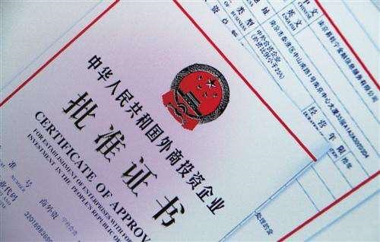
How to invest in China
Foreign Investment Catalogue
Encouraged
Restricted
Prohibited
negative list
Online record-filing
Approval process in MOFCOM

