Slide 1
Chapter 2 International Business Law and the World’s Legal System

Slide 2
Chapter topics:
The meaning of “international law”;
The classification of public international law and private international law;
The sources of international business law;
The main international organizations and their roles in regulating international business；
Two main legal systems around the world today, including common law and civil law systems.

Slide 3
1.International law
International law is the body of rules applicable to the conduct of nations in their relationships with other nations, and with individuals and other private parties, rules for settling disputes between nations, as well as rules for intergovernmental organizations.

Slide 4
2. The classification of public international law and private international law
International law
Public international law
deals with those rules affecting the conduct of nations in their relationships with each other and with individuals as citizens or residents.
Private international law
deals with the rights and responsibilities of individuals, corporations, or other private parties in their cross-border or international activities, as well as procedural rules for how courts resolve private international disputes.

Slide 5
International law
International public law |  |  | Private international law
Other international relations between states | International business law |  |  |  | Other international relations between persons
 | International treaties and conventions of the global business | Acts of private organizations with quasi-legislative effect | National law applying to international business transactions | Private rules created by the parties (contracts)

Slide 6
3. Sources of International Business Law
Contract
IBL
International conventions and treaties(eg. TRIPS under GATT)
International custom or general practice (eg. INCOTERMS 2010)
National law (eg. Contract of the PRC)
Other sources
Uniformity

Slide 7
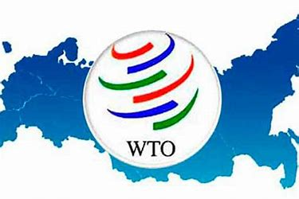
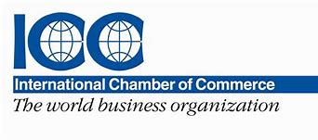
4. international organizations

Slide 8
The United Nations
Political organs:
Security Council
The General Assembly
The Secretariat
Other organs:
International court of Justice
ECOSOC
UNCTAD
UNCITRAL
IMF & World Bank

Slide 9
UNCITRAL
Full term: the United Nations Commission on International Trade Law
Headquarters: Vienna, Austria
Parent organization: UN General Assembly
Formation: 1966; 53 years ago
Member states: 60
Role: to promote harmonization and modernization of the law of international trade by preparing and promoting the use and adoption of legislative and non-legislative instruments in a number of key areas of commercial law

Slide 10
Legislative texts of UNCITRAL
Conventions
CISG
Model laws
on International Commercial Arbitration
Legislative guides
Model provisions
Hamburg Rules
on Electronic Commerce
New York Convention,

Slide 11
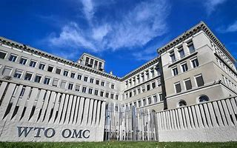
WTO
Headquarters: Geneva
Formation: 1 January 1995; 24 years ago
Membership: 164 member states
Purpose: Reduction of tariffs and other barriers to trade

Slide 13
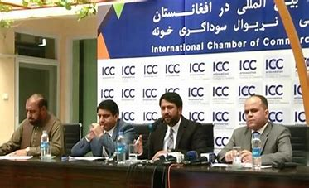
ICC
Headquarters: Paris, France
Formation: 1919; 100 years ago
Purpose: Enable business worldwide to secure peace, prosperity and opportunity for all.
Type: NGO
3 main activities:
rule setting
dispute resolution
policy advocacy

Slide 14
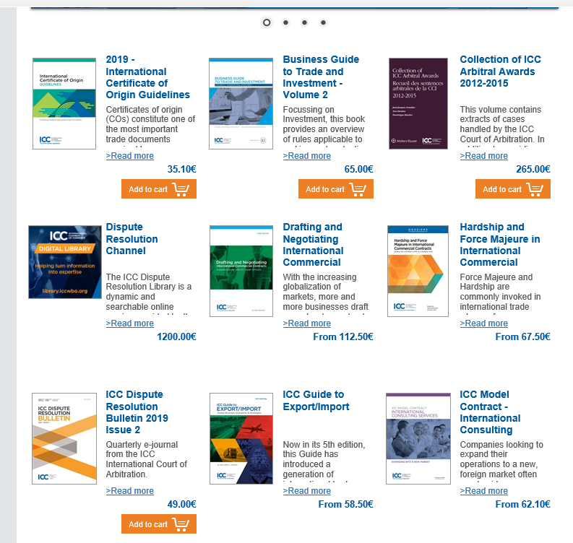
ICC’s Publications
ICC’s Publications
ICC standards and rules
UCP, Incoterms
Practical guidelines
Reference works

Slide 15
5. Legal system of the world

Slide 16
Comparison of Civil and Common Law Systems

