Slide 1
前沿科技英语教程
Advanced Technology English Course
主 编 王晓兰

Slide 2
Unit 2
Artificial Intelligence
01
Warm-up Exercises
CONTENTS
CONTENTS
02
Text A
03
Text B

Slide 3
Objectives
After learning this unit, students will be able to
---- grasp the English expressions concerning Artificial Intelligence;
---- grasp the fundamentals of how artificial intelligence works;
---- develop the capability of reading, translating and writing texts concerning Artificial Intelligence.

Slide 4
Artificial intelligence (AI), becoming a new buzzword in the world of technology in the second decade of the 21st century, is set to change the way future generations will function. But what exactly is AI and how does AI work? You may not be aware of it, but you probably interact with AI on a daily basis. From smartphones to chatbots, AI is already prevalent in many aspects of our lives. China leads the world in speech recognition, visual recognition, machine translation, Chinese information processing and other technologies.
Introductory Remarks

Slide 5
Directions: Watch the video clip entitled “Artificial Intelligence” and fill in the blanks.
Script

Slide 6
1. These machines are _________________ incorporated with human-like intelligence to perform tasks as we do. This intelligence is built using complex algorithms and ____________ functions.
2. The ability to react appropriately to a new situation is called ____________ learning.
3. In short, AI provides machines with the capability to adapt, ____________ and provide solutions.
4. That’s because it’s ____________, and eventually, even develops emotions. This makes the AI’s response unpredictable.
artificially
mathematical
generalized
reason
self-aware

Slide 7
Script
Picture this, a machine that could organize your cupboard just as you like it or serve every member of the house a customized cup of coffee, makes your day easier, doesn’t it? These are the products of artificial intelligence. But why use the term artificial intelligence? Well, these machines are artificially incorporated with human-like intelligence to perform tasks as we do. This intelligence is built using complex algorithms and mathematical functions.
But AI may not be as obvious as in the previous examples. In fact, AI is used in smartphones, cars, social media feeds, video games, banking, surveillance and many other aspects of our daily life. The real question is, what does an AI do at its core? Here is a robot prebuilt in our lab, which is now dropped onto a field in spite of a variation in lighting, landscape and dimensions of the field. The AI robot must perform as expected. This ability to react appropriately to a new situation is called generalized learning. The robot is now at a crossroad, one that is paved, and the other Rocky. The robot must determine which path to take based on the circumstances.
(to be continued)
下一页

Slide 8
Script
This portrays the robots’ reasoning ability. After a short stroll, the robot now encounters a stream that it cannot swim across. Using the plank provided as an input, the robot is able to cross this stream. So our robot uses the given input and finds the solution for a problem. This is problem-solving. These three capabilities make the robot artificially intelligent. In short, AI provides machines with the capability to adapt, reason and provide solutions.
Well, now that we know what AI is, let’s have a look at the two broad categories that AI is classified into. Weak AI, also called narrow AI, focuses solely on one task. For example, Alphago is a maestro of the game go. But you can’t expect it to be even remotely good at chess. This makes Alphago a weak AI. You might say Alexa is definitely not a weak AI since it can perform multiple tasks. Well, that’s not really true. When you ask Alexa to play despacito, it picks up the key words “play” and “despacito” and runs a program it is trained to. Alexa cannot respond to a question it isn’t trained to answer. For instance, try asking Alexa the status of traffic from work to home. Alexa cannot provide you this information as she is not trained to. And that brings us to your second category of AI, strong AI. Now, this is much like the robots that only exist in fiction as of now. Ultron from the Avengers is an ideal example of a strong AI. That’s because it’s self-aware, and eventually, even develops emotions. This makes the AI’s response unpredictable.
返回

Slide 9
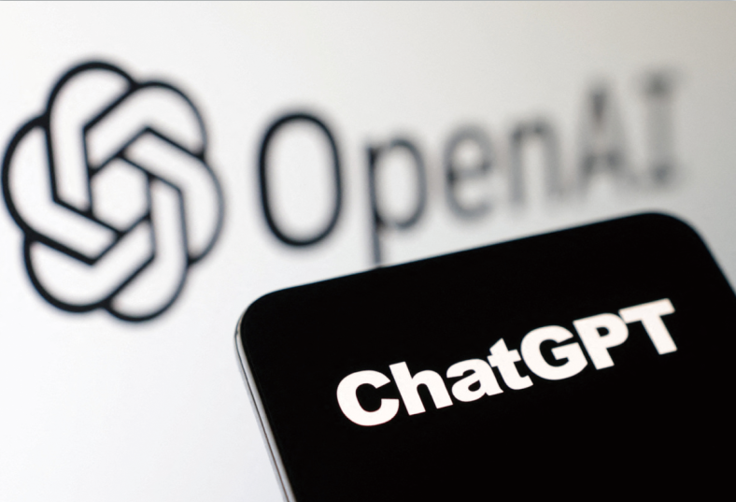
Is ChatGPT a High-Tech Breakthrough?
Artificial intelligence-powered chatbot, ChatGPT, has been a hot topic of online discussions mainly for its “chatty” nature. Is ChatGPT a new technology revolution? In which areas has it made breakthroughs and what are its shortcomings? Three experts share their views on these issues with China Daily’s Zhao Manfeng.
Exercises I.
Exercises II.
Exercises III.
Exercises IV.
Exercises V.

Slide 10
ChatGPT Is High-tech Progress, Not a Revolution
Jing Jiwu, a professor at the University of the Chinese Academy of Sciences.
ChatGPT is a powerful chatbot developed by OpenAI and launched in November 2022. Built on top of OpenAI’s GPT-3 family of large language models, it engages in human-like dialogue when prompted. It is designed to respond in a natural, intuitive way and has numerous potential uses.
From a scientific point of view, there is a need to closely watch the development of such technologies before reaching a conclusion about their efficacy and helpful nature. Technology progresses step by step. So we should not panic thinking that ChatGPT will take over jobs that till now need humans
to fulfill.
ChatGPT is an example of high-tech progress, not a revolution.
Exercises I.
Exercises II.
Exercises III.
Exercises IV.
Exercises V.

Slide 11
First, ChatGPT has made quite some progress in natural language processing, yet it still has a long way to go to completely ape the human mind and language faculty, because when it comes to professional writing or execution of a job, ChatGPT at times writes plausible-sounding but incorrect or nonsensical answers. It might give some good answers to most of the general questions, and it can produce articles, essays, jokes and even poetry with a little prompting, yet it is no substitute for professional advice, such as medical prognosis and prescriptions, or legal advice.
Second, ChatGPT is still a product with very limited application. It has the potential to be used for enhancing search engine functionality but, as a pre-trained language model, it will have limited use.
It is new technology, no doubt, which we should study, but investors should not blindly invest huge amounts to further develop ChatGPT, because it may not turn out to be successful and create bubbles in the high-tech market.
Exercises I.
Exercises II.
Exercises III.
Exercises IV.
Exercises V.

Slide 12
No Quick Return on Investment
Tao Jianhua, a professor at the Department of Automation, Tsinghua University.
The pre-trained, large-scale chatbot models, led by ChatGPT, could be one of the most important developments in the field of AI and play a key role in future AI products and applications.
As a pre-trained AI model, ChatGPT is based on the GPT-3 family of large language models and is fine-tuned to supervise and reinforce learning techniques. GPT-3, or Generative Pre-trained Transformer 3, has already caused a sensation. So we can say it is an optimized language model based on the development of AI technology.
Also, the fact that ChatGPT is good at multi-tasking is a breakthrough. This is beyond the imagination of many people, because in the past AI models could perform only a single task. For example, if you used an AI program to translate something, the program would just translate the piece. Now with ChatGPT, multi-tasking is easy to achieve.
Exercises I.
Exercises II.
Exercises III.
Exercises IV.
Exercises V.

Slide 13
As a pre-trained language model, ChatGPT is equipped with a massive volume of data, so it can accurately decide which word comes next in a sentence and thus stabilize its reliable performance, especially in the era of deep neural networks. That’s why many users are surprised at its ability to come up with human-like responses, creating the impression that it could replace humans in certain jobs one day.
Another feature of ChatGPT is that it has the ability to reinforce learning through feedback. It can recalculate figures or rewrite reports according to the user’s feedback on the answer. And this is one of the reasons why its performance is being optimized.
Yet it still has its shortcomings. For one thing, it could only be applied in a limited number of fields as it is a content-generating model. And the content it generates depends on what it has been pre-trained in. Therefore, despite writing articles, essays, jokes and even poetry, ChatGPT could be used only as reference, just like a search engine. It can never be a substitute for professional, in-depth knowledge ad research.
Exercises I.
Exercises II.
Exercises III.
Exercises IV.
Exercises V.

Slide 14
Due to these limitations, investment in ChatGPT should focus on research and development, and investors should not expect quick returns on investment. Yet as a promising AI development, ChatGPT is likely to advance in the medium, if not the short term.
China Needs Its Own ChatGPT Model
Zhang Huaping, an associate professor on natural language processing at Beijing Institute of Technology.
It is important to view ChatGPT objectively. As a pre-trained, large-scale language model developed by OpenAI, ChatGPT is a kind of groundbreaking research. Large-scale language models may have an impact on copywriting and other industries, and will also change the modes of education and scientific research. In the future, some simple, repetitive and less innovative jobs, and even some white-collar jobs, may get replaced by large-scale language models. But it is not infallible, and its potential risks have not been thoroughly studied. You can talk to it, acquire general knowledge or even get entertained by it, but it cannot be the sole source of your information, let alone take your place.
Exercises I.
Exercises II.
Exercises III.
Exercises IV.
Exercises V.

Slide 15
It is an AI program. And although its functions are very helpful to humans, they should not be deified. First, AI itself has been on the cusp of rising to greater heights in recent years. What’s more, ChatGPT can meet some “lazy” people’s need of avoiding repetitive and boring mental work. But mental work itself is part of the human cognitive faculty.
Exercises I.
Exercises II.
Exercises III.
Exercises IV.
Exercises V.

Slide 16
Search engines used to retrieve large volumes of information, enabling people to view page after page. With the aid of ChatGPT, search engines can present more precise answers to complex questions, and users can now get information in a more relaxing way of dialogue.
China has also developed its own large-scale language models, such as Huawei’s Pangu NLP models, Baidu’s ERNIE, Tencent’s HUNYUAN NLP models, and Alibaba’s AliceMind, and the performance of the models in natural language processing has been excellent. But China’s large-scale language models need to focus more on deeper technologies, and should not blindly follow trends.
Since ChatGPT is also a dialogue model, China needs more custom models in specific fields, such as modern Chinese language, ancient Chinese language, minority languages, and dialects, to break language barriers among people. (1,027 words)
(from chinadaily.com.cn)
Exercises I.
Exercises II.
Exercises III.
Exercises IV.
Exercises V.

Slide 17
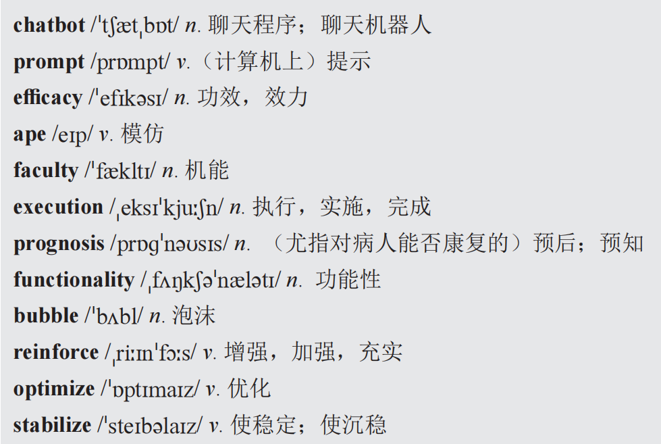
Words and Expressions
Exercises I.
Exercises II.
Exercises III.
Exercises IV.
Exercises V.

Slide 18
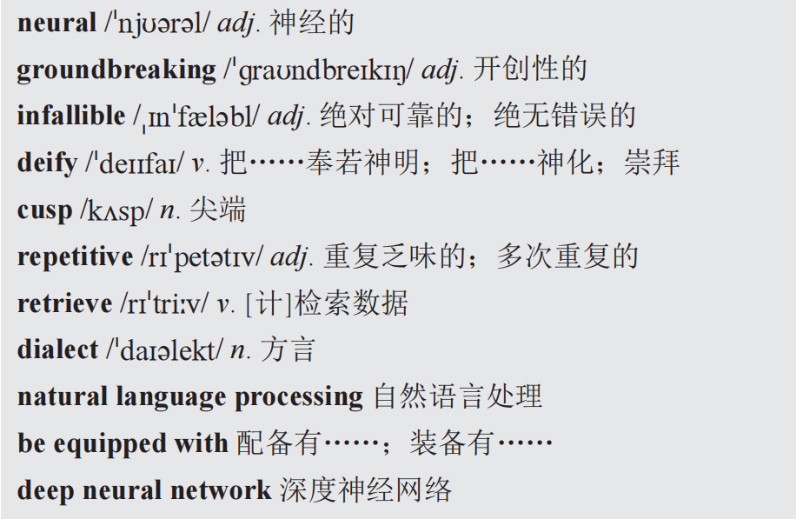
Words and Expressions
Exercises I.
Exercises II.
Exercises III.
Exercises IV.
Exercises V.

Slide 19
Note
OpenAI: 开放人工智能（美国的一个人工智能研究公司）
OpenAI is an AI research and deployment company. OpenAI’s mission is to ensure that artificial general intelligence (AGI)—highly autonomous systems that outperform humans at most economically valuable work—benefits all of humanity.
Exercises I.
Exercises II.
Exercises III.
Exercises IV.
Exercises V.
返回

Slide 20
I. Structure of Text A
Part I (paragraph 1-7):
Part II (paragraph 8-15):
Part III(paragraph16-20):
ChatGPT is high-tech progress, not a revolution.
No quick return on investment.
China needs its own ChatGPT model

Slide 21
II. Background
1.OpenAI (开放人工智能,美国一个人工智能研究实验室)
OpenAI is an AI research and deployment company.OpenAI’s mission is to ensure that artificial general intelligence (AGI)—highly autonomous systems that outperform humans at most economically valuable work—benefits all of humanity.
2.GPT-3
GPT-3, a new language model from the whizzes over at OpenAI, generates AI-written text that has the potential to be practically indistinguishable from human-written sentences, paragraphs, articles, short stories, dialogue, lyrics, and more.

Slide 22
3.Huawei’s Pangu NLP models
In April 2021, Huawei released the Pangu Model. The Pangu NLP Model represents the industry's first model of Chinese natural language processing (NLP).
4.Tencent’s HUNYUAN NLP models
Tencent's Hunyuan AI large model has covered natural language processing, computer vision, multimodality, and many industry and domain models. It has also improved ad recommendation accuracy in Tencent's own products and services. The integration of AI and cloud will enable faster and more efficient production.

Slide 23
5.Alibaba’s AliceMind
ALIbaba's Collection of Encoder-decoders from MinD (Machine Intelligence of Damo) Lab.This repository provides pre-trained encoder-decoder models and its related optimization techniques developed by Alibaba's MinD (Machine Intelligence of Damo) Lab.

Slide 24
III.Language Focus
1.Built on top of OpenAI’s GPT-3 family of large language models, it engages in human-like dialogue egged by prompting.
译文：它建立在OpenAI的GPT-3系列大型语言模型之上，通过提示进行类似人类的对话。
egg: verb,to incite to action
Eg.: 1)Don't let him egg you on--you shouldn't take any notice of him.
别听他煽动，你根本就不要去理睬他
2)Don't egg him on to play a trick on others.
不要怂恿他捉弄别人。

Slide 25
prompt: V-T If you prompt someone when they stop speaking, you encourage or help them to continue. If you prompt an actor, you tell them what their next line is when they have forgotten what comes next. 提示; 给 (演员) 提示词
Eg.: 1)I'll prompt her if she forgets her lines. 如果她忘掉台词，我将给她提示。
2)When someone neglects to brush their teeth, flush the toilet or wash their
hands, a speaker can prompt them to do so.
当有人忘记刷牙、冲厕所或洗手时，扬声器可以提示他们去做这些事。

Slide 26
2.ape: to do sth. in the same way as sb. else, especially when it is not done very well
Eg.: 1) For years the British film industry merely aped Hollywood.
2) Modelling yourself on someone you admire is not the same as aping all they
say or do.
3. faculty:a particular ability for doing sth
~ of/for (doing) sth
Eg.: 1)The faculty of understanding complex issues 理解复杂问题的能力
2)He had a faculty for seeing his own mistakes. 他具有看到自己错误的能力。

Slide 27
4.execution: the act of doing a piece of work, performing a duty, or putting a plan into action
Eg.: 1)He had failed in the execution of his duty.
2)The idea was good, but the execution was poor.
5.optimize:(VN) to make sth as good as it can be; to use sth in the best possible way
Eg.: 1)to optimize the use of resources
2)The new systems have been optimized for running Microsoft Windows.

Slide 28
6.multi-task: To work at several different tasks simultaneously
Eg.: 1)We like to "multi-task" which is actually counterproductive.
2)People who study the brain will tell you that you can't actually multi-task in that way.
7.be equipped with
Eg.:1)All overhead lights should be equipped with safety fasteners..
2)To that end, regulators have ordered more buildings to be equipped with solar water
heaters.
8.Massive:very large in size, quantity, or extent
Eg.:1) There was evidence of massive fraud.
2)a massive increase in spending

Slide 29
9.acquire : If you acquire something such as a skill or a habit, you learn it, or develop it through your daily life or experience.
Eg.:1)I've never acquired a taste for wine.
2)They acquire knowledge not found in books.
10.let alone:not to mention－used especially to emphasize the improbability of a contrasting example
Eg.:1)Her income was barely enough to maintain one child, let alone three.
2)While a few countries are making major strides in this regard, the majority are having
great difficulty even stemming the rate of increase, let alone reversing it.

Slide 30
11.Deify:to treat or worship sb as a god
Eg.:1)These young men deify financial success.
2)Under the influence of many factors, people, on the one hand, have high expectation
of and show great concern to school education, and even exaggerate and deify its role.
12.on the cusp of :at... intersection of
Eg.: 1)We are on the cusp of a global revolution in teaching and learning.
2)It was a very different country then, but what was absolutely clear to me was
that China was on the cusp of a remarkable transformation.
13.Retrieve:to find and get back data or information that has been stored in the memory of a compute
Eg.: 1)to retrieve information from the database
2)The program allows you to retrieve items quickly by searching under a keyword.

Slide 31
【翻译技巧】科技英语的词汇特点
一、大量使用专业术语。科技文章要求概念清楚，避免含糊不清和一词多义，因此使用较多的科技词汇。
科技词汇来源分三类：
A．第一类科技词来自英语中的普通词，但赋予了它们新的词义。
例如：Work is the transfer of energy expressed as the product of a force and the distance through which its point of application moves in the direction of the force．
在这句话中，work、energy、product、force都是从普通词汇中借来的物理学术语。work的意思不是‘工作’，而是‘功’；energy的意思不是‘活力’，而是‘能’；product的意思不是‘产品’，而是‘乘积’；force的意思不是‘力量’，而是‘力’。

Slide 32
B．第二类科技词是从希腊或拉丁语中吸收的。
例如：therm 热(希腊语) thesis 论文(希腊语)
parameter 参数(拉丁语) radius 半径(拉丁语)
这些希腊语和拉丁语来源的词的复数形式有些仍按原来的形式，如thesis的复数是theses，stratus的复数是strati。但是不少词由于在英语里用得久了，除了保留原来的复数形式，有的也有符合英语习惯的复数形式。例如formula(公式，拉丁语)可以是formulae，也可以是formulas；stratum(层，拉丁语)可以是strata，也可以是stratums。特别有意思的是datum(数据，拉丁语)，它的复数形式是data，但是由于这个字常用复数，所以有些外国人甚至误把它当成单数，又造出了一个所谓的复数形式datas。

Slide 33
C．第三类是新造的词。每当出现新的科学技术现象时，人们都要通过词汇把它表示出来。这就需要构造新的词汇。构成新词主要有以下几种方法：
a．转化：通过词类转化构成新词。英语中名词、形容词、副词、介词可以转化成动词，而动词、形容词、副词、介词可以转化成名词。但是最活跃的是名词、转化成动词和动词转化成名词。
例如，名词island(岛屿)转化成动词island(隔离)，动词coordinate(协调)转化成名词coordinate(坐标)。
b．合成：由两个独立的词合成为一个词。
例如：air+craft—aircraft 飞机
metal+work—metalwork 金属制品
power+plant—powerplant 发电站
有的合成词的两个成分之间要有连字符。
例如：cast-iron 铸铁
conveyer-belt 传送带
machine-made 机制的

Slide 34
英语中有很多专业术语有两个或更多的词组成，叫做复合术语。它们的构成成分虽然看起来是独立的，但实际上合起来构成一个完整的概念，因此应该把它们看成是一个术语。
例如：liquid crystal 液晶
water jacket 水套
computer language 计算机语言
machine building 机器制造
linear measure 长度单位
c．派生：这种方法也叫缀合。派生词是由词根加上前缀或后缀构成的。加前缀构成
新词只改变词义，不改变词类。
例如：decontrol(取消控制)v．——de+control(control是动词)
ultrasonic(超声的)a．——ultra+sonic(sonic是形容词)
subsystem(分系统)n．——sub+system(system是名词)

Slide 35
有些加前缀的派生词在前缀和词根之间有连字符。
例如：hydro-electric(水力的)
non-metal(非金属)
英语的前缀是有固定意义的，记住其中一些常用前缀对于记忆生词和猜测词义很有帮助。这里只举些表示否定的前缀。
anti． 表示“反对” antibody 抗体
counter- 表示“反对，相反” counterbalance 平衡
contra- 表示“反对，相反” contradiction 矛盾
de． 表示“减少，降低，否定” ．decrease 减少
devalue ． 贬值
decompose 分解
dis一 表示“否定，除去”discharge 放电
disassemble 拆卸

Slide 36
in-，il-(在字母l前)，im-(在字母m、b、p前)，表示“不”
inaccurate 不准确的
imbalance 不平衡的
impure 不纯的
mis- 表示“错误” mislead 误导
non- 表示“不，非” non-ferrous 有色金属的
un- 表示“不，未，丧失”
unaccountable 说明不了的
unknown 未知的
unbar 清除障碍

Slide 37
加后缀构成新词可能改变也可能不改变词义，但一定改变词类。例如：electricity n．——electric+ity(electric是形容词)
liquidize(液化)v．——liquid+ize(1iquid是名词)
conductor n．——conduct+or(conduct是动词)
invention n． invent+ion(invent是动词)
有些派生词加后缀后，语音或拼写可能发生变化。例如：simplicity(单纯)--simple+icity
maintenance(维修)--maintain+ance
propeller(推进器)--propel+1+er

Slide 38
英语后缀的作用和前缀有所不同，它们主要用来——词类。从一个词的后缀可以判别它的词类，这是它的语法意义。它们的词汇意义往往并不明显。下面举一些常见的形容词后缀。
-able，-ible，-uble 表示“可…” avoidable 可以避免的
audible 听得见的
soluble 可溶的
-a1 表示“……(性质)的” fundamental 基本的
-ant，-ent 表示“……(性质)的” abundant 富饶的
apparent 显然的
-ed 表示“有…的” cultured 有文化的
ful 表示“充满…的，有…倾向的”useful 有用的
-ic，-ical 表示“…的” basic 基本的
economical 经济的
-less 表示“没有” useless 无用的
-ous 表示“有…的，多…的” numerous 众多的

Slide 39
d．缩略：把词省略或简化，然后组合成新词。现在的趋势是缩略词的数目不断增大，使用面不断扩大。
例如：laboratory缩略成lab(实验室)
unidentified flying object缩合成UFO(不明飞行物)
radio detection and ranging缩减并拼读成radar(雷达)
transistor和receiver各取一部分，组合成transceiver(收发机)
二．英语科技文体中有很多词汇并不是专业术语，但在日常口语中很少用，它们多只见于书面语中，叫做文语词。俗话称它们为“大词”。掌握这类词对阅读科技文章或写科技论文十分重要。这类词用得很广，不仅出现在科技文体的各个专业中，也出现在政治、经济、法律、语言等社会科学的文体中。

Slide 40
Exercises
I. Paraphrasing
Directions: Match the words in the box with the meanings below.
A. groundbreaking B. chatbot C. dialect D. deify E. prompt
F. cusp G. optimize H. prognosis I. ape J. faculty
( ) 1. an opinion, based on medical experience, of the likely development of a disease or an illness
( ) 2. the form of a language that is spoken in one area with grammar, words and pronunciation that may be different from other forms of the same language
( ) 3. to treat sb. or sth. with extreme respect and admiration
( ) 4. a particular ability for doing sth.
( ) 5. making new discoveries; using new methods
H
C
D
J
A
Exercises I.
Exercises II.
Exercises III.
Exercises IV.
Exercises V.

Slide 41
A. groundbreaking B. chatbot C. dialect D. deify E. prompt
F. cusp G. optimize H. prognosis I. ape J. faculty
( ) 6. to do sth. in the same way as sb. else, especially when it is not done very well
( ) 7. a pointed end where two curves meet
( ) 8. to make sth. as good as it can be; to use sth. in the best possible way
( ) 9. a computer program in the form of a virtual e-mail correspondent that can reply to messages from computer users
( ) 10.to give an incentive for action that appears on the computer screen to indicate that the computer is ready to receive a command
I
F
G
B
E
Exercises I.
Exercises II.
Exercises III.
Exercises IV.
Exercises V.

Slide 42
II. Reading Comprehension
Directions: Decide whether the following statements are true (T) or false (F) according to the passage.
( ) 1. ChatGPT is high-tech progress, not a revolution.
( ) 2. We should panic thinking that ChatGPT will take over jobs that till now need humans to fulfill.
( ) 3. ChatGPT is a substitute for professional advice, such as medical prognosis and prescriptions, or legal advice.
( ) 4. As ChatGPT is a pre-trained language model, it will have limited use.
( ) 5. GPT-3, or Generative Pre-trained Transformer 3 is an optimized language model based on the development of AI technology.
( ) 6. ChatGPT could perform only a single task.
( ) 7. ChatGPT could be used only as reference, just like a search engine.
( ) 8. The performance of China’s large-scale language models in natural language processing has been excellent.
T
F
F
T
T
F
T
T
Exercises I.
Exercises II.
Exercises III.
Exercises IV.
Exercises V.

Slide 43
III. E-C Translation
Directions: Translate the following sentences into Chinese.
1. As a large AI-powered language model, ChatGPT features strong semantic understanding and logical capabilities based on context.
__________________________________________________________________________________________________________________________________________2. The use of ChatGPT-style conversational chatbots also raises concerns about ethics, copyright protection, academic cheating and leaks infringing on personal privacy.
__________________________________________________________________________________________________________________________________________
ChatGPT作为一种大型人工智能语言模型，具有强大的语义理解能力和基于上下文的逻辑能力。
使用ChatGPT风格的对话式聊天机器人也引发了人们对伦理道德、版权保护、学术作弊和侵犯个人隐私的泄密的担忧。
Exercises I.
Exercises II.
Exercises III.
Exercises IV.
Exercises V.

Slide 44
3. By incorporating AI in the work done using the Five-hundred-meter Aperture Spherical radio Telescope, Chinese astronomers are trying to discover celestial objects and phenomena like pulsars.
_____________________________________________________________________
_____________________________________________________________________
4. Chinese enterprises should step up efforts to roll out indigenous versions of the AI-powered chatbot, and increase investments to improve related algorithms and computing power.
__________________________________________________________________________________________________________________________________________
5. China filed more than half the world’s AI patent applications in 2021, and continued to lead the world in the number of AI journals, conference papers and relatedpublications.
__________________________________________________________________________________________________________________________________________
通过将人工智能纳入500米口径球面射电望远镜的工作，中国天文学家正试图发现像脉冲星这样的天体和现象。
中国企业应加大力度推出国产人工智能聊天机器人，并加大投资，提高相关算法和计算能力。
2021年，中国提交的人工智能专利申请占全球一半以上，在人工智能期刊、会议论文和相关出版物数量上继续领先全球。
Exercises I.
Exercises II.
Exercises III.
Exercises IV.
Exercises V.

Slide 45
IV. C-E Translation
Directions: Translate the following passage into English.
ChatGPT是美国OpenAI公司研发的聊天机器人程序，于2022年11月30日发布。它是人工智能技术驱动的自然语言处理工具，通过学习和理解人类的语言进行对话，根据聊天的上下文进行互动，能像人类一样聊天交流，甚至能完成撰写邮件、视频脚本、文案、代码以及翻译等基础任务。ChatGPT以GPT3.5为核心数据集，辅以进一步的RLHF技术训练，且加入更多人工监督进行微调。相比此前的GPT3，ChatGPT的主要提升点在于记忆能力，其可实现连续对话，极大地提升了对话交互模式下的用户体验。
Reference Answer
Exercises I.
Exercises II.
Exercises III.
Exercises IV.
Exercises V.

Slide 46
Reference Answer
ChatGPT, a chatbot program developed by OpenAI in the United States, was released on November 30, 2022. It is a natural language processing tool driven by artificial intelligence technology. It can communicate by learning and understanding human language, interact according to the context of the chat, chat and communicate like a human, and even complete basic tasks such as composing e-mails, video scripts, copywriting, code and translation. ChatGPT is built from a GPT3.5 core data set, with further training in RLHF techniques and additional human supervision for fine-tuning. Compared with previous GPT3, ChatGPT’s main improvement is its memory ability, which enables continuous conversations and greatly improves the user experience in conversational interaction mode.
返回

Slide 47
V. Reading and Writing
Directions: Read the following excerpt concerning AI and write a short essay in no less than 150 words, in which you should summarize the main idea of the excerpt and then give your own comments.
Chinese device maker Honor said it was exploring the possibilities of harnessing large language models (LLMs) based on artificial intelligence on devices to spearhead the advancement of human-centric technology in smartphones and beyond.
Zhao Ming, CEO of Honor Device Co. Ltd., said, “Smartphones represent the ultimate combination of computing systems, communications technologies, display technologies and AI platforms, tearing down boundaries by integrating various other devices and new technologies.”
Exercises I.
Exercises II.
Exercises III.
Exercises IV.
Exercises V.

Slide 48
“New AI and communications technologies are fueling a new wave of smartphone innovation, creating virtually limitless possibilities for us to explore. It is our responsibility as a company to embrace these opportunities and continue to push the boundaries of what is possible with smartphones,” Zhao said at the ongoing Mobile World Congress Shanghai 2023. According to him, Honor continues to embrace the possibilities of AI innovation by applying AI across various usage scenarios.
Recognizing how communication technology has evolved from 1G to 5G in the past few decades, and how 5G has been tearing down the boundaries between the physical and digital, Zhao shared how Honor continues to optimize its information communication capabilities to provide a more seamless user experience.
Exercises I.
Exercises II.
Exercises III.
Exercises IV.
Exercises V.

Slide 49
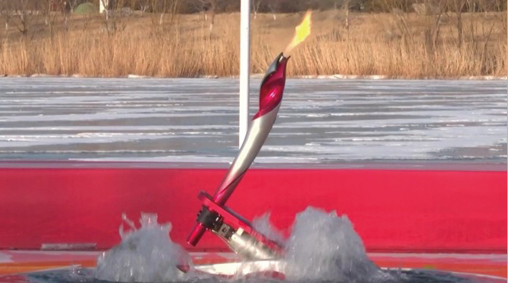
Technology the Big Winner at Winter Olympics
Digitalization Showcased as New Standards Set for the Future
An icy river in Beijing was the setting for a special Olympic torch relay as an amphibious robot shaped like a curling stone held a metallic red-and-silver torch.
The robot slid along the ice before plunging into an unfrozen area of the waterway, with the flame burning well underwater as it was passed to another robot.
Exercises I.
Exercises II.
Exercises III.

Slide 50
The second torch was swiftly lit, completing the first-ever robotic underwater Olympic torch relay. The entire process took about eight minutes, with the second robot successfully emerging from the water to pass the torch to a human bearer. The first robot and torch were later recovered from the river.
The futuristic torch ceremony, which took place earlier, was just one example of the use of cutting-edge technologies at the Beijing 2022 Winter Olympics.
The Chinese capital, the first city in the world to host the summer and winter editions of the Games, had come up with innovative high-tech standards for Beijing 2022, delivering China’s promise to hold a “simple, safe and splendid” event.
The city had gone to great lengths to make the Winter Olympics a smart sports experience.
These efforts included a breathtaking display of artistry mixed with technology at the opening ceremony, robot chefs cooking meals for athletes, cabins offering journalists high-tech power naps, and self-driving cars and smart navigation supported by augmented reality and artificial intelligence.
Exercises I.
Exercises II.
Exercises III.

Slide 51
Thomas Bach, the International Olympic Committee (IOC) president, said on February 6 that the Beijing Winter Olympics had made history by achieving an unprecedented level of digitalization and had set new technology standards for the future.
He made the comments while interacting virtually with journalists at a news center in Beijing through holographic communication technologies developed by the Chinese tech company Alibaba.
According to the IOC website, the virtual interaction, supported by a range of sophisticated technology, was projected onto a remote high-definition screen, generating a true-to-life hologram effect. All details were reconstructed in high definition, including detailed facial expressions and the texture of clothing.
Bach said Chinese companies were playing a crucial role in transforming the Olympic Games and leading them into the digital age.
Exercises I.
Exercises II.
Exercises III.

Slide 52
A wide variety of technological applications were on show at the Games as Chinese companies, including heavyweights and startups, constantly experimented with novel ideas and new technologies.
For example, the space giant China Aerospace Science and Industry Corp was responsible for developing the special torches used in the underwater Olympic relay.
The company said that compared with underwater torches overseas that use solid fuel and whose flames cause pollution, those for Beijing 2022 used gaseous fuel that is smokeless and causes no pollution. Numerous design obstacles were overcome to achieve this.
Tian Qiyan, an associate research fellow at the Chinese Academy of Sciences’ Shenyang Institute of Automation in Liaoning Province, who oversaw the project, said the robot relay was also supported by the latest high-precision underwater hovering and positioning technologies.
“Ensuring precise docking between the two robots in icy water, and igniting the second torch’s flame under the water, were the biggest difficulties for the handover—comparable to those for the docking of spacecraft,” Tian said.
Exercises I.
Exercises II.
Exercises III.

Slide 53
Intelligent Vehicles
A self-driving car carried the Olympic torch for the first time in the Games’ history, showcasing China’s ambitions and ability to produce such vehicles.
Developed by the information technology giant Baidu, the car carried the torch for about 800 meters on February 2 at Shougang Industrial Park in Beijing, which was hosting several Games events.
Wei Dong, vice-president of Baidu’s intelligent driving business group, said, “We prefer to call it a robot because we will increasingly engage with more moving robots in our daily lives.”
At the industrial park, China Unicom, the official telecommunications service provider for Beijing 2022, had built a 5G-enabled intelligent vehicle networking system covering 1 million square meters.
Liu Qi, a senior technical expert at China Unicom’s Smart City Research Institute, said this system supports four types of unmanned vehicles. For example, it can guide an unmanned ferry or delivery vehicle in complex environments where there is a mix of people and vehicles.
Exercises I.
Exercises II.
Exercises III.

Slide 54
Thanks to the integration of 5G technologies and the BeiDou Satellite Navigation System, the unmanned vehicles can achieve continuous, high-precision positioning to within 10 centimeters, Liu added.
This was the first systematic use of Level 4 intelligent vehicle networking in an Olympic setting, according to China Unicom. Level 4 autonomy means that a vehicle can operate in most conditions without a human driver.
China Unicom had also equipped all competition venues and stadiums with the 5G network, which enabled ultrahigh-definition video transmission, along with virtual reality and augmented reality live broadcasts. The company said it would fully use the opportunity of the Games to increase its international influence.
At the opening ceremony on February 4, the potential of many technologies, including 5G, AI and the Internet of Things, won many admirers by blending perfectly with art to deliver a realistic, dynamic and immersive experience for Chinese and overseas visitors.
Exercises I.
Exercises II.
Exercises III.

Slide 55
Chang Yu, director of the opening and closing ceremonies department for the Beijing 2022 organizing committee, said, “We decided about two years ago that instead of huge crowds, we were going to rely more on modern digital technologies and their ‘chemistry’ with performers.”
The National Stadium, also known as the Bird’s Nest, had undergone an intelligent transformation to host the opening and closing ceremonies. Digital technology was used to operate equipment and for energy management and environmental quality control, providing favorable conditions for the ceremonies.
Chang said, “Inside the Bird’s Nest, we’ve set up digital workstations and rendering workshops for instant visual effect generation, completely upgrading the venue from a traditional structure to a smart stadium.”
Instead of using traditional projection, the entire floor of the stadium was fully equipped with high-definition light-emitting diode, or LED, technology.
Exercises I.
Exercises II.
Exercises III.

Slide 56
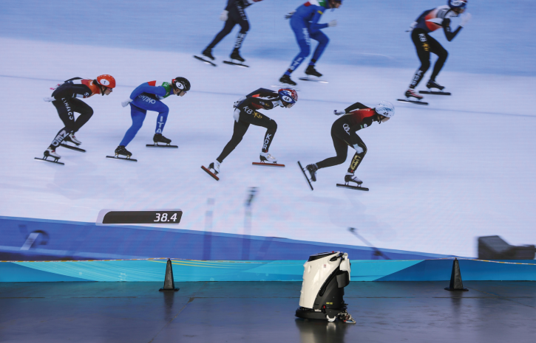
The huge LED screen boasts more than 10,000 square meters of display panels, each equipped to make the ceremonies as clear and detailed as possible, according to Chinese display manufacturer BOE, whose technologies are used in the panels.
The company also made the giant LED snowflake in the center of the stadium, which comprises 96 smaller counterparts. The snowflake housed more than 550,000 small LED light bulbs, as the designer wanted it to be a symbol to unite athletes, BOE added.
Exercises I.
Exercises II.
Exercises III.

Slide 57
Visual Appeal
At the opening ceremony, performers’ movements were captured in real time by the screens on the stadium floor.
During the “peace dove” part of the ceremony, no matter where the child performers ran, the snow at their feet followed, creating a strong visual appeal. Chang said this was not a pre-designed effect, but the use of “real-time capture, rendering and playback” technology.
Technologies such as AI and 5G also have been widely employed to construct venues. AI giant Megvii used GPS and vision fusion technologies to build a detailed high-precision 3D map of the Bird’s Nest and several other Olympic venues.
Such smart augmented reality navigation can provide an immersive virtual-real fusion effect with accurate positioning and no delays, Megvii said, adding that the technology was not affected by buildings, ice and snow, for example.
Exercises I.
Exercises II.
Exercises III.

Slide 58
Baidu used virtual reality technology for a 3D model of the Shougang ski jump platform, a landmark winter sports venue in Beijing. The model gives spectators an up-close view of athletes’ performances.
AI also provides more technical support for the Winter Olympics. AI-powered robots clean and disinfect venues, AI sign language “anchors” allow people with impaired hearing to enjoy the excitement of the Games, and robot chefs cook a wide variety of tasty meals.
Some athletes had been surprised to find food delivered to their rooms by robots developed by the Chinese tech company Segway-Ninebot. After orders were placed, these devices took elevators and navigated their way from restaurants to competitors’ rooms. They also patrolled competition venues as security guards.
Segway-Ninebot said the robots used technology that allowed them to operate in precise locations in different environments, as well as algorithms to achieve smooth movement.
Exercises I.
Exercises II.
Exercises III.

Slide 59
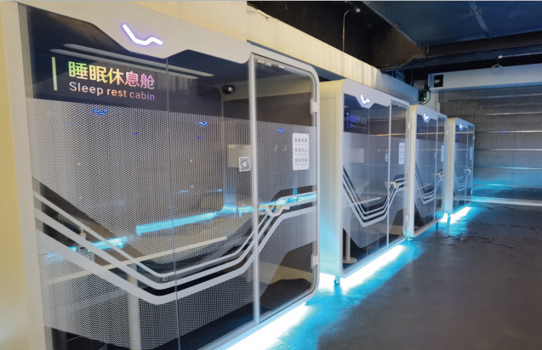
High-tech cabins at the Beijing media center also gave journalists the chance to catch up on some sleep. The 20 cabins were developed by China’s Keeson Technology Corp, and with a simple scan of their phone media representatives can use them for power naps for up to an hour.
The spacious cabins are equipped with the same type of beds provided for the athletes. Users adjust the position of the beds, which have a massage setting, by using a remote control or their phone.
Exercises I.
Exercises II.
Exercises III.

Slide 60
United States luge athlete Summer Britcher said on a social media platform that the beds’ “zero gravity” mode could produce the “phenomenal” feeling of being in outer space.
A reliable system for broadcasting Olympic events is also key to ensuring that more people enjoy the top-level competition, given that many spectators, especially foreigners, have been unable to attend the Games.
Dong Quanwu, director of the research and development department at Beijing International Cloud Broadcasting Technology Co., said traditional broadcasting methods were mostly asset-heavy and required expensive trucks and a large number of production directors.
Many tasks can be accomplished much more easily by using 5G and cloud technologies. A powerful, cloud-based rebroadcasting system means much of the editing work can be done remotely by people in other locations—for example, without the need for a broadcasting vehicle or numerous workers at the scene, Dong said.
Exercises I.
Exercises II.
Exercises III.

Slide 61
On-site reporters used a small camera or smartphone equipped with a stabilizer to livestream a sports event, thanks to 5G and cloud technologies, Dong added.
Zhang Xiaoyang, a technical manager for the Beijing 2022 organizing committee, said the pandemic had posed many challenges for the Games, but had also produced new opportunities to develop technologies. (1,644 words)
(from chinadaily.com.cn)
Exercises I.
Exercises II.
Exercises III.

Slide 62
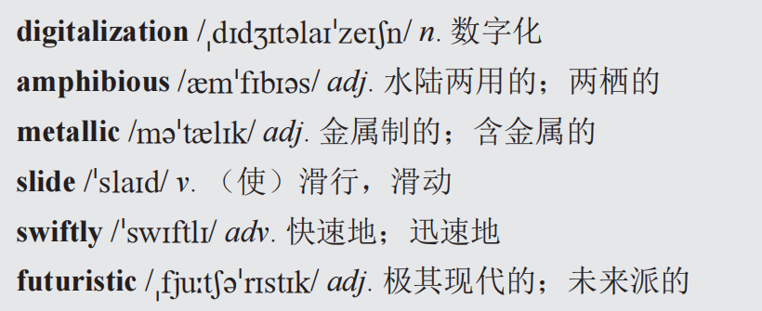
Words and Expressions
Exercises I.
Exercises II.
Exercises III.

Slide 63
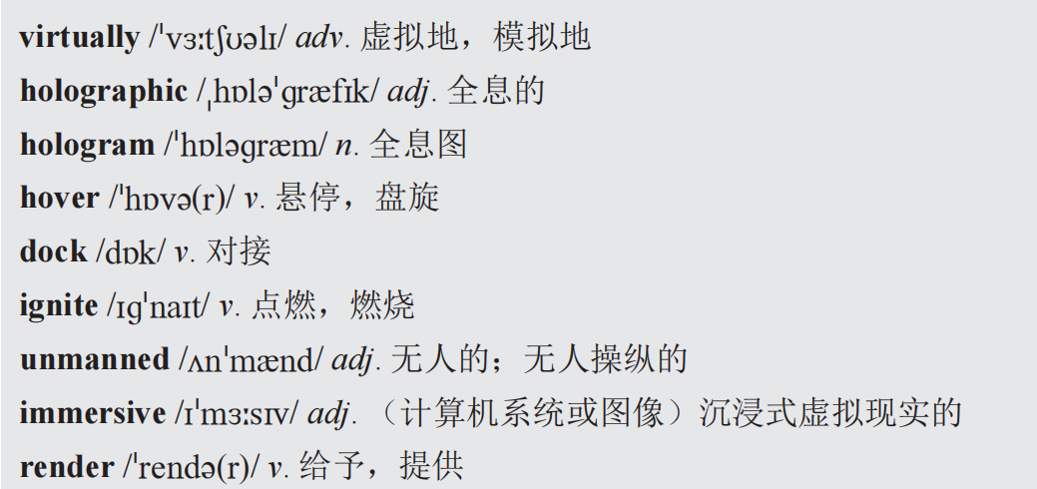
Words and Expressions
Exercises I.
Exercises II.
Exercises III.

Slide 64
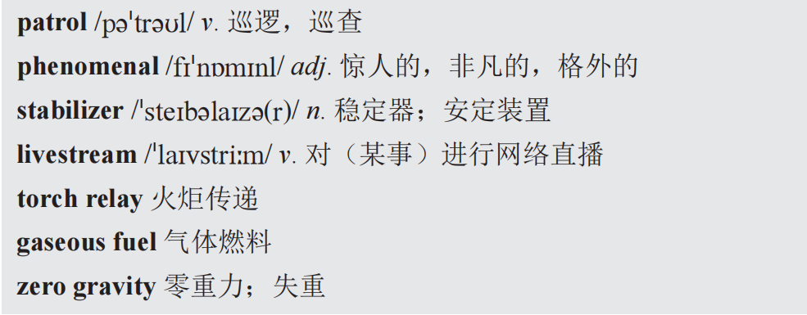
Words and Expressions
Exercises I.
Exercises II.
Exercises III.

Slide 65
Exercises
I. E-C Translation
Directions: Translate the following sentences into Chinese.
1. An icy river in Beijing was the setting for a special Olympic torch relay as an amphibious robot shaped like a curling stone held a metallic red-and-silver torch.
_____________________________________________________________________
_____________________________________________________________________
2. The futuristic torch ceremony, which took place earlier, was just one example of the use of cutting-edge technologies at the Beijing 2022 Winter Olympics.
_____________________________________________________________________
_____________________________________________________________________
在北京结冰的河流中，一个冰壶石形状的两栖机器人举着红色和银色相间的金属火炬进行了一次特殊的奥运火炬传递。
早些时候举行的未来圣火传递仪式只是2022年北京冬奥会使用尖端技术的一个例子。
Exercises I.
Exercises II.
Exercises III.

Slide 66
3. Thanks to the integration of 5G technologies and the BeiDou Satellite Navigation System, the unmanned vehicles can achieve continuous, high-precision positioning to within 10 centimeters.
______________________________________________________________________________________________________________________________________________
4. China Unicom had also equipped all competition venues and stadiums with the 5G network, which enabled ultrahigh-definition video transmission, along with virtual reality and augmented reality live broadcasts.
_____________________________________________________________________
_____________________________________________________________________
5. Digital technology was used to operate equipment and for energy management and environmental quality control, providing favorable conditions for the ceremonies.
_______________________________________________________________________
得益于5G技术和北斗卫星导航系统的集成，无人驾驶车辆可以实现10厘米以内的连续高精度定位。
中国联通还为所有比赛场馆配备了5G网络，可以实现超高清视频传输，以及虚拟现实和增强现实直播。
数字技术被用于设备操作、能源管理和环境质量控制，为仪式提供了有利条件。
Exercises I.
Exercises II.
Exercises III.

Slide 67
II. C-E Translation
Directions: Translate the following passage into English.
北斗卫星导航系统（BeiDou Navigation Satellite System）是中国自行研制的全球卫星导航系统。北斗卫星导航系统是中国着眼于国家安全和经济社会发展需要，自主建设、独立运行的卫星导航系统，是为全球用户提供全天候、全天时、高精度的定位、导航和授时服务的国家重要空间基础设施。随着北斗系统建设和服务能力的发展，相关产品已广泛应用于交通运输、海洋渔业、水文监
测、气象预报、测绘地理信息、森林防火、通信时统、电力调度、救灾减灾、应急搜救等领域。
Reference Answer
Exercises I.
Exercises II.
Exercises III.

Slide 68
Reference Answer
The BeiDou Navigation Satellite System (BDS) is a global satellite navigation system developed by China. It is a satellite navigation system built and operated independently by China to meet the needs of national security and economic and social development. It is an important national space infrastructure that provides all-weather, all-day and high-precision positioning, navigation and timing services for global users. With the development of BDS construction and service capacity, relevant products have been widely used in transportation, marine fisheries, hydrological monitoring, weather forecasting, surveying and mapping geographic information, forest fire prevention, communication time system, power dispatching, disaster relief and mitigation, emergency search and rescue and other fields.
返回

Slide 69
III. Further Thinking
Directions: Discuss with your classmates on how AI will influence our life in the future.
Open-ended.
Exercises I.
Exercises II.
Exercises III.

Slide 70
Thank you！

