Slide 1
大学英语 阅读教程 第二册
COLLEGE ENGLISH READING COURSE
主 编 毛 锋
施志渝

Slide 2
Unit 3 Sports and Games

Slide 3
Contents
Part I Before Reading
Part II While Reading
Part III After Reading
Part IV Micro-Class

Slide 4
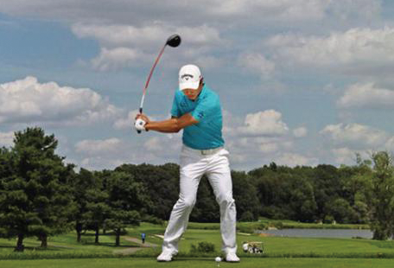
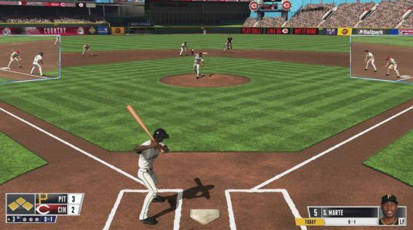
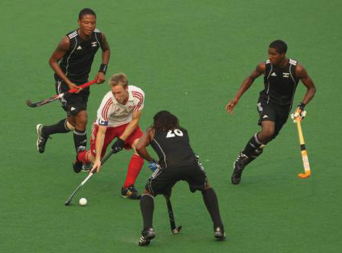
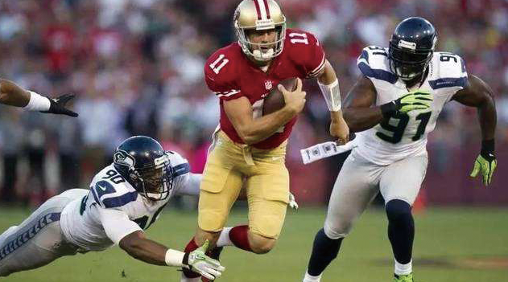
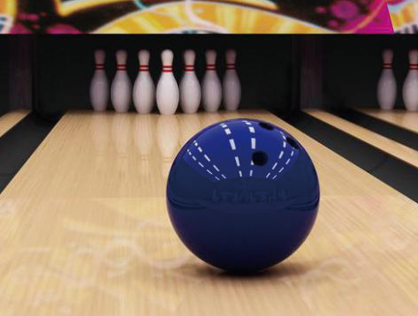
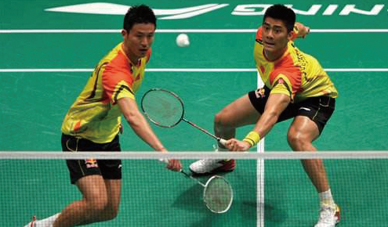
Part I Before Reading
A. Sports play an important role in our lives. People in different regions of the world have different favorite sports. Here are six popular ball games. Match the photos of the games with their names.
1.
2.
3.
4.
5.
6.
Back

Slide 5
Photo No. Name
1. ________ A) bowling
2. ________ B) American football
3. ________ C) badminton
4. ________ D) cricket
5. ________ E) golf
6. ________ F) baseball
E
F
D
B
A
C
Back

Slide 6
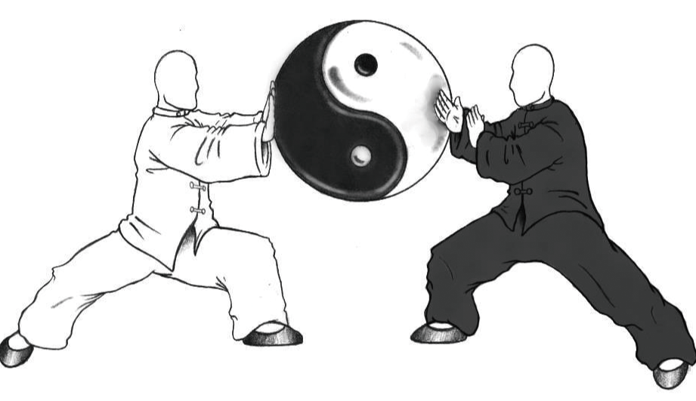
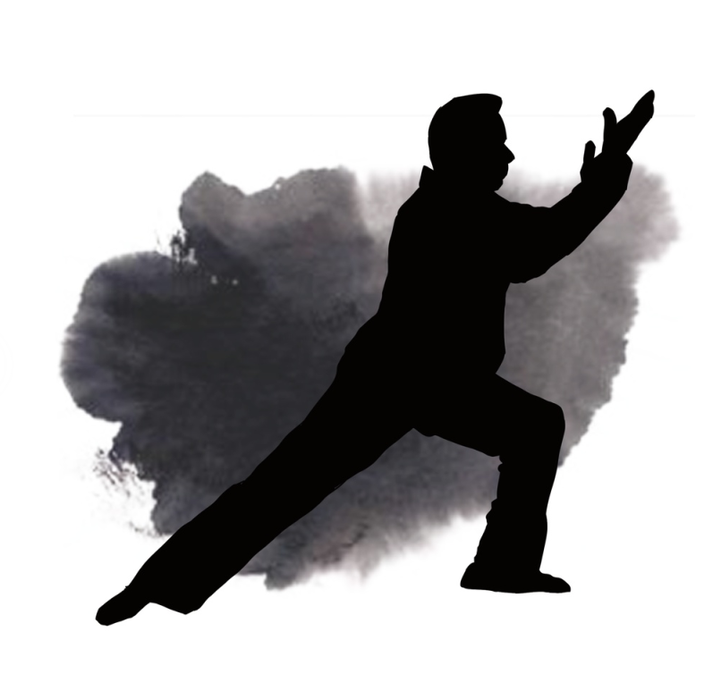
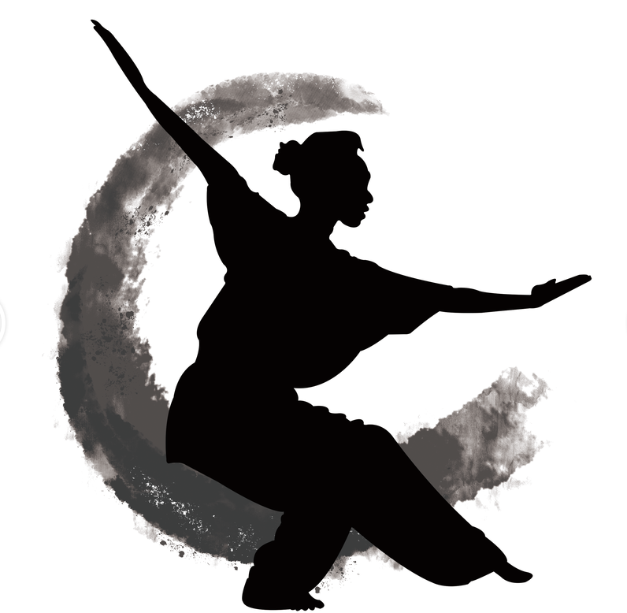
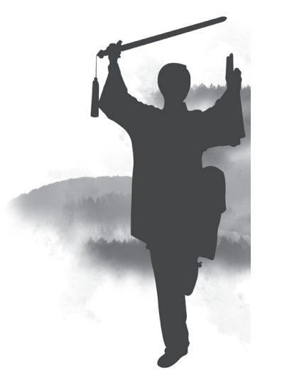
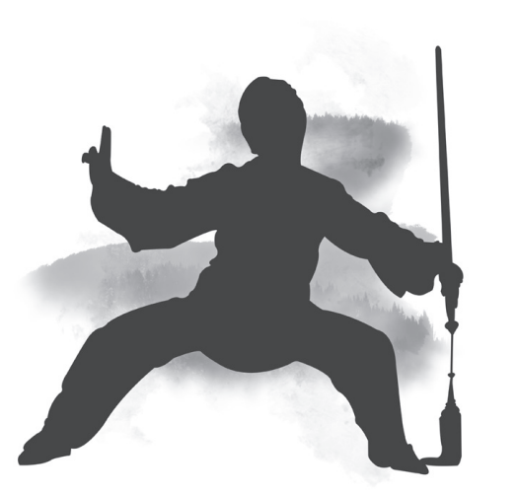
B. What kind of Wushu do the following pictures show? Dissuss with your partner what
you know about it.
Reference Answer
Back

Slide 7
Reference Answer
Tai Chi (太极) is a Chinese martial art practiced for self-defense and health benefits. Tai Chi is typically practiced for a variety of personal reasons: competitive wrestling in the format of pushing hands (Tui Shou, 推手), achieving greater longevity, and so on. As a result, a multitude of training forms exist, both traditional and modern. Some training forms of Tai Chi Chuan (太极拳) are especially known for their relatively slow movements. The most essential expression of Tai Chi philosophy is the concept of Yin and Yang. It is most often translated as the pairing of positive and negative or male and female. In truth, Yin and Yang should be understood as the pairing of any complementary opposites.
Back

Slide 8
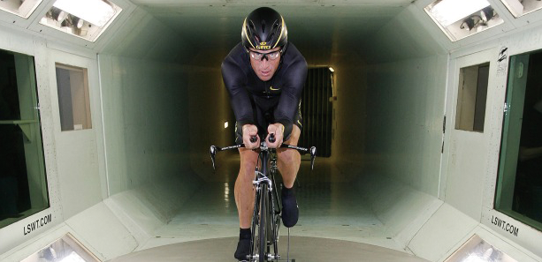
Part II While Reading
Section A: Blank Filling
You are required to select one word for each blank from a list of choices given in a word
bank following the passage. You may not use any of the words in the bank more than once.
Back

Slide 9
A lust for money, for fame, or for victory—these are the main motivations the world has assigned to Lance Armstrong following his revelations during the Oprah interview. Yet these explanations don’t fully account for his propensity to lie, no matter what the cost to others who (1) _______ him, in order to achieve victory and preserve his heroic self-image.
Lance’s mother was only 17 when he was born and his father abandoned them when the boy was two. The fact that Lance refers to his (2) _________ father as his “DNA donor” and refuses to this day to meet him suggests that this abandonment was both painful and traumatic. This is the kind of chaotic early childhood that instills a basic (3) _________ of shame and unworthiness.
O
H
I
A) shame B) constant
C) cooperative D) glory
E) admiration F) survivor
G) loser H) biological
I) sense J) drugs
K) gene L) threaten
M) idealized N) escape
O) challenge
Back

Slide 10
When the narcissist feels his (4) _______ self-image to be threatened, he found a way to rise above his lot. He says, “I had started with nothing. My mother was a secretary in Plano, Texas, but on my bike, I had become something. When other kids were swimming at the country club, I was biking for miles after school, because it was my chance.” Competitive sport gave Armstrong a way to (5) _________ the sense of being inferior to the “normal” children. Victory in competition made him feel he was a winner and not a loser.
M
N
A) shame B) constant
C) cooperative D) glory
E) admiration F) survivor
G) loser H) biological
I) sense J) drugs
K) gene L) threaten
M) idealized N) escape
O) challenge
Back

Slide 11
His (6) _______ aim in life is to prove he’s a winner and to triumph over the losers. In the competitive cycling world of Armstrong’s era, winning depended upon the use of performance-enhancing (7) _______. Right or wrong, you couldn’t win the Tour de France as a clean rider. The narcissist craves (8) _______, of course. It serves as an antidote to the unconscious feelings of (9) _______ and unworthiness. Millions of adoring fans fed Armstrong’s need to believe that he was someone very special. Even more than a winner, he was becoming a hero to millions of people around the world: cancer (10) _______, humanitarian, a model of bravery and perseverance. They praised and idealized him. (332 words)
(from theatlantic.com)
B
J
E
A
F
A) shame B) constant
C) cooperative D) glory
E) admiration F) survivor
G) loser H) biological
I) sense J) drugs
K) gene L) threaten
M) idealized N) escape
O) challenge
Back

Slide 12
Words
lust n. 贪求，渴望
Back

Slide 13
Words
revelation n. 揭露
Back

Slide 14
Words
propensity n. 倾向，习性
Back

Slide 15
Words
abandonment n. 抛弃；放纵
Back

Slide 16
Words
traumatic a. 创伤的
Back

Slide 17
Words
instill v. 逐步灌输； 使渗透
Back

Slide 18
Words
narcissist n. 自恋狂；自我陶醉者
Back

Slide 19
Words
lot n. 命运
Back

Slide 20
Words
antidote n. 解药，解毒剂
Back

Slide 21
Words
humanitarian n. 人道主义者；慈善家
Back

Slide 22
Words
idealize v. 使理想化
Back

Slide 23
Words
DNA donorDNA捐赠者
Back

Slide 24
Note
Lance Armstrong
兰斯·阿姆斯特朗。阿姆斯特朗1992年开始职业自行车生涯，1999年世界排名第七，并于当年代表美国的邮政车队获得环法大赛的车手总成绩冠军。之后直到2003年，他又连续五次夺冠，平了西班牙车手安杜兰等创造的环法五连冠的纪录。2004年，阿姆斯特朗再次夺得环法车手总冠军，成为环法历史上首位连续六次夺冠的车手。2005年，阿姆斯特朗第10次参加环法大赛，从第四赛段就穿上了黄色领骑衫，为连续第七次夺取车手总冠军奠定了基础。7月24日，阿姆斯特朗成功实现环法车手七连冠，再次创造了环法历史上的奇迹。
Back

Slide 25
Note
Oprah interview
美国演员、制片、主持人奥普拉·温弗瑞（Oprah Winfrey）主持的电视谈话节目《奥普拉脱口秀》，该节目平均每周吸引3300万名观众，并连续16年排在同类节目的首位。
Back

Slide 26
Note
the Tour de France
环法自行车大赛。环法自行车赛是一项每年举行的自行车比赛，参赛者骑自行车穿越法国各地，以确定谁是胜利者。这项赛事是一项艰苦的比赛，参赛者的平均速度接近每小时25英里（每小时40公里），在平坦的土地上骑行，以及在陡峭的山间通道攀爬。自行车赛分为不同的阶段，在23天的时间里，骑手们行驶了大约2220英里（3500公里）。
Back

Slide 27
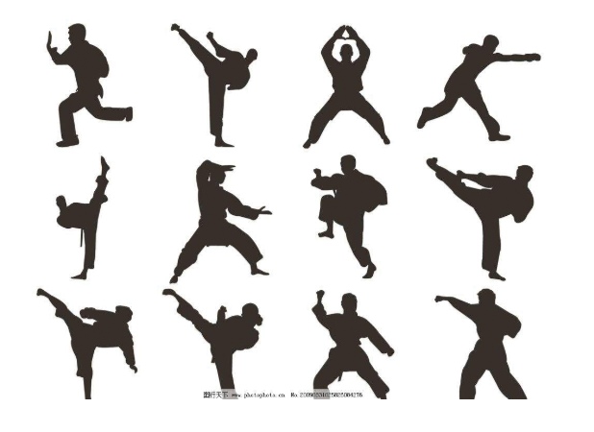
Section B: Matching
Read the passage with ten statements attached to it. Each of the statements contains information given in one of the paragraphs. Identify the paragraph from which the information is derived and mark the corresponding letter in the bracket. You may choose a paragraph more than once.
Chinese Wushu
Back

Slide 28
[A] Chinese Wushu (popularly referred to as Kung Fu) includes a series of fighting styles which has developed over a long historical period in China. Nowadays, it is regarded as a traditional sport and a symbol for Chinese culture, gaining more and more attention. Styles including Shaolin, Tai Chi and Qigong have many followers worldwide. Some Westerners think that all Chinese people are Kung Fu masters. That’s not true, but this tradition has its unique existence in modern times and exerts much influence on the locals’ lifestyle. Although being fighting styles, Chinese Wushu advocates virtue and peace, not violence or aggression. This value has been upheld by people from generation to generation. With a number of movement sets, boxing styles, weapon skills and some fighting stunts, Wushu keeps its original function of self-defense. Now its value in body-building and fitness is also highly appreciated.
[B] In order to survive in an extremely hostile environment, our primitive ancestors developed primary means of defense and attack that included leaping, tumbling and kicking. Although they knew how to fight with rudimentary weapons made from stones and wood, fighting with bare hands and fists became essential skills. The Martial Arts we recognize today as Wushu had their origins in the Shang (1600–1046 BC) and Zhou (1046–256 BC) dynasties. During the following Qin (221–206 BC) and Han (206 BC–220 AD) dynasties, wrestling, swordplay and spear skills became well developed and were popular among civilians and troops. In the Song Dynasty (960–1279), various schools, boxing styles, movement sets and weapon skills flourished.
Back

Slide 29
[C] Over the centuries of development in China, Wushu has become a large system containing various schools or sects. It is recorded that there are over 300 distinct types of boxing existing around the country. The styles in northern and southern China are quite different. Therefore it is hard to classify these types.
[D] Some of the schools are classified by geographical locations. For example, the Southern Fist (Nanquan) prevails in South China, and Shaolin School is based at Shaolin Temple in Henan Province. Some are named after the creator or master, like the Chen-style Tai Chi and Yang-style Tai Chi. Some are identified by different training methods, such as the Internal Boxing Arts (Neijiaquan) that concentrates on the manipulation of the inner breath and circulation of the body, and the External Boxing Arts (Waijiaquan) concentrating on improving the muscles and the limbs.
[E] The most outstanding and influential schools are listed as follows.
[F] Shaolin Martial Arts: Originated in the Shaolin Temple in Henan Province, Shaolin Martial Arts is considered the premier style in China and is widely spread all over the world. Both of its physical exercise and mental training are based upon Buddhist philosophy. The Shaolin Boxing, Southern Fist, Northern Legs (Beitui) and Wing Chun are the representatives of this school.
Back

Slide 30
[G] Wudang Martial Arts: This sect has almost the same fame as the Shaolin. Based at the Mt. Wudang in Hubei Province, it is developed under the guidance of Taoist theories. Tai Chi Chuan, Form/Intention Boxing, Eight-Diagram Palm are essentials of Wudang.
[H] Emei Martial Arts: Taking Mt. Emei in Sichuan Province as its camp, this sect blends the merits of Shaolin and Wudang. Many sub-branches derive from this sect, including Qingcheng, Tiefo, Qingniu, Dianyi, Huanglin, etc.
[I] Bruce Lee (1940–1973), named Lee Jun-fan in Chinese, is a world famous Kung Fu master, a martial arts film actor and the founder of Jeet Kune Do. He was born in China Town, San Francisco, but grew up in Kowloon, Hong Kong, China. In 1959, he went to the US and was admitted to the University of Washington in 1961. Lee made great contributions to introducing Chinese martial arts to the world. Because of his superb skills, he is called “King of Kung Fu” by Americans, “Sage of Martial Arts” by Japanese and “Master of Fighting” by Thais. Many great Chinese Kung Fu film shows of Bruce Lee were produced and to date, Bruce Lee still has a great number of followers.
Back

Slide 31
[J] Due to his poor health during his childhood, Lee was sent to a master at the age of 7 to practice Tai Chi, which was good for fitness. By age 13, he also learned Wing Chun from Ye Wen, a brilliant Wing Chun master. Later he learned Praying Mantis, Hung Kuen, Shaolin Boxing, Tam Tuei, and White Crane Boxing. He also explored Qigong and Yinggong, all of which laid solid foundation for his eventual creation of Jeet Kune Do. Besides Chinese boxing skills, he studied Western fists skills and learned the boxing methods, steps and motions from some masters. Bruce was good at playing Long Staff, Short Staff, Nunchakus and many other weapons. He organized a Chinese martial arts team in his university to practice and perform in extracurricular time.
[K] He took a break during his sophomore year at the university to establish the Jun-fan Martial Arts Club. The club became well-known ever since news spread about his saving a girl in Chinatown, Florida, by defeating four gangsters with bare hands. Very soon, branches of his club were established in Seattle, Auckland, Los Angeles, amongst others. He became well-known in America. An increasing number of learners or boxing stars, including Karate star Chuck Norris and King of Boxing Muhammad Ali, came to him. It was through this way that he spread Chinese Kung Fu by teaching and exchanging experiences. (906 words）
(from travelchinaguide.com)
Back

Slide 32
( ) 1. Bruce Lee was regarded as a great Kung Fu master both at home and abroad.
( ) 2. Wushu was originally developed by our ancestors for the purpose of survival.
( ) 3. Chinese Wushu is a complicated system with many schools and sects.
( ) 4. Chinese Wushu advocates virtue and peace instead of violence and aggression.
( ) 5. Emei Martial Arts combines both Shaolin and Wudang styles.
( ) 6. Bruce Lee was very interested in martial arts at a young age, and learned many different styles.
( ) 7. Some of the Wushu styles are named after the masters who created them.
( ) 8. Many international stars came to learn martial arts from Bruce Lee.
( ) 9. Wudang Martial arts is based on Taoist theories.
( ) 10.Shaolin Martial arts is regarded as the most important style in China and is famous overseas.
I
B
C
A
H
J
D
K
G
F
Back

Slide 33
Words
stunt n. a dangerous and difficult action that sb. does to entertain people, especially as part of a film/movie 特技表演
Back

Slide 34
Words
tumble v. to fall downwards, often hitting the ground several times, but usually without serious injury; to make sb./sth. fall in this way 摔倒；跌倒
Back

Slide 35
Words
rudimentary a. not highly or fully developed 原始的；简陋的
Back

Slide 36
Words
swordplay n. the sport or skill of fencing 剑术
Back

Slide 37
Words
prevail v. to exist or be very common at a particular time or in a particular place 流行；盛行
Back

Slide 38
Words
manipulation n. behavior that controls or influences sb./sth., often in a dishonest way so that they do not realize it 操纵；控制
Back

Slide 39
Words
premier a. most important, famous or successful 第一的；首要的
Back

Slide 40
Words
sage n. a very wise person 圣人
Back

Slide 41
Words
eventual a. happening at the end of a period of time or of a process 最后的，最终的
Back

Slide 42
Words
gangster n. a member of a group of violent criminals 歹徒；流氓
Back

Slide 43
Words
martial arts 武术
Back

Slide 44
Words
Internal Boxing Arts 内家拳
Back

Slide 45
Words
External Boxing Arts 外家拳
Back

Slide 46
Words
Karate 空手道
Back

Slide 47
Words
Wing Chun 永春（拳）
Back

Slide 48
Words
Form/Intention Boxing 形意拳
Back

Slide 49
Words
Eight-Diagram Palm 八卦掌
Back

Slide 50
Words
Qingcheng 青城（派）
Back

Slide 51
Words
Tiefo 铁佛
Back

Slide 52
Words
Qingniu 青牛（派）
Back

Slide 53
Words
Dianyi 点易（派）
Back

Slide 54
Words
Huanglin 黄林（派）
Back

Slide 55
Words
Jeet Kune Do 截拳道（李小龙创立的武术流派）
Back

Slide 56
Words
Praying Mantis 螳螂拳
Back

Slide 57
Words
Hung Kuen 洪拳
Back

Slide 58
Words
Tam Tuei 谭腿
Back

Slide 59
Words
White Crane Boxing 白鹤拳
Back

Slide 60
Words
Yinggong 鹰爪功
Back

Slide 61
Words
Long Staff 长棍
Back

Slide 62
Words
Short Staff 短棍
Back

Slide 63
Words
Nunchakus 双节棍
Back

Slide 64
Note
Bruce Lee
李小龙（1940—1973），原名李振藩，师承叶问，出生于美国加州旧金山，
祖籍中国广东省佛山市顺德区均安镇，世界武道变革先驱者、武术技击家、
武术哲学家、MMA（综合格斗）之父、武术宗师、功夫片的开创者、截拳道
创始人、华人武打电影演员，中国功夫首位全球推广者、好莱坞首位华人主角。1962年李小龙开办“振藩国术馆”，1967年自创截拳道。1973年7月20日，李小龙在香港逝世，享年33岁。
Back

Slide 65
Note
the Internal Boxing Arts (Neijiaquan), the External Boxing Arts (Waijiaquan)
内家拳和外家拳。内家拳以练气为主，讲究内修；外家拳以练力为主，讲究外型。外家拳提倡“内练一口气，外练筋骨皮”，以练身体的速度、力量、技巧等为主，在技击方面效果比较快；内家拳注重的不是速度、力量、技巧的训练，而是以开发人体内在的潜能、健身为主，在技击上讲究技巧和自身内力的培养。简而言之，以练速度力量、主动进攻为主为外家；以练气力，以守为主多为内家。
Back

Slide 66
Note
Chuck Norris
查克·诺里斯（1940—），空手道世界冠军，美国电影演员、动作片演员，因1972年拍摄电影《猛龙过江》在古罗马竞技场与李小龙搏击声名大噪，该片段被誉为世界电影功夫片不朽的经典镜头。
Back

Slide 67
Note
Muhammad Ali
默罕默德·阿里（1942—2016），美国著名拳击运动员、拳王。
Back

Slide 68
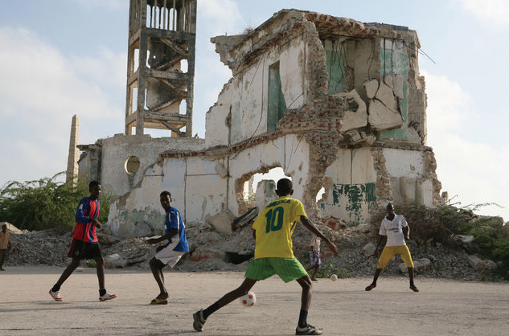
Section C: Detailed Comprehension
Passage 1
Sport and the Decline of War
Sport satisfies most of psychological and social needs. It certainly provides a sense of belonging and unity. Fans of soccer, baseball or basketball teams feel a strong sense of allegiance to them. Once they have formed an attachment to a team (usually during childhood) they “support” it loyally through thick and thin. The team forms part of their identity; they feel bonded to it, and a strong sense of allegiance to the other supporters, a tribal sense of unity. Sport also enables the expression of “higher” human qualities which often lie dormant in ordinary life. It provides a context for heroism, a sense of urgency and drama where team members can display courage, daring, loyalty, and skill. It creates an artificial “life and death” situation which is invested with meaning and importance far beyond its surface reality.
passage 1
passage 2
passage 3
Back

Slide 69
Sport can certainly lift life to a “higher plane of power” too. Watching a
major sports match—e.g. a soccer match in the UK, or a baseball game in the
US—is an empathic, rather than a passive experience. It is an experience of
complete, passionate engagement, generating powerful emotional responses. At
the end of the game, the spectator often feels emotionally drained, in a mood of
euphoria or desolation (depending on the result).
In some sense, sport as a substitute for war can bring about a decline in
warfare. Is there any evidence for this?
There are both small scale and large scale examples. In the second half
Sport can certainly lift life to a “higher plane of power” too. Watching a major sports match—e.g. a soccer match in the UK, or a baseball game in the US—is an empathic, rather than a passive experience. It is an experience of complete, passionate engagement, generating powerful emotional responses. At the end of the game, the spectator often feels emotionally drained, in a mood of euphoria or desolation (depending on the result).
In some sense, sport as a substitute for war can bring about a decline in warfare. Is there any evidence for this?
There are both small scale and large scale examples. In the second half of the 19th century, Manchester, the UK, was gripped by an epidemic of youth gangs and knife crime. Large parts of the city were unsafe, as pedestrians could easily be caught up in fighting, and were often randomly attacked. But during the 1890s, a small number of enlightened people realized that the youths needed to be offered other outlets for satisfying their psychological needs other than gang
membership and violence. They set up “working lads’ clubs” throughout the city, which gave the poorest slum youths access to sport and recreation. This led to a new “craze” for football (soccer) that spread rapidly through the city. (Indeed, it was during this decade that Manchester’s two famous modern soccer teams—Manchester United and Manchester City—were originally established.)
passage 1
passage 2
passage 3
Back

Slide 70
These kinds of differences in cultural values which inform how the
negotiation process runs may cause frustration for both sides, but are relatively
These kinds of differences in cultural values which inform how the
negotiation process runs may cause frustration for both sides, but are relatively
In 2012, Yuan published his original song Wrong Person Again on the Internet. The composition cost him over a thousand yuan. To his surprise, it was promoted by some major music websites and became quite a hit online. Yuan soon had the status of an Internet celebrity. In photos, he looked very much like a professional singer.
Also a music lover, Yuan’s father knew what his son was doing. With his experience across the country, the father wrote a song called Honest Us. This song dedicated to the migrant workers became quite popular and sent Yuan Chen promptly to perform on the shows of the state-run China Central Television (CCTV).
The lyrics are simple and frank. It portrays the life of Yuan Chen and his father, while reflecting the lifestyle of most migrant workers.
“I waved goodbye to my family / but always keep them in my dream.”
“I feel needed by the city / honest and loyal / are us migrant workers.”
Through the song, Yuan Chen found his own voice.
“To some extent, my musical dream has come true,” he says. (417 words)
(from news.cgtn.com)
As a result, youths who had previously fought against each other in gangs were soon “fighting” each other in football teams, both in “street football” and in organized games through the lads’ clubs. This suggests that the psychological needs which had given rise to gang membership and conflict, were now seemingly being channeled into sport—bringing a massive reduction in actual conflict.
The same principle has been applied in the modern world too. In Columbia and Brazil, for example, the promotion of soccer in areas of high gang activity has led to a significant reduction in crime and violence.
On a global scale, the last 75 years have seen a steady ongoing decline in the number of deaths due to group conflict in the world as a whole. Since the Second World War, there has been a massive reduction in international conflict. In particular, the last 25–30 years have been by far the least war-afflicted in recent history, and have seen a correspondingly low number of casualties.
passage 1
passage 2
passage 3
Back

Slide 71
These kinds of differences in cultural values which inform how the
negotiation process runs may cause frustration for both sides, but are relatively
These kinds of differences in cultural values which inform how the
negotiation process runs may cause frustration for both sides, but are relatively
In 2012, Yuan published his original song Wrong Person Again on the Internet. The composition cost him over a thousand yuan. To his surprise, it was promoted by some major music websites and became quite a hit online. Yuan soon had the status of an Internet celebrity. In photos, he looked very much like a professional singer.
Also a music lover, Yuan’s father knew what his son was doing. With his experience across the country, the father wrote a song called Honest Us. This song dedicated to the migrant workers became quite popular and sent Yuan Chen promptly to perform on the shows of the state-run China Central Television (CCTV).
The lyrics are simple and frank. It portrays the life of Yuan Chen and his father, while reflecting the lifestyle of most migrant workers.
“I waved goodbye to my family / but always keep them in my dream.”
“I feel needed by the city / honest and loyal / are us migrant workers.”
Through the song, Yuan Chen found his own voice.
“To some extent, my musical dream has come true,” he says. (417 words)
(from news.cgtn.com)
Why has the world become more peaceful? It may be partly due to the nuclear deterrent, increased international trade and commerce and many other factors. But sport is most likely an important factor too. It’s surely not a coincidence that, over the 75 years of this steady decline in conflict, sport has grown correspondingly in popularity. The excitement and intoxication which was once derived from warfare can be gained from national and international sporting competitions, from following your country at the Olympics or the Soccer World Cup.
This shows how essential it is for sport to be promoted in the world’s conflict zones. It shows how important it is for governments—and other organizations—to make sport more accessible and attractive to young people, particularly in areas of social deprivation, where gang membership flourishes. And it also shows that war and conflict aren’t natural or inevitable, and can be transcended. (690 words)
(from psychologytoday.com)
passage 1
passage 2
passage 3
Back

Slide 72
Read Passage 1 and decide on the best choice for each of the following questions or
unfinished statements.
( ) 1. Based on the passage all the following qualities can arise in fans from sport EXCEPT _____________.
A) being part of a team
B) seeking for fame and gain
C) becoming brave and professional
D) getting devoted and unchangeable
( ) 2. What happens during a soccer match that makes spectators emotionally drained in the end?
A) The cheering members on both sides are working so hard.
B) The experience on the spot is too surprising or unforgettable.
C) Both teams are fighting hard enough to win the match.
D) People watching the match can’t help getting excited and involved.
( ) 3. Manchester United could change the fate of a team member who __________________.
A) might have become a soldier
B) might have become a criminal
C) might have become a university student
D) might have become a psychologist
B
D
B
Back

Slide 73
( ) 4. “Social deprivation” in the last paragraph most probably means __________________.
A) the state of living in poverty
B) lack of sports facilities
C) high rate of crimes
D) conflicting groups of youths
( ) 5. What can be inferred from the passage?
A) Nations at war have no passion for sport.
B) Where there is sport there is no war.
C) Millions of lives are saved thanks to sport.
D) World War II could have been avoided with the Olympics held.
A
C
Back

Slide 74
Words
allegiance n. 忠诚，效忠
Back

Slide 75
Words
through thick and thin 不顾艰难险阻；在任何情况下
Back

Slide 76
Words
tribal a. 部落的
Back

Slide 77
Words
dormant a. 休眠的，蛰伏的
Back

Slide 78
Words
empathic a. 移情作用的
Back

Slide 79
Words
euphoria n. 极度愉快的心情
Back

Slide 80
Words
desolation n. 荒芜；孤寂；忧伤
Back

Slide 81
Words
enlightened a. 开明的；进步的
Back

Slide 82
Words
outlet n. 发泄途径；出路；出口
Back

Slide 83
Words
slum n. 贫民窟；棚屋区
Back

Slide 84
Words
war-afflicted 饱受战争之苦的
Back

Slide 85
Words
casualty n. 事故；伤亡者；伤亡人数
Back

Slide 86
Words
deterrent a. 威慑的
Back

Slide 87
Words
intoxication n. 陶醉
Back

Slide 88
Words
deprivation n. 剥夺；匮乏；丧失
Back

Slide 89
Words
transcend v. 超越；胜过
Back

Slide 90
Passage 2
Should Video Games Be
Considered a Sport?
Let’s start by throwing the idea against some of those definitive words conjured up when thinking about the meaning of “sport”—competition, entertainment, athletic ability.
When you pit video games against those terms, take a look at how they match up.
passage 1
passage 2
passage 3
Back

Slide 91
1. Competition, wins, and losses
The basic tenet of any sport is competition. A team or individual competes against another team or individual in hopes of achieving victory. So, it’s not a stretch at all to say video games are competitive. With any type of video game—but especially those with players going head to head with another player—you’re going to have competition. Even if you’re alone and playing a campaign against simulated competition in the form of a computer, you’re still very much competing, right?
2. Athletic ability
What makes athletes like Deion Sanders and Bo Jackson so special? Both played professional football and baseball, and were quite good at both.
There are great athletes all around us, but a large percentage of those athletes are only good at the sport in which they’ve found professional success. Put a professional basketball player on a baseball diamond and hilarity will probably ensue.
Then, when you consider the fact that each sport—and each position within a sport, even—requires a specific athletic ability, who is to say video game playing can’t just be another set of a different type of athletic skill?
passage 1
passage 2
passage 3
Back

Slide 92
While playing video games doesn’t require as many abilities as other sports, it does share a big one—coordination. Just like you need coordination to catch a 90 MPH baseball in a glove, or hit one with a bat, video game players need coordination to strike at the perfect time, synching the technique they use on their controller with whatever their eyes see unfolding in front of them.
Video gaming also shares another big ability with traditional sports—stamina. Quite frequently, head-to-head video game battles are a true test of a gamer simply trying to outlast their opponent. First one to blink (aka, get tired, worn down, etc.), loses.
And last, but certainly not least, what about responsiveness? It’s an ability required of pretty much any fast-moving athlete, especially someone like a hockey goaltender. Successful video game players must also be able to quickly respond to a game’s changing landscape, whether it’s to counter a thrown punch from an opponent, or even getting their on-screen athlete in their favorite sports game to dodge a tackle or dribble past the other team.
passage 1
passage 2
passage 3
Back

Slide 93
3. Fans and entertainment; Stadiums, fields, and arenas
In fact, more than 173,000 attendees gathered to watch the 2017 World Championship held in Katowice, Poland, which was 100,000 more than the group that was in attendance for the Super Bowl that same year. Last year in total, esports tournaments and live streams drew 258 million unique visitors.
4. Practice, dedication, and training
To become a professional gamer, one must practice and dedicate time, daily even, to their craft. The more skilled one becomes, the more like sports video games become. In fact, many esports athletes endure physical and strength training to avoid common esports injuries like carpal tunnel syndrome or tennis elbow. And of course training to improve coordination and the aforementioned
responsiveness. (571 words)
(from idtech.com)
passage 1
passage 2
passage 3
Back

Slide 94
Read Passage 2 and decide on the best choice for each of the following questions or
unfinished statements.
( ) 1. Video games don’t seem different in competition from sports EXCEPT that ____________________.
A) it can be done by the player himself
B) it is much more challenging to win
C) it is more demanding to the player
D) it can be played in the virtual world
( ) 2. Who are referred to when the word “hilarity” is used in Paragraph 5?
A) The athletes themselves.
B) The audience or spectators.
C) The judges on the sportsground.
D) The reporters or the mass media.
( ) 3. The word “coordination” in paragraph 7 most probably means ____________.
A) good cooperation of the team players
B) good use of different parts of the body
C) good skill displayed against a tough competitor
D) good sportsmanship even as a loser
D
B
B
Back

Slide 95
( ) 4. What do a hockey goaltender and a successful video game player have in common?
A) The threat of being punched by an opponent.
B) The possibility of being hurt any time.
C) The ability to react in no time.
D) The great pressure from the spectators.
( ) 5. What does the expression “unique visitors” suggest?
A) They are simply viewers of digital screens.
B) They outnumber spectators of other sports.
C) They are more enthusiastic fans.
D) They are more understanding to their stars.
C
A
Back

Slide 96
Words
conjure up 想象出
Back

Slide 97
Words
pit v. 使竞争；使较量
Back

Slide 98
Words
tenet n. 信条；原则
Back

Slide 99
Words
stretch n. 曲解；夸大
Back

Slide 100
Words
diamond n. 棒球内场
Back

Slide 101
Words
hilarity n. 欢乐；狂欢
Back

Slide 102
Words
ensue v. 跟着发生
Back

Slide 103
Words
synch v. 同时发生
Back

Slide 104
Words
stamina n. 耐力；毅力
Back

Slide 105
Words
goaltender n. 守门员
Back

Slide 106
Words
punch n. 拳打
Back

Slide 107
Words
dodge v. 避开；躲避
Back

Slide 108
Words
tackle n. 铲球；（美式足球）阻截
Back

Slide 109
Words
dribble v. 运球
Back

Slide 110
Words
carpal tunnel syndrome 腕管综合征
Back

Slide 111
Words
tennis elbow 肘部发炎；网球员肘病
Back

Slide 112
Notes
Deion Sanders
迪恩·桑德斯（1967—），美国职业橄榄球和棒球运动员，拥有9年MLB（美国职业棒球大联盟）和14年NFL（美国国家橄榄球联盟)）的职业生涯，是传奇的双栖运动员。
Back

Slide 113
Notes
Bo Jackson:
博·杰克逊（1967—），美国前棒球与橄榄球运动员，是首位在这两项美国主流运动职业比赛中都入选全明星赛的球员。
Back

Slide 114
Notes
esports
电子竞技（electronic sports），是电子游戏比赛达到“竞技”层面的体育项目。电子竞技运动就是利用电子设备作为运动器械进行的、人与人之间的智力对抗运动。通过运动，可以锻炼和提高参与者的思维能力、反应能力、四肢协调能力和意志力。
Back

Slide 115
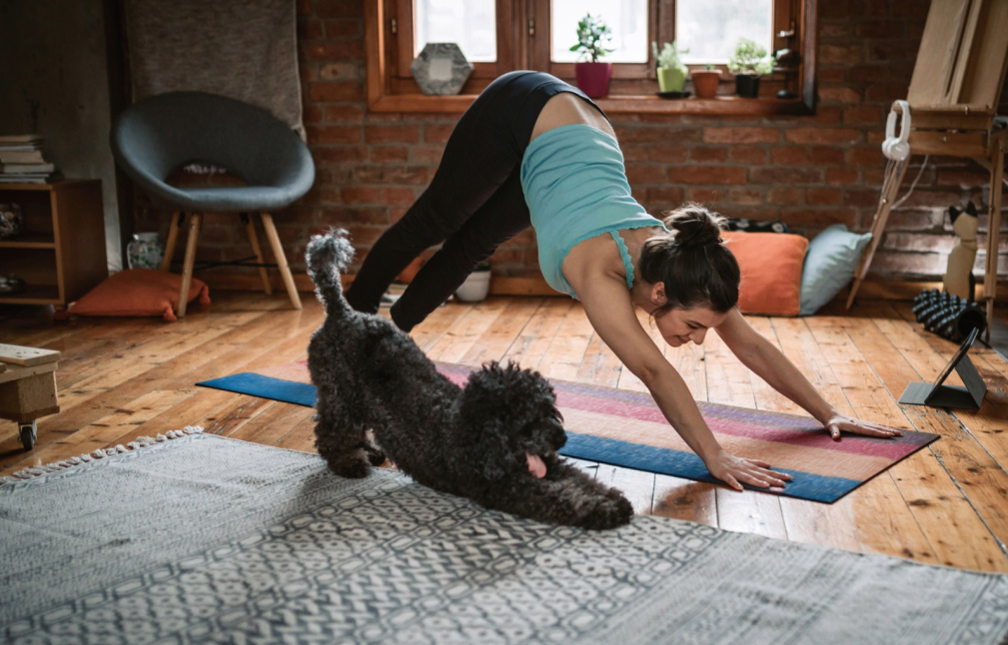
Passage 3
You Can Exercise at Home Without
Any Equipment
Wouldn’t it be wonderful to be able to afford all of that fancy equipment used in the gyms? Well, as nice as it sounds, it just isn’t an option for most people. And since exercise is so important, you need to find exercises that are effective and don’t require any equipment at all. To make these exercises even more fun, you can blast music while you’re doing them. Some you can even do while watching TV. Now you have no more excuses! Here are some great exercises that you can do at home, without the need for any equipment:
1. Walking—If the weather is nice, it’s wonderful to get outside and enjoy the scenery around you while you exercise. However, if the weather has other ideas, you can just as easily get an effective walking workout at home. If you have a flight of stairs, go up and down them a few times. (You could even grab a load of laundry as you’re going that way anyway!) This will help to tone up your legs, while getting some low impact aerobic exercise as well. If you don’t have any stairs available, just walk around the house a few times—it may not be very exciting, but it will do the job!
passage 1
passage 2
passage 3
Back

Slide 116
2. Jumping jacks—These are always fun, as they bring back memories of being a kid! Who hasn’t done jumping jacks for fun as a child? Well, surprise—they are also great cardio exercises, and good for warming up, too.
3. Pushups—These are probably not the most favorite exercise of many people, but while they can be hard to do, you can find easier ways to do them. You don’t need to pretend you’re “Rocky”, and do them with one hand; just do what works for you. Do them on your knees, instead of keeping your legs straight. Or, do them standing up against a wall. You will be building up arm strength and working out muscles in your chest area.
4. Crunches—The best exercise for building up and strengthening abdominal muscles. When you’re just getting started, don’t worry about getting your head all the way up. So long as you’re going up until you feel the stretching of the muscles, you will see some benefit.
5. Squats—These are wonderful exercises for your legs and buttocks. You can even just try these by sitting and standing up again from a regular chair, if you’re finding them to be too difficult. As long as you’re able to do a few repetitions, you will be providing some benefit to your body.
passage 1
passage 2
passage 3
Back

Slide 117
Getting some exercise is important, but you don’t need to go out and join a gym, paying a large amount in membership fees each month. You don’t even need the expensive equipment in order to give your body an effective workout. Use what you have in your house, and work out in the comfort of your home. You will be more likely to keep up with the exercises when you’re comfortable, so just get up and start exercising! (558 words)
(from tritontransport.com)
passage 1
passage 2
passage 3
Back

Slide 118
Read Passage 3 and answer the following questions.
1. Why should we find effective exercises at home?
_____________________________________________________________________________
2. How does doing pushups benefit you?
_____________________________________________________________________________
3. What are the benefits of crunches?
_____________________________________________________________________________
Because exercising is important and most of us cannot afford the fancy equipment in gyms.
You can build up arm strength and work out muscles in your chest area.
It is the best exercise for building up and strengthening abdominal muscles.
Back

Slide 119
Words
blast v. 使（音乐）轰响
Back

Slide 120
Words
aerobic a. （健身运动）有氧的
Back

Slide 121
Words
cardio n. 有氧运动
Back

Slide 122
Words
pushup n. 俯卧撑
Back

Slide 123
Words
abdominal a. 腹部的
Back

Slide 124
Words
squat n.下蹲
Back

Slide 125
Words
buttock n. 臀部
Back

Slide 126
Words
membership fee 会员费
Back

Slide 127
Notes
Rocky
巨石强森，指道恩·强森（Dwayne Johnson），美国男演员、制片人、职业摔跤手。强森作为职业摔跤手的绰号为Rocky，因此也被影迷称为“巨石强森”。主演了《木乃伊归来》《速度与激情》《摩天营救》等好莱坞影片。
Back

Slide 128
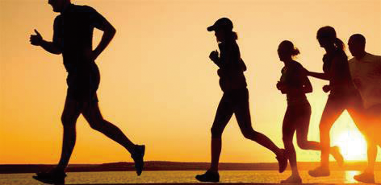
Part III After Reading
A. Summary
Here is a passage on twelve benefits of exercise with the topic sentence of each paragraph removed and put in the box for you to match the right paragraph numbered from 1 to 12. The first one has been done as an example.
Benefits of Exercise
You know exercise is good for you. Here are just a few of the health issues you can prevent by moving more.
1. ________________________ A medium-intensity routine is a proven cold-stopper. Taking a brisk (轻快的), 40-minute walk 4 days a week, for example, can cut the number of colds you experience by 25 to 50 percent and can make the colds you do catch shorter by half, studies show. Moderate exercise raises the number and activity level of important immune-system players called natural killer cells.
Back

Slide 129
2. ________________________ In one study that compared brisk walking or jogging with the antidepressant sertraline (Zoloft) [抗抑郁症的药物舍曲林（左洛复）] or a combination of the drug plus the exercise, after 4 months, all three groups had about the same improvement in their depression, but at 6 months, the people who kept up the exercise, had the lowest rates of remission (反弹).
3. ________________________ Though brisk walking will help, it may not be sufficient. The impact as your feet hit the ground stimulates cells in the bones of your legs, hips, and spine (脊柱) to build new bone, preventing the thinning that can lead to osteoporosis. But higher-impact activities such as dancing, hiking, jogging, jumping rope, climbing stairs, or playing tennis do more to stimulate bone growth and maintain bone density. Check with your doctor first if your bones are already thinning or if you have joint problems or are prone to falls.
4. ________________________ It stimulates bone growth when muscles and ligaments (韧带) “tug” on bones as you lift weights, use resistance bands or machines, or do exercises (think pushups) that rely on your own body weight to build muscle. Your best bet is a combination of high-impact exercise and strength-training; in one study, this strategy preserved bone mineral density in women who had just reached
menopause, a time when loss of bone density accelerates.
5. ________________________ At least ten minutes of aerobic exercise—biking, fast walking, running on the treadmill—can significantly improve chronic pain, likely by releasing natural pain relievers called endorphins (内啡肽，安多芬).
Back

Slide 130
6. ________________________ A workout may leave you exhausted, but you’ll probably feel better in the long run. British researchers asked a group of chronic fatigue syndrome patients to walk or perform some other aerobic exercise at least 5 days a week, increasing their daily activity to a maximum of 30 minutes. After 3 months, these patients were twice as likely as others who took flexibility or relaxation classes to say that their symptoms had improved and that they felt better. A year later, three-quarters of the exercisers had resumed normal daily activities, and some had returned to work.
7. ________________________ Getting regular exercise can lower your risk of colon cancer by up to 25 percent; a half-hour walk, four times a week, is all it takes. And if you’re a regular meat-eater, cutting back on red meats and processed meats such as hot dogs, sausages, and lunch meats can also help. Experts at the National Cancer Institute estimate that people who eat red meat or processed meats twice a day most days increase their cancer risk by 24 percent; eating it once a day raises risk by about 20 percent above normal.
8. ________________________ A way to get things moving is to get yourself moving. Exercise can reduce straining (拉紧，过负荷) and speed the passage of food through your digestive system. For some people, it cuts the odds of becoming constipated by about 40 percent.
Back

Slide 131
9. ________________________ It depends on where you are in the course of your disease. At first, eating a healthy diet, getting regular exercise, and losing weight can be quite effective at battling insulin (胰岛素) resistance, the metabolic (代谢的) problem behind type 2 diabetes. Insulin tells cells to take in blood sugar. Staying sensitive to insulin can help delay your need for medication or allow you to use smaller doses.
10. ________________________ —an average of 24 pounds—within 1.5 years after their diagnoses were twice as likely to bring their blood sugar levels under control as those who did not. Food choices matter, too. In a recent Italian study of people with type 2 diabetes, 56 percent of those who followed a traditional Mediterranean diet (think fish, olive oil, whole grains, nuts, and vegetables) were still medication-free after 4 years compared to just 30 percent of those on a low-fat diet with the same number of calories. The “good” fats from the Mediterranean diet seem to nurture insulin sensitivity, the researchers say.
11. ________________________ Playing your kids’ or grandkids’ Wii—the Nintendo (日本任天堂公
司) video game system in which the users move around as if actually playing various sports—could improve some symptoms of Parkinson’s disease. In one study, 20 people with the disease played Wii tennis, bowling, and boxing an hour a day, 3 days a week for 4 weeks. After the 4 weeks, the participants moved more easily, their fine motor skills improved, and they had more energy. Scores on a depression test also dropped to zero. The benefit may come from increased levels of dopamine (多巴胺) released during exercise and while playing video games. Dopamine is the chemical lacking in the brains of people with Parkinson’s.
Back

Slide 132
12. ________________________ Just 30 minutes a day of exercise intense enough to get your heart beating faster can reduce your risk of stroke by 20 percent. Exercise harder and watch the risk drop another 7 percent. (Check with your doctor about what amount of exercise is right for you.) (1,023 words)
(from thehealthy.com)
Back

Slide 133
A) Strength-training is also important.
B) It prevents and relives constipation.
C) It improves depression without drugs.
D) It can help treat Parkinson’s Disease.
E) It can prevent strokes by increasing your heart rate.
F) It reduces chronic pain.
G) It helps prevent and treat osteoporosis.
H) It reduces your risk of the common cold.
I) In one study, people with type 2 diabetes who lost a significant amount of weight
J) It battles chronic fatigue syndrome.
K) It can battle diabetes.
L) It can help prevent colon cancer.
1. H 2. ______ 3. ______ 4. ______ 5. ______ 6. ______
7. ______ 8. ______ 9. ______ 10. _____ 11.______ 12.______
C
G
A
F
J
L
B
K
I
D
E
Back

Slide 134
B. Critical Thinking
Most parents especially in China disapprove of their child playing video games even after school insisting that the game does more harm than good as illustrated below in the five points. Now based on what you have read, try to list a few advantages from playing video games so that you can change the ideas or stereotypes of parents on the game.
1. Health issues
2. Academic issues
3. Exposure to wrong values
4. Making children socially disconnected
5. Aggressive behavior
Reference Answer
1. Working together as a team
2. Better decision-making skills
3. Maintaining accuracy in quick decisions
4. Coordination between hands and eyes
5. Better cognitive functioning
Back

Slide 135
C. Translation
少林武术是最重要的中国功夫之一，被视为中国武术的象征。它起源于河南嵩山少林寺。其精髓是将功夫与佛教思想融为一体，僧人从中不仅学习功夫技巧，而且通过掌握佛教思想来修身。此外，这种功夫因其自卫、健身和运动的功能而闻名。近年来，少林武术已经出现在世界舞台上，越来越多的西方人对学习少林武术产生了兴趣。
据史书记载，少林功夫包括708种拳技、552种拳击风格和兵器技能以及72种绝技。少林弟子 的基本技能主要包括翻滚、跳跃、滚动等日常练习。
Reference Answer
As one of the most important Chinese Kung Fu, Shaolin Martial Arts is regarded as the symbolization. It originated in the Buddhist culture of the Shaolin Temple in Mt. Songshan, Henan Province. Its essence lies in the combination of Kung Fu and Buddhist ideology, in which manner the monks not only learn the Kung Fu skills, but also cultivate themselves by grasping the Buddhist ideology. Furthermore, this Kung Fu style has been well-known due to the functions of self-defense, body-building and athletics. In these years, it has been presented on the world stage and more and more westerners take interest in learning it.
According to the historic records, Shaolin Kung Fu includes 708 series of skills and tricks, 552 boxing styles and weapon skills as well as 72 stunts. The basic skills are daily practices for Shaolin disciples, mainly including tumbling, jumping, rolling and others.
Back

Slide 136
Part IV Micro-Class
Video
Script
Back

Slide 137
Script
The victory of the underdog over the favored team. The last minute penalty shot that wins the tournament. The high-energy training montages. Many people love to glorify victory on the playing field, cheer for favorite teams, and play sports. But here is a question: should we be so obsessed with sports? Is playing sports actually as good for us as we make it out to be, or just a fun and entertaining pastime? What does science have to say?
First of all, it’s well accepted that exercise is good for our bodies and minds, and that’s definitely true. Exercising, especially when we’re young, has all sorts of health benefits, like strengthening our bones, clearing out bad cholesterol from our arteries, and decreasing the risk of stroke, high blood pressure, and diabetes. Our brains also release a number of chemicals when we work out, including endorphins. These natural hormones, which control pain and pleasure responses in the central nervous system, can lead to feelings of euphoria, or, what’s often called, a runner’s high. Increased endorphins and consistent physical activity in general can sharpen your focus and improve your mood and memory. So does that mean we get just as much benefit going to the gym five days a week as we would joining a team and competing?

Slide 138
Script
Well, here’s where it gets interesting: because it turns out that if you can find a sport and a team you like, studies show that there are all sorts of benefits that go beyond the physical and mental benefits of exercise alone. Some of the most significant are psychological benefits, both in the short and long term. Some of those come from the communal experience of being on a team, for instance, learning to trust and depend on others, to accept help, to give help, and to work together towards a common goal. In addition, commitment to a team and doing something fun can also make it easier to establish a regular habit of exercise. School sport participation has also been shown to reduce the risk of suffering from depression for up to four years. Meanwhile, your self-esteem and confidence can get a big boost. There are a few reasons for that. One is found in training. Just by working and working at skills, especially with a good coach, you reinforce a growth mindset within yourself. That’s when you say, “Even if I can’t do something today, I can improve myself through practice and achieve it eventually.” That mindset is useful in all walks of life. And then there’s learning through failure. One of the most transformative, long-term benefits of playing sports. The experience of coming to terms with defeat can build the resilience and self-awareness necessary to mange academic, social and physical hurdles. So even if your team isn’t winning all the time, or at all, there’s a real benefit to your experience.

Slide 139
Script
Now, not everyone will enjoy every sport. Perhaps one team is too competitive, or not competitive enough. It can also take time to find a sport that plays to your strengths. That’s completely OK. But if you spend some time looking, you’ll be able to find a sport that fits your individual needs, and if you do, there are so many benefits. You’ll be a part of a supportive community, you’ll be building your confidence, you’ll be exercising your body, and you’ll be nurturing your mind, not to mention having fun.
Back

Slide 140
Further Reading
5 of the Top Most Extreme Sports in
the World
Our need for speed, adrenaline and new experiences is pushing the wide world of sports to increasingly extreme levels. Videos of extreme downhill skateboarding and street luge starting making a splash online a few years ago, but that’s just the tip of the extreme sports iceberg.
The X Games don’t hold a candle to these top extreme sports found around the world.
Paraskiing
As if jumping out of a helicopter to go skiing (heli-skiing) wasn’t extreme enough, there are some thrill seekers who combine skiing and flying even more.
Paraskiing is a combination of skiing (or snowboarding) and parasailing. The skier wears a parasail and when they pick up enough speed to make the parasail rise, they’re lifted off the ground and start soaring.
Some parasailers fly for the entire run while others bounce back and forth between sailing and skiing. It essentially combines two top extreme sports into one ultimate extreme sport. To get to an even more extreme level, some athletes combine heli-skiing and paraskiing—which opens up a whole new world of terrain.
Back

Slide 141
Wingsuit Flying
Right now, wingsuit flying is probably the closest humans can get to controlled, non-machine-assisted flying.
Wingsuit flying is a variation of sky diving in which the “pilot” or jumper wears a special suit that essentially makes them look like a flying squirrel. This specialized suit features “wings” along the side of the body and between the legs. The wings have air pockets that give the pilot more lift, allowing them to fall slower and control where they go with an amazing amount of precision.
Wingsuit flying can take place from a helicopter or off a base and some expert flyers get incredibly close to mountainsides and even cruise in a controlled free fall through ravines.
Highlining
What could make walking a tight rope harder? When that rope isn’t actually taunt (很高的). You might have seen slacklines set up at festivals for slackliners to exhibit their skills and to give the general public a chance to try this extreme sport (albeit, without the possibility of falling very far).
Where slacklining turns into an extreme extreme sport is when it becomes known as highlining. A slackline is set up high off the ground (typically between buildings or cliffs) and a slackliner crosses without a safety net or pole for additional balance. The only thing keeping them secure while the line moves and sways is their intense balance and a small safety harness.
Back

Slide 142
Volcano Boarding/Volcano Surfing
When skiing or sledding on snow isn’t extreme enough, it’s time to take a trip to an active volcano.
Volcano boarding or volcano surfing is exactly what it sounds like, you slide down the side of a volcano that’s covered in cool cinders or ash. And by ash we mean mostly little bits of sharp volcanic rock.
After hiking over rocks and rubble to the peak, riders go down the volcano on makeshift plywood toboggans (平底雪橇), which makes this extreme sport accessible to anyone. The best of the best, though, can surf down the slope while standing on the board.
Free diving
When you’re scuba (水下呼吸器) diving, you’re literally in a situation where you could be physically unable to breathe if something goes wrong. Most divers have oxygen tanks with them, but some athletes disregard this normal equipment and opt to free dive.
Like many of these top extreme sports, free diving is exactly what it sounds like—a diver goes down with no survival equipment other than flippers. They plan on making the descent and ascent on a single breath of air. The pressure changes of deep diving, physical exertion it takes to climb back to the surface and mental panic that can set in make this more than just holding your breath for a really long time. (645 words)
(from flipbelt.com)
Back

